Slide 1

CSCI 232: Data Structures and Algorithms
Course Conclusion, Review
Reese Pearsall
Spring 2024
https://www.cs.montana.edu/pearsall/classes/spring2024/232/main.html

Slide 2
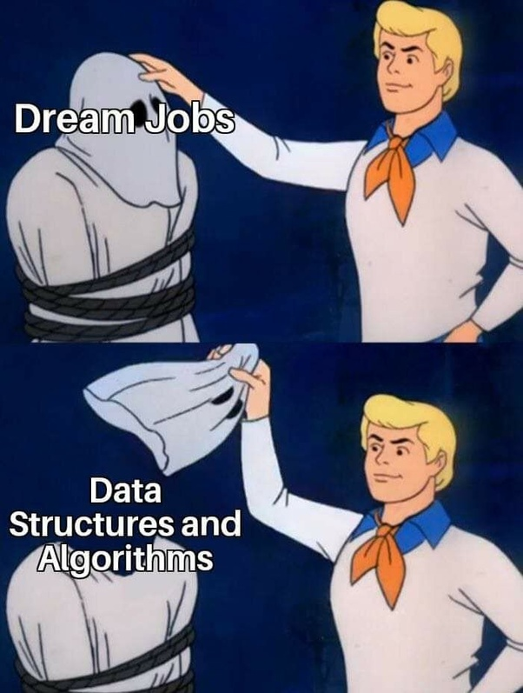
Announcements
Lab 13- Course Evaluation
Program 4 due Sunday @ 11:59 PM
Check your grades this week. Make sure nothing seems wack

Slide 3

Average of your 4 program grades
Final Exam
3

Slide 4
Final Exam
Optional
Thursday, May 9th @ 10:00 AM – 11:50 AM
Barnard Hall 103
(1) Show up, take the exam normally
OR
(2) Don’t show up, and accept the average of your 4 program grades
Exam Contents
Graphs
Minimum Spanning Tree
Shortest Path
Dynamic Programming
Greedy Algorithms
Divide and Conquer
Same rules and format as midterm exam
I will always take the highest of these two grades
4

Slide 5
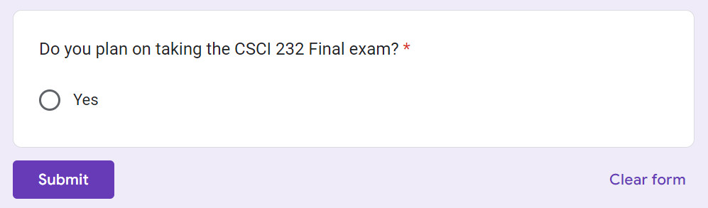
Please Let me know if you are planning on taking the final exam
On the course → website
5

Slide 6
Final Exam Review
6

Slide 7
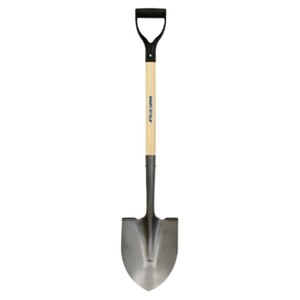
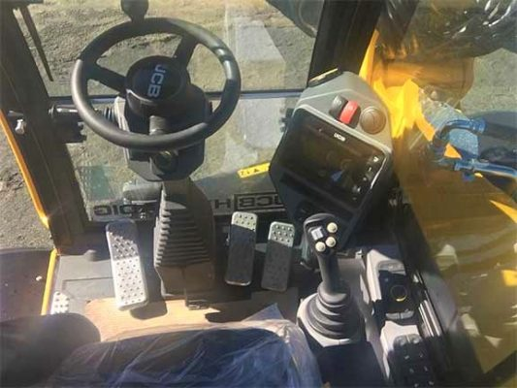
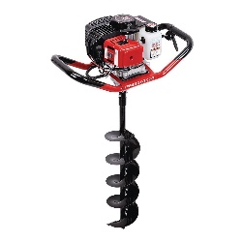

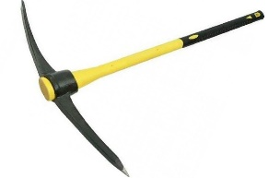


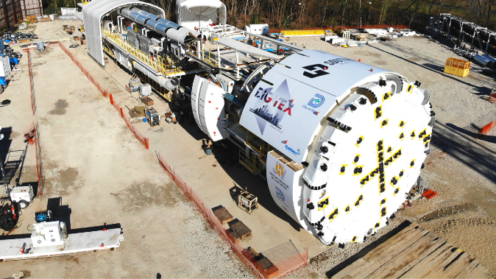


CSCI 232- Data Structures and Algorithms
“Tools”
Arrays
Linked Lists
Stacks/Queues
Hash Tables
Trees
Graphs
“Use of tools”
Sorting
Searching
Routing
Optimization
A data structure is a mechanism for storing and organizing data
An algorithm is a series of instructions to be followed to solve some problem

Slide 8
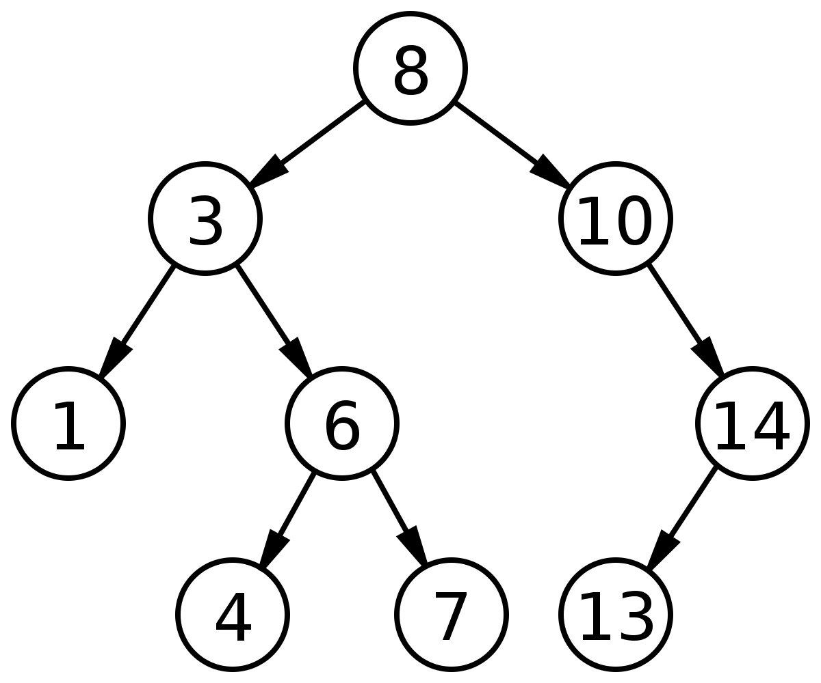


(Balanced) Binary Search Trees
O(logn) Addition Time
O(logn) Removal Time
O(logn) Search Time
Not as efficient for adding/removing, but much more efficient to search through
How to guarantee balance?
→ Red/Black Trees!
More complex operations, especially in a self-balancing tree (rotations, replacements, etc)
8

Slide 9
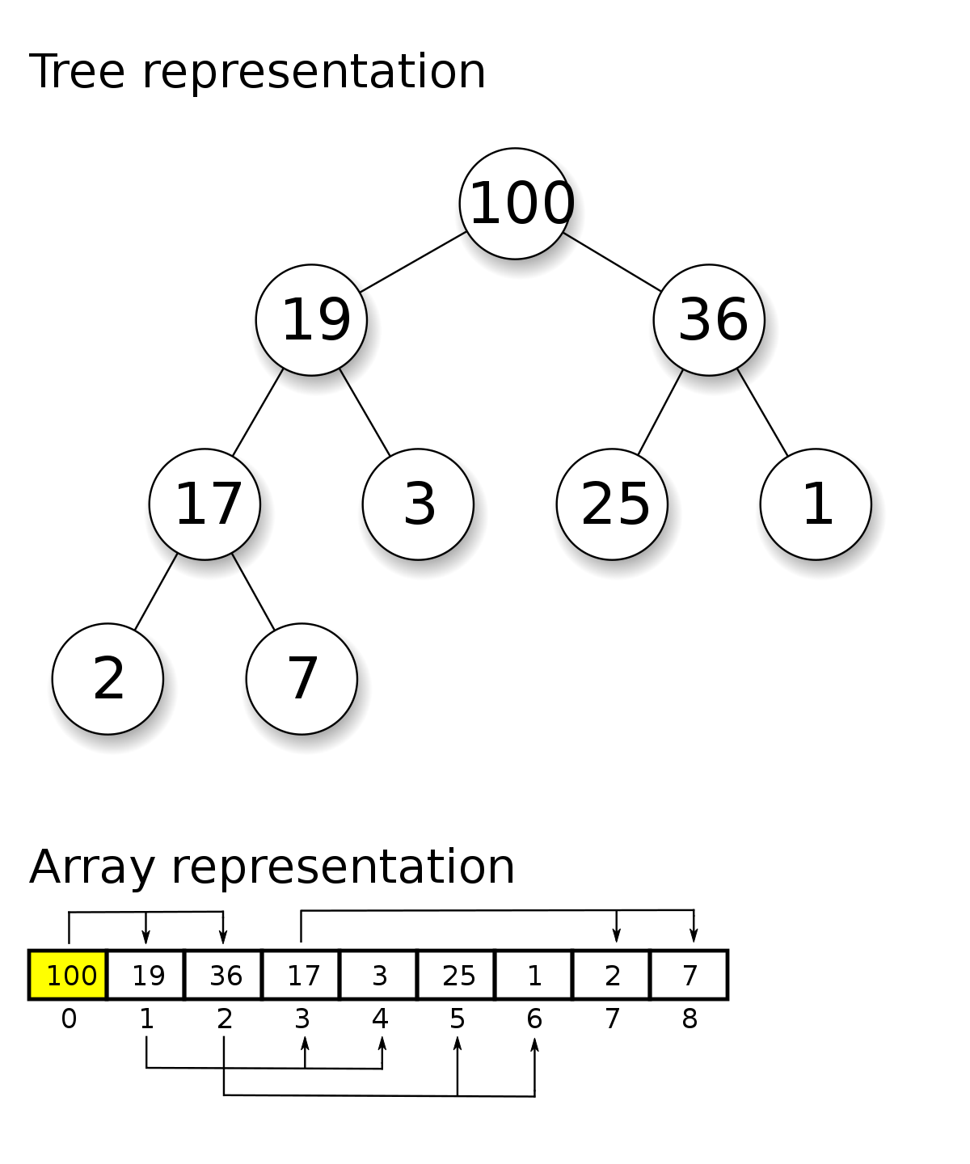
Heap
O(logn) Addition Time
O(logn) Removal Time
O(n) Search Time
O(1) Retrieving Highest Priority Element
A priority queue!!
Efficient at retrieving the highest priority element
General searches are not as efficient
Creating a heap from an (unsorted) array is also efficient
9

Slide 10

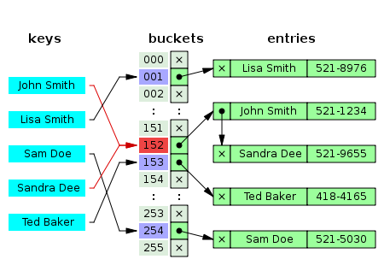


Hash Tables
O(1) Addition
O(1) Removal
O(1) Retrieval/Contains
O(n) searching if you don’t have key
(n = # of keys)
Hashing Function
Downsides
No Duplicate Keys
Unordered
Difficult to Sort
Collisions can be spooky
(These libraries are very optimized to avoid collisions ☺ )
10

Slide 11
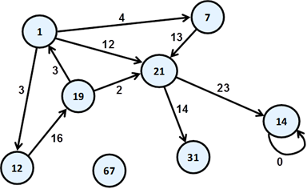
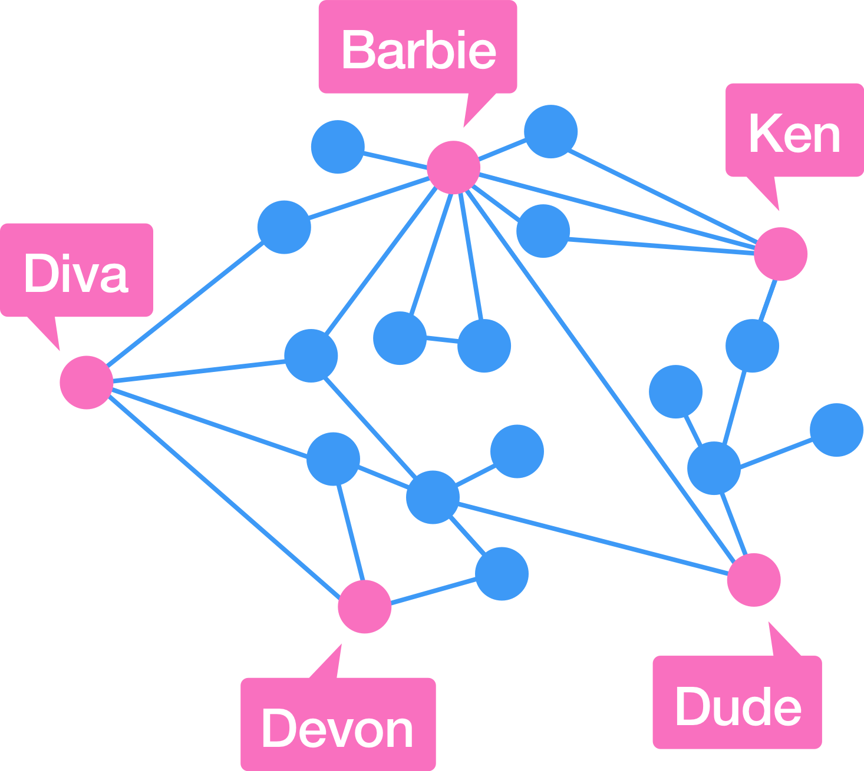
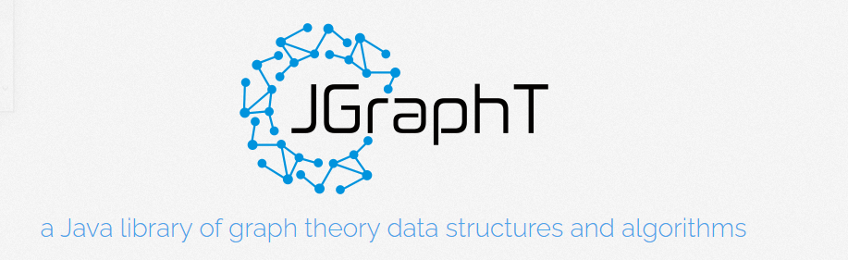
Graphs
A fundamental data structure that can be applied to many problems
Many problems that don’t seem like a graph problem can be restructured to a graph problem
Many graph algorithms can be done in polynomial time (shortest path, searching, MST)
11

Slide 12
Algorithms
Dijkstra’s Algorithm (Shortest Path)
A* (Shortest Path)
Greedy Algorithms
Knapsack Problem
Traveling Salesman
Dynamic Programming
Change Making
Rod Cutting
Edit Distance
Divide and Conquer
Closest Pair
Breadth-First
Depth-First
Heap Sort
Hashing Function
Collision Resolution
Kruskal’s Algorithm (MST)
Primm’s Algorithm (MST)
There are some problems that we don’t have an efficient algorithm for!
12

Slide 13
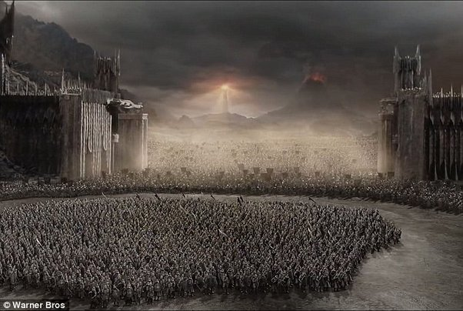
Literally every upper division CS class
CSCI 232
CS students
13

Slide 14
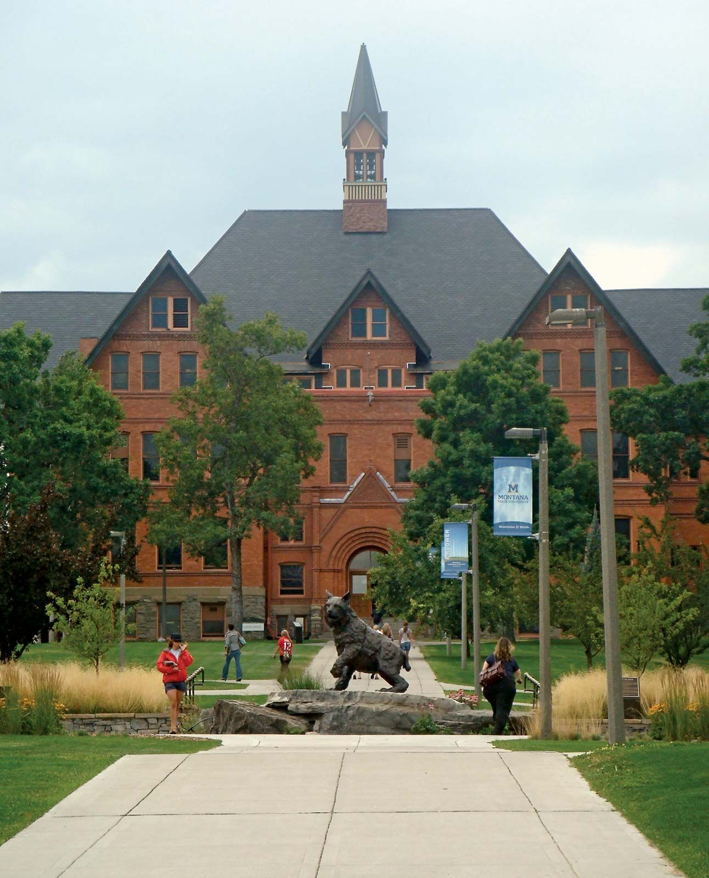

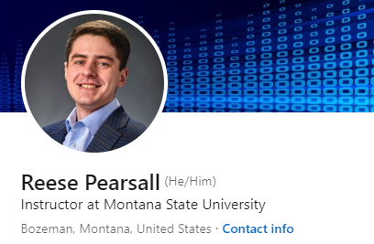
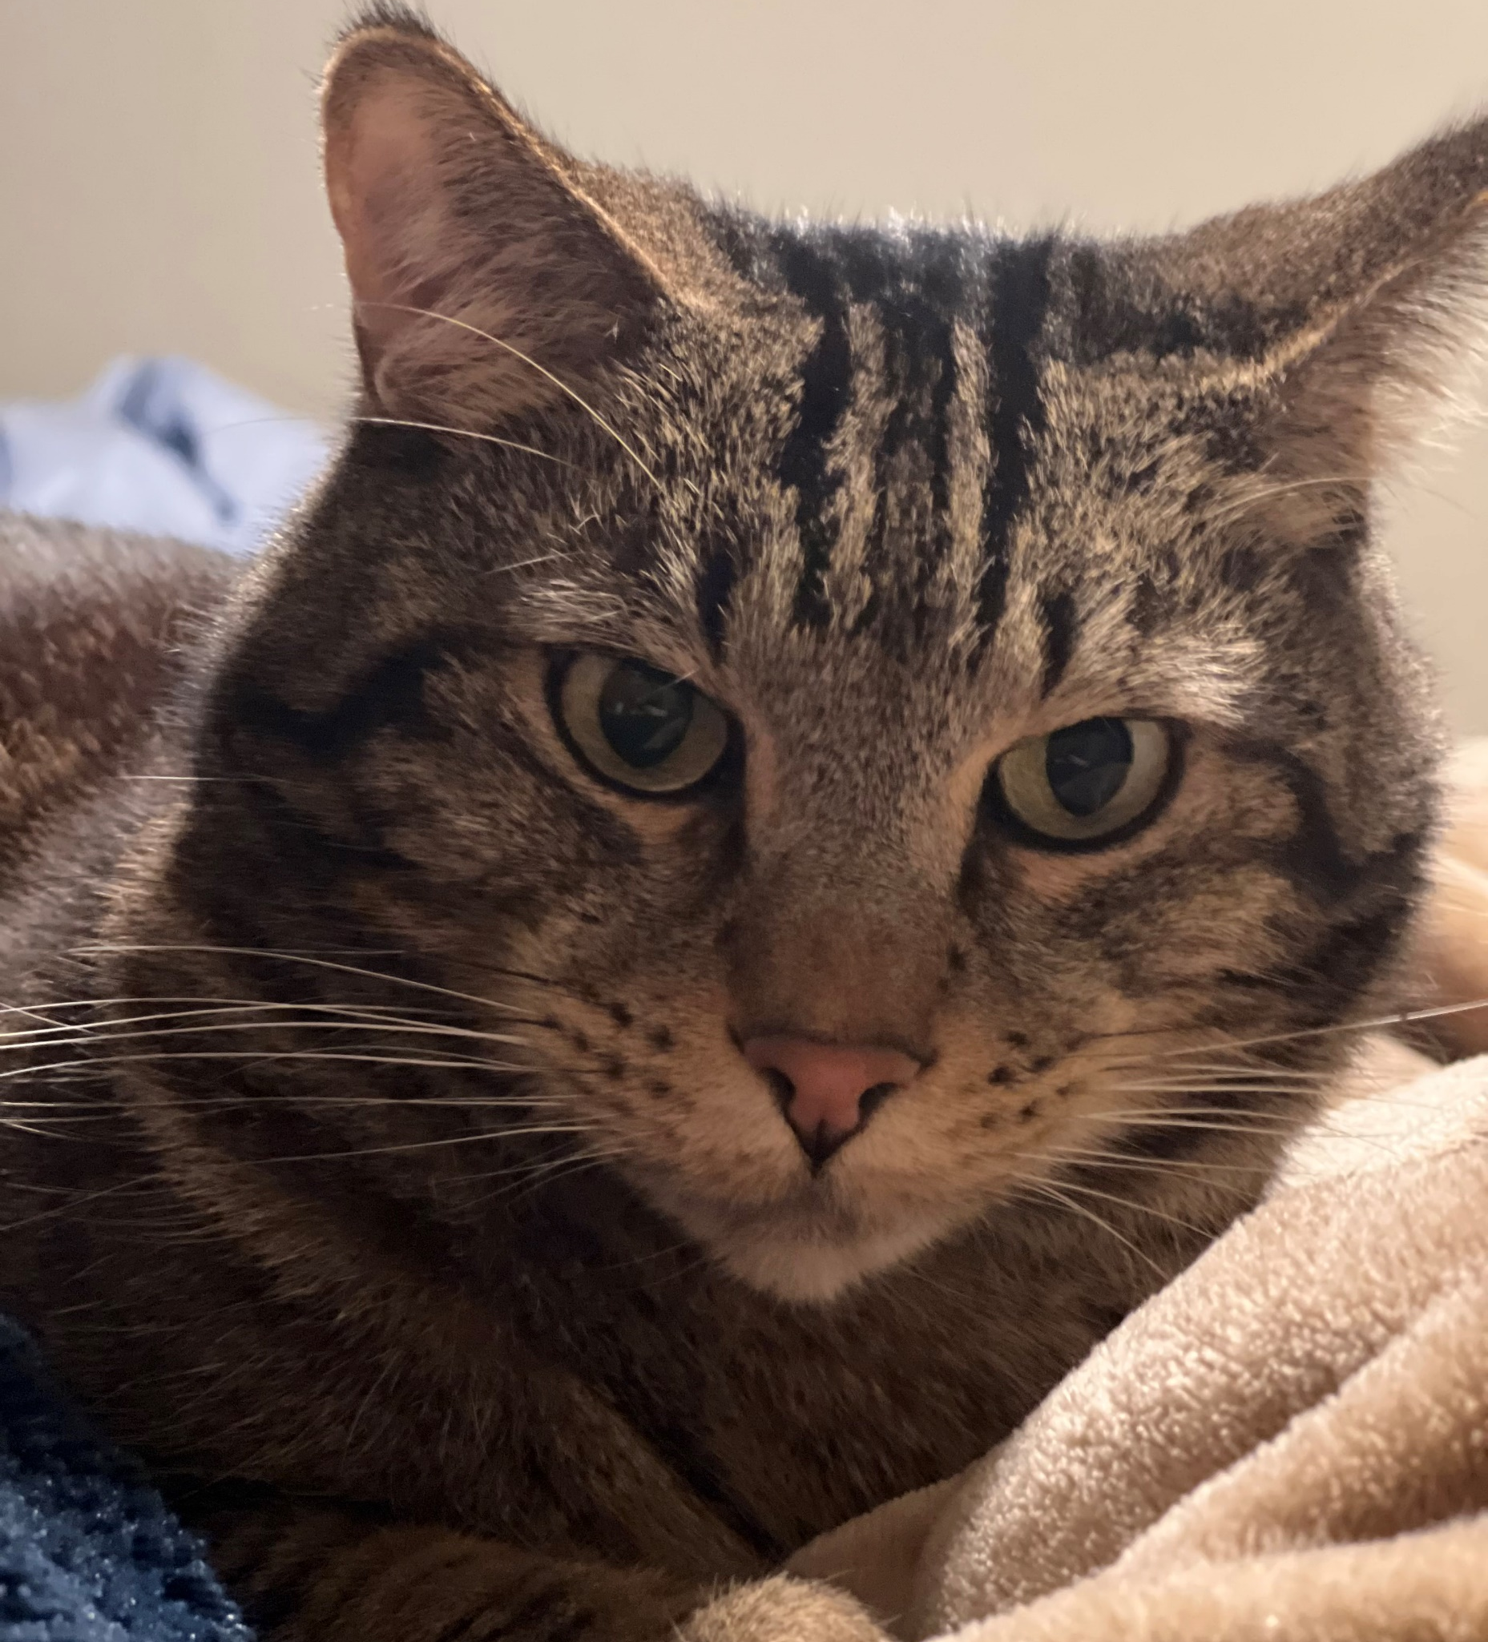
Thank You!
This class has been fun to teach. I think this class is much more enjoyable and interesting than CSCI 132.
It really enjoyed being able to have you in CSCI 132 and CSCI 232
I hope you enjoyed this class, and I hope the stuff you learned will be helpful in your career/future classes (this is one of the most important classes you take!)
If I can be of assistance to you for anything in the future (reference, advising, support), please let me know!
(you built some pretty cool things in this class!)
I will be teaching CSCI 466, CSCI 476, and ??? next semester**
Congrats to those that are graduating next weekend! I hope you find a job that you love!
Meatball wishes you good luck
Connect with me on LinkedIn!
**if I am here
14

