Slide 1
Springboard Capston-2
Topic: Mining Amazon Product Reviews using NLP
Reeshma K

Slide 2
Problem Statement
Ratings alone do not give a complete picture of the products we wish to purchase. So secondary option is looking at the reviews. Review’s plays an important role in the decision-making process. If the number of reviews is less, it is easy to read and understand but what if there are thousands of reviews.
So, the problem is how we can analyze great number of online reviews using Natural Language Processing (NLP).

Slide 3
Purposes
Help Consumers to understand sentiment of the review (Sentiment Analysis).
Help the consumers to get consumer feedback in the form of topics covered by the reviews without having to go through all of them(Topic Modeling).
Enable consumers to quickly extract the summary of the reviews without reading the entirely(Text summarization).

Slide 4
Data Description
Dataset:https://www.kaggle.com/snap/amazon-fine-food-reviews
Context: This dataset consists of reviews of fine foods from amazon. The data span a period of more than 10 years, including all ~500,000 reviews up to October 2012. Reviews include product and user information, ratings, and a plain text review. It also includes reviews from all other Amazon categories.

Slide 5
Text Wrangling and Pre-processing
Removing HTML Tags
Expanding Contractions
Removing Special Characters
Lemmatization
Removing Stop words

Slide 6
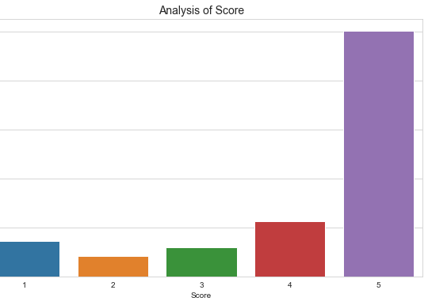
Exploratory Data Analysis (EDA)
Most of the reviews have score 5
very a smaller number of reviews got score 2.

Slide 7
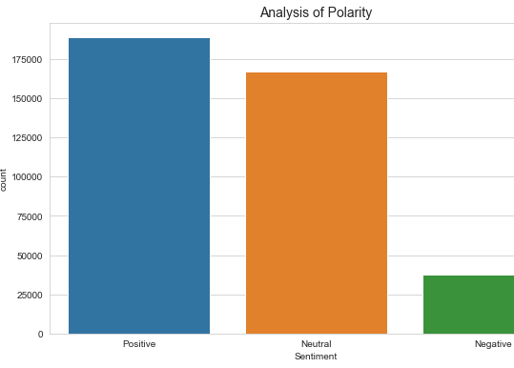
Sentiment Analysis
TextBlob
Polarity: Polarity is float which lies in the range of [-1.0,1.0]
Subjectivity: A float value which lies in the range of [0,1]

Slide 8
Sentiment Prediction using Reviews
Logistic Regression
The logistic regression model on the Bag-of-Words features gave an accuracy 93.8%
Artificial Neural networks
Artificial Neural Networks using keras API and TensorFlow managed to get a better result of 95.3% accuracy on validation data.

Slide 9
Topic Modeling
Topic modeling helps in exploring large amounts of text data, finding clusters of words, similarity between documents, and discovering abstract topics.
Enable consumers to quickly extract the key topics covered by the reviews without having to go through all of them.
Latent Dirichlet Allocation (LDA) is a popular algorithm for topic modeling with excellent implementations in the Python’s Gensim package.

Slide 10
Steps involved
Tokenize words and clean-up text
Creating Bigram and Trigram Models
Feature Engineering
The Word2Vec Model
Word Algebra
Building the Topic Model
View the topics in LDA model

Slide 11
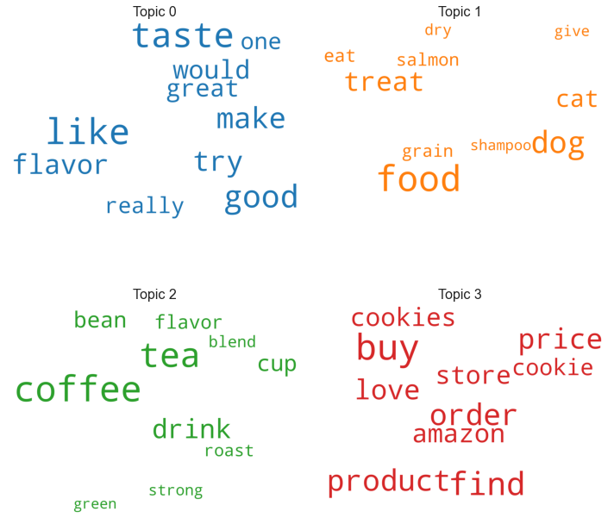
Visualize the topics-keywords
Topic 1 | Topic 2 | Topic 3 | Topic 4
Term1 | like | food | coffee | buy
Term2 | taste | dog | chocolate | get
Term3 | good | treat | cup | product
Term4 | flavor | cat | bean | find
Term5 | try | hair | milk | order
Term6 | make | eat | roast | love
Term7 | tea | salmon | blend | price
Term8 | really | grain | dark | time
Term9 | great | chew | cake | bag
Term10 | one | dry | coconut | box

Slide 12
Text Summarization
Extractive Summarization and Abstractive Summarization
Text Summarization Steps
Convert Paragraphs to sentences
Text Preprocessing
Tokenizing the sentences
Find Weighted Frequency of Occurrence
Replace Words by Weighted Frequency in Original Sentences
Sort Sentences in Descending Order of Sum

Slide 13
Conclusion and Future work
Ideally, the aim of the project was to help Amazon consumers to understand the sentiment of the review, to get consumer feedback in the form of topics covered by the reviews without having to go through all of them and Enable them to quickly extract the summary of the reviews without reading the entirely. As a future work I would like to implement the Text summarization using Artificial Neural Network.

