Slide 1
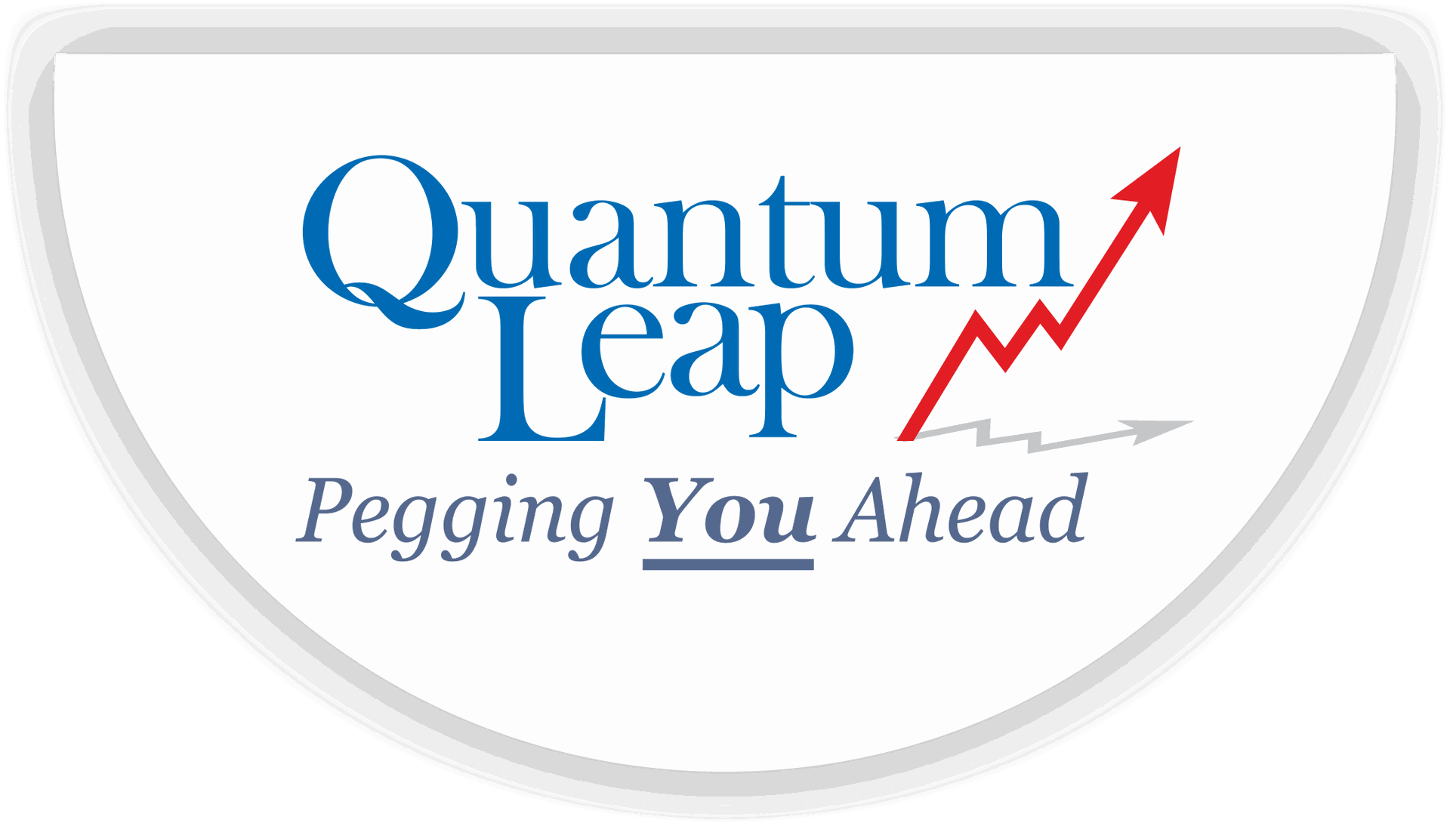

Quantum Leap Trainers and Consultants
Design Thinking
From Empathy to Engineering — Linking the Design Thinking Process
with the Spiral Model of Software Development
Internal Training • General session for all Qltc team members, with focus for the Solution Development team
Prepared by Krishna Praveen Rao | Qltc | July 2026

Slide 2






What We'll Cover
A concise walkthrough — from mindset to method to a Qltc-specific example.
1
2
Why This Matters for Qltc
What is Design Thinking?
The cost of building the wrong thing well
A human-centered, iterative mindset
3
4
The Five Stages
What is the Spiral Model?
Empathize, Define, Ideate, Prototype, Test
A risk-driven, iterative way to build software
5
6
Where They Connect
Applying It at Qltc
Mapping Design Thinking onto the spiral
A worked example from Solution Development
Qltc | Design Thinking & the Spiral Model
2
Notes:
Set expectations: this is a short, practical session. Emphasize that the last third of the deck focuses specifically on how Solution Development can apply this on live client projects.

Slide 3


Why This Matters for the Qltc Team
The Problem We See
Why It's Personal to Qltc
Teams build well-engineered solutions that miss the real user need.
Requirements are gathered once, frozen, and revisited only at delivery.
Rework happens late — the most expensive time to discover a mismatch.
Clients feel handed a solution rather than partnered with on one.
We deliver across six verticals — including Software Development & Managed Services and ERP Implementation — where user needs and technical build must stay tightly linked.
Our clients (manufacturing, FMCG, and services conglomerates) expect operational rigor, not guesswork.
Design Thinking gives every team member — technical or not — a shared way to start with the client's real problem.
Qltc | Design Thinking & the Spiral Model
3
Notes:
Anchor this in real Qltc experience if possible — a project where late-stage rework happened, or one where early client involvement clearly paid off. Keep it general enough for non-technical attendees, but signal that Solution Development will get a deeper example later.

Slide 4
What is Design Thinking?
A human-centered, iterative approach to innovation that draws together what people genuinely need, what technology makes possible, and what a business requires to succeed.
Human-Centered
Iterative & Non-Linear
A Mindset, Not a Template
Starts with people's real needs and lived experience — not assumptions made in a conference room.
Teams move back and forth between stages as they learn; it's a cycle, not a checklist.
The five stages are a discipline for thinking, applicable to a product, a process, or a client proposal.
Qltc | Design Thinking & the Spiral Model
4
Notes:
Popularized by Stanford d.school and IDEO. Stress the mindset point — this isn't only for designers; anyone scoping a client engagement or a feature uses the same discipline.

Slide 5




The Five Stages, at a Glance
1
2
3
4
5
Empathize
Define
Ideate
Prototype
Test
Understand real user needs
Frame the core problem
Generate possible solutions
Build something testable
Learn from real feedback
Not a straight line: teams loop back — a Test often sends you straight back to Empathize or Define.
Qltc | Design Thinking & the Spiral Model
5
Notes:
This is the map for the next three slides — we'll go two stages at a time, then close on Test and the loop-back, which is the bridge into the Spiral Model.

Slide 6
Stages 1 & 2 — Understand Before You Solve
1. Empathize
2. Define
Understand real user needs
Frame the core problem
Typical Activities
Typical Activities
Interview clients, users, and frontline staff directly
Observe how work actually happens, not how it's documented
Immerse yourself in the user's environment and constraints
Suspend judgment — collect, don't solve yet
Synthesize research into clear patterns and pain points
Write a human-centered problem statement (user need first, not a feature or business metric)
Agree with stakeholders on what 'success' looks like
Set the boundary for what this cycle will (and won't) solve
Qltc | Design Thinking & the Spiral Model
6
Notes:
Empathize and Define together are about resisting the urge to jump to a solution. In consulting terms, this is the discovery phase — but done with the end user, not only the sponsor.

Slide 7
Stages 3 & 4 — Explore Widely, Then Build Small
3. Ideate
4. Prototype
Generate possible solutions
Build something testable
Typical Activities
Typical Activities
Brainstorm broadly before narrowing — quantity before quality
Use 'How Might We...' questions to reframe the problem
Involve a mix of roles — not just the 'experts'
Shortlist ideas against user needs and feasibility
Create the cheapest version that lets you learn something
Wireframes, mockups, clickable demos, or paper sketches
Expect to build several — prototypes are meant to fail fast
Focus on the riskiest assumption first
Qltc | Design Thinking & the Spiral Model
7
Notes:
Ideate is where teams often under-invest — jumping to the first workable idea. Prototype should be the cheapest possible way to test the idea, not a finished build.

Slide 8
Stage 5 — Test, and Close the Loop
5. Test
The Real Punchline
Learn from real feedback
Design Thinking rarely runs once, start to finish.
Feedback from Test almost always sends you back — sometimes to Prototype, sometimes all the way to Empathize.
That repeated cycling — small loops of learning, each one reducing uncertainty — is exactly the same DNA behind the Spiral Model, which is next.
Put the prototype in front of real users or clients
Watch behavior as much as you listen to opinions
Capture what worked, what confused, and what's missing
Treat every result as an input to the next cycle
Qltc | Design Thinking & the Spiral Model
8
Notes:
This is the pivot slide — make the iteration point land clearly, since the next section builds directly on 'Design Thinking is a loop, not a line.'

Slide 9


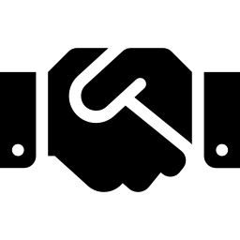
What is the Spiral Model?
A risk-driven, iterative software development model (Barry Boehm, 1986) that repeats a cycle of planning, risk analysis, building, and evaluation — each pass delivering a more complete, better-understood version of the product.
Each Loop = One Iteration
Risk Drives the Pace
Built for Complex, Evolving Work
The spiral's radius reflects cumulative cost; the angle reflects progress within the current cycle.
Unlike a single-pass Waterfall, each cycle explicitly surfaces and resolves the biggest unknowns first.
Well suited to large, high-stakes, or requirement-shifting projects — exactly the profile of custom client software.
Qltc | Design Thinking & the Spiral Model
9
Notes:
Keep this brief for non-technical attendees — the point is 'iterative and risk-first,' not the full history. Solution Development members may already recognize this from SDLC training.

Slide 10



The Four Quadrants of Each Spiral Loop
Q1
Q2
Determine Objectives
Identify & Resolve Risks
Identify goals, alternatives, and constraints for this cycle
→
Evaluate alternatives; prototype to reduce the biggest unknowns
↑
↓
Q4
Q3
Review & Plan Next Loop
Develop & Test
Customer evaluates progress; feedback shapes the next cycle
←
Design, build, and verify the next working version
Loops back to Q1 for the next cycle, at a larger scale
Qltc | Design Thinking & the Spiral Model
10
Notes:
Walk the arrows clockwise: Q1 to Q2 to Q3 to Q4, then back to Q1 for the next, larger loop. This is the same shape as the Design Thinking loop we just covered — that's the bridge to the next slide.

Slide 11
Where Design Thinking Meets the Spiral Model
Two different names for the same underlying discipline: reduce uncertainty in small, feedback-driven cycles.
Empathize + Define
→
Q1
Determine Objectives
Understanding user needs IS how objectives, alternatives, and constraints get set.
Ideate
→
Q1→Q2
Alternatives Considered
Generating creative options is exactly what 'evaluating alternatives' requires as input.
Prototype
→
Q2→Q3
Resolve Risk & Build
A prototype is simultaneously a risk-reduction tool and the seed of the engineered product.
Test
→
Q4
Review & Plan Next Loop
User feedback IS the customer evaluation that shapes the next spiral loop's objectives.
Qltc | Design Thinking & the Spiral Model
11
Notes:
This is the slide to slow down on. The mapping isn't perfectly 1:1 by design — Design Thinking's five stages and the Spiral's four quadrants are two lenses on the same loop, not a strict translation table.

Slide 12
Applied at Qltc: A Client Portal Module
One spiral loop, built the Design Thinking way — Software Development & Managed Services vertical.
1
2
3
4
→
→
→
Understand
Explore
Build & De-risk
Confirm
Empathize + Define → Q1
Ideate → Alternatives
Prototype + Engineer → Q2/Q3
Test + Review → Q4
Interview the client's ops team and portal end-users; define this increment's goal — e.g. a self-service dashboard for order status.
Sketch 2–3 workflow options for the dashboard with the client in the room; agree on the most promising direction.
Build a clickable prototype; flag the ERP data-integration risk early; develop and unit-test the real increment.
Demo to client stakeholders, capture feedback and sign-off — which becomes the objective for the next spiral loop.
This loop repeats for the next feature increment — each pass a little faster, a little more informed.
Qltc | Design Thinking & the Spiral Model
12
Notes:
Swap in a real, recent Qltc Solution Development example here if one is available — ERP module, client dashboard, or managed-services tooling — the structure of the four steps stays the same.

Slide 13

Why This Combination Works for Qltc
Fewer Costly Rebuilds
Stronger Client Trust
Creativity + Discipline, Together
Fits Qltc's DNA
Catching a mismatch during Empathize/Q1 costs a conversation. Catching it after delivery costs a re-build.
Clients see their input shape each cycle — consulting delivered as a partnership, not a handoff.
Design Thinking's openness balances the Spiral Model's structure — neither alone is enough.
Structured, risk-aware, client-partnered delivery — the same posture behind our Operational Excellence work.
Qltc | Design Thinking & the Spiral Model
13
Notes:
Tie the last point explicitly back to Qltc's six verticals and the 100 Crore growth ambition — this way of working scales client trust, which scales referrals and repeat engagements.

Slide 14
Key Takeaways for Your Next Project
Start with Empathize, not a spec document
Every engagement — technical or not — begins by understanding the real user, not writing requirements first.
Treat prototypes as risk-reduction, not demos
A prototype's job is to answer 'what could go wrong,' the same job as Quadrant 2 of the spiral.
Run every project as a spiral, not a single pass
Plan for cycles from the start — smaller loops beat one long build-and-hope.
Make client feedback a scheduled checkpoint
Every iteration ends with real user or client review — never assume, always confirm.
Qltc | Design Thinking & the Spiral Model
14
Notes:
Close by asking the room: which current project could benefit from starting its next phase with an explicit Empathize step? Use a real, live example if one comes up.

Slide 15
Thank You
Questions & Discussion
Krishna Praveen Rao | Founder & Managing Partner, Qltc | www.qltc.in
Notes:
Open the floor. Good prompts: 'Where in our current pipeline are we skipping Empathize?' or 'Which client project would benefit from an explicit spiral, iteration-based plan?'

