Slide 1
Enhancing Infrastructure Resilience: An AI-Driven Solution for Road Management
Reetika Chauhan⋆, Sixian Zheng†, Wei Cheng⋆, Juhua Hu⋆
⋆School of Engineering and Technology, University of Washington, Tacoma, USA
†Eastlake High School, Sammamish, USA

Slide 2
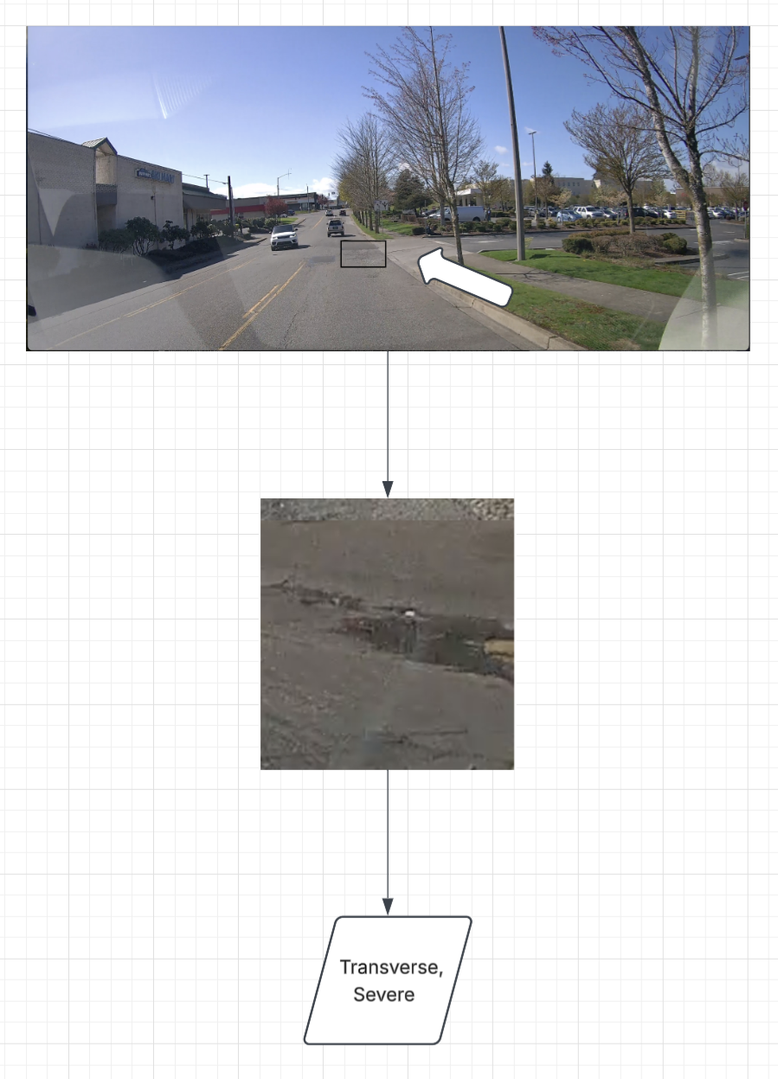
Motivation
Hidden Road Damage: Repeated vehicle usage causes cracks, raveling, and structural damage on road surfaces over time.
Increasing Accident Risk: Undetected pavement damage increases the risk of accidents and infrastructure failure.
Scalable Monitoring: Manual inspection is slow and expensive automated crack detection enables large-scale road assessment.
Low-Cost Data Collection: Inexpensive, widely available dashcams capture road footage during routine driving, with no specialized survey vehicles needed.
The goal of this project is to enhance automated road crack detection and characterization, identifying crack type and severity from dashcam videos.

Slide 3
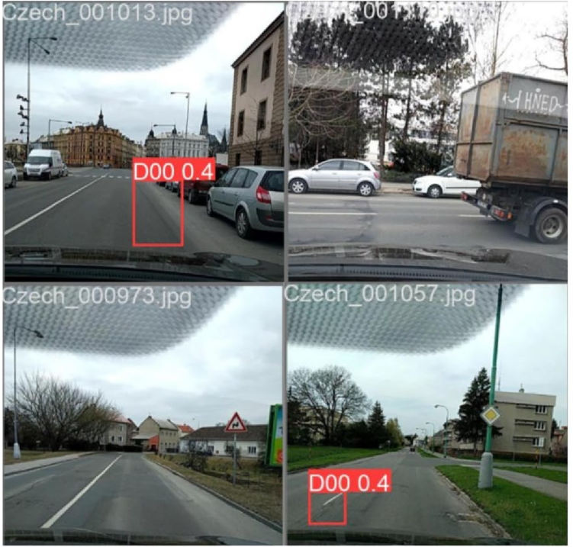
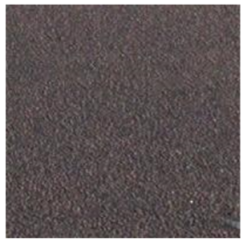
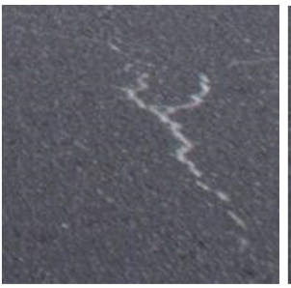
Related Work
Limitation
Zeng and Zhong, 2024: Finds and labels crack type but gives no severity, needs costly box labels, and still misses small potholes.[7]
Abrudan, 2025: Relies on in domain data and well-cropped inputs, so it doesn't adapt well to dashcam imagery with varying viewpoints and clutter.[2]
Detection
Classification
Bounding box label
Positive
Negative

Slide 4
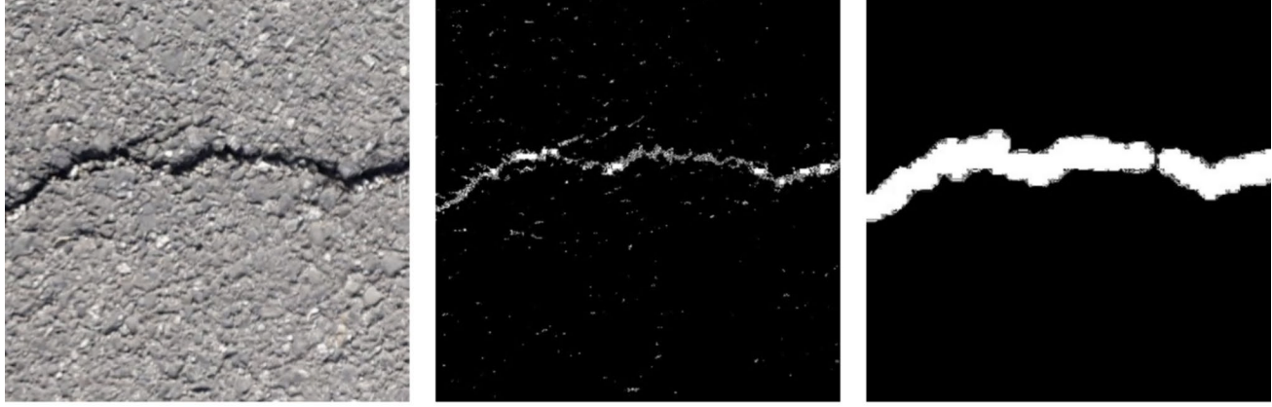
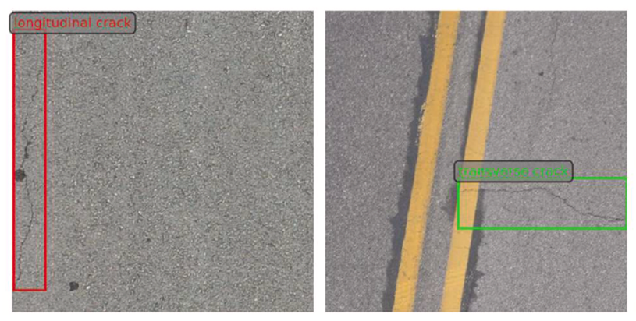
Related Work
Segmentation
Characterization
Limitation
Tapamo et al., 2023: Binary classification and segmentation on fixed, clean patches with in-domain evaluation only, with no cluttered dashcam scenes and no crack type or severity.[4]
Abdallah et al., 2026: High computational cost, and its general-purpose detectors still miss thin cracks.[2]
Original image
Segmented
Noise Removal
Annotated Crack Types

Slide 5
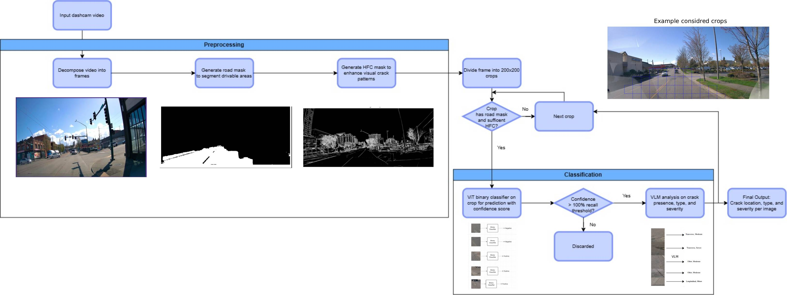
Proposed Method: Cascaded Visual Signal and Semantic Filtering

Slide 6
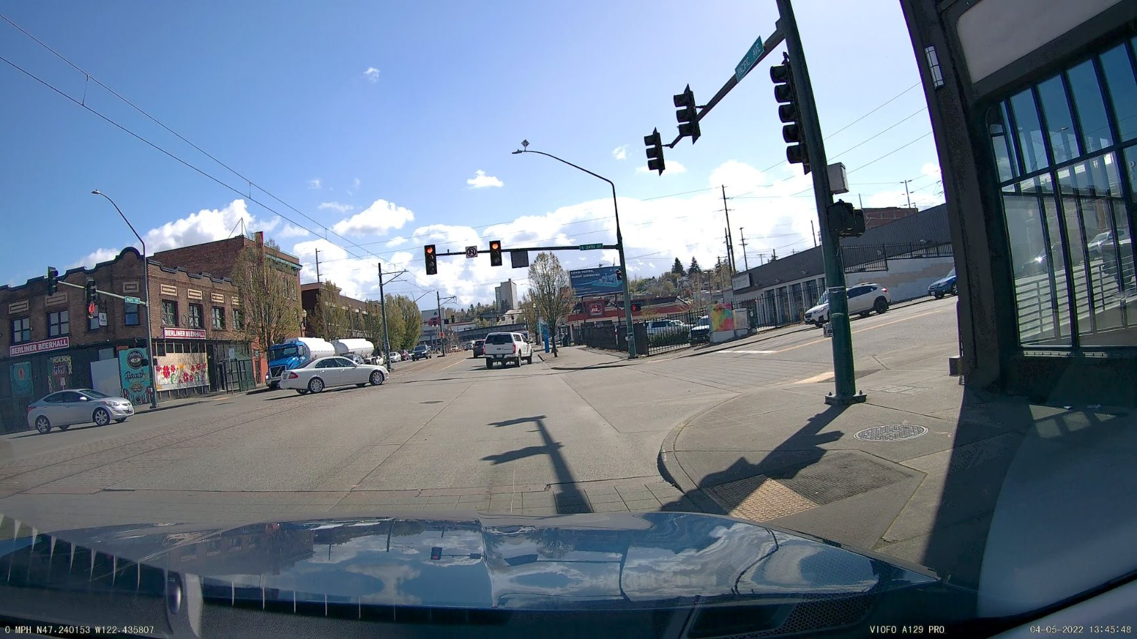
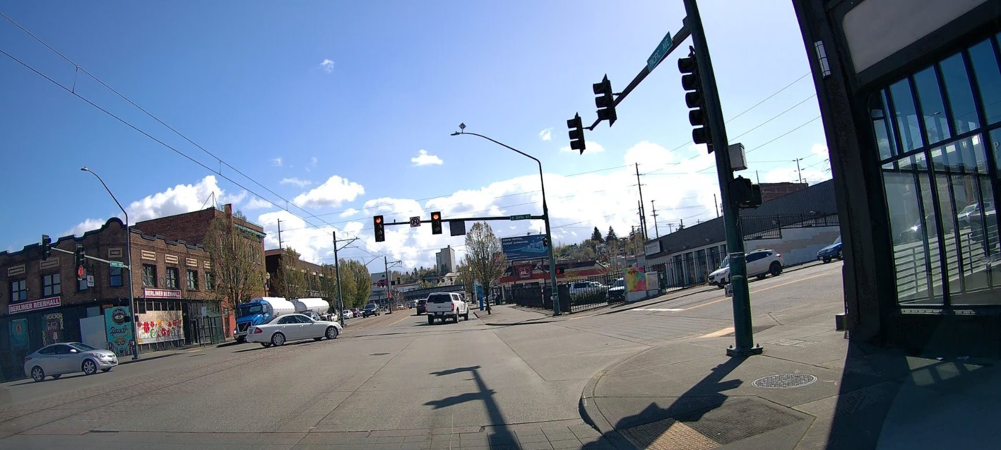
Input Data
Continuous road video is captured using a dashcam mounted on a moving vehicle.
Frames are extracted at fixed intervals and preprocessed to remove the car hood before further analysis.
Removing hood

Slide 7
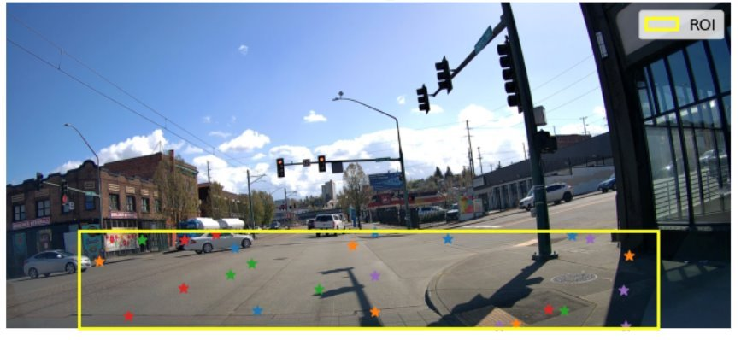
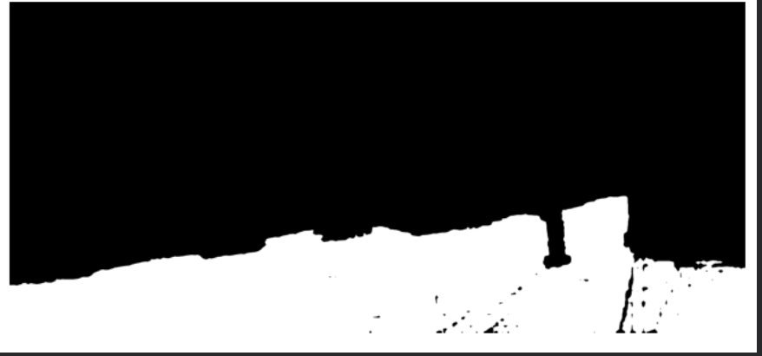
Road Region Segmentation using SAM
Remove irrelevant regions: Exclude background elements (trees, buildings, vehicles) so only the road surface is analyzed.
Bounding box initialization: Place a fixed box at the frame center, where the road and cracks usually appear.
Point prompt generation: Add 10 random point prompts inside the box to cover more of the road.
Road mask generation: SAM uses the box and points to produce a binary road mask that isolates the pavement.
Segmentation

Slide 8
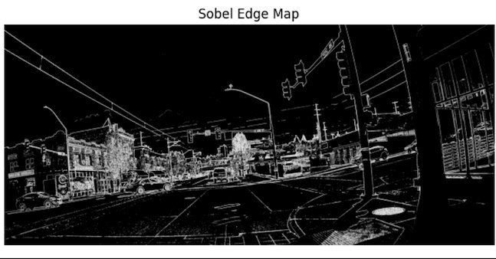
High Frequency Component (HFC)
What are HFCs?
High-frequency components (HFCs) are rapid intensity changes, such as edges, thin structures and crack boundaries.
Why extract HFCs after road segmentation?
Processing the whole pavement is slow and noisy, so we focus only on suspicious edge regions.
How are HFCs extracted?
Apply the Sobel operator to compute image gradients:
  Gx detects horizontal intensity changes.
  Gy detects vertical intensity changes.
Combine Gx and Gy into a gradient magnitude. High values mark likely crack edges.

Slide 9
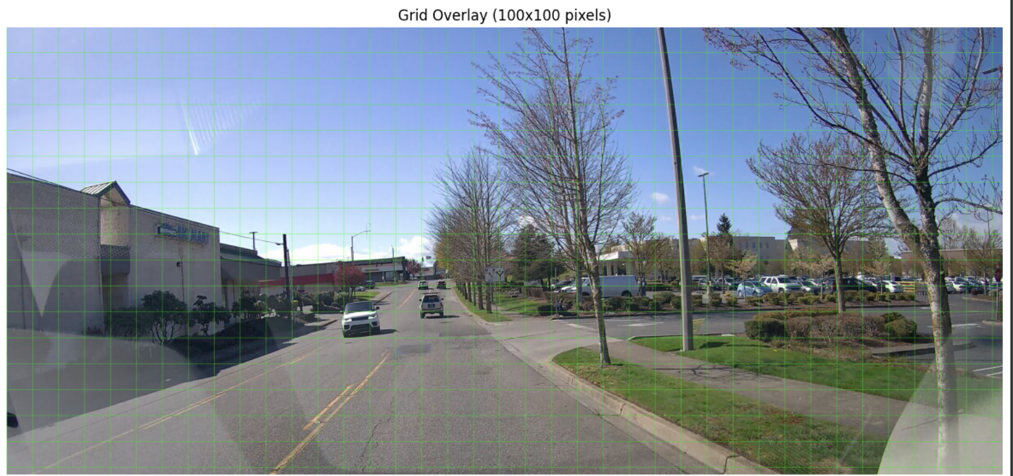
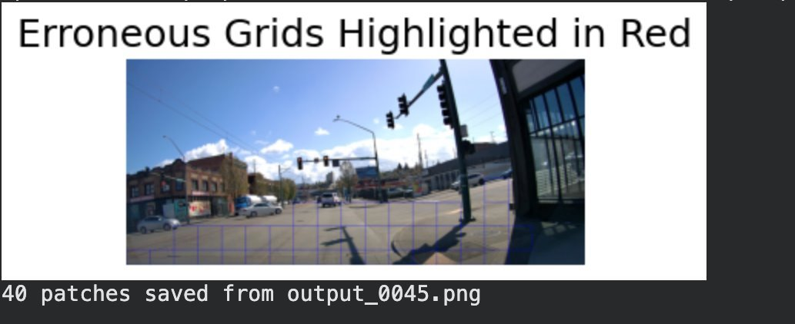
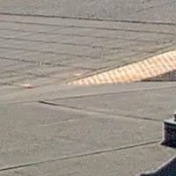

Grid Based Patch Extraction
Road mask and HFC overlap: A bitwise AND of the HFC image and the road mask keeps only edges on the pavement and removes background noise.
Localized grid analysis: The filtered image is split into 200×200 grid cells, so each area is inspected separately instead of the whole road at once.
Patch filtering and extraction: Grids with enough road coverage and crack-like edge intensity are kept as candidate patches.

Slide 10
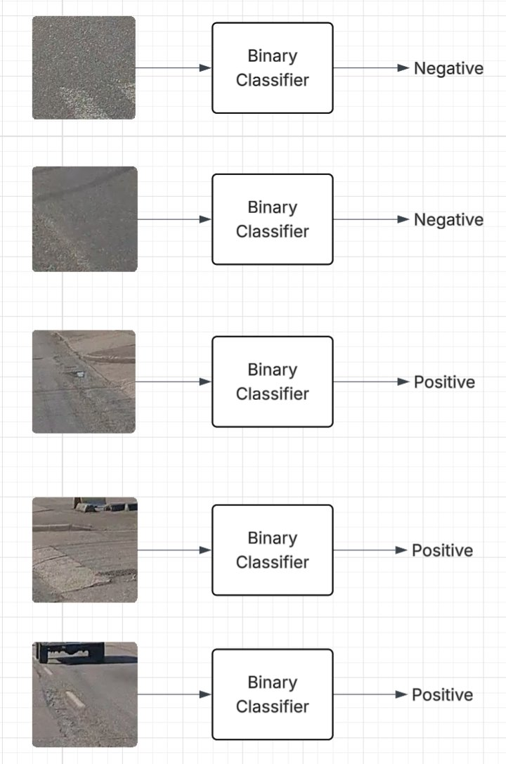
High-Recall ViT Classifier
A Vision Transformer, initialized with ImageNet weights, predicts the probability that a patch contains a crack.
The threshold is calibrated on validation data to reach 100% true-positive recall.
The ViT acts as a broad screen that sends highly likelihood of cracks to VLM for characterization.

Slide 11
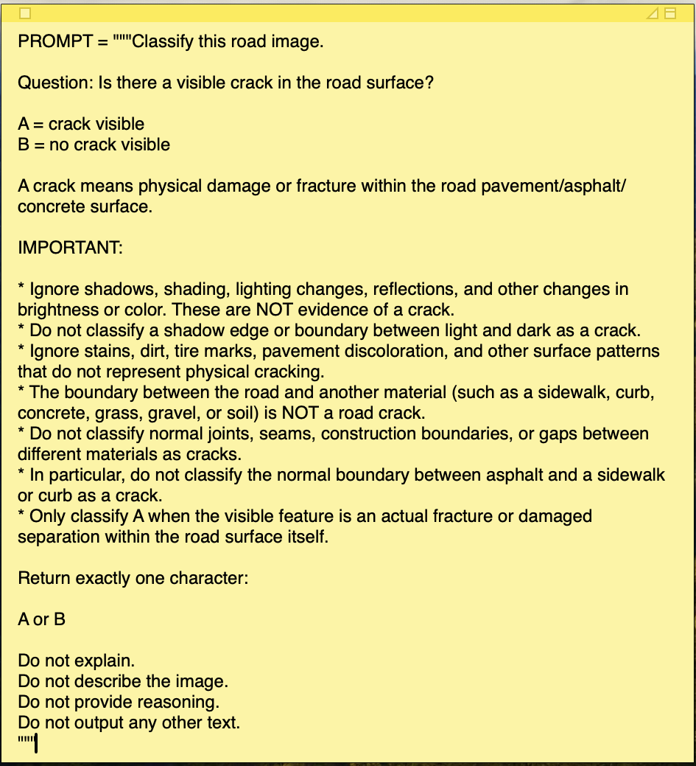
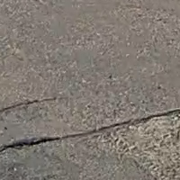
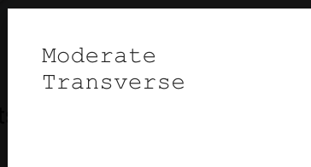
VLM Verification and Characterization
Verification: Is this real pavement damage? (yes/no; ignores stains, shadows, markings, and material boundaries).
Crack type: longitudinal, transverse, alligator, or other.
Severity: negligible, minor, moderate, serious, severe, or extreme.
Each task uses a structured prompt restricted to predefined outputs.

Slide 12
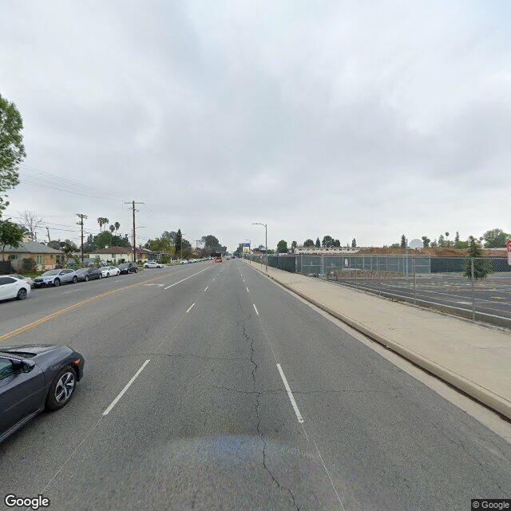
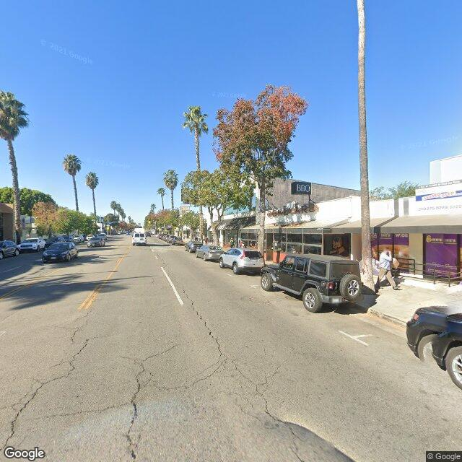
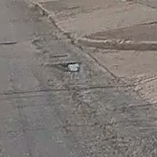
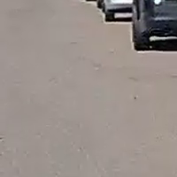
Experiments: Data
Public1 [4]: Comes already split into train, valid and test folders.
Train: positive 5,601, negative 5,601
Valid: positive 701, negative 701
Test: positive 701, negative 701
Public2 [5]: Crops inside the bounding boxes are positives and crops outside are negatives. Used to fine-tune the ViT with gradual unfreezing.
Train: positive 10,253, negative 14,509
Valid: positive 2,564, negative 3,628
UW: 120 images from a fixed vehicle-mounted camera in the UW Tacoma area gave 2,775 patches. We hand-labelled some of them for cross-domain testing.
Test: positive 200, negative 200

Slide 13
Baseline Comparison: Setup
We compare our ViT + VLM pipeline with four baselines on the UW test set:
ResNet (Public1 → Fine-tuned): Trained in the same two stages as the ViT.
Qwen2-VL (VLM only): Applied directly to patches with no classifier filtering.
U-Net (pretrained): Crack masks become image labels by thresholding the share of crack pixels.
ViT (Public1 → Fine-tuned): Our classifier without VLM verification.
ViT + VLM (ours): Adding VLM verification.

Slide 14
Performance Comparison on UW Dataset
Method
ResNet (Public 1)
ResNet (Fine-tuned)
Qwen2-VL (VLM only)
U-Net (pretrained)
ViT (Public 1)
ViT (Fine-tuned)
ViT + VLM (ours)
Acc. | Prec. | Recall | F1
0.5614 | 0.6923 | 0.2250 | 0.3396
0.7393 | 0.7394 | 0.7393 | 0.7393
0.7068 | 0.6367 | 0.9598 | 0.7655
0.6136 | 0.7700 | 0.6100 | 0.5500
0.8020 | 0.7521 | 0.8995 | 0.8182
0.8396 | 0.8054 | 0.8945 | 0.8476
0.8803 | 0.8348 | 0.9444 | 0.8863
\

Slide 15
Conclusion
Classifier and VLM Work Better Together
VLM alone produces many false positives; ViT alone cannot verify ambiguous patches
Together, they outperform ResNet, U-Net, and standalone VLM baselines
Beyond Binary Detection
VLM provides crack type and severity for each verified crack
Helps agencies prioritize road maintenance
Future Work
Do more comprehensive evaluation on larger scale data especially for crack type and severity estimation.

Slide 16
Q/A
Any questions?

Slide 17
References
[1] Abdallah, M., Kaloop, M. R., El-Diasty, M., Hassan, H. F., Alshamsi, K., and Hu, J. W. Automated pavement crack inspection using vision-language models and unmanned aerial vehicle imagery. Engineering Applications of Artificial Intelligence 181 (2026), 115451.
[2] Abrudan, D. TRIB crack dataset: Automatic recognition system for road cracks detection. Earth Science Informatics 18, 2 (2025), 251.
[3] Ha, J., Kim, D., and Kim, M. Assessing severity of road cracks using deep learning-based segmentation and detection. The Journal of Supercomputing 78 (2022), 17721–17735.
[4] Li, D., Duan, Z., Hu, X., Zhang, D., and Zhang, Y. Automated classification and detection of multiple pavement distress images based on deep learning. Journal of Traffic and Transportation Engineering (English Edition) 10, 2 (2023), 276–290.
[5] Liu, Y., Yao, J., Lu, X., Xie, R., and Li, L. DeepCrack: A deep hierarchical feature learning architecture for crack segmentation. Neurocomputing (2019).

Slide 18
References
[6] Tapamo, H., Bosman, A., Maina, J., and Horak, E. Convolutional neural networks for crack detection on flexible road pavements. Springer Nature Switzerland (2023), 194–204.
[7] Zeng, J., and Zhong, H. YOLOv8-PD: An improved road damage detection algorithm based on YOLOv8n model. Scientific Reports 14, 1 (2024), 12052.
[8] Zeng, K., Fan, R., and Tang, X. Efficient and accurate road crack detection technology based on YOLOv8-ES. Autonomous Intelligent Systems 5 (2025).
[9] Zhou, W., Huang, H., Zhang, H., and Wang, C. Teaching segment-anything-model domain-specific knowledge for road crack segmentation from on-board cameras. IEEE Transactions on Intelligent Transportation Systems 25, 12 (2024), 20588–20601.
[10] Ranyal, E., Sadhu, A., and Jain, K. Road condition monitoring using smart sensing and artificial intelligence: A review. Sensors 22, 8 (2022), 3044.

