Slide 1

TALENTINE 2026
TITLE PAGE
Challenge Statement Title-
Category- Artificial Intelligence / Productivity / SaaS
Team Name-Synaptrix
Enhancing Professional Digital Communication Using Artificial Intelligence

Slide 2
IDEA TITLE
SYNAPTIX
Proposed Solution (Describe your Idea/Solution/Prototype)
The problem (Why This Matters):
Email is a key part of professional communication.
Many students and employees struggle with proper tone and structure.
Messages written in hurry often sound rude or unclear.
Poor emails can cause misunderstandings and damage relationships.
Existing tools focus only on grammar, not full email transformation.
What Makes It Unique:
Complete email transformation, not just grammar fixing
Context and intent-based rewriting
Automatic subject line generation
Multiple tone customization options
Real-time AI-powered response
Split-screen “Before vs After” comparison
Clean, minimal, user-friendly design
The Solution –
AI-based system that converts rough text into professionally structured emails.
Automatically enhances tone, clarity, and formatting.
Generates complete email with subject, greeting, body, and closing.
Provides customizable tone options based on user needs.
Ensures fast, accurate, and user-friendly communication support.

Slide 3
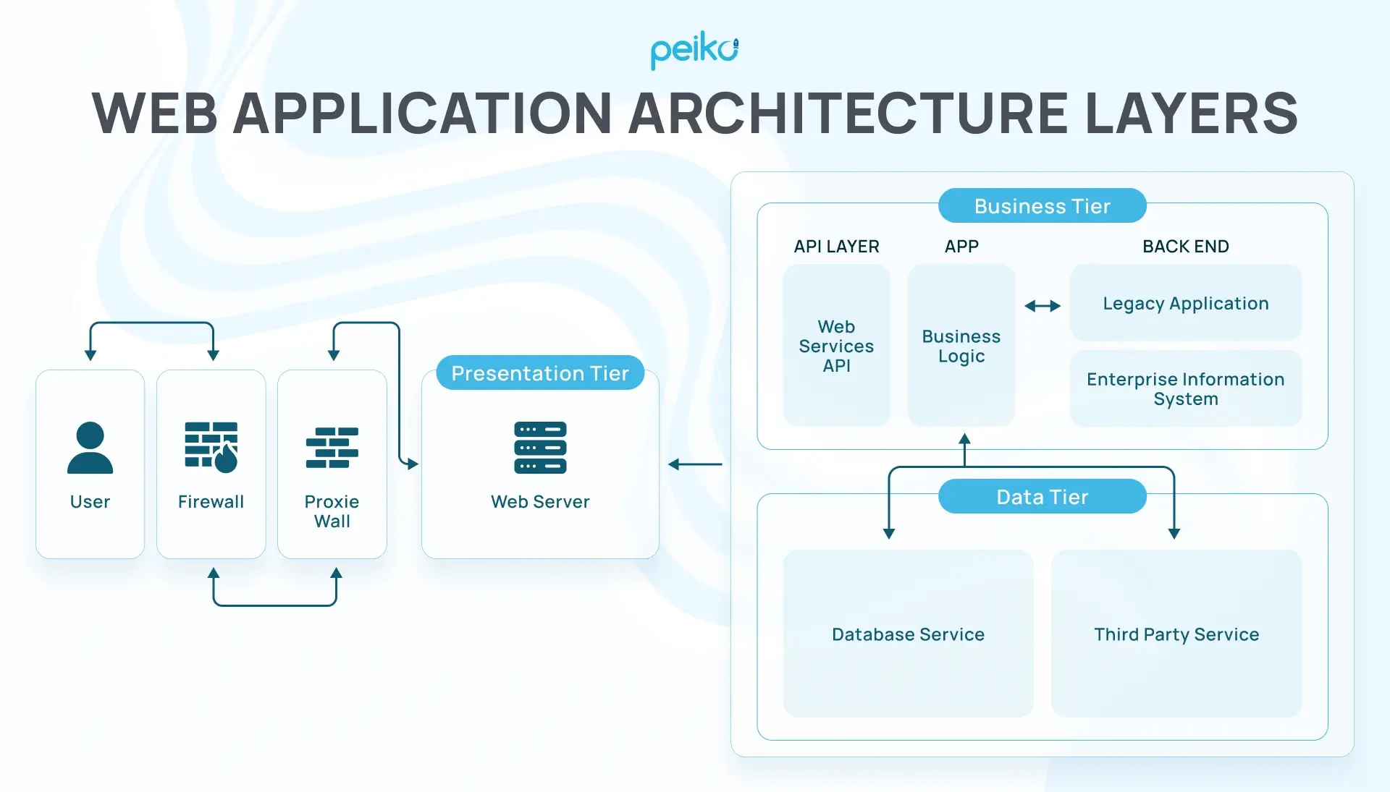
TECHNICAL APPROACH
SYNAPTIX
Layer | Technology / Tool | Role in System
Presentation Layer | React / HTML / CSS | Provides split-screen UI for input and output
Application Layer | FastAPI (Python) | Processes requests and manages AI interaction
AI Processing Layer | Large Language Model API | Understands context and rewrites email professionally
API Communication | RESTful API | Secure data transfer between frontend and backend
Deployment | Vercel (Frontend) / Render (Backend) | Cloud hosting and scalability
User Input
↓
Backend Server
↓
AI Processing
↓
Structured Email Output

Slide 4
FEASIBILITY AND VIABILITY
SYNAPTRIX
Feasibility
Uses existing AI APIs
No hardware required
Web-based scalable solution
Low infrastructure cost
Challenges & Risks
Challenge | Solution Strategy
API Cost | Optimize response length & usage
Data Privacy | Secure API & encrypted communication
Competition | Unique tone control & clean UI
User Adoption | Simple interface & free plan
Business Model / Revenue Model
💰 Freemium Model
Free Plan: Limited email rewrites per day
Premium Plan (₹199/month):
  Unlimited rewrites
  Advanced tone options
  Email history saving
🏢 Future Expansion
Enterprise plan for companies
Integration with Gmail & corporate tools

Slide 5
IMPACT AND BENEFITS
SYNAPTRIX
IMPACT & BENEFITS
Target Audience Impact
Empowers students to communicate professionally with professors and recruiters
Helps working professionals maintain formal workplace communication
Assists startups and freelancers in client handling
Reduces hesitation and builds communication confidence
Saves time in daily email drafting tasks
Government Mission Alignment
Aligns with Digital India by promoting smart digital solutions
Supports Skill India by improving professional communication skills
Encourages responsible use of Artificial Intelligence in daily tasks
Social Benefits
Promotes respectful and structured digital communication
Reduces workplace conflicts caused by miscommunication
Supports individuals with limited English proficiency
Encourages a culture of professionalism in digital platforms
Scalability & Future Growth
Cloud-based infrastructure enables national and global expansion
Can integrate with Gmail, corporate tools, and learning platforms
Future expansion into multilingual AI communication assistant
Economic Benefits
Increases employee productivity by reducing drafting time
Improves business reputation through better communication
Minimizes costly misunderstandings in corporate environments
Supports growth of AI-based productivity ecosystem

Slide 6
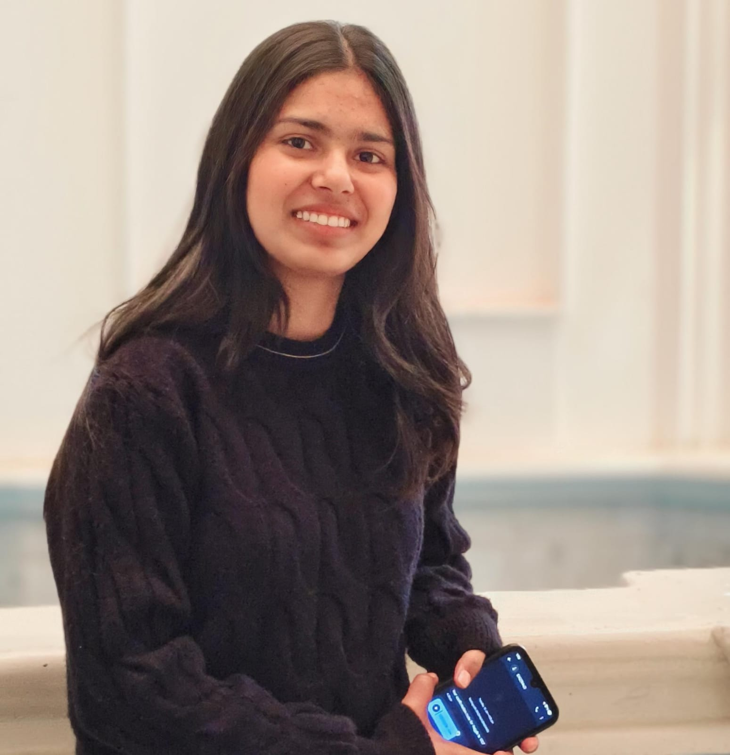
Team
SYNAPTRIX
 | Name: Reetika Choudhary | Course: BCA(DATA SCIENCE) | Year: 1st year
b

