Slide 1
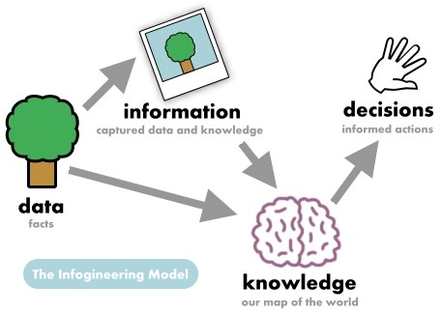
In Machine Learning context:
Knowledge and Model are same?

Slide 2
In language sciences…
Knowledge means, pattern, facts, information, skills that is acquired through experience
In Machine Learning…
Model is a algorithm that learns patterns (facts, artifacts ) from the data (experiences)

Slide 3
Data vs Information vs Knowledge
The words Data and Information may look similar and many people use these words very frequently, But both have lots of differences between them.
what is data:
Data are plain facts.
The word "data" is plural for "datum."
When data are processed, organized, structured or presented in a given context so as to make them useful, they are called Information.
It can be anything like name of a person or a place or a number etc. The main examples of data are weights, prices, costs, numbers of items sold, employee names, product names, addresses, tax codes, registration marks etc.
Data is the raw material that can be processed by any computing machine.
Data themselves are fairly useless, but when these data are interpreted
and processed to determine its true meaning, they becomes useful and can
be named as Information.
contextualize
Processed
Organized
Structured
Transformed

Slide 4
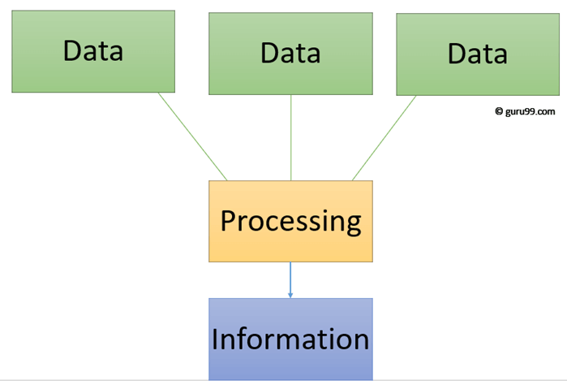
Data vs Information vs Knowledge
Information
It is data that has been processed in such a way as to be meaningful to the person who receives it.
Information is data that has been converted into a more useful or intelligible form.
It is the set of data that has been organized for direct utilization of mankind, as information helps human beings in their decision making process.
Examples are: Seating plan, Time Table, Merit List, Report card, Headed tables, printed documents, pay slips, receipts, reports etc.

Slide 5
Data vs Information vs Knowledge
Knowledge
Human mind purposefully organized the information and evaluate it to produce knowledge.
In other words the ability of the person recalls or uses his information and experience is known as knowledge.
For example, "386" is data, "your marks are 386/400" is information, and "It is result of your hard work" is knowledge

Slide 6
Data vs Information vs Knowledge
Raw Data
Information
Technically corrected data
Knowledge
(PATTERNS/TRENDS ETC)
Learning
Consistent data
Modelling
Decision Making
Data Preprocessing
Machine Learning
Data Mining
Statistical Learning

Slide 7
Knowledge Discovery (KDD) Process (Knowledge Discovery in Data bases)
Data Mining/Modelling—core of knowledge discovery/learning process
Knowledge
Pattern/model Evaluation/Presentation
Data Mining, Learning and Modelling
contextualization
Task-relevant Data
Selection
Data Warehouse
Data Preprocessing
Data Cleaning
Data Integration
Databases

Slide 8
Data Mining and Business Intelligence
End User
Increasing potential
to support
business decisions
Decision Making
Business
Analyst
Pattern Presentation and Model Evaluation
Visualization/validating Techniques
Data Mining/Modelling
Data
Analyst
Information Discovery/Learning
Data Exploration
Statistical Summary, Feature Engg., and Reporting
Data Preprocessing/Integration, Data Warehouses
Data Sources
DBA
Paper, Files, Web documents, Scientific experiments, Database Systems

