Slide 1
SC-Net: Spatio-Temporal Contrast Network for CAD Diagnosis
MICCAI 2024 Paper Implementation — Progress Update
Dual-branch DETR-style architecture for coronary artery disease diagnosis from CCTA
1
2
3
Clinically-Credible Data Augmentation
Spatio-Temporal Dual-Task Learning
Dual-Task Prediction- Contrast Optimization
Lesion recombination on CPR volumes for data-scarce settings
Object detection (spatial) + sampling-point classification (temporal)
Cross-supervision via detached pseudo-labels between branches

Slide 2
Implementation Progress & Bug Fixes
13+ Architecture Bugs Identified & Fixed
Key Discovery: Paper Code ≠ Paper Equations
• nn.ModuleList for extraction blocks (weights were invisible to optimizer)
• Learnable parameters: feature weights, view fusion as nn.Parameter
• Fixed query embeddings via nn.Embedding (was random every forward pass)
• Conv3d spatial flattening projection (defined but never called)
• Gradient detachment in contrastive loss (circular gradient flow)
• Box format consistency: center-width throughout pipeline
• Device handling: targets moved to output device in loss functions
• Deep copy targets before each loss term (in-place mutation bug)
• Paper equations: λ_L1 = 5, λ_IoU = 2
• Paper code actually uses: 1:1:1 equal weighting
• Our "fixes" matching equations broke convergence
• Resolution: Reverted to paper code weights (1:1:1)
Two-Stage Training Pipeline
• Stage 1 — Pre-train on augmented data (3-class plaque)
• Stage 2 — Fine-tune on clinical data (6-class: stenosis × plaque)
• Head reinitialization (3→6 classes) is by design in paper code
• AdamW optimizer, CosineAnnealingLR, gradient clipping = 0.1
Development Phases
• Phase 1: Initial codebase setup (Jan 2025)
• Phase 2: 15+ critical bug fixes across 6 files (Jan 2025 – Feb 2026)
• Phase 3: Training infrastructure, DDP, evaluation pipeline (Feb 2026)
• Phase 4: Root cause analysis — paper code vs. paper equations (Feb 2026)

Slide 3
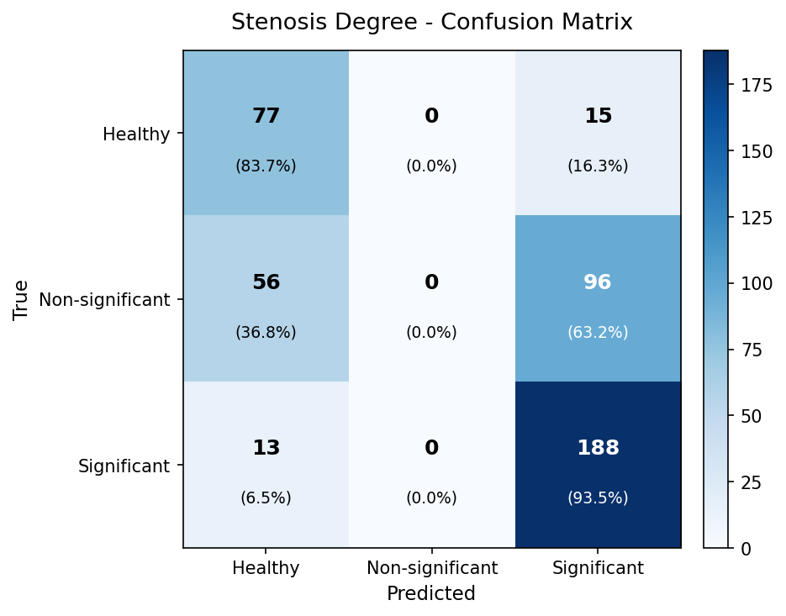
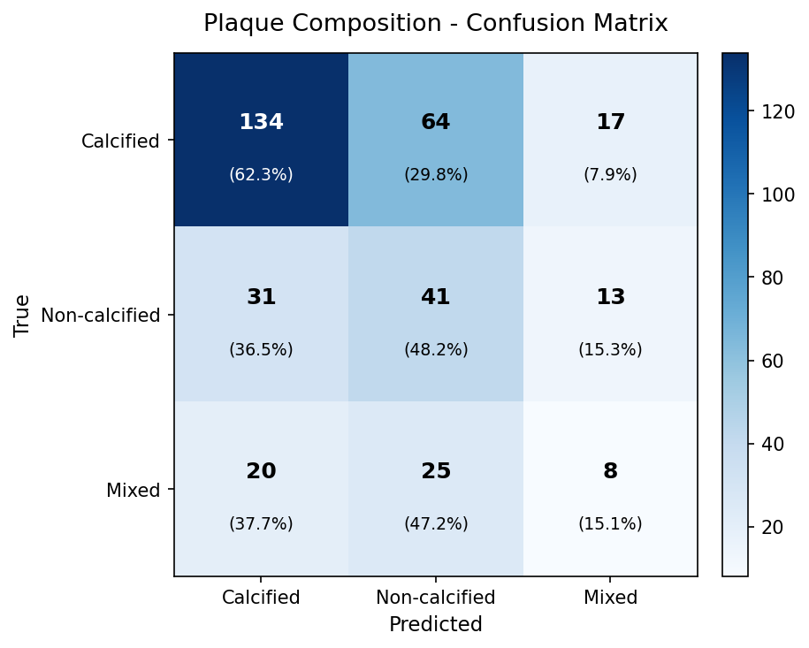
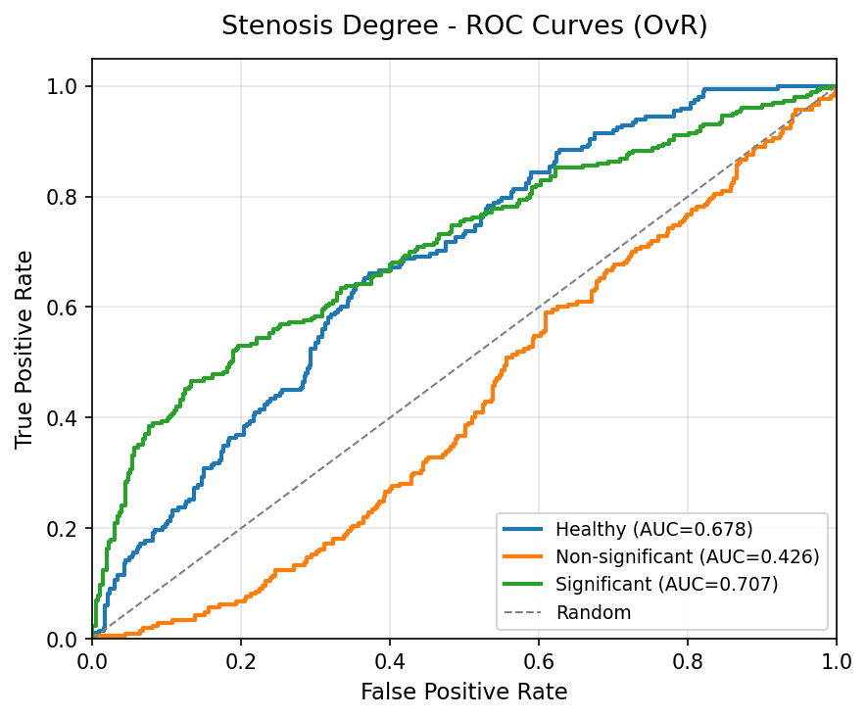
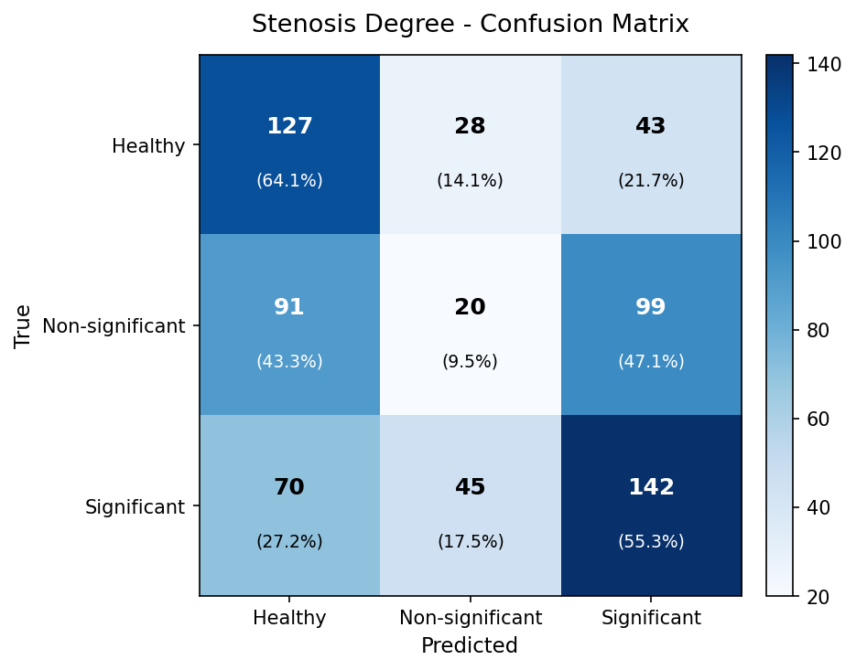
Current Results
Run | Stenosis ACC | Macro F1 | Sig. F1 | Macro AUC | Notes
v2-ft (baseline) | 0.316 | 0.160 | 0.000 | 0.573 | Majority class only
v6-ft (held-out, cal.) | 0.435 | 0.393 | 0.525 | 0.604 | Best prev. result
v7-ft (argmax) | 0.402 | 0.342 | 0.000 | 0.713 | Plaque collapsed
v7-ft (calibrated) ★ | 0.596 | 0.466 | 0.752 | 0.720 | Sig Rec=93.5%
Paper target | 0.914 | — | — | — | 100% data (218 patients)
v7-ft Constrained Calibration — Best Results
Stenosis: ACC=0.580 F1=0.585 AUC=0.713
Non-sig Recall=0.581 ✓ Sig Recall=0.595 ✓
Calibration thresholds: [Healthy=2.20, NonSig=0.35, Sig=0.25]
Failure analysis (67 test arteries):
Healthy: 1/17 correct (6%) — model over-predicts disease
Non-sig: 13/23 correct (57%)
Sig: 11/27 correct (41%) — detects lesion, mis-grades severity
Root cause: Healthy threshold t=2.20 too coarse; backbone (v6)
converged too early — v9 pre-training underway to fix

Slide 4
Next Steps & Roadmap
Completed
Next: v8 / Non-sig Fix
Medium-Term
v7-ft training: delayed Ldc ramp, confidence gating, balanced sampling ✔
Constrained 3D calibration: NonSig Rec=0.581, Sig Rec=0.595 ✔
CPR visualization tool: GT/Pred bars per-slice (viz_v7ft_clean/) ✔
Failure analysis: Healthy 6%, NonSig 57%, Sig 41% — root causes identified ✔
13+ architecture bug fixes across 6 core files ✔
v9 pre-training (running): longer warmup, patience=40, 200 epochs
v9-ft fine-tuning: once v9 backbone beats v6 val loss 3.22
Calibration with higher Healthy threshold to fix 6% Healthy recall
Target: Healthy Rec > 50%, maintain NonSig Rec > 50%, Sig Rec > 50%
• Plaque Mixed class: F1=0.176 (53 GT samples — more data needed)
• Non-significant stenosis: architectural or data solution?
• Data scaling: additional patient cohorts if available
• Full ablation study matching paper's Table 2 format
Paper Target Metrics (100% data, 218 patients)
Stenosis: ACC 0.928 | F1 0.944 | Precision 0.948 | Recall 0.940 | Spec 0.917 Plaque: ACC 0.805 | F1 0.840

