Slide 1

A Survey on 3D Point Cloud Compression Using Machine Learning Approaches
Reetu Hooda, Dr. W. David Pan and Tamseel Mahmood Syed
Department of Electrical and Computer Engineering
University of Alabama in Huntsville
Huntsville, Alabama
1st April 2022

Slide 2
Outline
Introduction
Autoencoders
Fully Connected Neural Networks
Recurrent Neural Networks
Conclusion

Slide 3
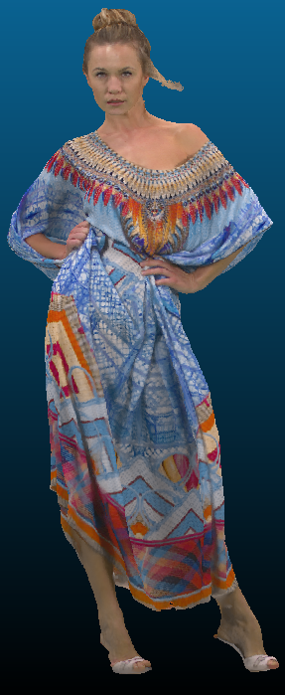

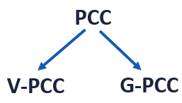
Introduction
Autoencoders
Fully Connected NN
Recurrent NN
Conclusion
INTRODUCTION
What is a Point cloud?
- Geometry -> 3D coordinates
- Attributes -> color information or normal vectors
Applications: Cultural heritage, Autonomous driving, Robotics etc.
Need of Point Cloud Compression.
MPEG PCC standardization:

Slide 4
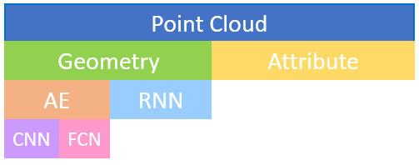
Introduction
Autoencoders
Fully Connected NN
Recurrent NN
Conclusion
OVERVIEW
Machine learning for media applications.
Traditional Vs Machine learning based techniques.

Slide 5
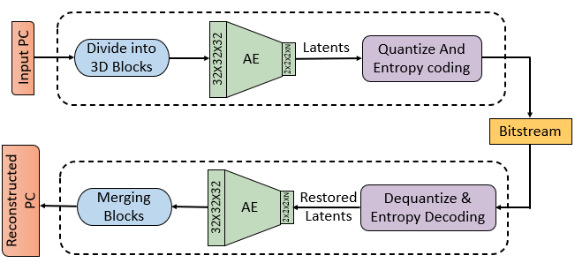
Introduction
Autoencoders
Fully Connected NN
Recurrent NN
Conclusion
POINT CLOUD GEOMETRY AUTOENCODER
CNNs: Most effective in extracting features.
Characteristics found in images and videos.
PCG-AE: Basic implementation.
Occupancy signaled by ‘1’ and ‘0’.
Adaptive forward and Inverse Transform.
Four models, for N = 32, 64, 96 and 128.
MPEG dataset, PCL as benchmark, RD performance.

Slide 6
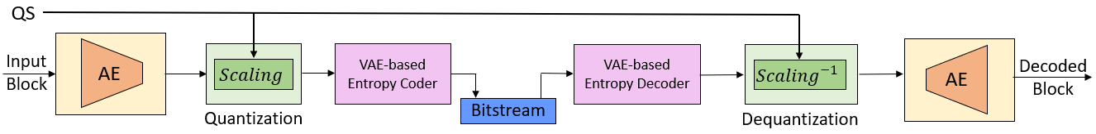
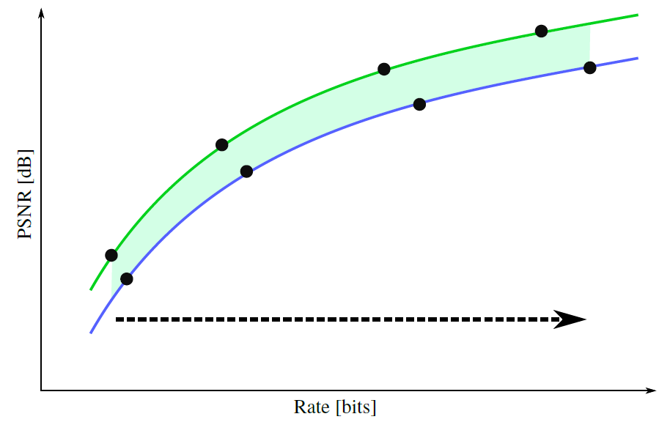

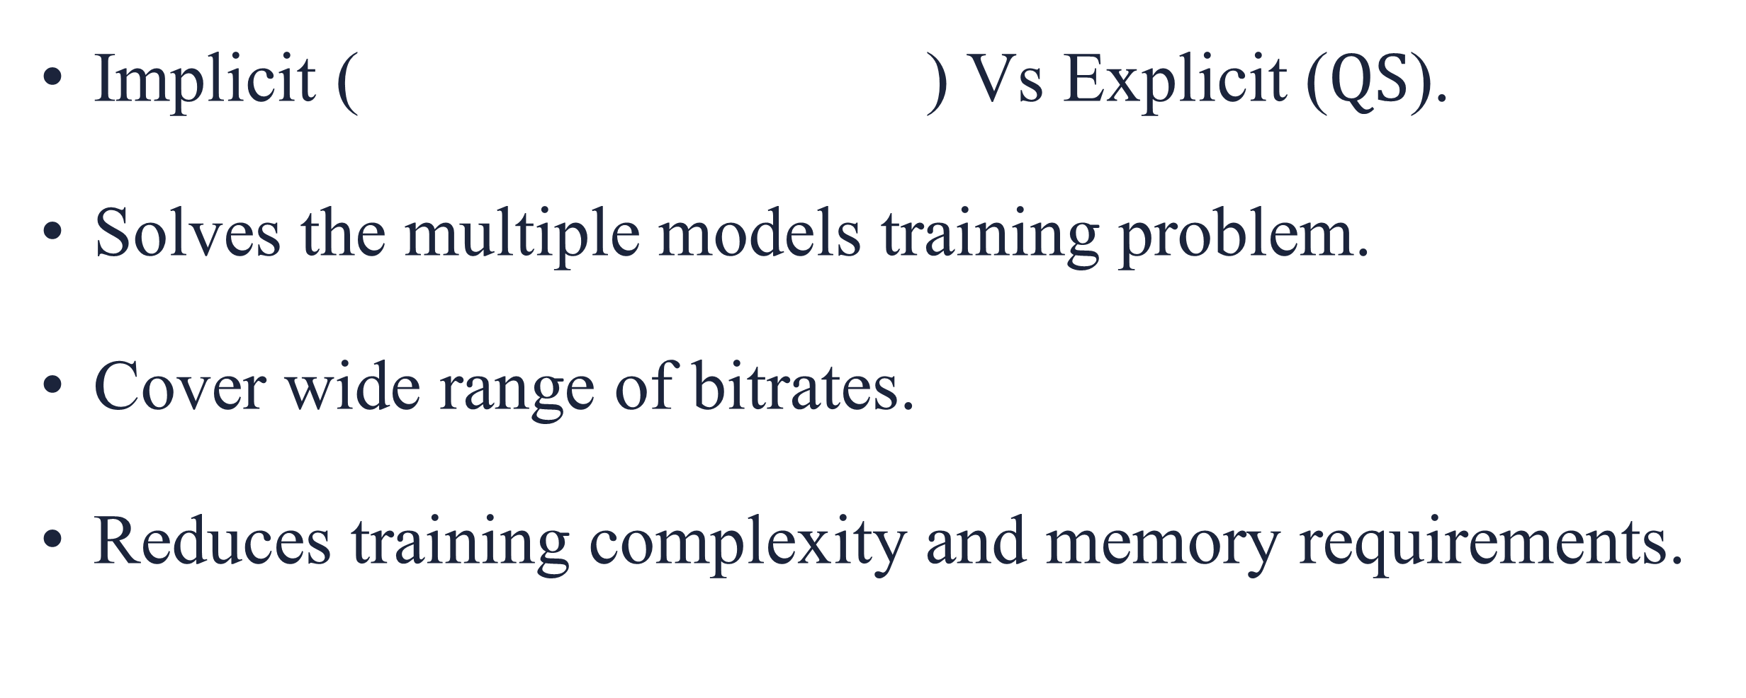
Introduction
Autoencoders
Fully Connected NN
Recurrent NN
Conclusion
RD CONTROL THROUGH IMPLICIT AND EXPLICIT QUANTIZATION
Implicit ( ) Vs Explicit ($QS$).
Solves the multiple models training problem.
Cover wide range of bitrates.
Reduces training complexity and memory requirements.

Slide 7
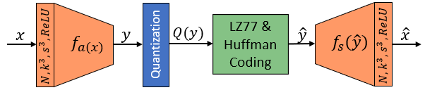
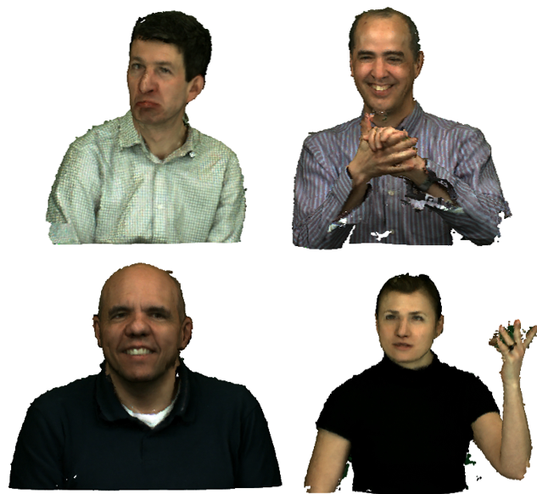
Introduction
Autoencoders
Fully Connected NN
Recurrent NN
Conclusion
LEARNED CONVOLUTIONAL TRANSFORMS
Directly operates on voxels and decoding-> Classification problem.
Analysis and synthesis transform.
Number of filters, filter size and strides.
Convolution and transpose convolution.
Trained on ModelNet40, Tested on MVUB, MPEG anchor (51.5%).

Slide 8
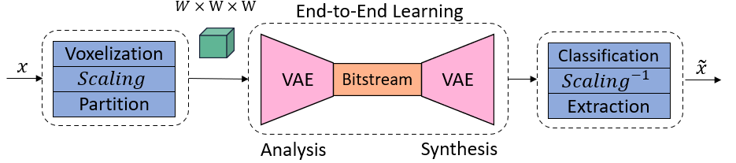
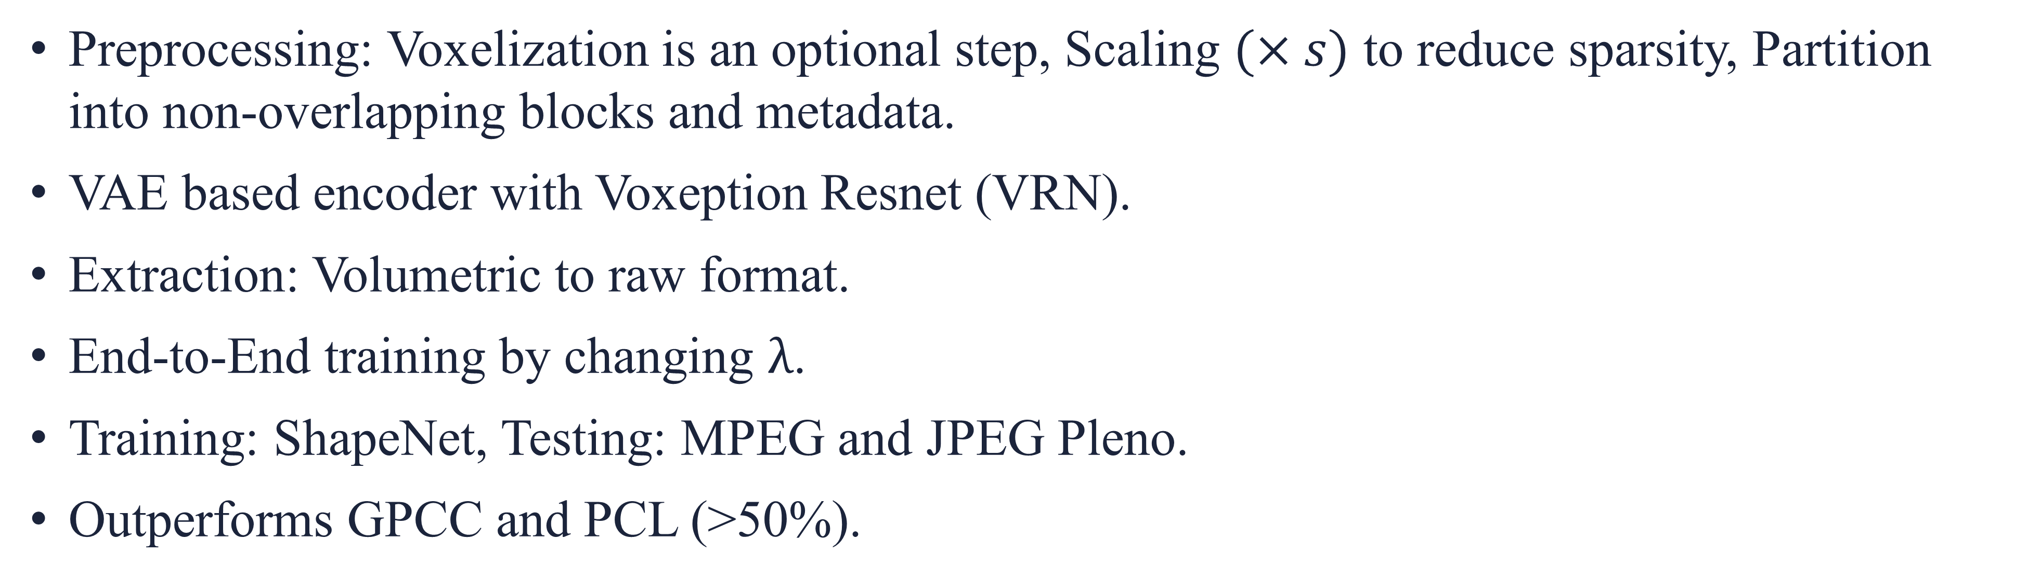
Introduction
Autoencoders
Fully Connected NN
Recurrent NN
Conclusion
LEARNED PC GEOMETRY COMPRESSION
Preprocessing: Voxelization is an optional step, Scaling $(×s)$ to reduce sparsity, Partition into non-overlapping blocks and metadata.
VAE based encoder with Voxeption Resnet (VRN).
Extraction: Volumetric to raw format.
End-to-End training by changing $λ$.
Training: ShapeNet, Testing: MPEG and JPEG Pleno.
Outperforms GPCC and PCL (>50%).

Slide 9
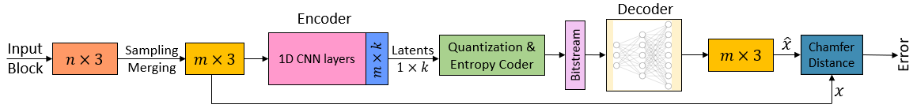

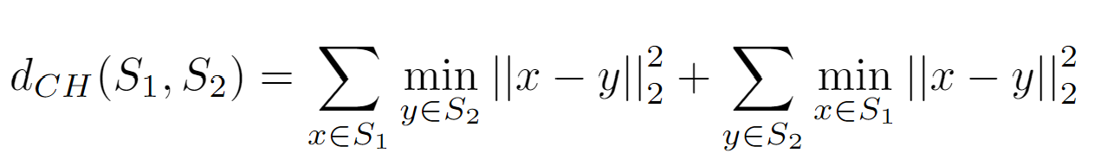
Introduction
Autoencoders
Fully Connected NN
Recurrent NN
Conclusion
DEEP AE-BASED POINT CLOUD GEOMETRY COMPRESSION
Advantages of CNNs: Retain spatial relations and weight sharing.
FCNN: It works directly on the geometry coordinate.
Filters in each layer: 64, 128, 128, 256 and k (no. of input points).
ShapeNet with 90%, 10% split from a single class.
MPEG-GPCC: 73.17% average gain.

Slide 10
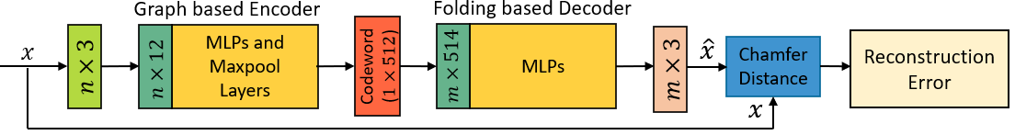
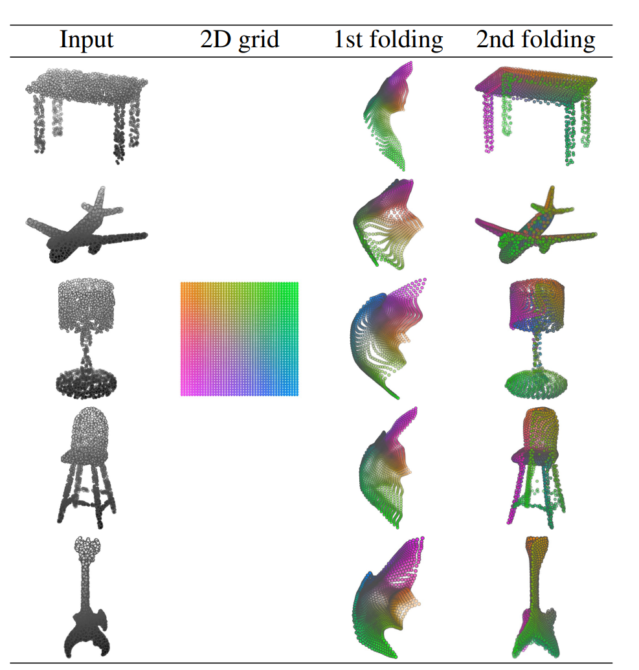
Introduction
Autoencoders
Fully Connected NN
Recurrent NN
Conclusion
FOLDING NET: DEEP GRID FORMATION
Voxelization is performed to make CNN more meaningful.
However, it sacrifices the original representation.
Folding operation: 2D to 3D mapping.
Starts with random folding.
ShapeNet dataset and uses only 7% parameters of a FC decoder.

Slide 11
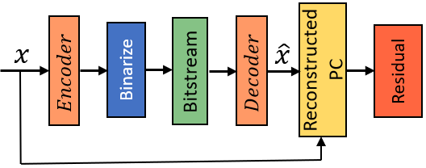
Introduction
Autoencoders
Fully Connected NN
Recurrent NN
Conclusion
RECURRENT NEURAL NETWORK (RNN)
Limited research on usage of RNN for PCC.
Focused on data from 3D LiDAR sensors (Driving data from 11 areas of Japan)
Challenging data to compress and hence works on raw packets.
Raw packets to 2D matrices losslessly.
Uses residual blocks for accurate decompression.

Slide 12
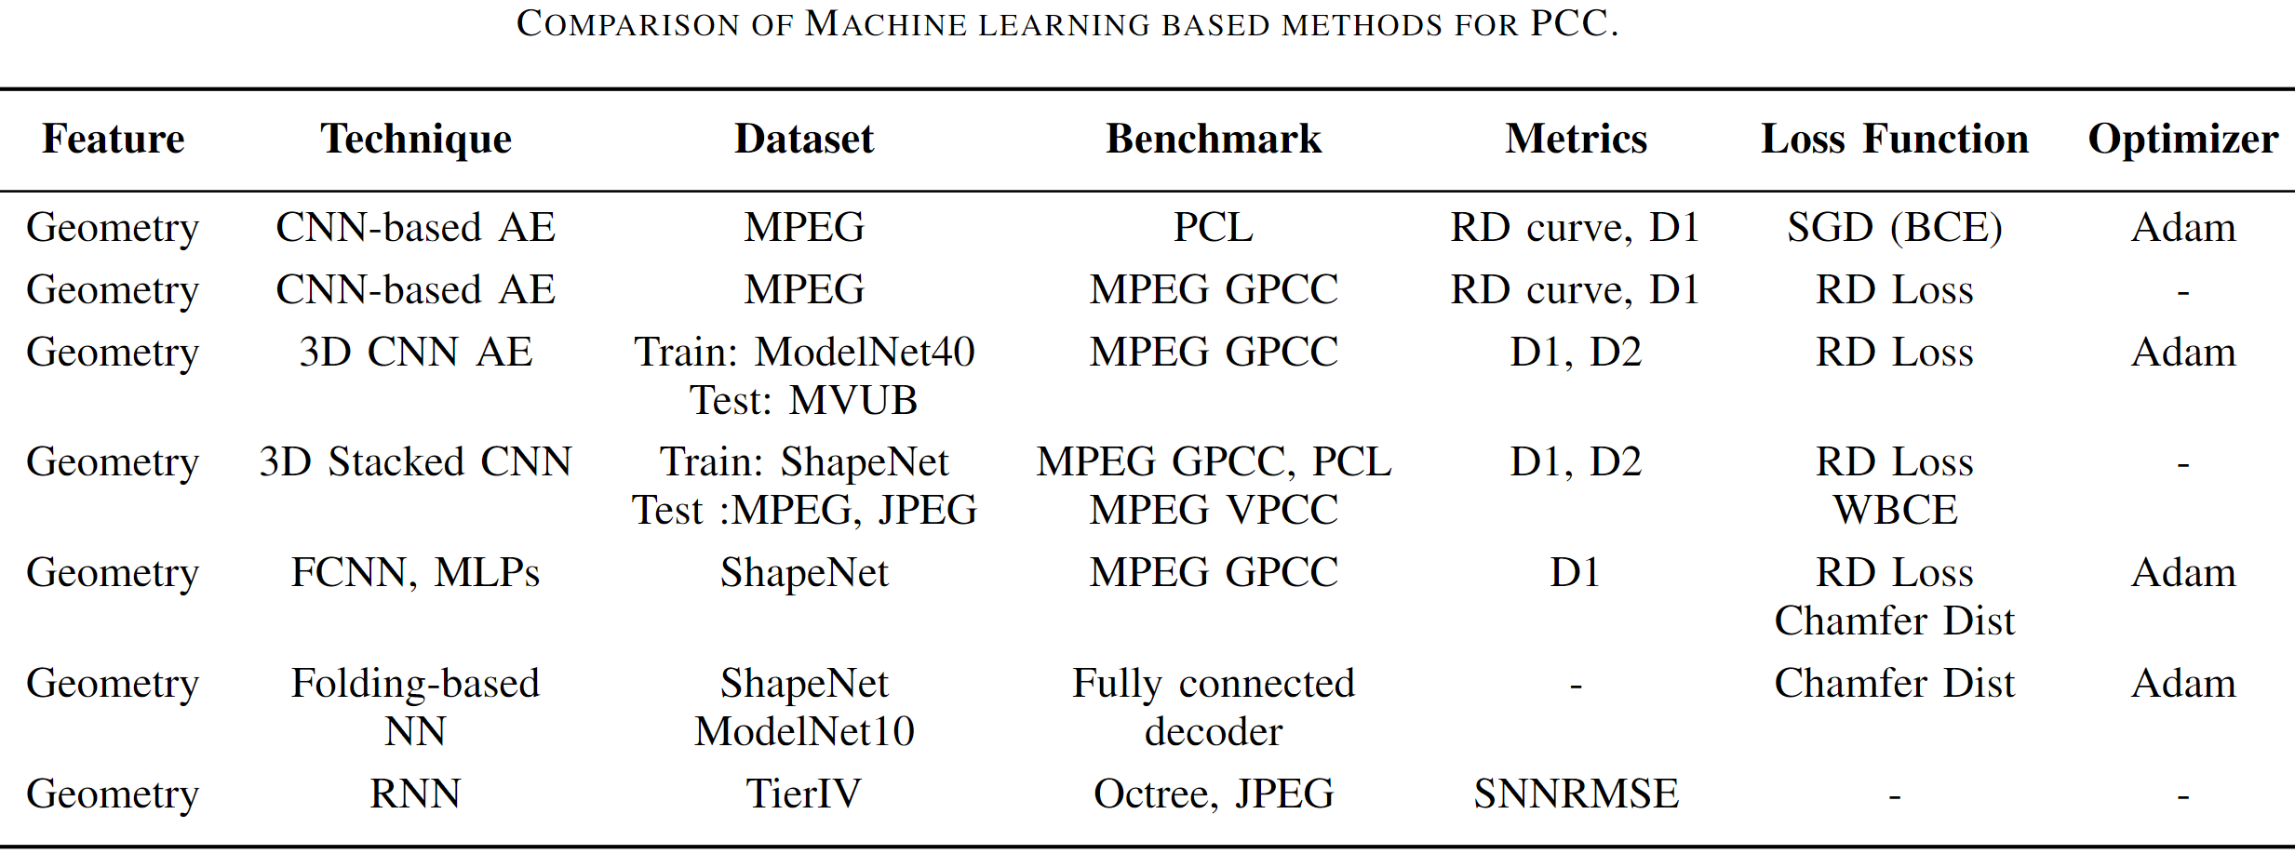
Introduction
Autoencoders
Fully Connected NN
Recurrent NN
Conclusion
CONCLUSION
CNN
FCNN
RNN
An emerging research area of PCC using ML/DL.
Most existing work focuses on geometry compression.
Most common choice is CNN-based AE with few FCNN and even fewer RNN.

Slide 13
Thank You!
Questions?

