Slide 1
Hailey Weinschenk TJX Data Analyst Assignment - July 2023

Slide 2
Firstly, I performed exploratory data analysis on the given data set.
This includes checking data types, as well as observing and handling null values, duplicates and other ‘problem’ entries.
The ‘Size’ column proved to be problematic and a variety of procedures were taken to clean this column’s values.

Slide 3
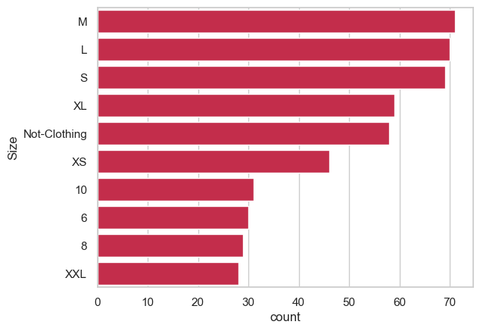
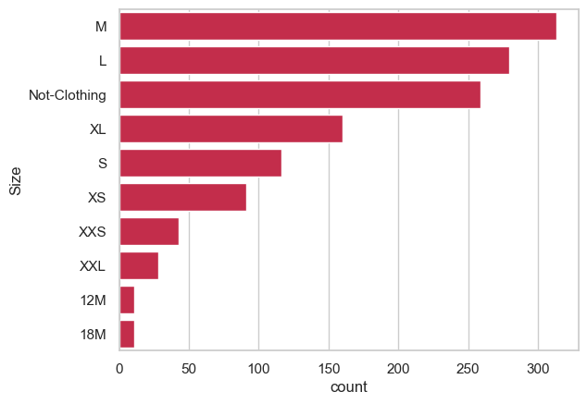
Pre Cleaning
Post Cleaning

Slide 4
Then, recommendations for promotional policies for various departments were considered.
This includes both raising and lowering average promotional discounts, as well as emphasizing certain product types.
The `Bedding` sales data displayed a high extent of promotional purchases, with an absence of promotional discount at all. The `Mens Furnishing` department also had a high percentage of markdown sales with an extremely friendly discount.
Both are not ideal policies.

Slide 5
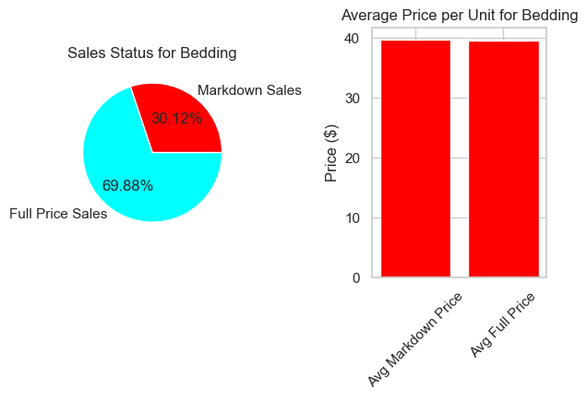
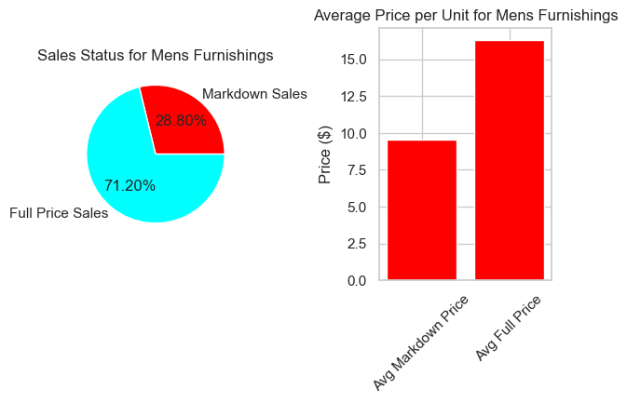
High average discount with high markdown purchase rate.
High markdown rate, with no discount present.

Slide 6
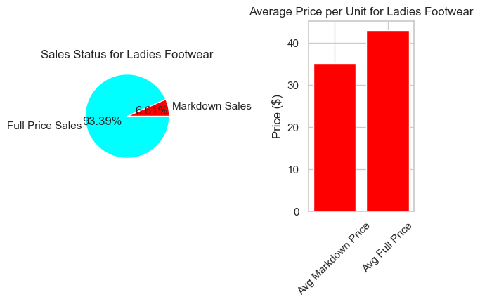
A more ideal distribution…

Slide 7
Finally, conclusions were drawn after grouping by the newly cleaned `Size` column.
Firstly, logic was invoked to determine when a product needs to be restocked.
Then, a surplus of XS and S clothes was discovered by observing inventory:sales ratios. This overstocking results from less total units sold and, therefore, a disproportionately low percentage of total sale value.

Slide 8
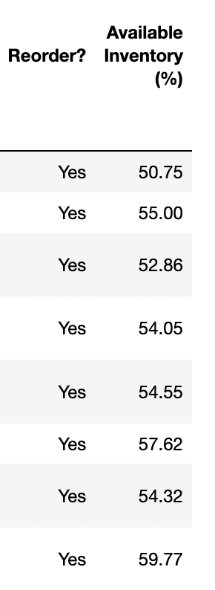
If available inventory is < 60% of original units, then restock is needed.

Slide 9
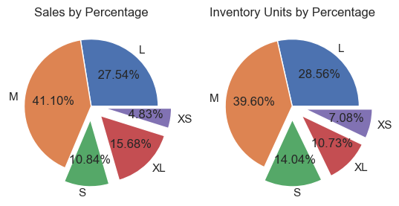
XS and S items hold a disproportionate amount of inventory space relative to their profit generated, while XL items generate much more profit than their inventory size suggests.

