Slide 1

IDA Project
Dev Vasudevan – 220962378
Reeva Nanda - 220962308

Slide 2

Objectives
To develop a predictive model that accurately forecasts the closing prices of stocks based on historical data
Identifying the best suited predictive model
Assessing the reliability and accuracy of the model
To plot the predicted values against the actual values

Slide 3
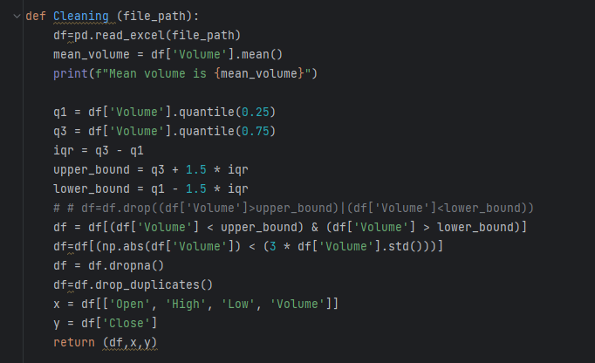
Methodology - I
Importing dataset from Kaggle
Cleaning the Data

Slide 4
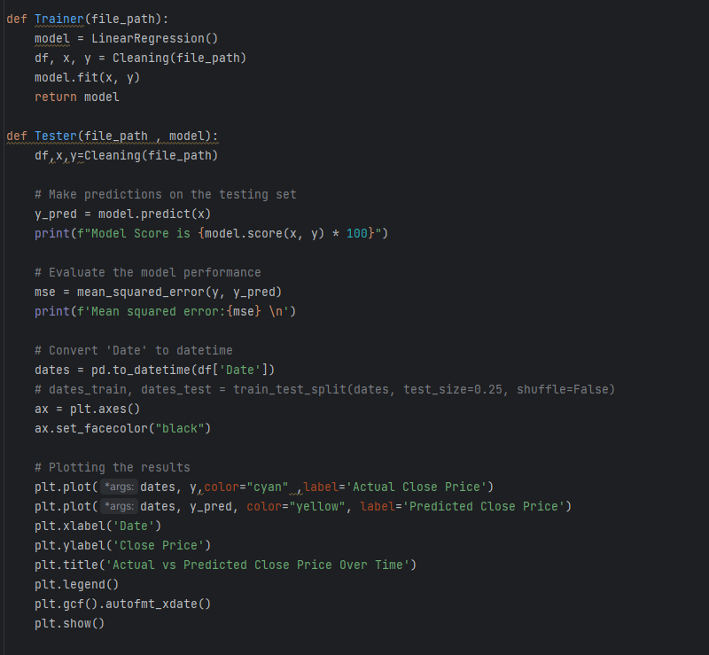
Methodology - II
Predictive Analysis
Linear Regression

Slide 5
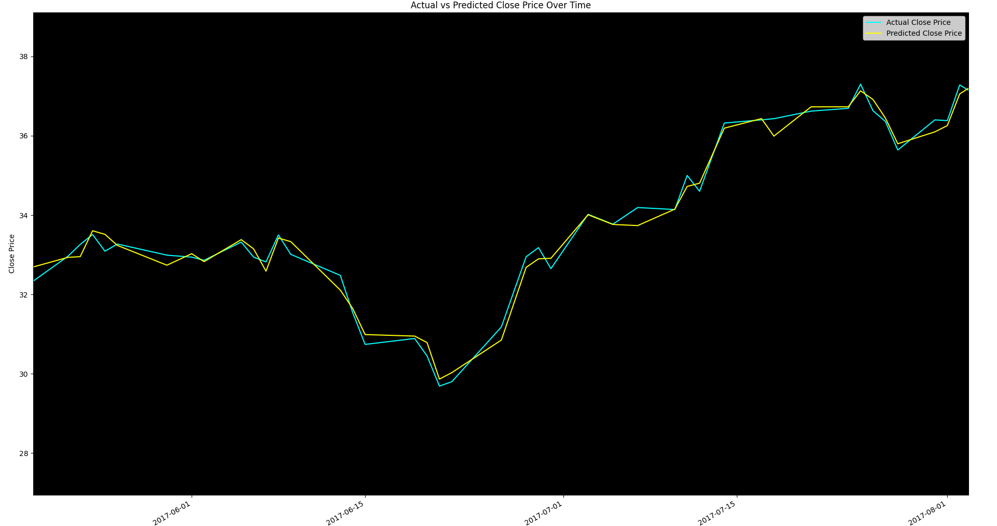
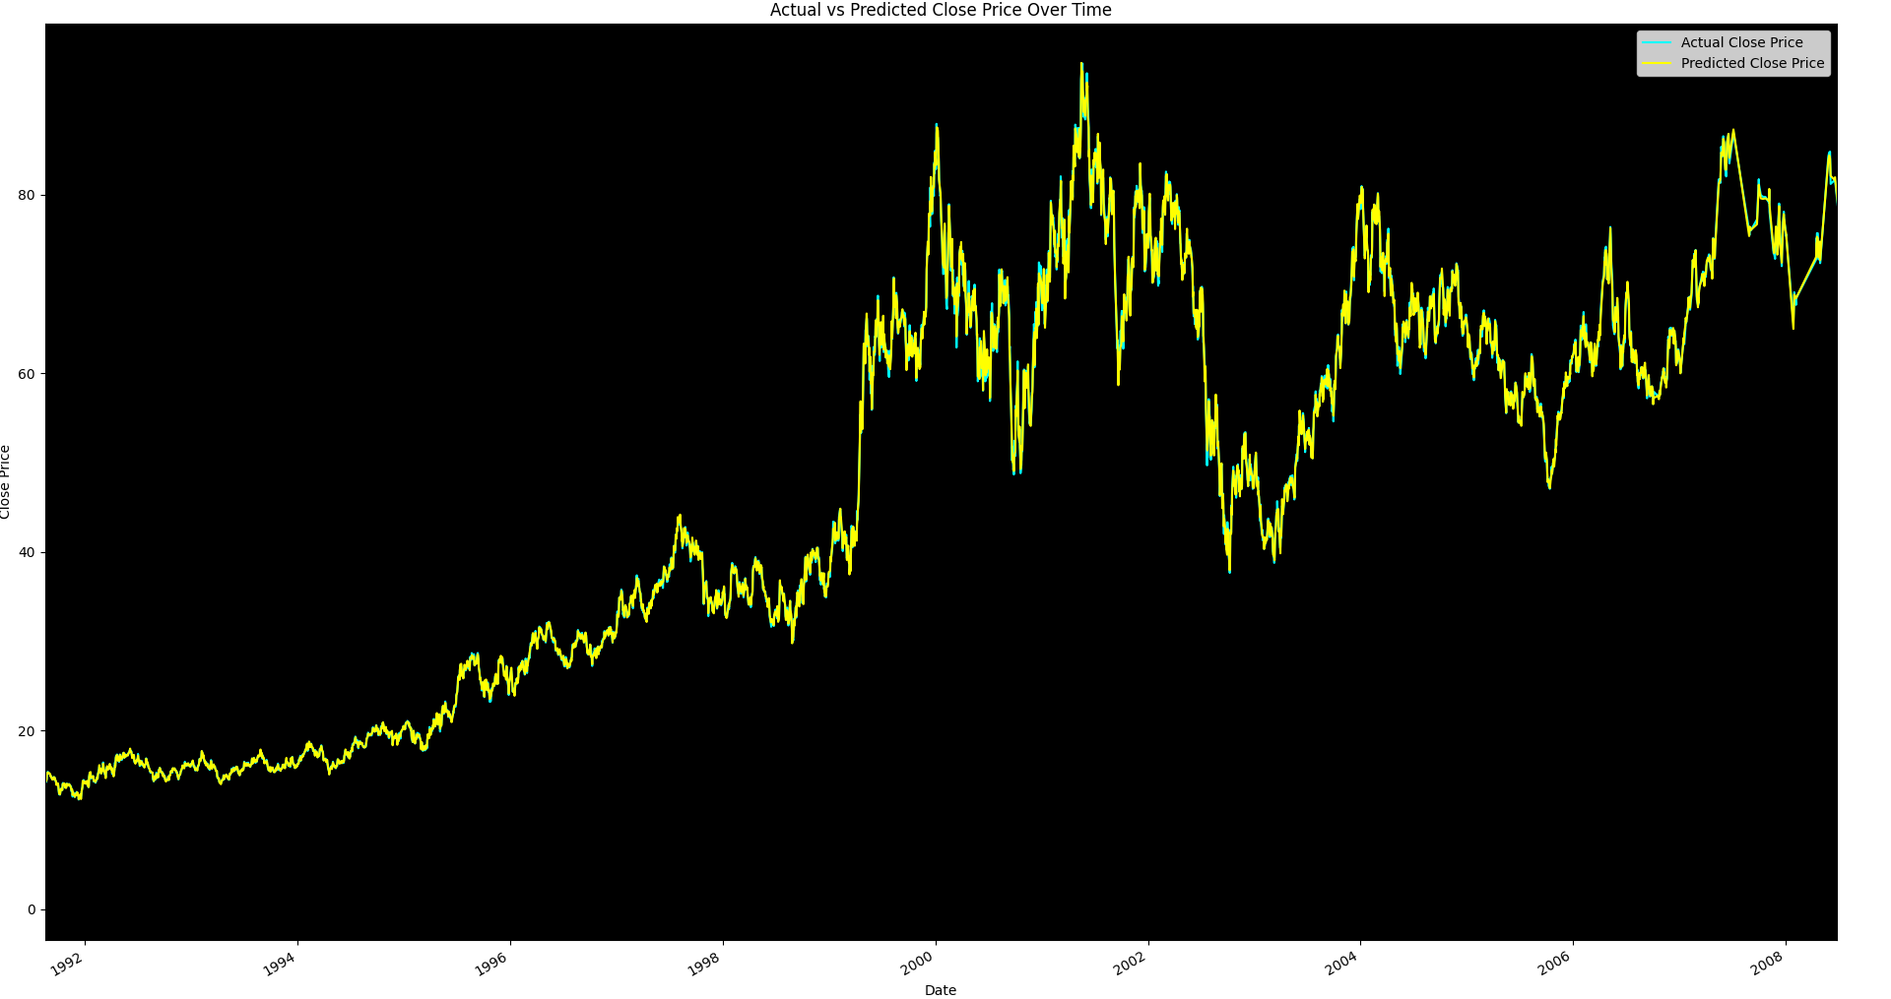
Methodology - III
Data Visualization using matplotlib

Slide 6



Results
Tested against 3 different scripts

Slide 7
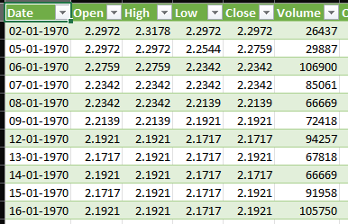
Limitations
Predicting the close price based unrealistic data
Notes:
Here we can talk about how this can be fixed using CNN or LTSB etc and why its unrealistic

