Slide 1
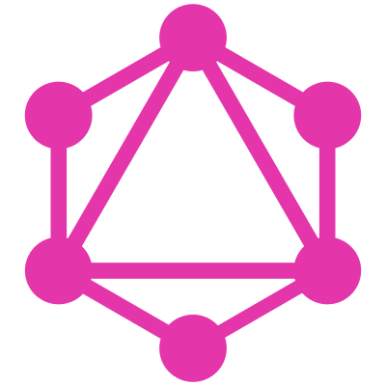

Almost everything about graphql
Prateek Gogia
@reeversedev

Slide 2
What the heck is Graphql?
GraphQL is a query language for APIs and a runtime for fulfilling those queries with your existing data. (from the website).
People are saying the it will replace REST API because of it’s features and performance.
It has three major tools/workarounds to deal with, TypeDefs, Resolvers, Subscriptions.
To get data or to save data you need create a schema.

Slide 3
Benefits of using graphql
Ask for only the data that you need, as a result giving you flexibility.
Helps in reducing the unnecessary payload, hence reducing the overall response time.
It provides a graphiql interface with the proper documentation of your Query and Mutations.
Community support is Top Notch since it is in open source environment.
We can rely on it since, big companies are already using it in fancy products like Github, Facebook and AirBnb.

Slide 4

GraphQL queries and database queries
Just like database, even GraphQL requires some sort query of that needs to be done to get data.
In order to query in database, we need a schema so that we can declare the type of data that should be there. Well, same is the case with GraphQL also.
In raw database, at database level ,you make queries based on what data do you want. In GraphQL, you can do the same but that’s on Application level.

Slide 5
Enough of this hype!!
show me the damn code!

Slide 6
The problems with graphql
It’s still not a very matured domain in the industry yet.
The GraphQL world still keeps on changing mainly because of it’s open source nature and the excitement by the community to build better.
Because of the changes, you will distract more, will get more not-well-cooked knowledge and in turn your frustrated developer life will be enriched.

Slide 7

So should you really use GraphQL?
NO!
Handling your co-workers.
Convincing a stubborn Manager/Boss.
Keeping an update to market in almost every 2-3 months.
Handling the overall stress.

Slide 8

But should you really really use the graphql?
Oh Yes!
Instead of directly jumping into production software, build side projects first.
Create good amount of documentation to understand your project so that other can also relate to it.
Your manager can be convinced if you yourself are confident enough to use the technology. So get the damn POC ready already.

