Slide 1
Java当中的ClassLoader
Classloader作用: 1. 加载.class文件; 2. 加载资源文件（各种格式的文件）
不同的Classloader加载目录不同,意味着你使用不同的Classloader来getResource时候，搜索范围是不一样的，子Classloader总能搜索到父Classloader作用域的资源，反之则不行
CLASSPATH有两个地方可以设置: 1. 系统环境变量； 2. 启动java时使用 –classpath参数指定（推荐）
(idea在运行时就是用-classpath方式，把程序所有依赖库文件地址都放到classpath中)

Slide 2
第 1 步：SpringBoot 创建Springboot实例
spring.factories 文件是放在resources/META-INF/目录下面的springboot能识别的文件，可以实现引入依赖即能配置好引入的库，也就是spring-starter，在spring.factories中指定库的@Configuration配置文件路径，就能实现自动配置库，而不用在主类上面设置Component Sacn base package，况且一个项目你也不知道你引用的库的@Configuration在哪个路径下
按优先级启动/执行，用数字表示优先级，数字越小，优先级越高
spring.factories
Ordered
initializers
ApplicationContextInitializer
initializers & listeners
listeners
ApplicationListener
SpringApplication在初始化的时候会调用这些initializer的 initialize 方法，对ApplicationContext实例做一些额外的初始化工作
SpringApplication 实例
接收ApplicationContext事件通知，onApplicationEvent(E event) 方法被调用
mainApplicationClass
webApplicationType
SERVLET, NONE, REACTIVE
...

Slide 3
第 2 步： SpringBoot.run
// 监听Spring启动过程的listner
SpringApplicationRunListeners listeners = getRunListeners(args);
listenlers.starting(); try { ...
// 1. 获取环境变量和配置信息（如application.properties） ConfigurableEnvironment environment = prepareEnvironment(listeners, applicationArguments); configureIgnoreBeanInfo(environment);
// 控制台打印 SpringBoot banner Banner printedBanner = printBanner(environment);
// 2. 创建ApplicationContext实例（ AnnotationConfigServletWebServerApplicationContext ） context = createApplicationContext(); // 3. 初始化ApplicationContext（1. 关联environment和ApplicationContext、2. 使用ApplicationContextInitializer.initialize初始化ApplicationContext等等） prepareContext(context, environment, listeners, applicationArguments, printedBanner); // 4. 准备ApplicationContext
refreshContext(context);
// afterRefresh(context, applicationArguments);
... listeners.started(context); callRunners(context, applicationArguments); } catch (Throwable ex) { ... } return context;

Slide 4
第 2.1 步： SpringBoot.run - createApplicationContext
AnnotationConfigServletWebServerApplicationContext
// 默认无参构造方法
public AnnotationConfigServletWebServerApplicationContext() { this.reader = new AnnotatedBeanDefinitionReader(this); this.scanner = new ClassPathBeanDefinitionScanner(this); }
2. 解析使用注解配置的bean
createApplicationContext
1. 在classpath下扫描bean
注册bean: CONFIGURATION_ANNOTATION_PROCESSOR_BEAN_NAME -> ConfigurationClassPostProcessor
// 解析 @Autowired 和 @Value 注解
注册bean: AUTOWIRED_ANNOTATION_PROCESSOR_BEAN_NAME -> AutowiredAnnotationBeanPostProcessor
// Check for JSR-250 support, and if present add the
注册bean: COMMON_ANNOTATION_PROCESSOR_BEAN_NAME -> CommonAnnotationBeanPostProcessor
// Check for JPA support, and if present add the PersistenceAnnotationBeanPostProcessor.
注册bean: PERSISTENCE_ANNOTATION_PROCESSOR_BEAN_NAME -> PersistenceAnnotationBeanPostProcessor
注册bean: EVENT_LISTENER_PROCESSOR_BEAN_NAME -> EventListenerMethodProcessor
注册bean: EVENT_LISTENER_FACTORY_BEAN_NAME -> DefaultEventListenerFactory
添加注解过滤器 AnnotationTypeFilter: Component.class、javax.annotation.ManagedBean、javax.inject.Named

Slide 5
第 3 步： ApplicationContext.refresh() - 准备ApplicationContext
// Prepare this context for refreshing. prepareRefresh(); // Tell the subclass to refresh the internal bean factory. ConfigurableListableBeanFactory beanFactory = obtainFreshBeanFactory(); // Prepare the bean factory for use in this context.
// 向BeanFactory添加ApplicationContext需要的一些BeanPostProcessor、添加ApplicationContext类型的依赖 prepareBeanFactory(beanFactory); try { // Allows post-processing of the bean factory in context subclasses.
// 抽象方法，子类实现， AnnotationConfigServletWebServerApplicationContext在这一步 postProcessBeanFactory(beanFactory); // Invoke factory processors registered as beans in the context. invokeBeanFactoryPostProcessors(beanFactory); // Register bean processors that intercept bean creation. registerBeanPostProcessors(beanFactory); // Initialize message source for this context. initMessageSource(); // Initialize event multicaster for this context. initApplicationEventMulticaster(); // Initialize other special beans in specific context subclasses. onRefresh(); // Check for listener beans and register them. registerListeners(); // Instantiate all remaining (non-lazy-init) singletons. finishBeanFactoryInitialization(beanFactory); // Last step: publish corresponding event. finishRefresh();

Slide 6
第 2 步： SpringBoot创建ApplicationContext
AbstractApplicationContext
BeanDefinitionRegistry
DefaultListableBeanFactory
ThemeSource
GenericApplicationContext
ConfigurableWebApplicationContext
GenericWebApplicationContext
ConfigurableWebServerApplicationContext
ServletWebServerApplicationContext
AnnotationConfigRegistry
webApplicationType
AnnotationConfigServletWebServerApplicationContext
SERVLET
StandardServletEnvironment

Slide 7
第 2.2 步： SpringBoot.run - prepareContext
AnnotationConfigServletWebServerApplicationContext
// 默认无参构造方法
public AnnotationConfigServletWebServerApplicationContext() { this.reader = new AnnotatedBeanDefinitionReader(this); this.scanner = new ClassPathBeanDefinitionScanner(this); }
createApplicationContext
注册bean: CONFIGURATION_ANNOTATION_PROCESSOR_BEAN_NAME -> ConfigurationClassPostProcessor
注册bean: AUTOWIRED_ANNOTATION_PROCESSOR_BEAN_NAME -> AutowiredAnnotationBeanPostProcessor
// Check for JSR-250 support, and if present add the CommonAnnotationBeanPostProcessor.
注册bean: COMMON_ANNOTATION_PROCESSOR_BEAN_NAME -> CommonAnnotationBeanPostProcessor
// Check for JPA support, and if present add the PersistenceAnnotationBeanPostProcessor.
注册bean: PERSISTENCE_ANNOTATION_PROCESSOR_BEAN_NAME -> PersistenceAnnotationBeanPostProcessor
注册bean: EVENT_LISTENER_PROCESSOR_BEAN_NAME -> EventListenerMethodProcessor
注册bean: EVENT_LISTENER_FACTORY_BEAN_NAME -> DefaultEventListenerFactory
添加 AnnotationTypeFilter: Component.class、javax.annotation.ManagedBean、javax.inject.Named

Slide 8
第 3 步： SpringBoot prepareContext
开始
设置ApplicationContext的environment
postProcessApplicationContext
applyInitializers
执行所有的initializer的initialize方法，
对ApplicationContext进行初始化
listeners.contextPrepared
listeners.contextLoaded
结束

Slide 9
第 4 步： SpringBoot refreshContext
ApplicationContext初始化一般流程
开始
bf = obtainFreshBeanFactory()
ApplicationContext子类重写方法
prepareBeanFactory(bf)
AnnotationConfigServletWebServerApplicationContext
postProcessBeanFactory(bf)
bf = obtainFreshBeanFactory()
AnnotationConfigServletWebServerApplicationContext
invokeBeanFactoryPostProcessors(bf)
DefaultListableBeanFactory
registerBeanPostProcessors(bf)
initMessageSource
initApplicationEventMulticaster
postProcessBeanFactory(bf)
onRefresh
registerListeners
finishBeanFactoryInitialization(bf)
onRefresh
createWebServer
finishRefresh
结束

Slide 10
ServletWebServerApplicationContext
createWebServer
继承
AnnotationConfigServletWebServerApplicationContext

Slide 11
Connector
Http1.1 Connector
ProtocolHandler
Http11NioProtocol
Endpoint
NioEndpoint
http connection

Slide 12
Http1.1 Connector
Http11NioProtocol
NioEndpoint
ServerSocketChannel
accept
Acceptor线程
Executor线程池
SocketChannel
socketWrapper
Poller线程
Selector
PollerEvent队列

Slide 13
Tomcat中的读请求处理链
Poller线程
loop
register new connected socket channel
select()
precessKey
with OP_READ interest operation
SelectionKey
PollerEvent
Selector
register
PollerEvent
PollerEvent队列
NioChannel
NioSocketWrapper
event
NioSocketWrapper
NioEndpoint
Executors
http connection
ServerSocketChannel
setSocketOptions
SocketProcessor
accept
Acceptor线程
SocketChannel

Slide 14
Tomcat中的Connector组件
Connector结构
Connector
service :Service
handler :Handler<S>
adapter :Adapter
protocolHandler :ProtocolHandler
endpoint :AbstractEndpoint<S,?>
handler :Handler<S>

Slide 16
Tomcat
poller :Poller
port :String
baseDir :String
hostname :String
selector :Selector
events :SynchronizedQueue<PollerEvent>
server :StandardServer
address :String
port :String
services :StandardService []
name :String
server :StandardServer
engine :StandardEngine
connectors :Connector []
service :Service
adapter :Adapter
protocolHandler :Http11NioProtocol
adapter :Adapter
endpoint :NioEndpoint
handler :ConnectionHandler
poller :Poller
executor :Executor
acceptor :Acceptor
selectorPool :NioSelectorPool

Slide 17
Http11Processor
adapter: CoyoteAdapter
service(org.apache.coyote.Request req, org.apache.coyote.Response res)
service(SocketWrapperBase<?> socketWrapper)
process(SocketWrapperBase<?> socketWrapper, SocketEvent status)
NioEndpoint
executor :ThreadPoolExecutor
handler: ConnectionHandler
process(SocketWrapperBase<S> socket,SocketEvent status)
SocketProcessor
SocketProcessor
SocketProcessor
doRun()

Slide 18
connector: Connector
Http11Processor
service: StandardService
adapter: CoyoteAdapter
engine: StandardEngine
service(org.apache.coyote.Request req, org.apache.coyote.Response res)
pipeline: StandardPipeline
first :StandardEngineValue
next
service(SocketWrapperBase<?> socketWrapper)
invoke(Request request, Response response)
process(SocketWrapperBase<?> socketWrapper, SocketEvent status)
下一页再见
request.getHost().getPipeline().getFirst().invoke(request, response)
Context
StandardHost
pipeline: StandardPipeline
pipeline: StandardPipeline
first :StandardContextValue
first :StandardHostValue
next
request.getContext().getPipeline().getFirst().invoke(request, response)
next
invoke(Request request, Response response)
invoke(Request request, Response response)

Slide 19
// Allocate a servlet instance to process this request servlet = wrapper.allocate();
// Create the filter chain for this request ApplicationFilterChain filterChain = ApplicationFilterFactory.createFilterChain(request, wrapper, servlet);
filterChain.doFilter(request.getRequest(), response.getResponse());
StandardWrapper
pipeline: StandardPipeline
first :StandardWrapperValue
next
invoke(Request request, Response response)
request.getWrapper().getPipeline().getFirst().invoke(request, response)
Context
pipeline: StandardPipeline
first :StandardContextValue
next
invoke(Request request, Response response)

Slide 20
Netty中的读请求处理链
AbstractNioChannel
pipeline
ChannelHandler LinkedList
fireChannelRead
SelectionKey.OP_READ
NioEventLoop
select
processSelectedKey
AbstractNioChannel

Slide 21
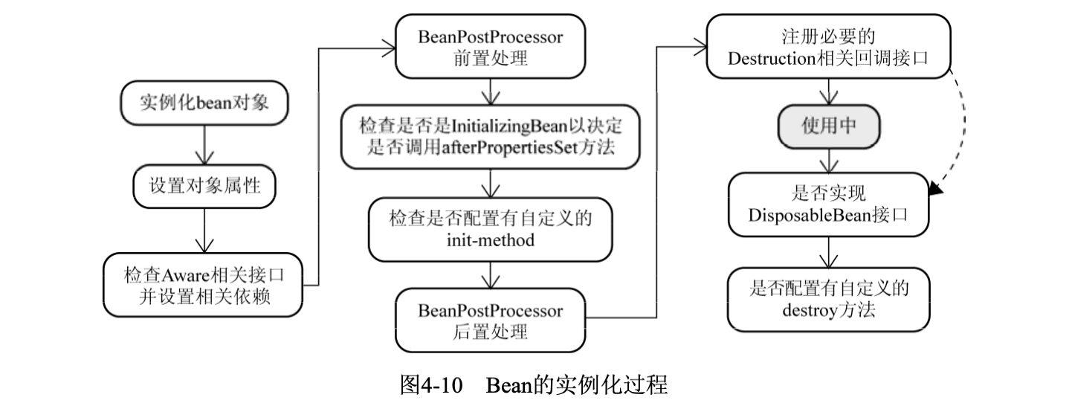

Slide 22
SpringFramework Bean的生命周期
BeanDefinitionRegistry
BeanDefinition
BeanDefinition
BeanFactoryPostProcessor
1. 根据BeanDefinition的Bean所属Class，通过反射或者CGLib等方式实例化对象或其子类对象，并返回BeanWrapper包装对象
修改BeanDefinition
根据Beandefinition创建对象
2. 设置Bean实例的属性和依赖
Bean
3. 把Bean实例实现的Aware接口对应的对象注入到Bean实例中，如实现 ApplicationContextAware接口，则向Bean注入ApplicationContext对象
修改Bean实例
BeanPostProcessor
Spring AOP 的原理就是在这一步使用增强的代理对象替换原来的Bean实例
进一步修改Bean状态
InitializingBean & init_method
如果实现InitializingBean接口，则调用afterPropertiesSet方法继续设置Bean实例状态，如果XML中指定bean的init_method，则调用指定的方法
DisposableBean & init_method
实现DisposableBean或者在XML中自定义destroy-method定义对象销毁时的回调，在调用BeanFactory.destroySingletons方法时，对象销毁回调才会被调用执行
开始使用bean实例

Slide 23
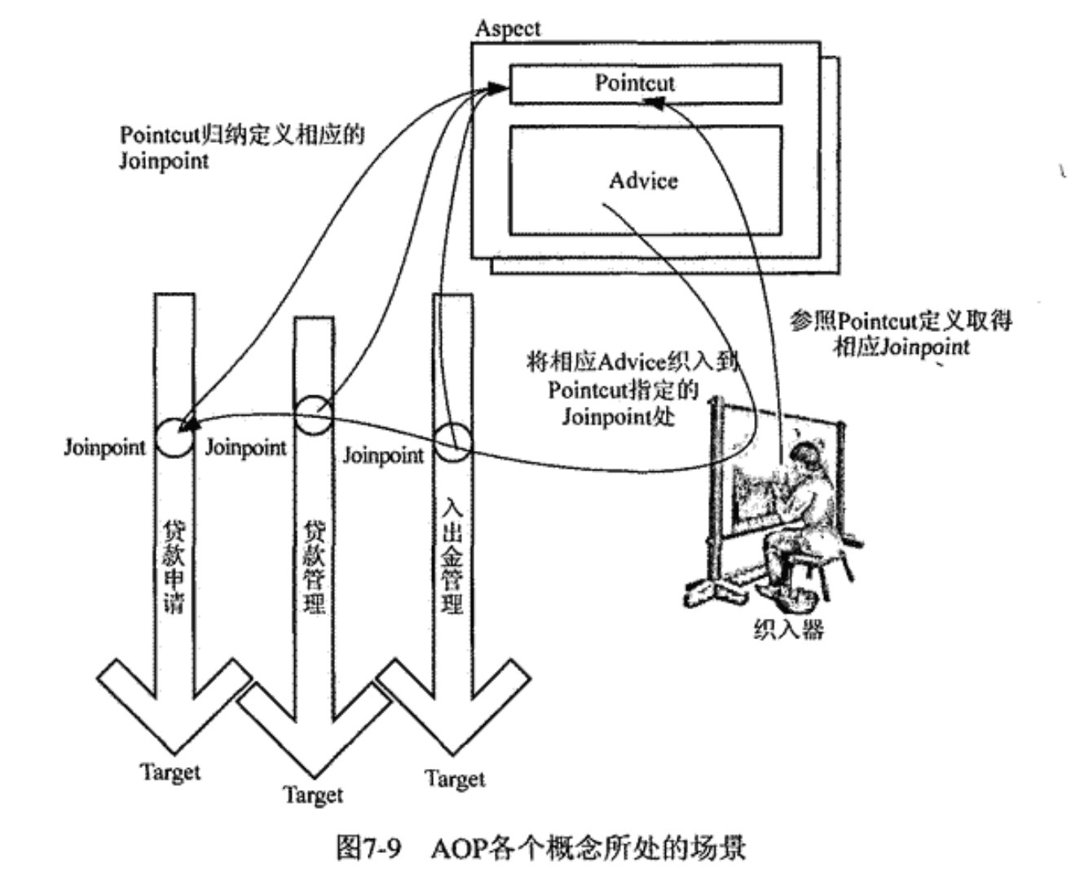
AOP概念

Slide 24
HandlerMapping(请求->处理器映射)
HttpServletRequest
Handler
HttpServletRequest
Handler

Slide 25
万恶之源，Spring框架启动第一步
Tomcat
web应用生命周期监听接口
web.xml
<listener> <listener-class>
org.springframework.web.context.ContextLoaderListener
</listener-class> </listener>
ServletContextListener
ContextLoaderListener
Spring监听器，web应用启动时，启动Spring
Spring框架在启动过程中，将ApplicationContext对象设置为ServletContext的一个属性，这样SpringMVC就能直接拿到Spring框架启动好的ApplicationContext
-> servletContext.setAttribute(WebApplicationContext.ROOT_WEB_APPLICATION_CONTEXT_ATTRIBUTE, this.context);
ContextLoaderListener
ContextLoader
AbstractApplicationContext
contextInitialized
initWebApplicationContext
refresh
createWebApplicationContext
configureAndRefreshWebApplicationContext
customizeContext

Slide 26
殊途同归，refreshContext

Slide 27
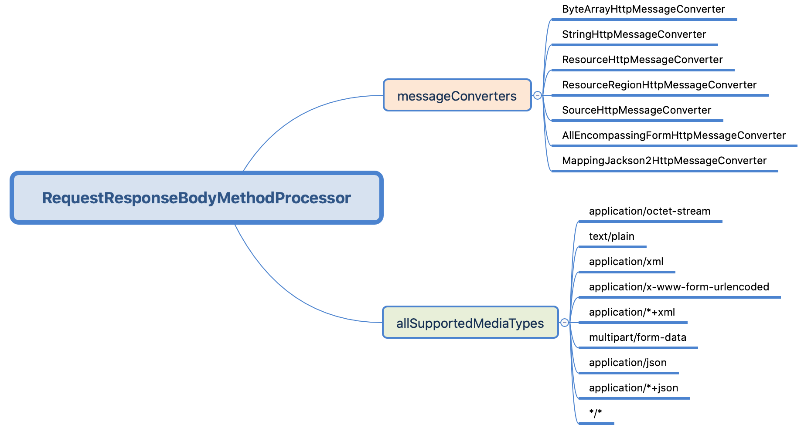

Slide 28
第 x 步： ApplicationContext中创建一个BeanFactory
Bean的生命周期 – 缘起
BeanFactory初始状态
BeanDefinitionRegistry
DefaultListableBeanFactory
BeanDefinition
BeanDefinition
BeanDefinitionRegistry
ConfigurationClassPostProcessor
BeanDefinitionRegistryPostProcessor
EventListenerMethodProcessor
BeanFactoryPostProcessor
AutowiredAnnotationBeanPostProcessor
Bean
CommonAnnotationBeanPostProcessor
BeanPostProcessor
DefaultEventListenerFactory
InitializingBean & init_method
AnnotatedGenericBeanDefinition
DisposableBean & init_method
开始使用bean实例

Slide 31
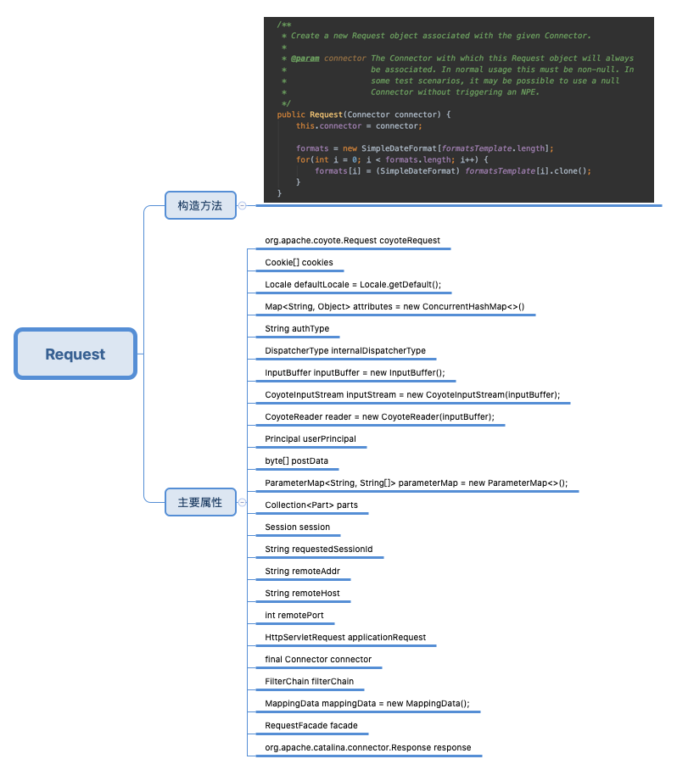
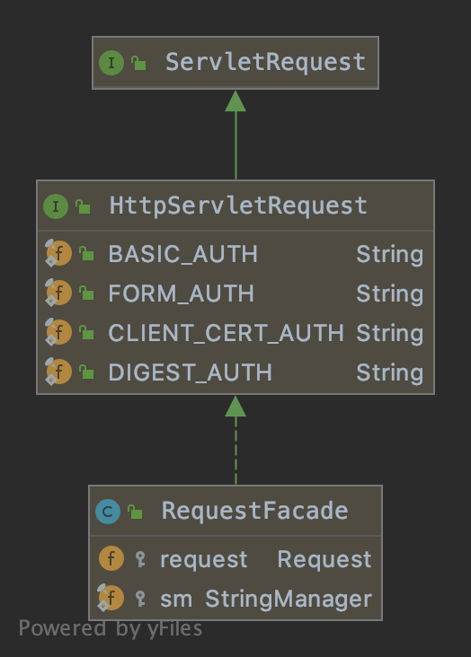
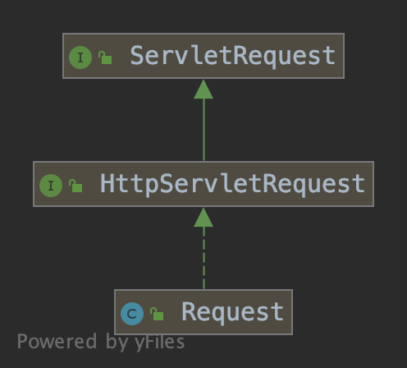
SpringMVC的入口是 DispatcherServlet，它是一个标准的HttpServlet，Tomcat把请求作为参数调用 DispatcherServlet中的service方法，那Tomcat给DispatcherServlet传给的请求参数是什么呢？是 RequestFacade 类型的对象
DispatcherServlet in Spring
RequestFacade完全交给代理对象来提供功能，代理对象就是Request对象

Slide 32
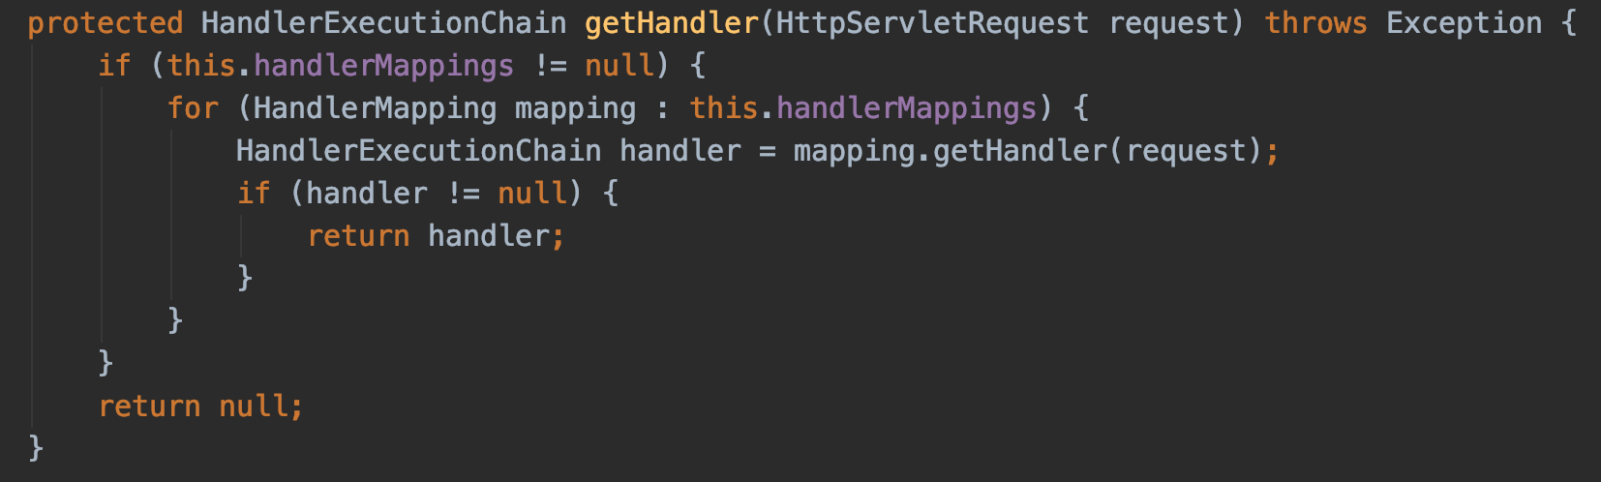
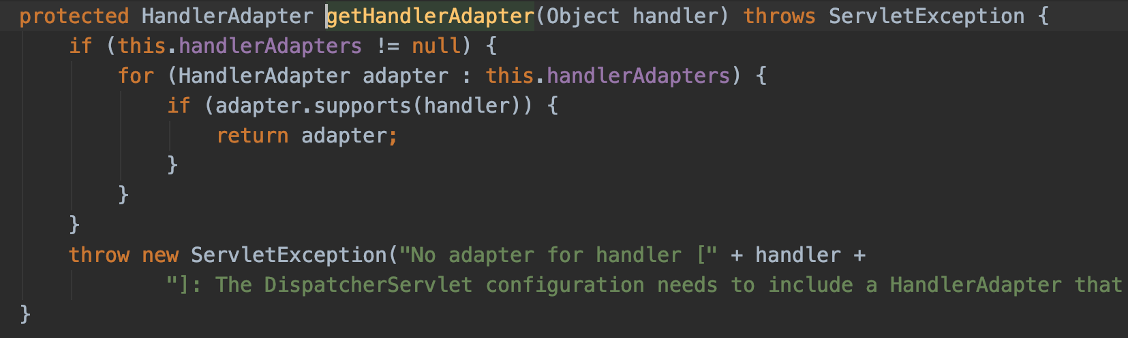
DispatcherServlet
protected void doDispatch(HttpServletRequest request, HttpServletResponse response) throws Exception {
...
checkMultipart(request);
...
// Determine handler for the current request. mappedHandler = getHandler(request);
if (mappedHandler == null) { noHandlerFound(processedRequest, response); return; }
...
// Determine handler adapter for the current request. HandlerAdapter ha = getHandlerAdapter(mappedHandler.getHandler());
...
mappedHandler.applyPreHandle(processedRequest, response);
...
// Actually invoke the handler. mv = ha.handle(request, response, mappedHandler.getHandler());
...
mappedHandler.applyPostHandle(processedRequest, response, mv);
...
processDispatchResult(request, response, mappedHandler, mv, dispatchException);
...
mappedHandler.applyAfterConcurrentHandlingStarted(request, response);
if (multipartRequestParsed) { cleanupMultipart(processedRequest); }
}

Slide 33
DispatcherServlet
List<HandlerMapping> handlerMappings
List<HandlerAdapter> handlerAdapters
......
DispatcherServlet
protected void initStrategies(ApplicationContext context) { initMultipartResolver(context); initLocaleResolver(context); initThemeResolver(context); initHandlerMappings(context); initHandlerAdapters(context); initHandlerExceptionResolvers(context); initRequestToViewNameTranslator(context); initViewResolvers(context); initFlashMapManager(context); }

