Slide 1
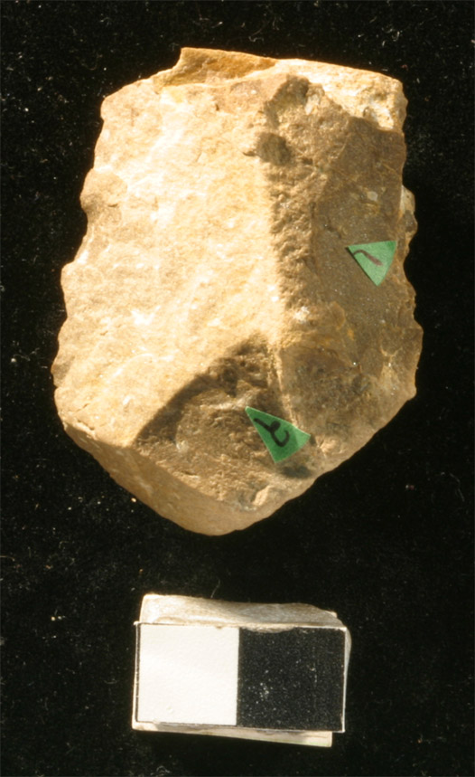
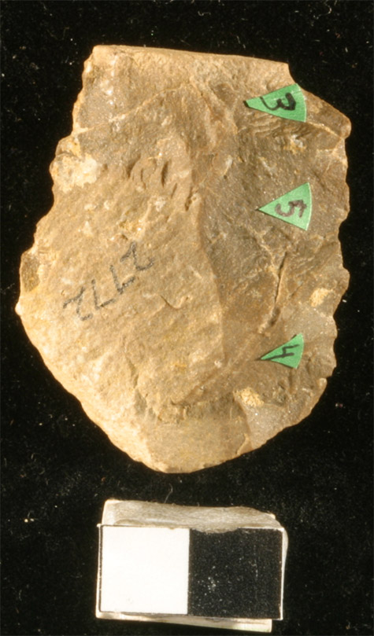
KJS2743EXC1(a-b)
Flake scars are in order of removal
3
1
5
2
4
Notes:
Fenetized

Slide 2
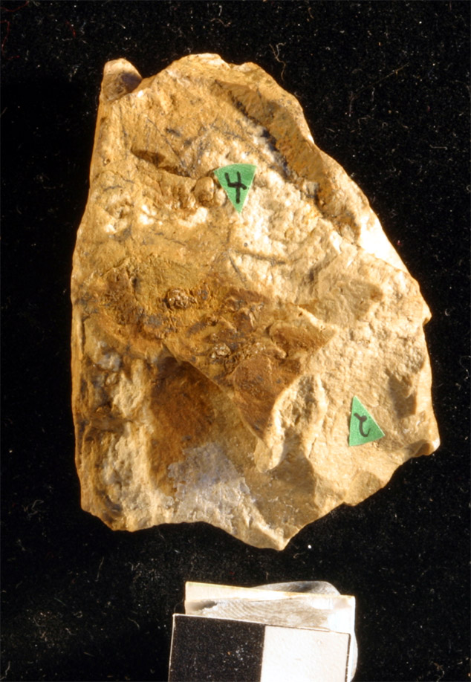
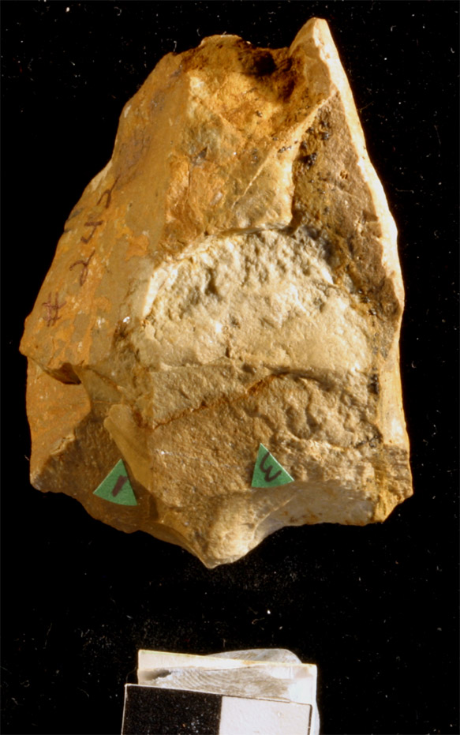
KJS242EXC2(a-b)
Flake scars are in order of removal
cortex
4
cortex
2
3
1
Notes:
Fenetized

Slide 3
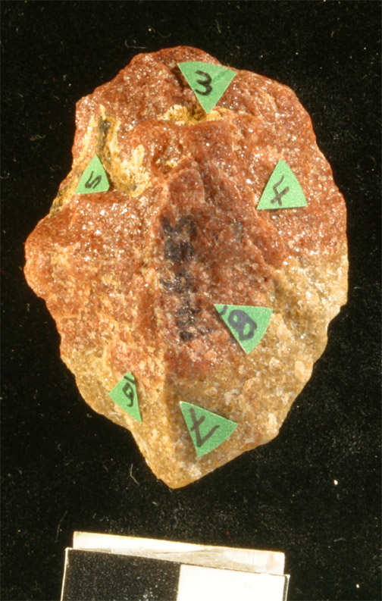
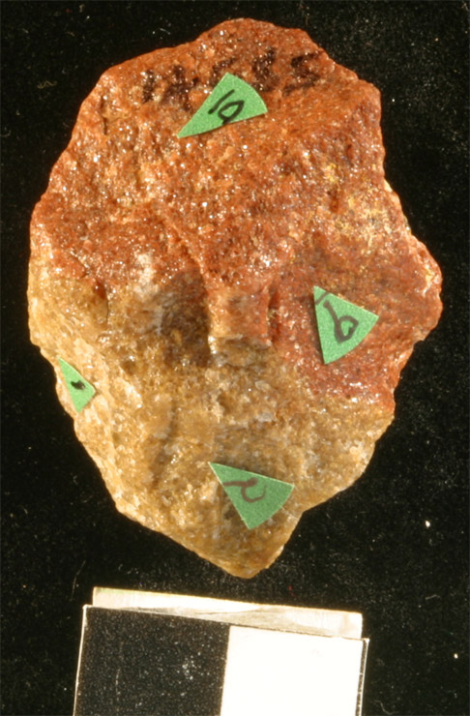
KJS14685EXC1(a-b)
Flake scars are in order of removal
3
10
5
4
9
8
1
6
7
2
Notes:
Quartzite

Slide 4
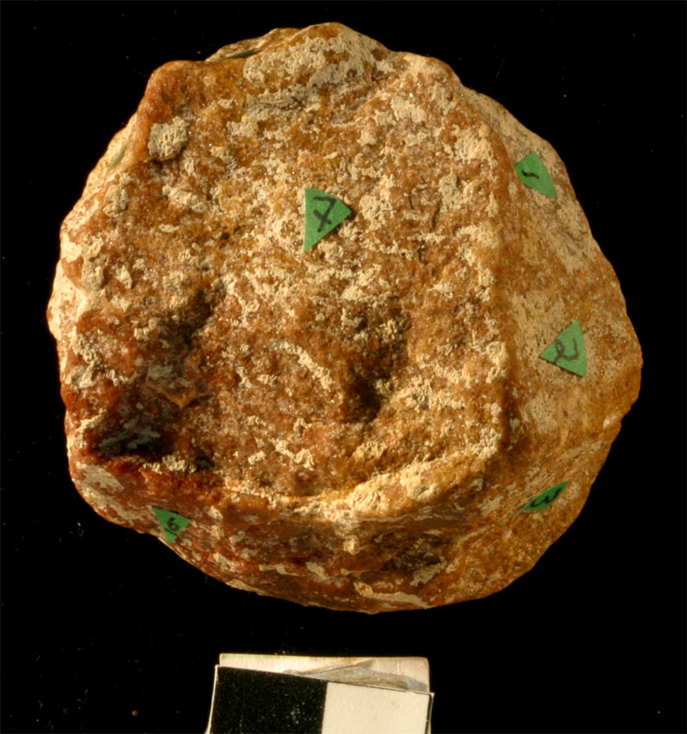
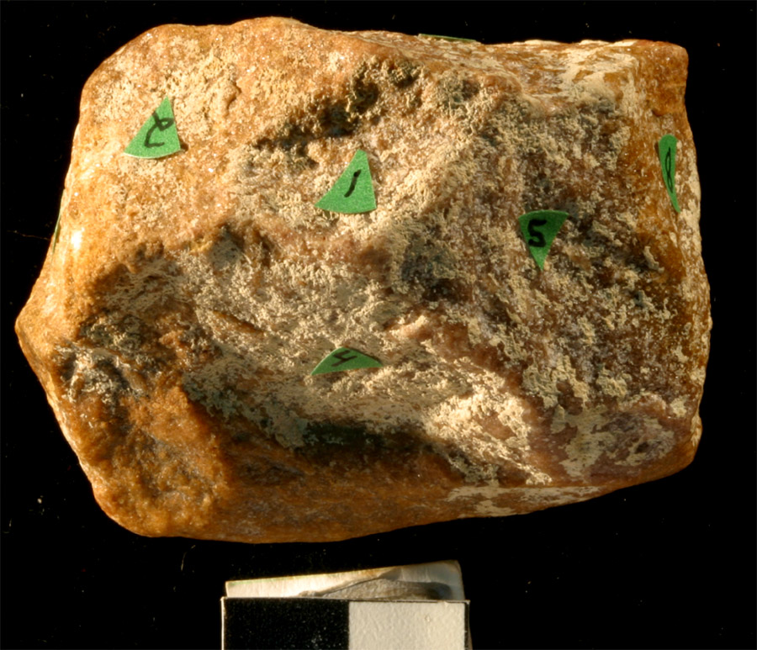
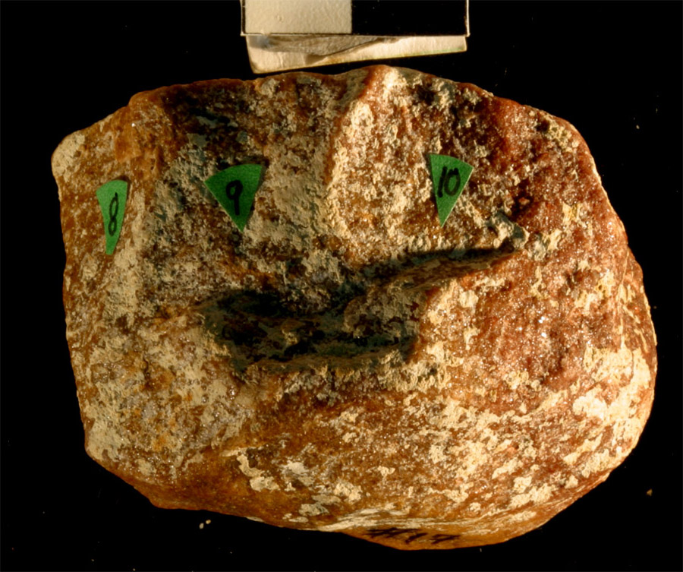
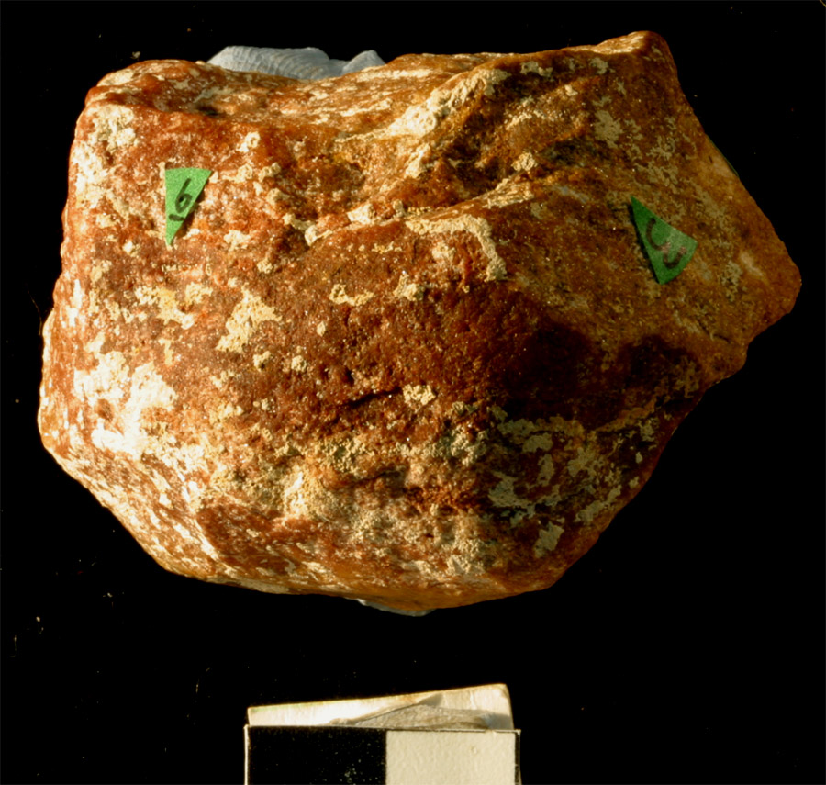
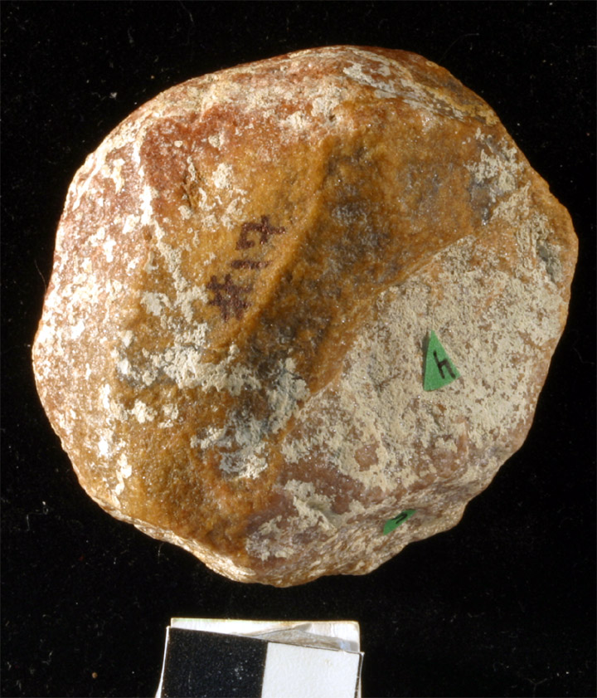
KJS17EXC5(a-e)
8
1
7
Flake scars are in order of removal
9
2
10
7
6
3
2
7
3
1
8
5
8
9
10
6
3
4
10
cortex
4
5
Notes:
Quartzite

Slide 5
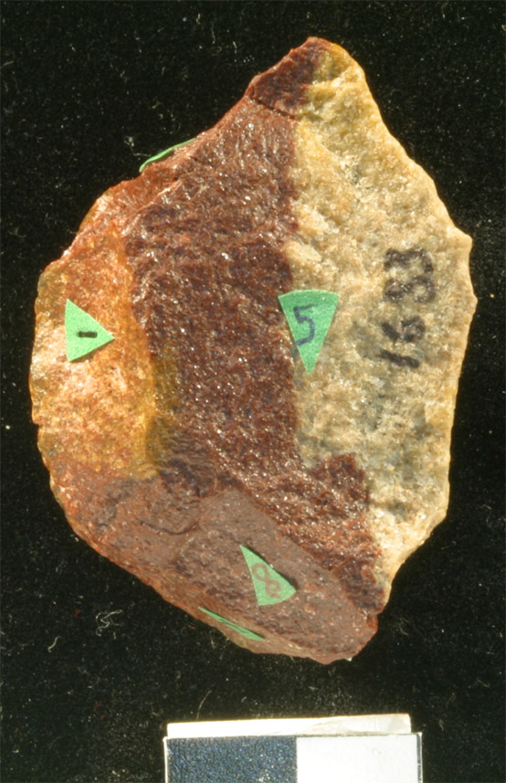
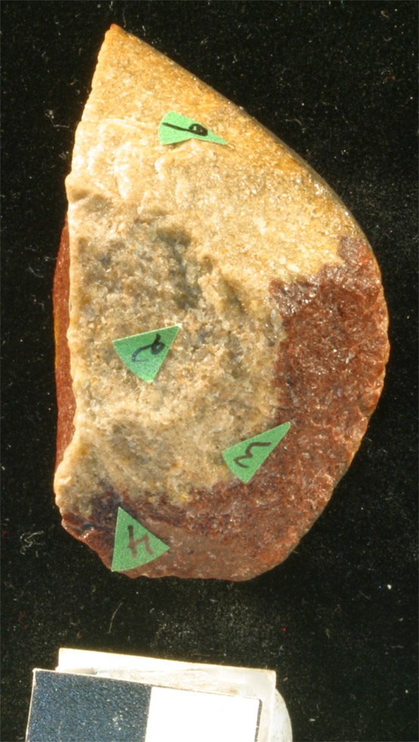
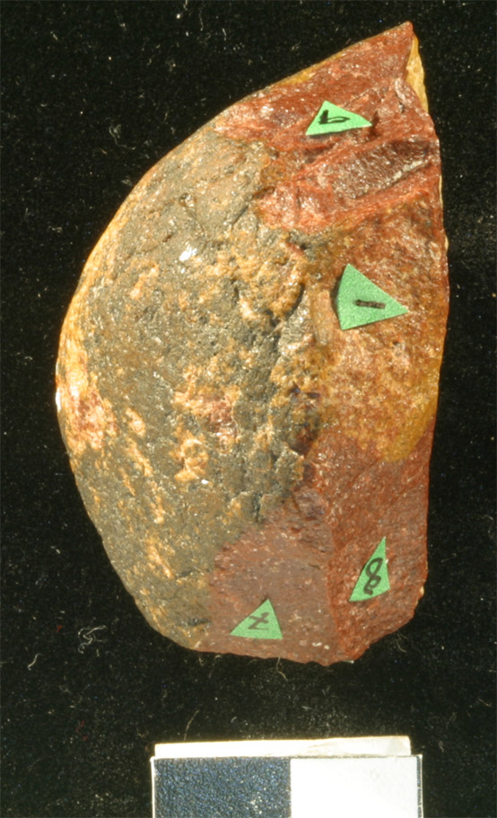
KJS1683EXC1(a-b)
Flake scars are in order of removal
9
9
6
1
5
1
2
cortex
3
8
8
7
4
7
Notes:
Quartzite

Slide 6
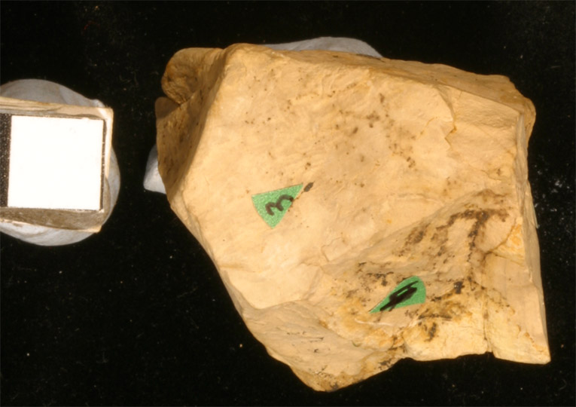
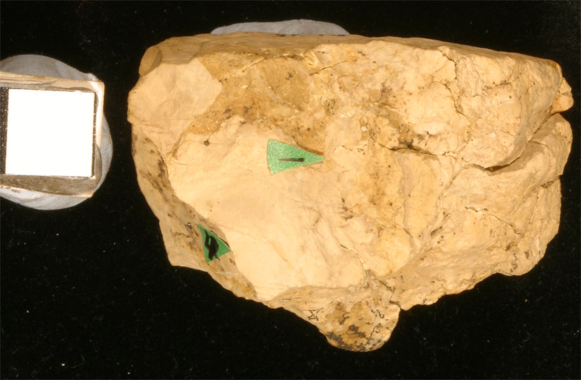
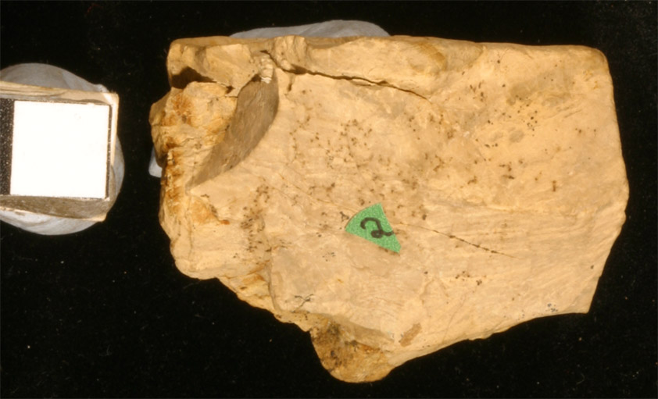
KJS5693EXC1(a)
1
3
2
4
4
Notes:
Limestone

Slide 7
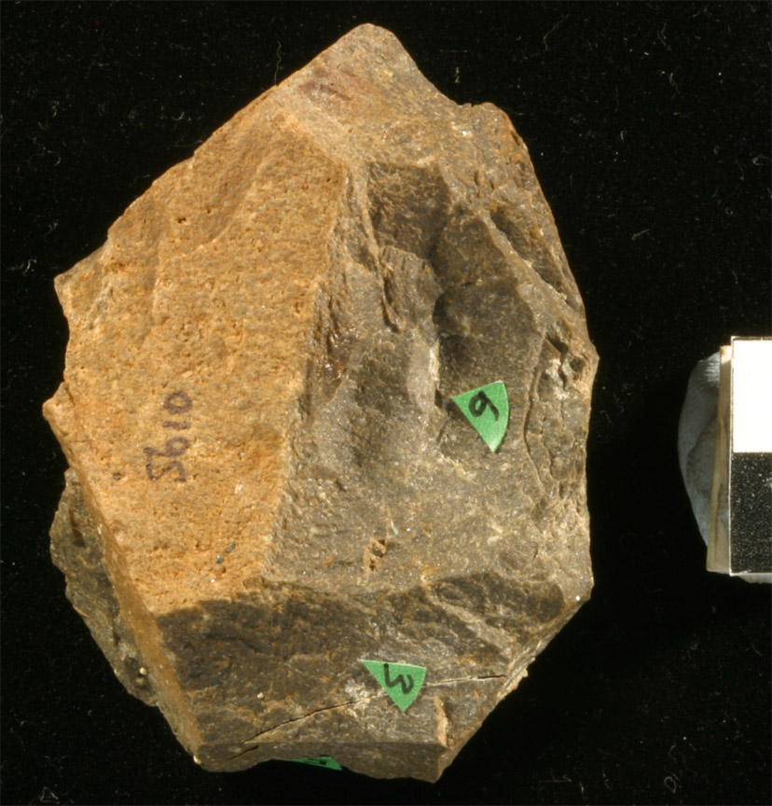
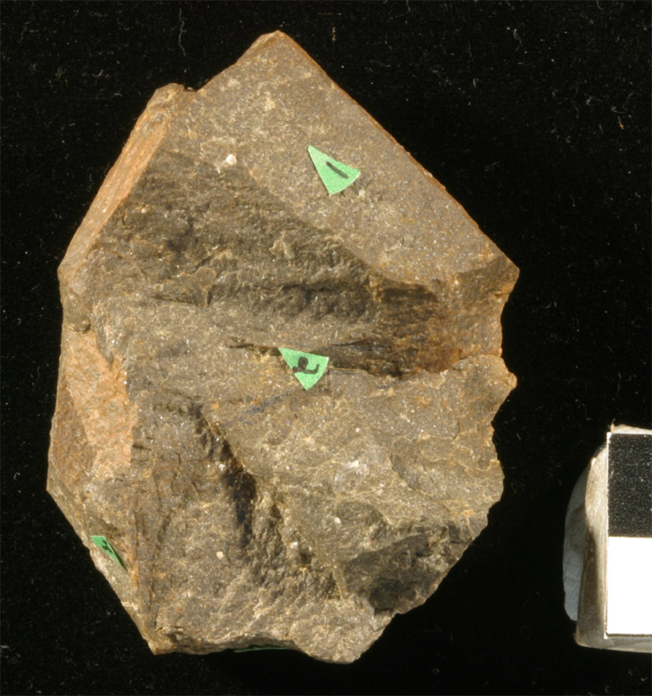
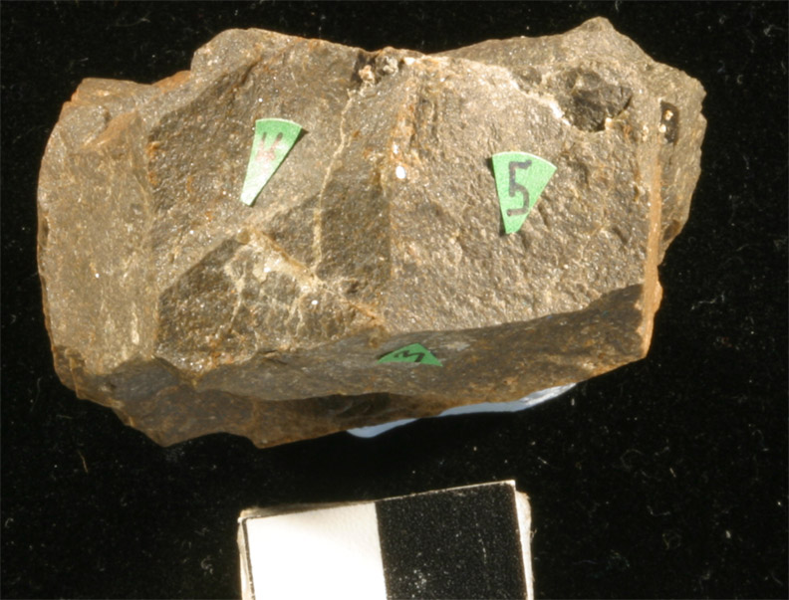
KJS5610EXC1(a-b)
Flake scars are in order of removal
1
2
6
4
3
5
4
5
unidirectional
3
Notes:
fenetized

Slide 8
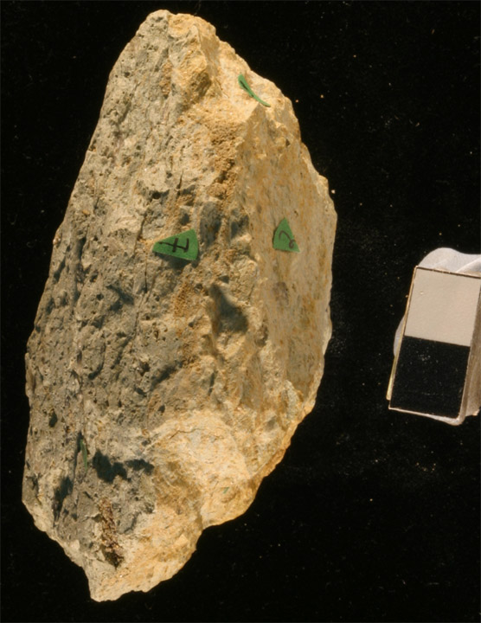
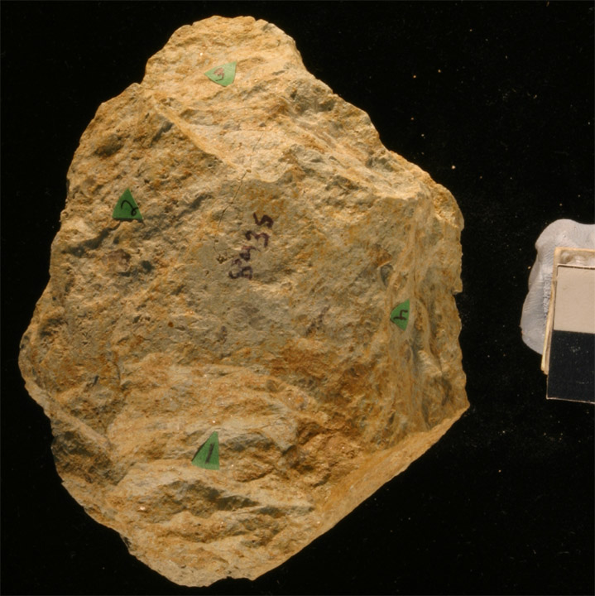
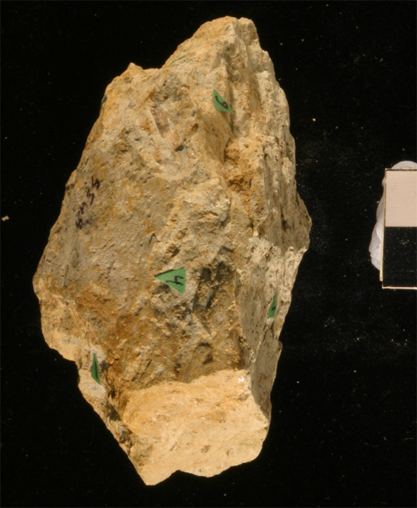
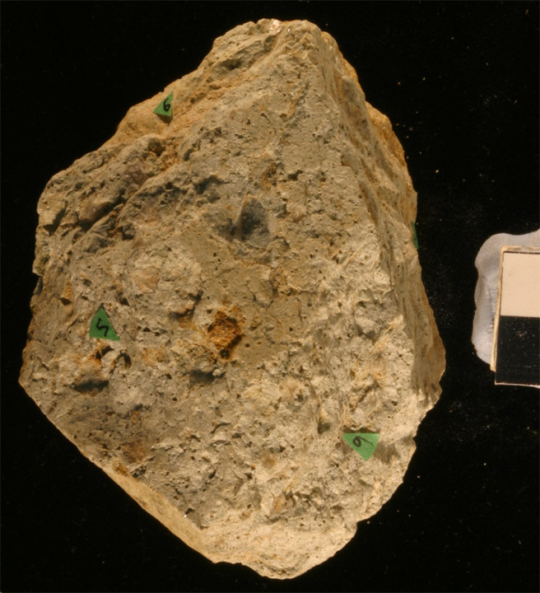
KJS8435EXC1(a-b)
3
3
3
6
6
8
2
2
8
4
4
5
5
7
1
7
1
Notes:
Homa phonolite

Slide 9
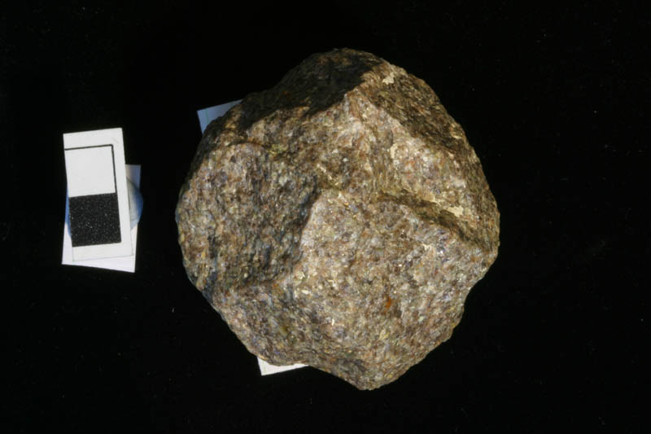
KJS10502EXC1a
1
1
7
6
6
2
8
11
3
9
4
10
5
Notes:
microgranite

Slide 10
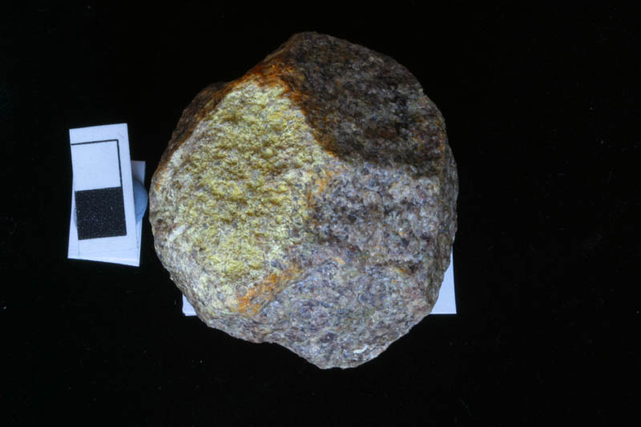
KJS10502EXC1b
12
13
14
15
17
16
18
Notes:
Microgranite

Slide 11
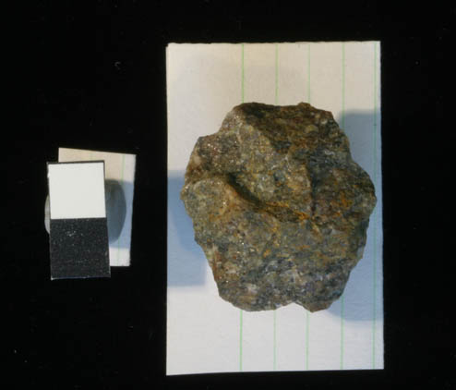
KJS14892EXC1a
2
1
3
4
5
Notes:
microgranite

Slide 12
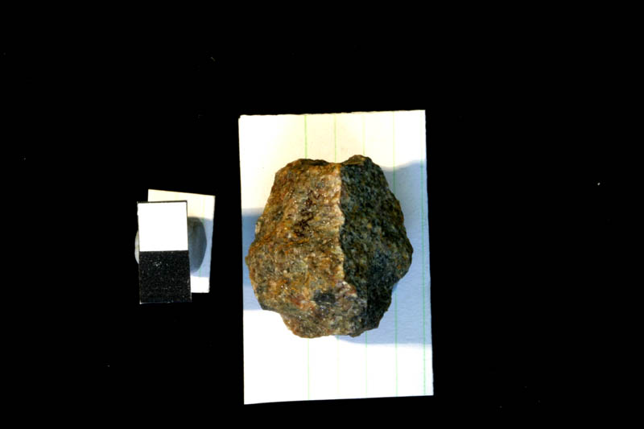
KJS14892EXC1b
7
5
3
4
9
10
6
8
1
Notes:
microgranite

