Slide 1
Pattern-based Information Extraction at MAVERIC and UCLA
Frank Meng
Medical and Imaging Informatics Group,
UCLA Dept. of Radiological Sciences
MAVERIC, VA Boston Healthcare System

Slide 2
MAVERIC – UCLA NLP tool sharing
Overall task: Extracting specific data elements from free text clinical documents
Requirements from both sides drove research / implementation direction
MAVERIC – Precision Oncology Program
UCLA – Lung cancer Screening
Seamlessly integrate into existing workflows
Develop tools that can be used by both institutions with minimal customization

Slide 3
MAVERIC Precision Oncology Program (POP)
POP is developing infrastructure to enable patient-specific treatment plans
Currently being rolled out nationally within VA
(Semi) automatically determine lung cancer patient status
Agile treatment decisions
Starting with cancer stage, pathology stage, changes in nodule size, etc.

Slide 4
UCLA Lung Cancer Screening
UCLA lung cancer screening clinic started in late 2014
Led by D. Aberle, Co-Leader on NLST study
Goal is to screen all patients within the UCLA healthcare system who meet NLST criteria
Structure data elements from screening reports to curate research database for secondary use
Target representation established by radiologists
LungRADS standard
Reporting template being recommended

Slide 5
Clinical use case
Documents filtered / ETL’d from EHR to gather relevant data sets
Manually extract data elements of interest into Excel / DB
Iterative and continuous process
Relatively small annotated data sets
Doc Set
EHR
Filter / ETL
…
Manual
Extraction
Excel/DB

Slide 6
Proposed information extraction framework
EHR
Filter / ETL
…
NLP
Pipeline
Annots
Pattern
Generator
Filter
Patterns
Patterns
Extraction
UI
Gold
Standard
Generated
Annots
Structured
Data
Evaluation (Random Sample)

Slide 7
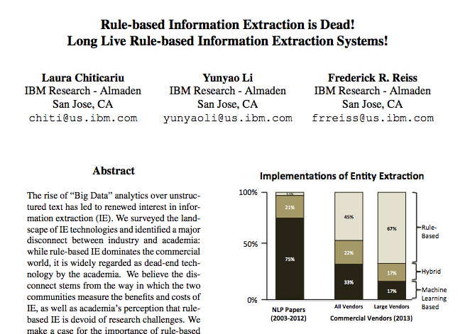
Using patterns for extraction
Patterns vs. Statistical Models
Patterns easier to maintain, understand, can be trained with smaller amounts of labeled data
Require extensive manual labor, heuristic in nature
Statistical models are more trainable and adaptable, reduce manual effort
Require more expertise and more difficult to understand
Transparent system behavior can be a factor to increase user adoption
Training on small data sets allows system to incrementally learn within clinical workflows

Slide 8
Automatically identify things from text
Age
This is a 76 year-old patient with metastatic lung carcinoma.
There are multiple nodules: left upper lobe
currently 12 x 14 mm (2, 95) previously 13 x 13 mm (3, 100)
Jan 10, 2012.
Location
Size
Series, Image
Size
Series, Image
Date

Slide 9
Usage-based theory of language acquisition
Language is acquired by seeing (hearing) it in action
No assumed innate language ability
Contexts (patterns) are learned from seeing multiple examples and identifying areas of variation
Humans are able to recall patterns quickly and apply to current situation
Requires all of childhood (and more!) to master and accumulate linguistic knowledge
Meaning depends on context

Slide 10
Automatically generating extraction patterns
Use multiple sequence alignment (MSA) on phrases and sentences to automatically generate patterns from annotated text
Find commonalities
Generate patterns from these commonalities (represent contexts)
More automated than manual crafting of patterns and but requires annotated data
Meng F, Morioka C. Automating the generation of lexical patterns for processing free text in clinical documents. J Am Med Inform Assoc. 2015 May 14.
This is a 70-year-old patient with a mass in the left upper lobe.
In terms of disease, there’s a mass in the left upper lobe.
The mass in the left upper lobe has increased in size.
In the current study, the mass in the left upper lobe can be clearly seen.

Slide 11
Annotations
Layers of semantics (metadata) added on top of text
Notes in margins
For IE, this is the main product
Annotations can be overlapping and potentially conflicting
User determines priority of annotations to resolve overlaps
the | patient | has | lung | cancer
:det | :noun | :verb | :noun | :noun
:mod(patient) | :clinical subj | have | :anatomy | :finding
:noun phrase |  |  | :finding
 |  |  | :object(has)
 |  | :verb phrase

Slide 12
Finding contexts
Following usage-based theory, meaning of word or phrase depends on how it’s used
Use multiple sequence alignments to determine the common words surrounding the word or phrase of interest
Instead of only using actual words, allow for other higher level annotations
May reduce variation by removing unnecessary detail
The patient is a 70 year old male.
The patient is a 65 year old female.
The patient is a 55 year old male.
The patient was a 85 year-old female.
The patient :be a :number year old :gender.

Slide 13
Smith-Waterman alignment
M is alignment matrix (dynamic programming)
Neighbors are used to calculate score
S is scoring matrix
Matches, mismatches
d is gap penalty
Setting this to 0 favors inserting gaps over mismatches

Slide 14
Smith-Waterman back-tracking
As M is being constructed, link each cell to the neighbor it used to calculate score (above, left, or upper left diagonal)
Find highest score in matrix M
Back track from highest score using the neighbor links
Upper left link indicates match (token added to both alignments)
Left link indicates gap added to first alignment
Above link indicates gap added to second alignment

Slide 15
 | the | patient | is | a | :number | year | old | :gender
a | 0 | 0 | 0
patient | 0 | 1 | 1
who | 0 | 1 | 1
is | 0 | 1 | 2
a | 0 | 1 | 2 | 3
:number | 0 | 1 | 2 | 3 | 4
year | 0 | 1 | 2 |  |  | 5
old | 0 | 1 | 2 |  |  |  | 6
:gender | 0 | 1 | 2 |  |  |  |  | 7
is |  |  | 2
a |  |  |  | 3
very
nice
person
patient who is a :number year old : gender
patient - is a :number year old : gender

Slide 16
Multiple sequence alignment from local alignments
Pairwise local alignment of all text segments sharing the same type of target
E.g., patient ages
Target similarity score set to be very high score in the scoring matrix (always match targets)
Set match score to 1 and mismatch score to -1 (avoid mismatches)
Set gap penalty to 0 (favor gaps over mismatches)

Slide 17
Multiple sequence alignment
a :target year old
a :target year old
a :target year old
The patient be a :target year old :gender.
A :target year old patient be see who be :gender.
This be a patient :target year of age.
This patient of :target year came into the clinic today.
A :target yo patient.
A :target year old patient be see.
patient - :target year
patient of :target year
a :target
a :target
a :target
a :target
a :target year old - - - - - :gender
a :target year old patient be see who be :gender

Slide 18
Pattern generation process
Obtain gold standard (training) for information you want to extract (targets)
E.g., manually annotate documents for patient age
Generate MSAs for all sentences that contain annotated targets
Derive extraction patterns from generated MSAs
Filter patterns based on pattern structure-based criteria
Number of gaps
Filter for high precision patterns
Not all patterns represent contexts that affect meaning
Evaluate patterns on existing gold standard to determine performance

Slide 19
Apply patterns for extraction
Within incoming text, replace all potential targets with “:target” symbol
E.g., all numbers are potential targets for patient age
Match patterns against text to extract information
Use same local alignment algorithm to match pattern against incoming text
?
?
This be a :target year old patient who present with a fever and chronic cough and has been smoking for :target year.
a :target year old

Slide 20
Quality control
Need framework to continuously measure quality of data being extracted
E.g., achieve specific confidence level and interval for precision and recall
May not be feasible to validate entire extracted data set for many real-world problems
Treat NLP like any other quality control process
Continuous validation on smaller random samples
Built-in sentinels to generate automatic alarms

Slide 21
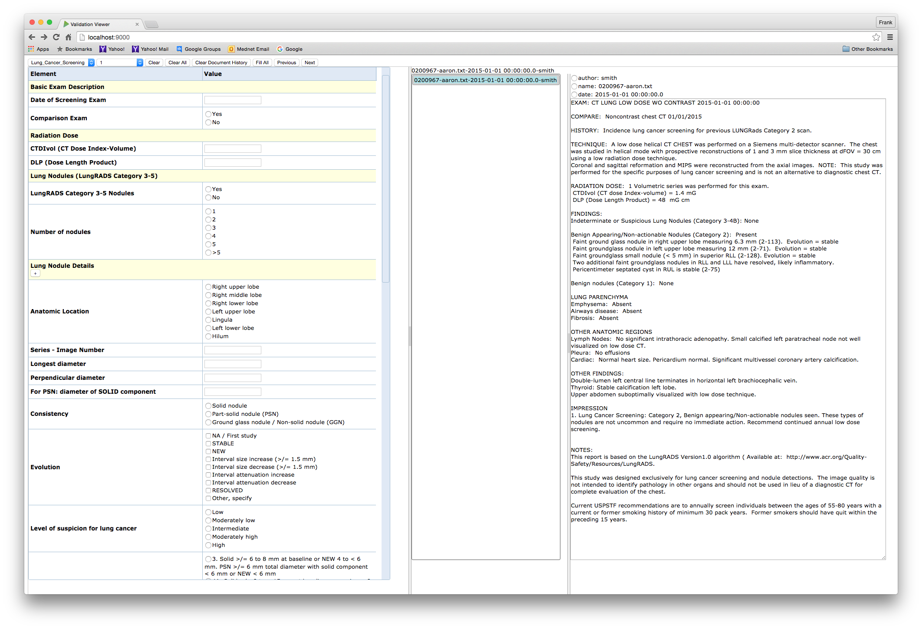
Annotation and validation GUI
Fill out form
with information
from report
Report
Form
Document
List

Slide 22
Limitations of v 1.0
User must establish priority ordering for overlapping annotations
In many cases, cannot know the best choice of annotations beforehand
There may be overlapped annotations that perform better
Target must be clearly defined
Numbers, dates, countries, certain semantic types from ontologies are relatively well-defined (may still get false negatives)
But many examples of targets that cannot be clearly defined or completely enumerated (e.g., proper names)
Human annotators may introduce variations

Slide 23
Generating patterns using multiple annotations
Instead of aligning sequence to sequence, align grid to grid
M matrix is now a “box” (technically, it’s a 3-orthotope or 3 dimensional hyperrectangle)
Resulting MSA is still a grid and patterns are still sequences
The | patient | has | lung | cancer
:det | :noun | :verb | :noun | :noun
:mod(patient) | clinical subj | have | :anatomy | :finding
:noun phrase |  |  | :finding
 |  |  | :object(has)
 |  | :verb phrase
The | patient | has | heart | disease
:det | :noun | :verb | :noun | :noun
:mod(patient) | :clinical subj | have | :anatomy | :finding
:noun phrase |  |  | :finding
 |  |  | :object(has)
 |  | :verb phrase

Slide 24
Add third dimension to Smith-Waterman
lung
=?
:noun
:anatomy
1
 | :noun: 2 :anatomy: 2
heart
:noun
:anatomy

Slide 25
Annotations span multiple tokens
 |  | patient | has | lung | cancer | with
 |  |  |  | :finding |  | :prep
the
patient |  | 1
has |  |  | 2
emphysema | :finding |  |  | 3
in | :prep |  |  |  |  | 4

Slide 26
Keep track of annotation spans and scores
 |  | patient | has | lung | cancer | with
 |  |  |  | :finding |  | :prep
the
patient |  | 1
has |  |  | 2
emphysema | :finding |  |  |  | 3
in | :prep |  |  |  |  | 4

Slide 27
Cell can now have multiple scores
 |  | patient | has | lung | cancer | with
 |  |  |  | :finding |  | :prep
the
patient
has
lung | :finding
cancer
in | :prep
1
2
3
3
4
5

Slide 28
Grid alignment algorithm
Finds best subsequence of annotations even with overlaps
Can handle variable numbers of annotations for each column
More layers of annotations can be added without changing algorithm
Efficiency decreases with number of annotation layers
Greedy in the sense that it looks for the best score up to the point of the current cell
No global optimization
But this buys us the computational efficiency of dynamic programming

Slide 29
Characterizing targets using patterns
Targets themselves can also be characterized using patterns
Divide each pattern into left context and right context
Some patterns may only have either left or right
Perform MSA on text in between left and right contexts to generate target patterns
MSA
:number year old
:number year-old
:number yo
left context
target
right context

Slide 30
Extracting information with patterns (v 2.0)
Represent each incoming sentence as a grid (instead of sequence)
Align left context
Align right context
Align text in between against target patterns
Text must “look like” a target
left context
right context
target
patterns

Slide 31
Alignment bias
Alignment algorithm behavior affected by scoring matrix and gap penalty
sentence
large gap penalty
The :noun :noun was seen.
:noun was seen.
?
:noun was seen.
:noun - was seen.
pattern
small gap penalty

Slide 32
Multiple context matches
Left and right contexts could match multiple segments in text
Must determine best matches based on the characteristics of target
Possibly more than one target within a sentence
Parse errors
left context
right context
target

Slide 33
Preliminary evaluation against CoNLL2003 data set
Named entity recognition (NER) task to identify people, organizations, and locations in Reuters news articles
Annotated data
POS and NER tag for every token
Training set: 1300+ articles
Test set (testb): 300+ articles
Our system’s NLP pipeline provided tokens, sentences, POS, numbers, dates, gazetteer lookups, and syntactic phrases (GATE)
Results for people
Entity level: Precision = 0.931, Recall = 0.905, F1 Score = 0.917
Token level: Precision = 0.948, Recall = 0.925, F1 Score = 0.936
Comparison Entity Level (Stanford NER CRF): F1 Score = 0.923

Slide 34
CoNLL 2003 using small training sets
Train on 50 articles (~5% of training set)
11,508 tokens out of 229,934 overall
Results for patterns
Precision = 0.95, Recall = 0.34
Results for Stanford NER
50% training: Precision = 0.93, Recall = 0.91
5% training: Precision = 0.83, Recall = 0.76
High precision patterns trained on small labeled sets may enable semi-supervised learning or better random sampling for validation

Slide 35
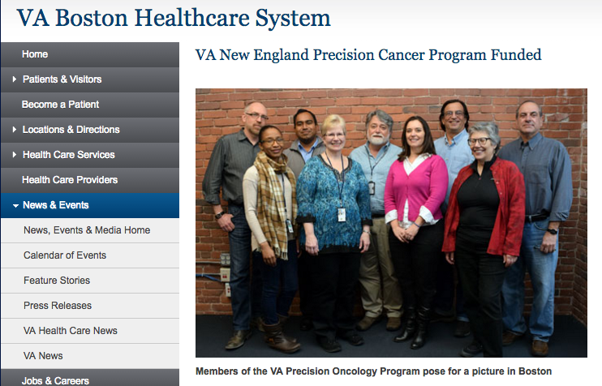

POP status

Slide 36
UCLA lung cancer screening status
Plans to deploy system for lung cancer screening clinic
PCORI-funded project to determine efficacy of alternate screening frequencies for lung cancer

Slide 37

Toward Natural Language Understanding

Slide 38
Acknowledgements
Craig Morioka, MII, VA Hines (Pharm)
Funding from MAVERIC, NIH
Alex Bui, Director, MII
Lou Fiore, Executive Director, MAVERIC

