Slide 1
By reeya pandey
Career analysis in india

Slide 2
INTRODUCTION
The Career Analysis India provides a comprehensive overview of the current job market across different states, companies, and job roles. It visually represents the distribution of job types, top hiring organizations, and the most demanded designations. By combining state-wise opportunities with company-level insights, this dashboard helps job seekers, recruiters, and policymakers identify employment trends and make data-driven decisions.

Slide 3
Key Insights
Total Jobs: There are 1.66K job opportunities available, showing a strong hiring trend across India.
Designations: A wide variety of 812 unique job designations indicates diverse roles across industries.
States: Jobs are spread across 22 different states, reflecting nationwide opportunities.
Locations: With 199 unique job locations, hiring is not limited to metro cities but extends to multiple regions.
Companies: Over 1.04K companies are actively hiring, showing strong employer participation.

Slide 4
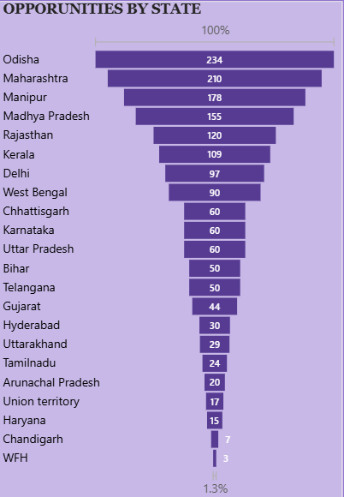
Opportunities by State
Type: Bar Chart
Purpose: This chart shows the total number of job opportunities available in different Indian states. It is useful for understanding which states have the most job openings.

Slide 5
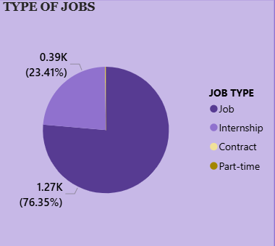
Type of Jobs
Type: Pie Chart
Purpose: This chart displays the proportion of job types (Job, Internship, Contract, Part-time) to show the distribution of available positions.

Slide 6
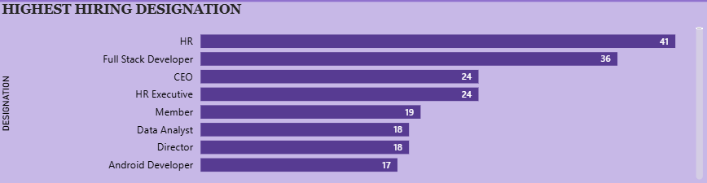
Highest Hiring Designation
Type: Bar Chart
Purpose: This chart highlights the most in-demand job designations, providing insight into which roles companies are hiring for most frequently.

Slide 7
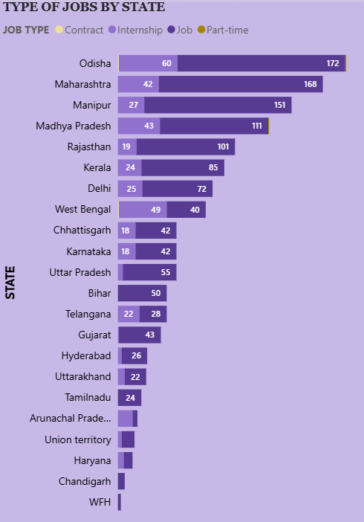
Type of Jobs by State
Type: Stacked Bar Chart
Purpose: This chart provides a detailed breakdown of job types within each state, allowing for a more granular understanding of the employment landscape in different regions.

Slide 8
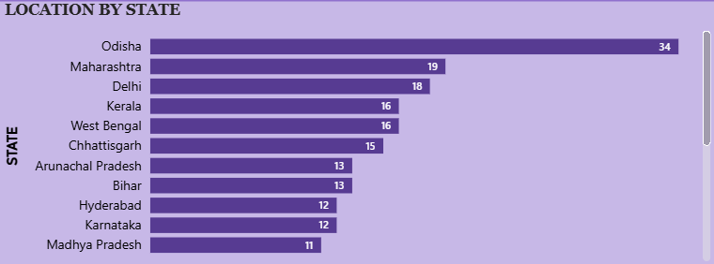
Location by State
Type: Bar Chart
Purpose: This chart shows the geographic distribution of hiring, indicating which states and cities are major centers for employment.

Slide 9
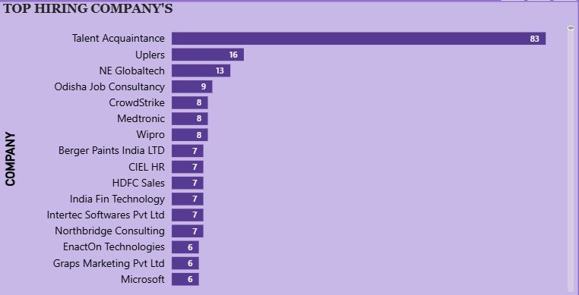
Top Hiring Companies
Type: Bar Chart
Purpose: This chart identifies the companies with the highest number of job postings, useful for understanding which employers are most active in hiring.

Slide 10
Recommendations
Focus on High-Demand States: Direct training and placement efforts toward Odisha, Maharashtra, and Manipur, where opportunities are highest.
Skill Development: Promote upskilling in HR roles and Full Stack Development, as they are among the most in-demand positions.
Industry Collaboration: Build partnerships with top hiring companies (e.g., Talent Acquaintance, Uplers, NE Globaltech) for better placement pipelines.
Encourage Internships: Expand internship and part-time job opportunities to help fresh graduates gain experience.
Geographic Expansion: Encourage companies to diversify hiring into smaller states and emerging job hubs.

Slide 11
Conclusion
The Career Analysis in India provides a comprehensive view of the Indian job market, covering opportunities by state, company, job type, and designation. It highlights that full-time jobs dominate, HR and tech roles are in high demand, and Odisha, Maharashtra, and Delhi are leading states for opportunities. With over 1.6K jobs across 1K+ companies, the employment landscape shows strong potential for job seekers. This analysis can guide students, professionals, and policymakers to align skills, strategies, and policies with current market needs.

Slide 12
Thank you

