Slide 1
Error Correction Code For Information Reconciliation In QKD
Ayesha Reezwana

Slide 2
Noisy Communication Channel
Alice
Bob
Noiseless channel
01011
01011
Noisy Channel
01011
01001
The amount of noise in the noisy channel is defined by Bit Error Rate, BER.
BER = (Number of Error bits) / (Number of Message bits)

Slide 3
Binary Symmetric Channel
1 - ε
0
0
ε
ε
1 - ε
1
1
Probability of bit flip due to noise is ε > 0

Slide 4
Noiseless communication through noisy channel using ECC
Encoder
c
Noisy Channel
c’
Decoder
m
m
Noiseless channel

Slide 5
Examples of Error Correction Codes
Best “2 out of 3” repetition code
Hamming code(7,4)
Cascade
Low density parity check code (LDPC)
Turbo Code
Reed-Solomon codes

Slide 6
Best “2 out of 3” repetition code
Original message: 00101
Repetition code: 000 000 111 000 111
Received message: 001 100 111 010 110
Decoded message: 00101
Tra la! Decoded properly!

Slide 7
Uses of Error Correction Code
For digital communication storage Reed-Solomon codes are used.
In recent communication standards, for example 5G standard, low density parity check code (LDPC) are being used.

Slide 8
Why ECC is essential for QKD?
Alice
Bob
Raw Key
Raw Key
01011
01001
After the quantum process, there might be some erroneous bits in the raw keys . To reconcile the errors we will need to use error correction code.

Slide 9
Classical usages of ECC
Message: m
Error correction information (ECI, or syndrome): s
m
Compute ECI
s
Code: c
Send over noisy channel
code with error
m
s
m’
s’
Correct error
m
Alice
Bob

Slide 10
ECC as information reconciliation for QKD
Message m is not sent explicitly over classical channel.
m is the sifted key after the basis reconciliation step of the QKD protocol.
Alice’s sifted key: m, Bob’s sifted key: m’, Error correction information: s
Compute ECI
m
s
m’
m
Send ECI over Reliable public channel
Correct error
s
s
Alice
Bob

Slide 11
Some Definitions
Code length = message length + ECI length = |m|+|s| = |c| (here |.| denotes the length of a bit string)
Coding efficiency = (message length)/(code length) = |m|/|c|
Privacy = (|m| - |s| ) / |m| (This is the asymptotic upper limit on the extraction ratio during the privacy amplification phase)
We estimate the number of leaked bit by the ECI length, |s|.

Slide 12
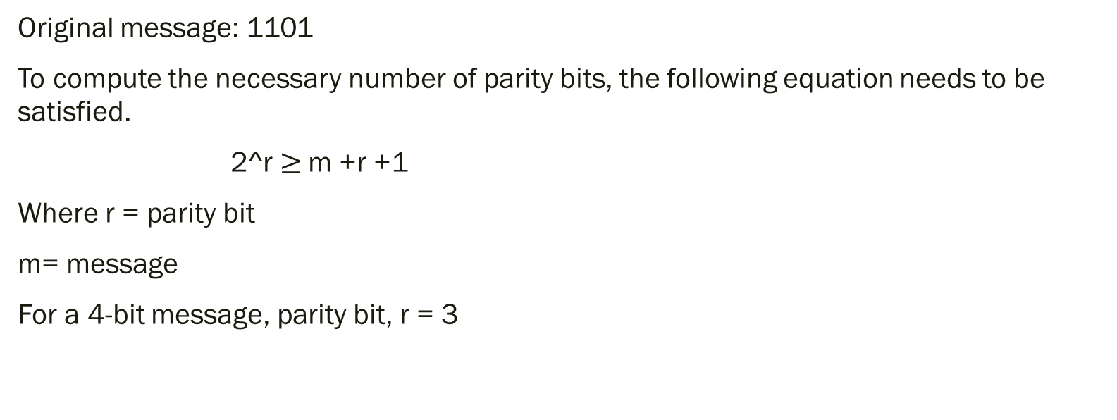
Hamming Code(7,4)

Slide 13
Parity of a binary string
Parity bit of a binary string is computed by doing xor of the bits of the string.
Another quick way to compute the parity is by counting the number of 1’s in the string.
A binary string with even number of 1’s is said to have even parity. (represented by 0)
A binary string with odd number of 1’s is said to have odd parity. (represented by 1)
Example:
Binary string : 1001100. It has three 1s, therefore parity = 1 (Odd Parity)
Binary string: 100100. It has two 1s, therefore parity = 0 (Even Parity)

Slide 14
Hamming code(7,4)- parity bit computation and encoding message
Original message : 1101
Parity bits : (To be computed)
Position of the parity bit is computed as 2^{i} where i = 0, … , (r-1)
In the example below number or message bits m = 4, and number of parity bits r = 3
^{Encoded message :}
D₇
D₆
D₅
P₄
D₃
P₂
P₁

Slide 15
Identifying the bits to be xor’ed to compute each parity bit:
Index | P₃ | P₂ | P₁
0 | 0 | 0 | 0
1 | 0 | 0 | 1
2 | 0 | 1 | 0
3 | 0 | 1 | 1
4 | 1 | 0 | 0
5 | 1 | 0 | 1
6 | 1 | 1 | 0
7 | 1 | 1 | 1
The bit patterns on the parity columns are derived from the binary representation of the index column.
P₁ is computed by taking the xor of the bits positioned at 1,3,5,7
P₂ is computed by taking the xor of the bits positioned at 2,3,6,7
P₃ is computed by taking the xor of the bits positioned at 4,5,6,7

Slide 16
Hamming code(7,4)- parity bit computation and encoding message
P₁ is computed by taking the xor of the bits positioned at 1,3,5,7
P₂ is computed by taking the xor of the bits positioned at 2,3,6,7
P₃ is computed by taking the xor of the bits positioned at 4,5,6,7
1
1
0
P₄
1
P₂
P₁

Slide 17
Hamming code(7,4)- parity bit computation and encoding message
P₁ = D₃⊕D₅⊕ D₇ = 1 ⊕ 0 ⊕ 1 = 0
P₂ = D₃⊕D₆⊕D₇ = 1 ⊕ 1 ⊕ 1 = 1
P₄ = D₅⊕D₆⊕D₇ ₌ 0 ⊕ 1 ⊕ 1 = 0
Original message : 1101
Parity bits: P₁ = 0, P₂ = 1, P₄ ₌ 0
Encoded message: 1100110
D₇
D₆
D₅
P₄
D₃
P₂
P₁
1
1
0
P₄
1
P₂
P₁
1
1
0
0
1
1
0

Slide 18
Hamming code(7,4)- parity bit computation and encoding message
Alice Bob
1100110 1101110
Error Detection and Correction:
Let’s decode the message on Bob’s side:
P₁ = 0, P₂ = 1, P₄ = 0
a₁ = P₁ ⊕ D₃⊕D₅⊕ D₇ = 0 ⊕ 1 ⊕ 0 ⊕ 1 = 0
a₂ =P₂ ⊕ D₃⊕D₆⊕D₇ = 1 ⊕ 1 ⊕ 1 ⊕ 1 = 0
a₃ =P₄ ⊕ D₅⊕D₆⊕D₇ ₌ 1 ⊕ 0 ⊕ 1 ⊕ 1 = 1
(a₃ a₂ a₁)₂ = (1 0 0)₂ = 4
Therefore 4th bit has got flipped.
Noisy channel
1
1
0
1
1
1
0
D₇
D₆
D₅
P₄
D₃
P₂
P₁

Slide 19
Transmission of data bits using hamming code
Received message: 1101110
After flipping the C bit, corrected recovered message: 1100110
Efficiency and limitation:
1 correction per 7 bit can be done
Coding Efficiency = |m| / |c| = 4/7 = 57.1 %
Privacy = (|m| - |s|) / |m| = 1/4

Slide 20
Information Reconciliation
Desirable error correction code (ECC) for satellite QKD has following properties:
Computes a separate error correction information (ECI) for each message.
ECI length is as low as possible for a given error rate or block size.
Number communication rounds is minimized.
Such ECCs will lead to information reconciliation protocol with:
Low communication overhead (number or rounds).
High error correction efficiency.
Low information leakage.

Slide 21
Information Reconciliation
Examples of unsuitable ECC protocols for satellite communication:
Repetition code: All the information is leaked.
Convolutional code: Message bits and ECI are not separate in the code.

Slide 22
Cascade
Qubit error rate (QBER) is the probability of mismatch between Alice’s and Bob’s raw key bits
Alice
Bob
1011
0101
1011
0111
parity
1 0
1 1
response
01 01
01 11
parity
parity
1 1
1 0
response
0 1
parity
1 1
0 1
1 1

Slide 23
Cascade failure case
Qubit error rate (QBER) is the probability of mismatch between Alice’s and Bob’s raw key bits
Alice
Bob
1011
0101
1101
0111
parity
10
11
response
01 01
01 11
parity
parity
1 1
1 0
response

Slide 24
Cascade
Parity and response are visible to Eve (Adversary)
This requires to perform privacy amplification that reduces Eve’s knowledge on the final secret key.
Usually you need tens of thousands of error corrected bits to perform privacy amplification to account for finite key effect.

Slide 25
Naïve cascade
Sifted key length: |m| = 1024
QBER = 1/32 (approx. 3% )
Expected number or error, E = |m|*QBER = 1024/32 = 32
Approximate block size = |m|/E = 32
Number of steps in Binary for each block= log₂32 = 5
Bit exposed during binary = 5 *2
Total bit exposed during cascade |s| = 32 *5 *2 = 320
Privacy = (1024-320)/1024 = 0.68

Slide 26
Computing Efficiency of Cascade
Example:
Let,
B = Block Size
Number of Binary Search Steps = log₂B
Total exposed bits during the binary is = 2xlog₂B
Block size, B = 8
Exposed bit = 2 x log₂8
= 6

Slide 27
Computing Efficiency of Cascade
Block Size | Exposed Bits | Privacy Survived
8 | 6 | 2/8
16 | 8 | 8/16
32 | 10 | 22/32
64 | 12 | 52/64
128 | 14 | 114/128
256 | 16 | 240/256

Slide 28
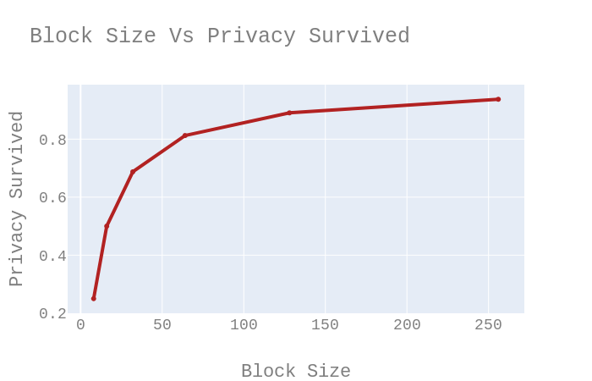
Computing Efficiency of Cascade

