Slide 1
Graduation Project
Banking system

Slide 2

Agenda
Client
Component Diagram
Class Diagram
State Diagram
Server
Component Diagram
Class Diagram
State Diagram
Sequence Diagram
Security in the system
Algorithms
Techniques

Slide 3
Client
Component Diagram

Slide 4
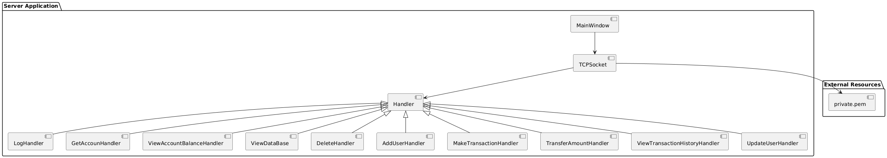

Slide 5
Client
Class Diagram

Slide 6
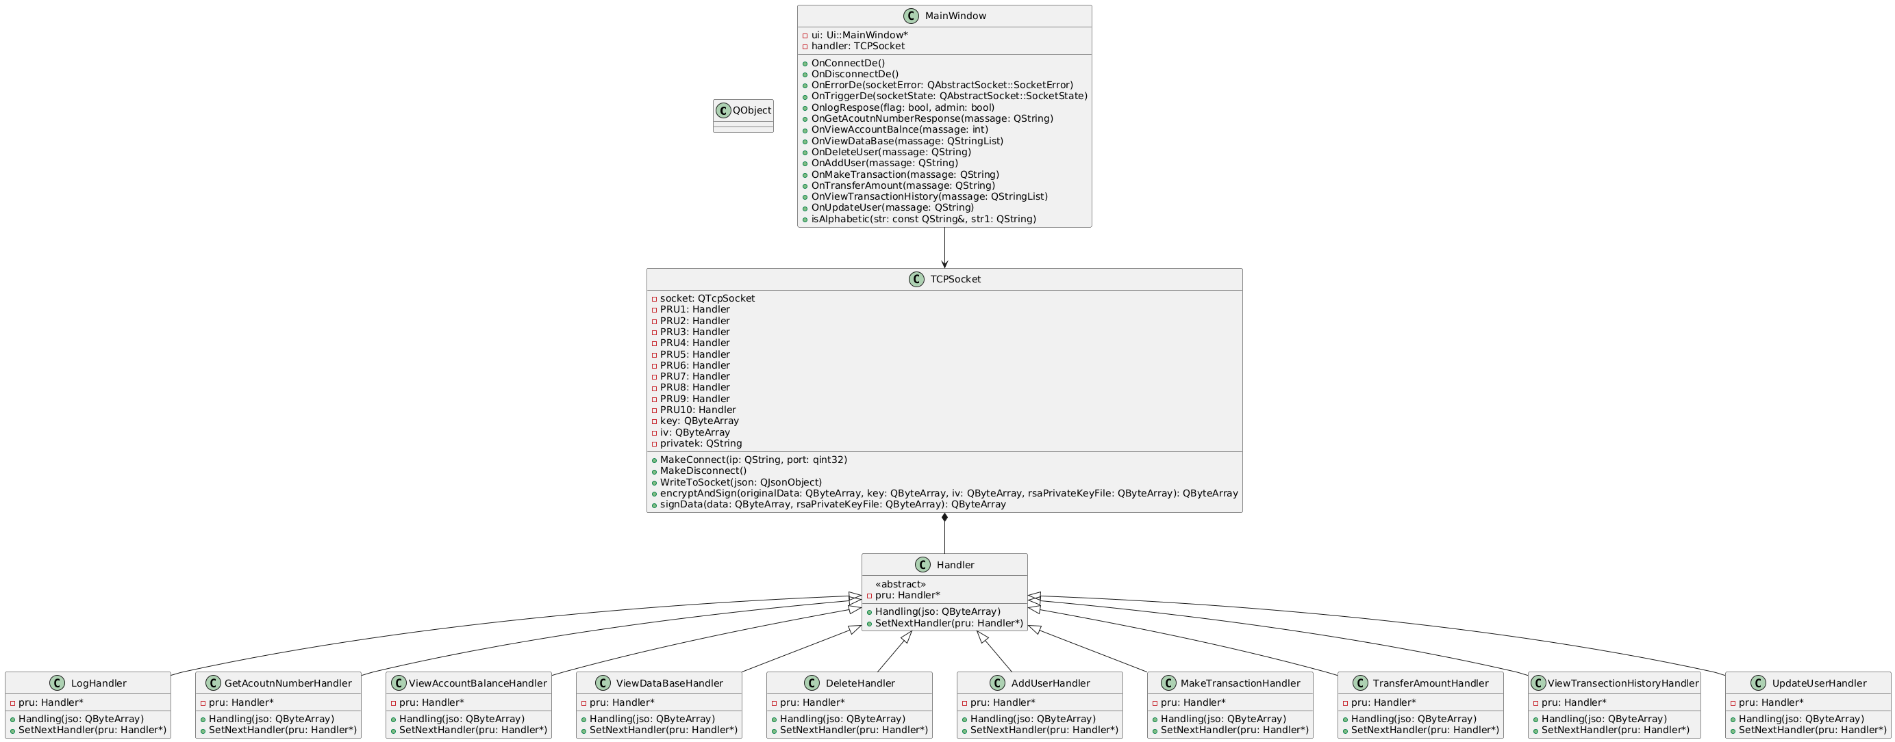

Slide 7
Client
State Diagram

Slide 8
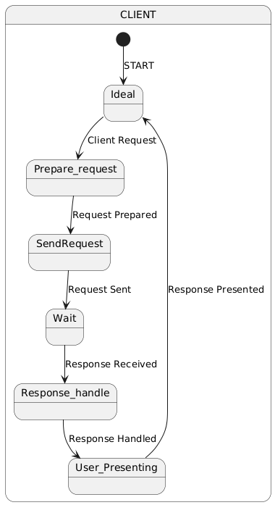

Slide 9
server
Component Diagram

Slide 10
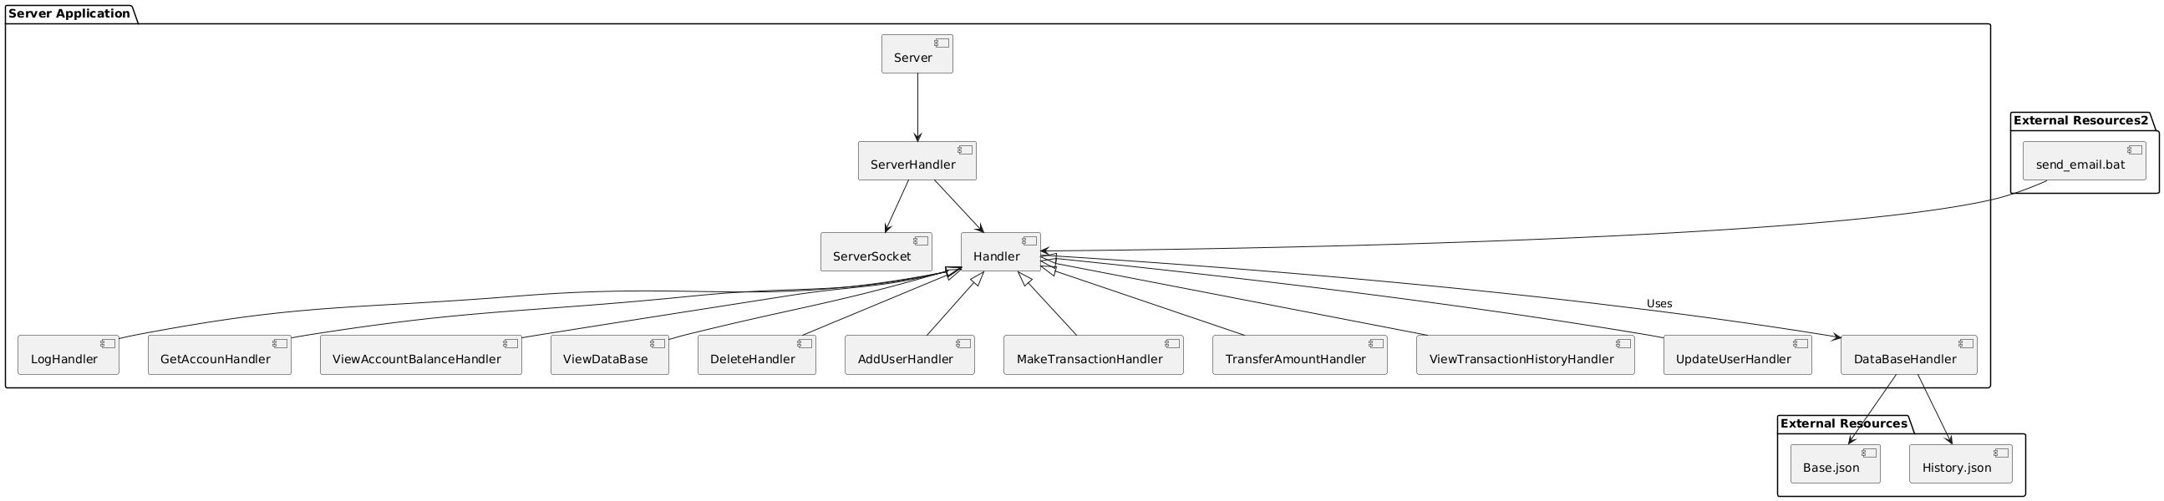

Slide 11
Server
Class Diagram

Slide 12
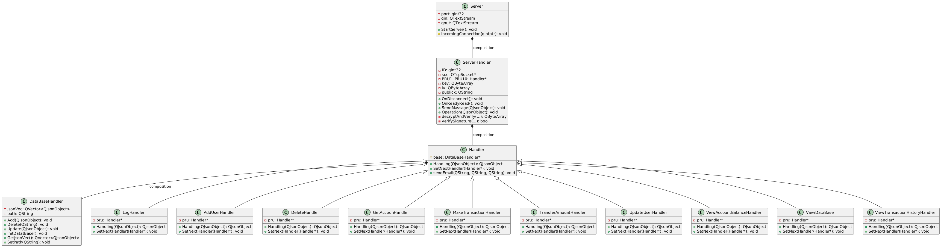

Slide 13
Server
State Diagram

Slide 14
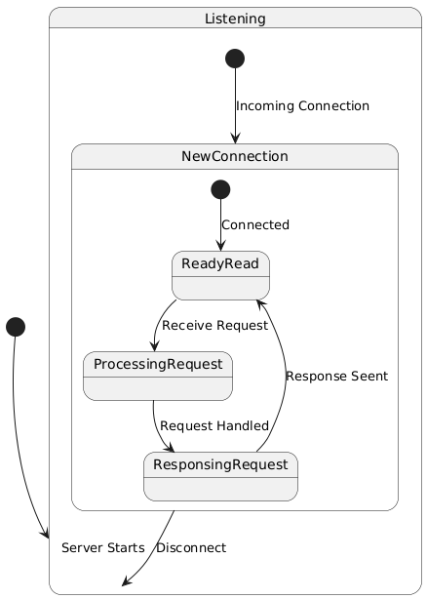

Slide 15
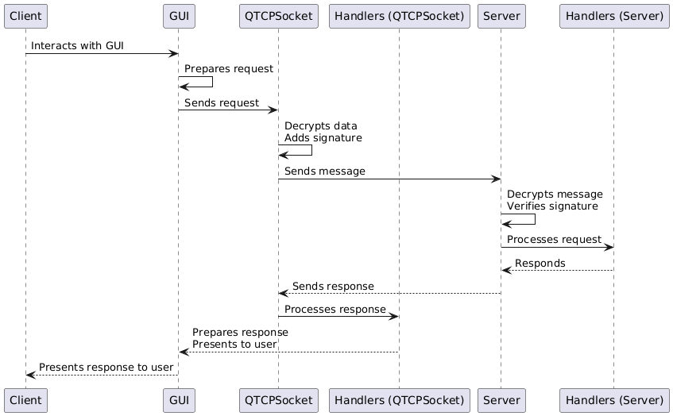
Sequence Diagram

Slide 16
Client
Sequence Diagram

Slide 17
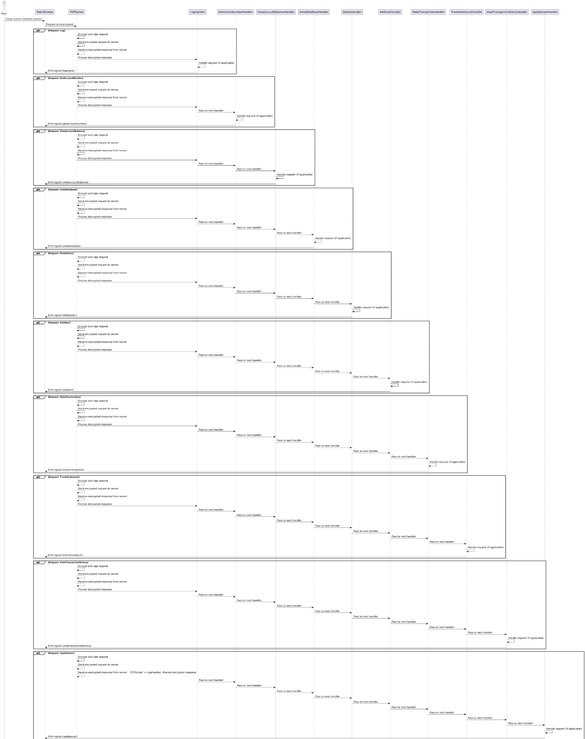

Slide 18
Server
Sequence Diagram

Slide 19
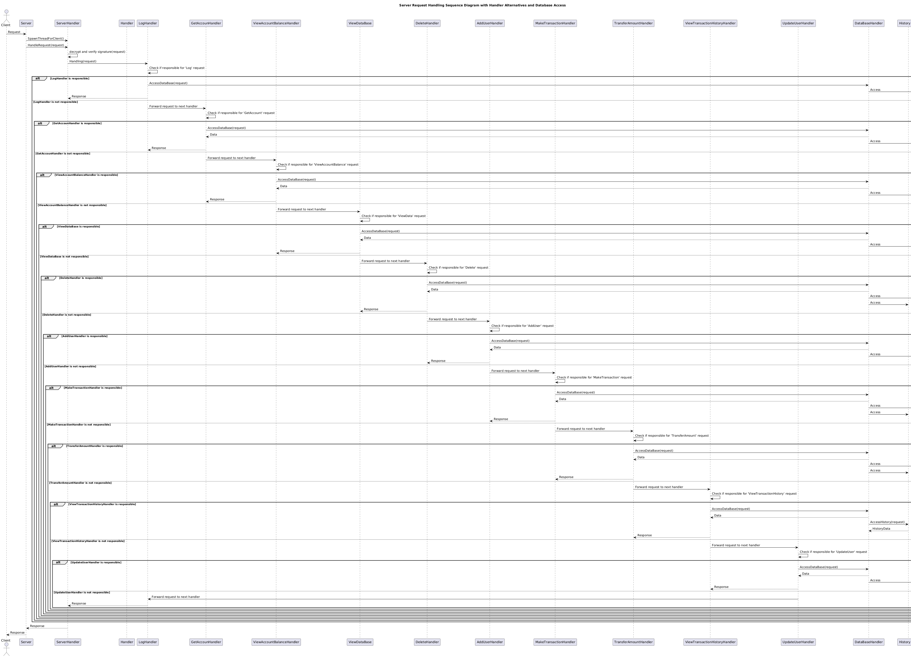

Slide 20
Security
Algorithms
AES 128-bit (Advanced Encryption Standard)
RSA 2048-bit
SHA-256(Secure Hash Algorithm)

Slide 21
Techniques
Security

Slide 22
client
server
Send the public key to the server after the connection
Has a 16-byte key to use the AES algorithm to encrypt massage
Has a 16-byte key to use the AES algorithm to decrypt massage
Generate public and private RSA 2048-bit key to use in signature
Receive a public from the client to verify the signature

Slide 23
The massage sending client
RSA
Algorithm
Signature
data
SHA256
Algorithm
hash
Private key
AES Algorithm
Send
Encrypted data

Slide 24
The massage RECEIVING Server
Check if the hash and received hash are the same
Received hash
SERVER Handlers
hash
SHA256
Algorithm
RSA
Algorithm
AES Algorithm
Encrypted data
data
Received
public key
Signature

