Slide 1
Towards Feedback Loops Design
Project number : P-2022-110
Project Advisor : Prof. Lewkowicz Izchak
Student Names : Eretz Kdosha Ron , Ben Maor Refael

Slide 2


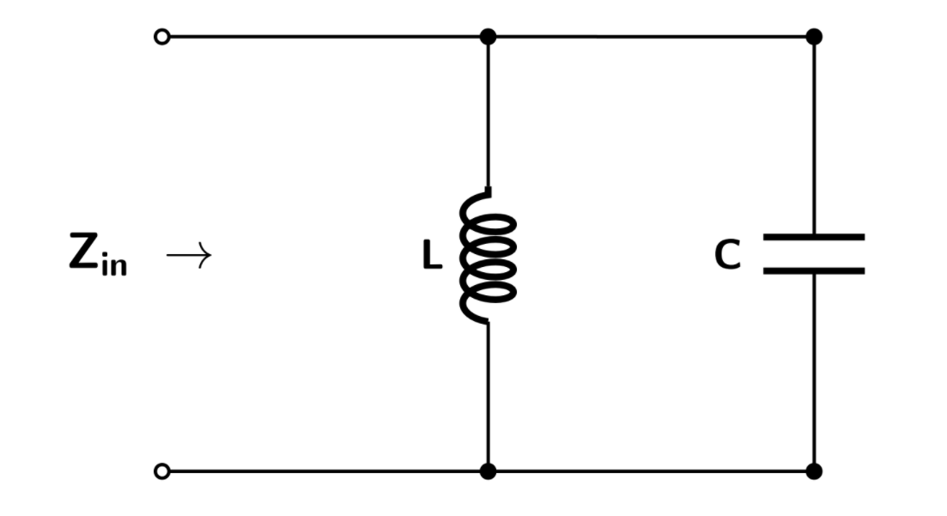
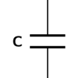



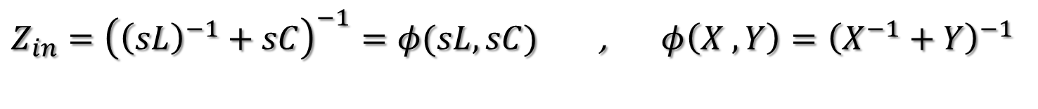
INTRODUCTION : LC CIRCUITS
LC circuits:

Slide 3
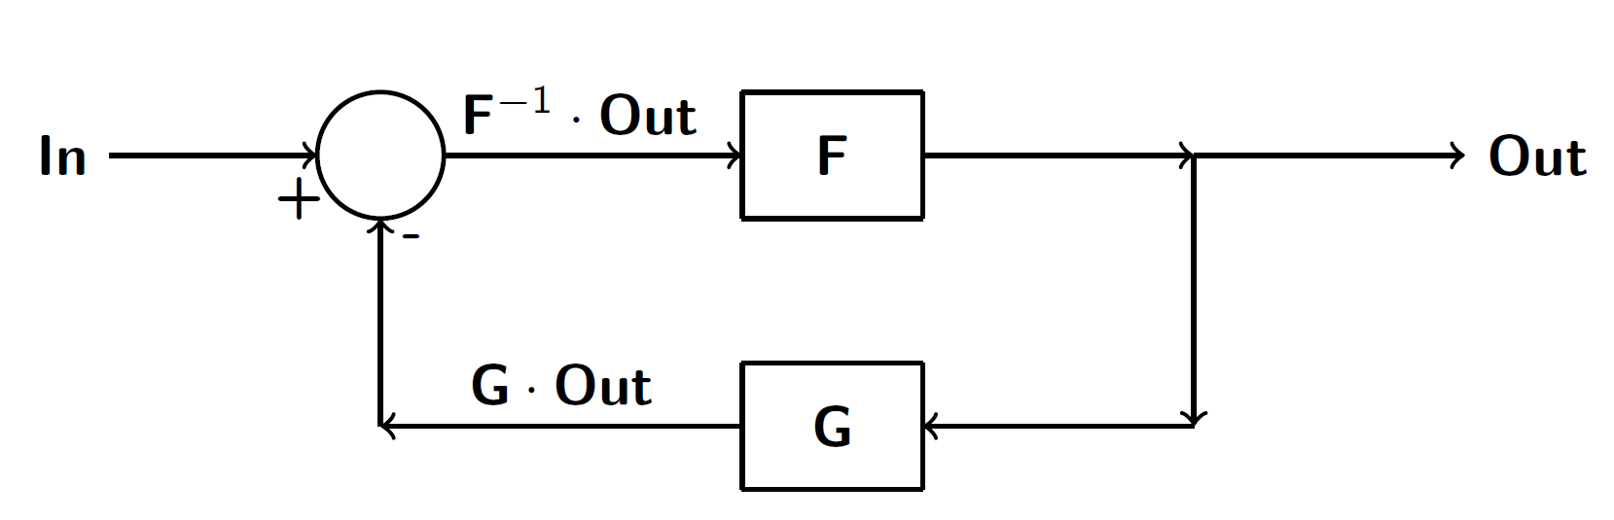
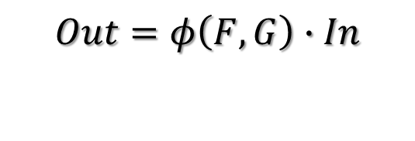





INTRODUCTION : FEEDBACK LOOPS
Closed feedback loop networks:

Slide 4
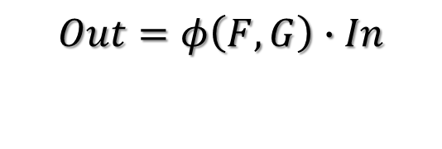






INTRODUCTION : FEEDBACK LOOPS
Closed feedback loop networks:

Slide 5
PROJECT’S MAIN GOAL
Identification of large groups of matrix-valued non-commutative LC functions

Slide 6
TECHNICAL GOALS
Learning Wolfram Mathematica and MATLAB required features
Finding ways to parameterize LC functions
Generating all multivariable LC functions under varying constraints
Creating matched scalar LC functions detector for each generated group
Creating methods to detect the non-commutative matrix valued LC functions
in each group

Slide 7
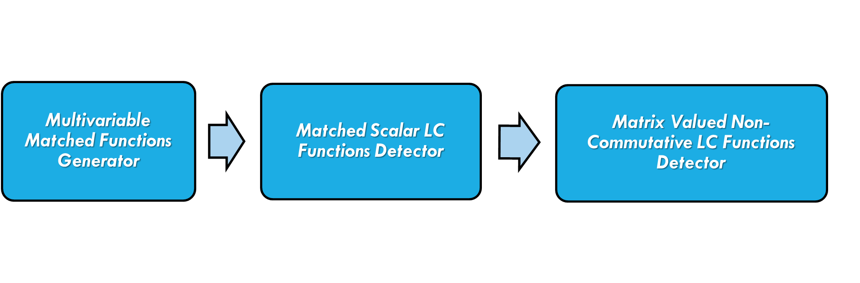


DESIGN FLOW : BLOCK DIAGRAM
Programming Platforms : Wolfram Mathematica
MATLAB

Slide 8

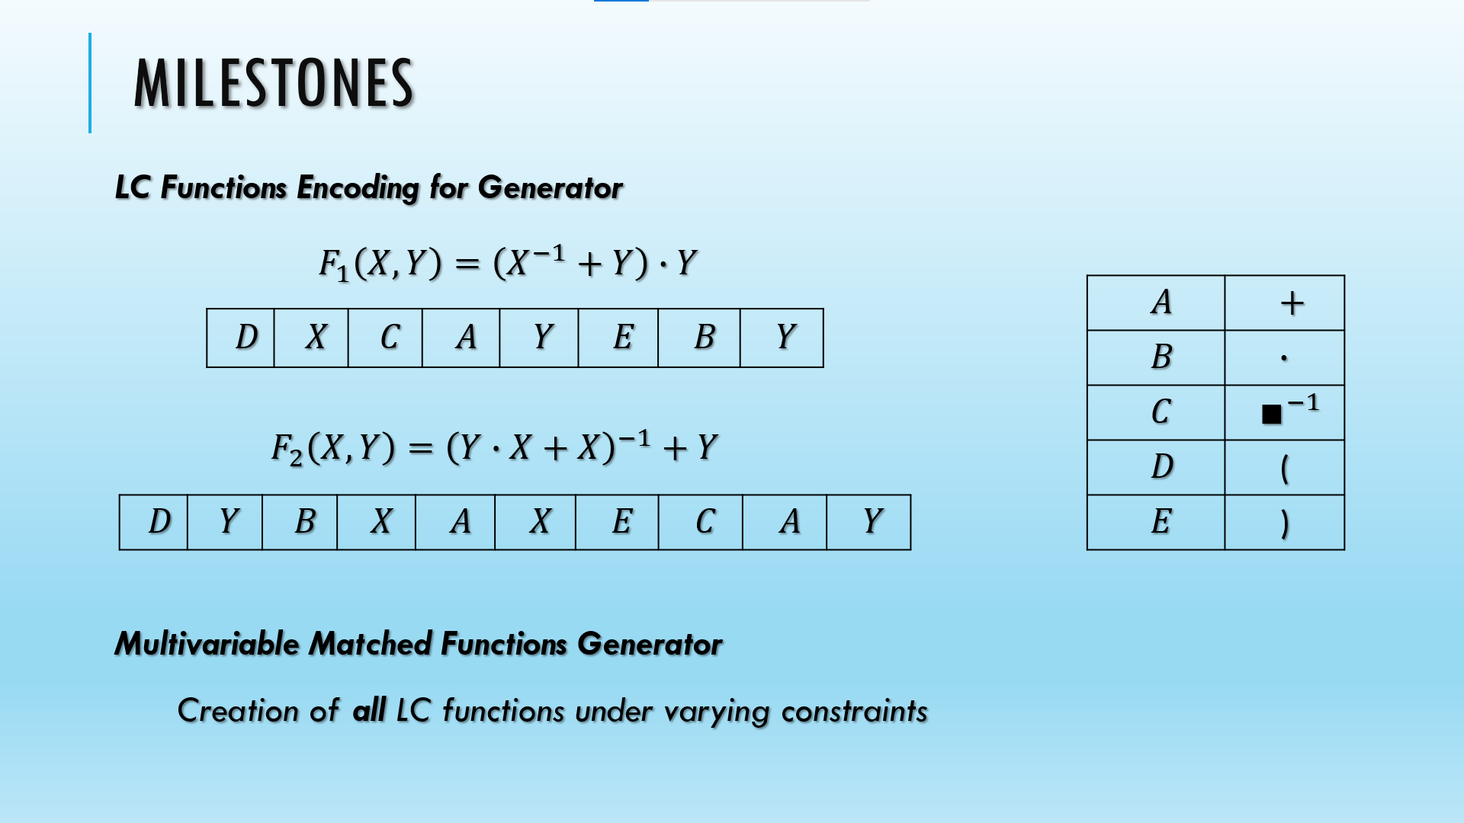
MILESTONES
LC Functions Encoding for Generator
Multivariable Matched Functions Generator
Creation of all LC functions under varying constraints

Slide 9
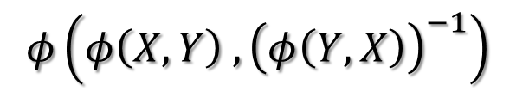
MILESTONES
Matched Scalar LC Functions Detector Algorithms
Memory
Function Operations Detector:
a. Basic Operations Detector – such as addition of LC functions, inversion of a
LC function, etc.
b. LC Functions Composition Detector
Matched By-Definition Detector – in some cases, we can design algorithms which
identifies (by-definition) scalar LC functions.

Slide 10
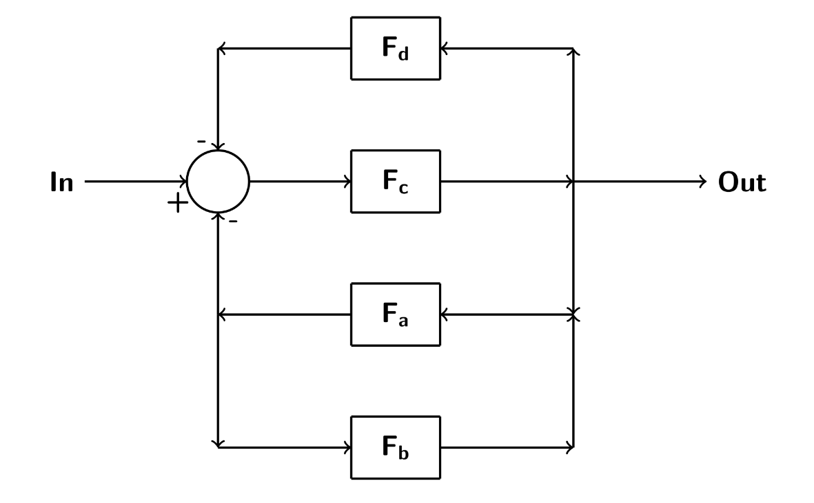
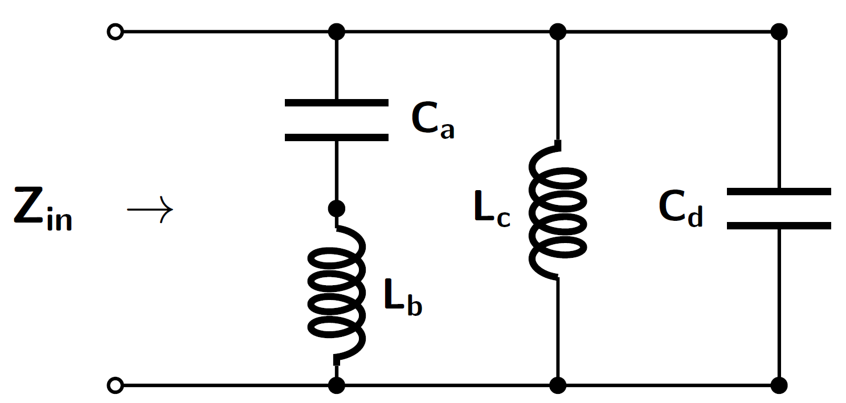

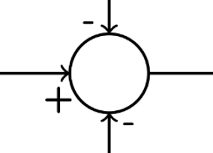


MILESTONES
Scalar LC Functions Composition:
Creation and realization of scalar LC functions compositions, as:

Slide 11

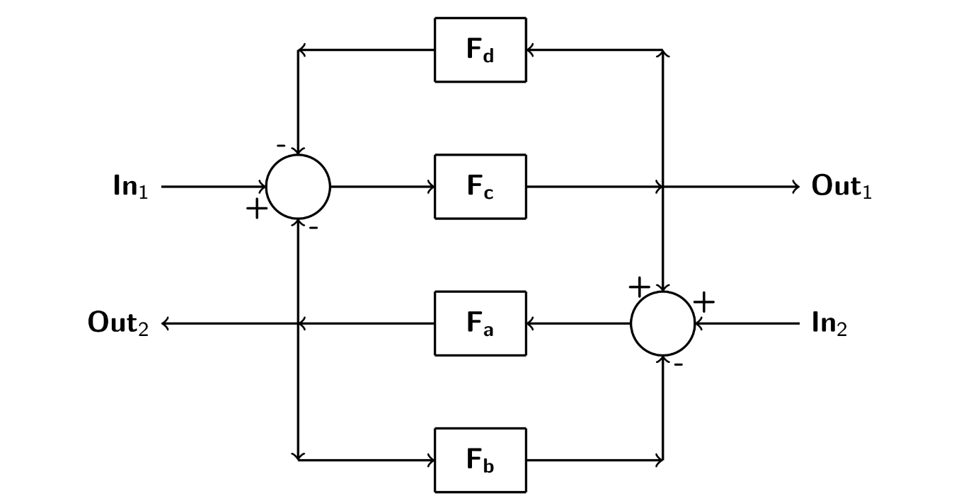


MILESTONES
MIMO Functions Realization
Creation and realization of MIMO functions, as:

Slide 12
CHALLENGES AND SOLUTIONS
Project’s Challenges:
Verification for covering all LC functions in complicated groups.
Creation of system which checks functions composition in complicated
LC functions.
Creation of methods for MIMO functions generation & NC-verification
Solution Suggestions:
Using combinatorics theory and programming platforms as MATLAB and Mathematica.
Creation of a matched suitable encoding method for function representation which will
assist in function composition checking routine.
Learning relevant mathematical aspects and generation & NC-verification by-hand.

Slide 13
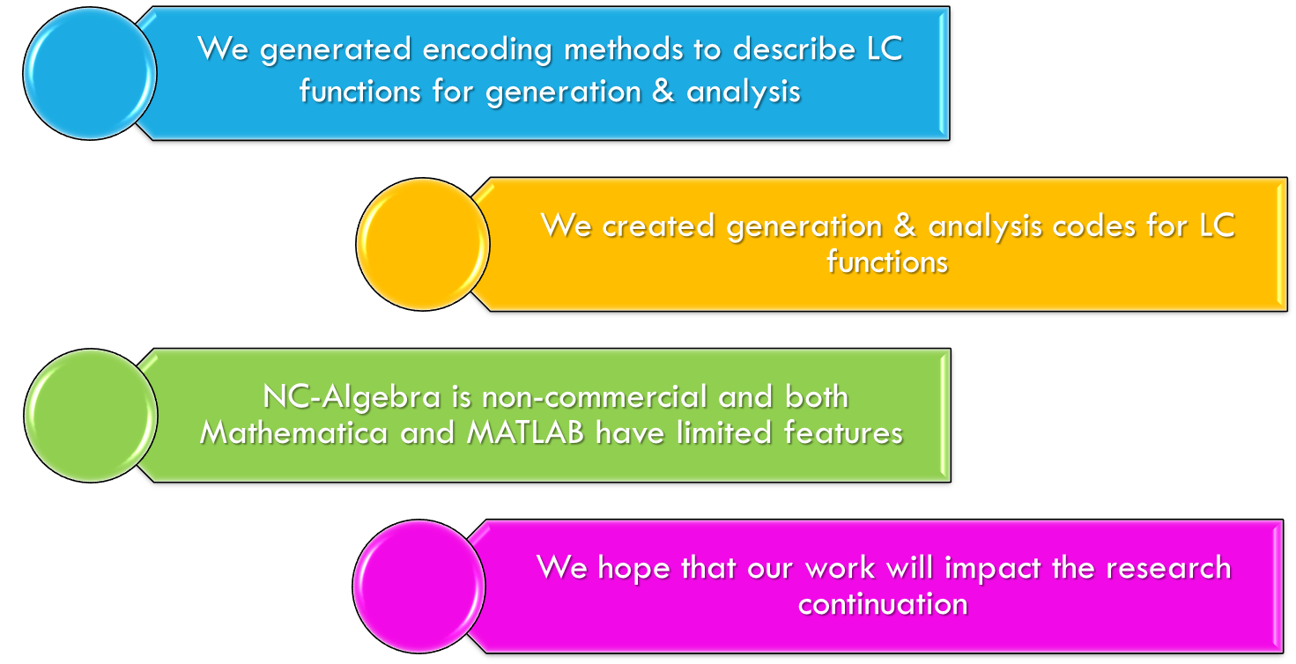
CONCLUSIONS

Slide 14

Thank you for listening !

