Slide 1




Stata vs. R: Making The Move
Data Wrangling overview

Slide 2
STATA Vs R – What we are going to Cover today?
Who we are?
Why we are here?
What we are not going to cover
What we are going to cover
Where Stata and R are similar
The data for today
Lets see some code
What questions do we need to address?
Some more code and graphs
Where to find more information

Slide 3




Who we are?
Jason Burwen
Refael Lav (Rafi)
Jason is formerly a consultant with
FSC Group (now Nexant), where he
worked with large smart meter data extracts in
STATA to craft experimental research designs and conduct data analysis on demand-side issues in electricity--i.e., how electric rates and other utility programs affect residential, commercial and industrial energy consumption patterns. He came to this from being a grad student working with sensor, survey, and other data from improved biomass cookstoves in developing countries. Jason's training is in econometrics and experimental & quasi-experimental research design. He currently works in energy policy at the Bipartisan Policy Center
Following me @jburwen
Rafi is an EY data consultant with the
Enterprise Intelligence - Data analytics
practice. Rafi is a practitioner with a
background in economic research, finance and data analytics including algorithms, data management, business intelligence, statistical analysis, outlier detections, and data mining. He has consulted on new product developments, business initiatives, process reengineering, technology solutions and efficacy implementations. He has developed R models for EY as well as the EY R training. Rafi holds a Master's of Science of Finance Johns Hopkins University and B.S. Economics from George Washington University
Following me @refaellav

Slide 4
Why we are here?
Our goal tonight is not to show a solution rather:
Show logical similarity between the programs
Develop initial understanding of R for STATA users
Practical examples
Assumptions:
You know something about one of the software’s code
You are here because you are not an advance R user (code is based on that fact)
You like data!
What we are not going to cover?
Main aim of this group is the data wrangling aspect therefore:
No advance analytics in this presentation
No specific packages discussion
No automation or GUI
No high level visualization

Slide 5
What we are going to cover
Data Preparation
Upload
Basic view
Naming
Column handling
Data type
Selection
Subsets
Basic Data wrangling
Column type update
Organization
Basic counts
Basic plots
Aggregation
Merge data sets
Functions

Slide 6
Pros and cons of data wrangling in R and Stata
STATA
Pros
Generally simple syntax Easy to work with values of different types (including things like date formats, etc)
Cons
Slower than R for wrangling big data sets Holds only one file in memory at a time (excepting temporary files) Not as agile as R sometimes—hard to move things around in certain ways Proprietary software—doesn’t play well with others (though is changing in newer versions), and you can’t run a .do file without software
R
Pros
Can hold multiple datasets in memory at the same time Reasonably fast in loading bigger datasets Very agile with data manipulation Open—anyone can read your R script, run it, and see what you did Live development language
Cons
Syntax is initially more challenging Limited to physical memory
STATA is great for analysis!
…but not ideal for wrangling
R is more ideal for wrangling.
…a little harder to use than STATA for analysis.

Slide 7
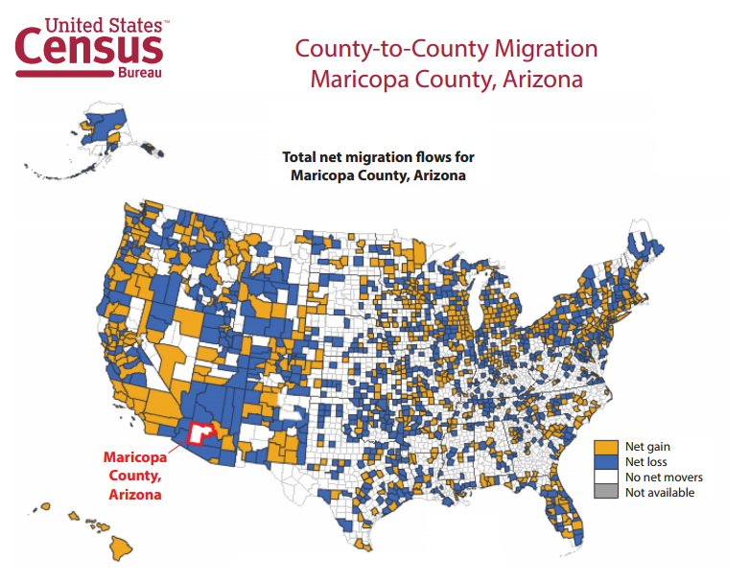
The data for today
Overview of Census data:
US Census Data – Migration
US Census Data – Education
Code: A) Formatted data
B) R code
C) STATA code

Slide 8
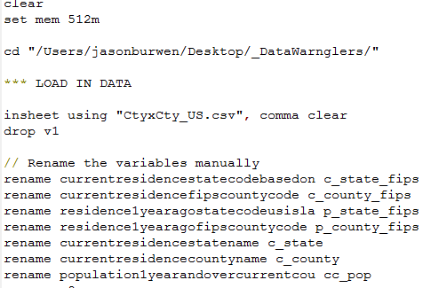
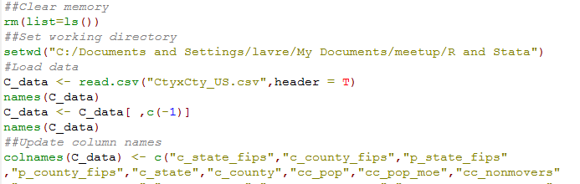
Lets see some code

