Slide 1
Information Warfare
Lecture 3

Slide 2
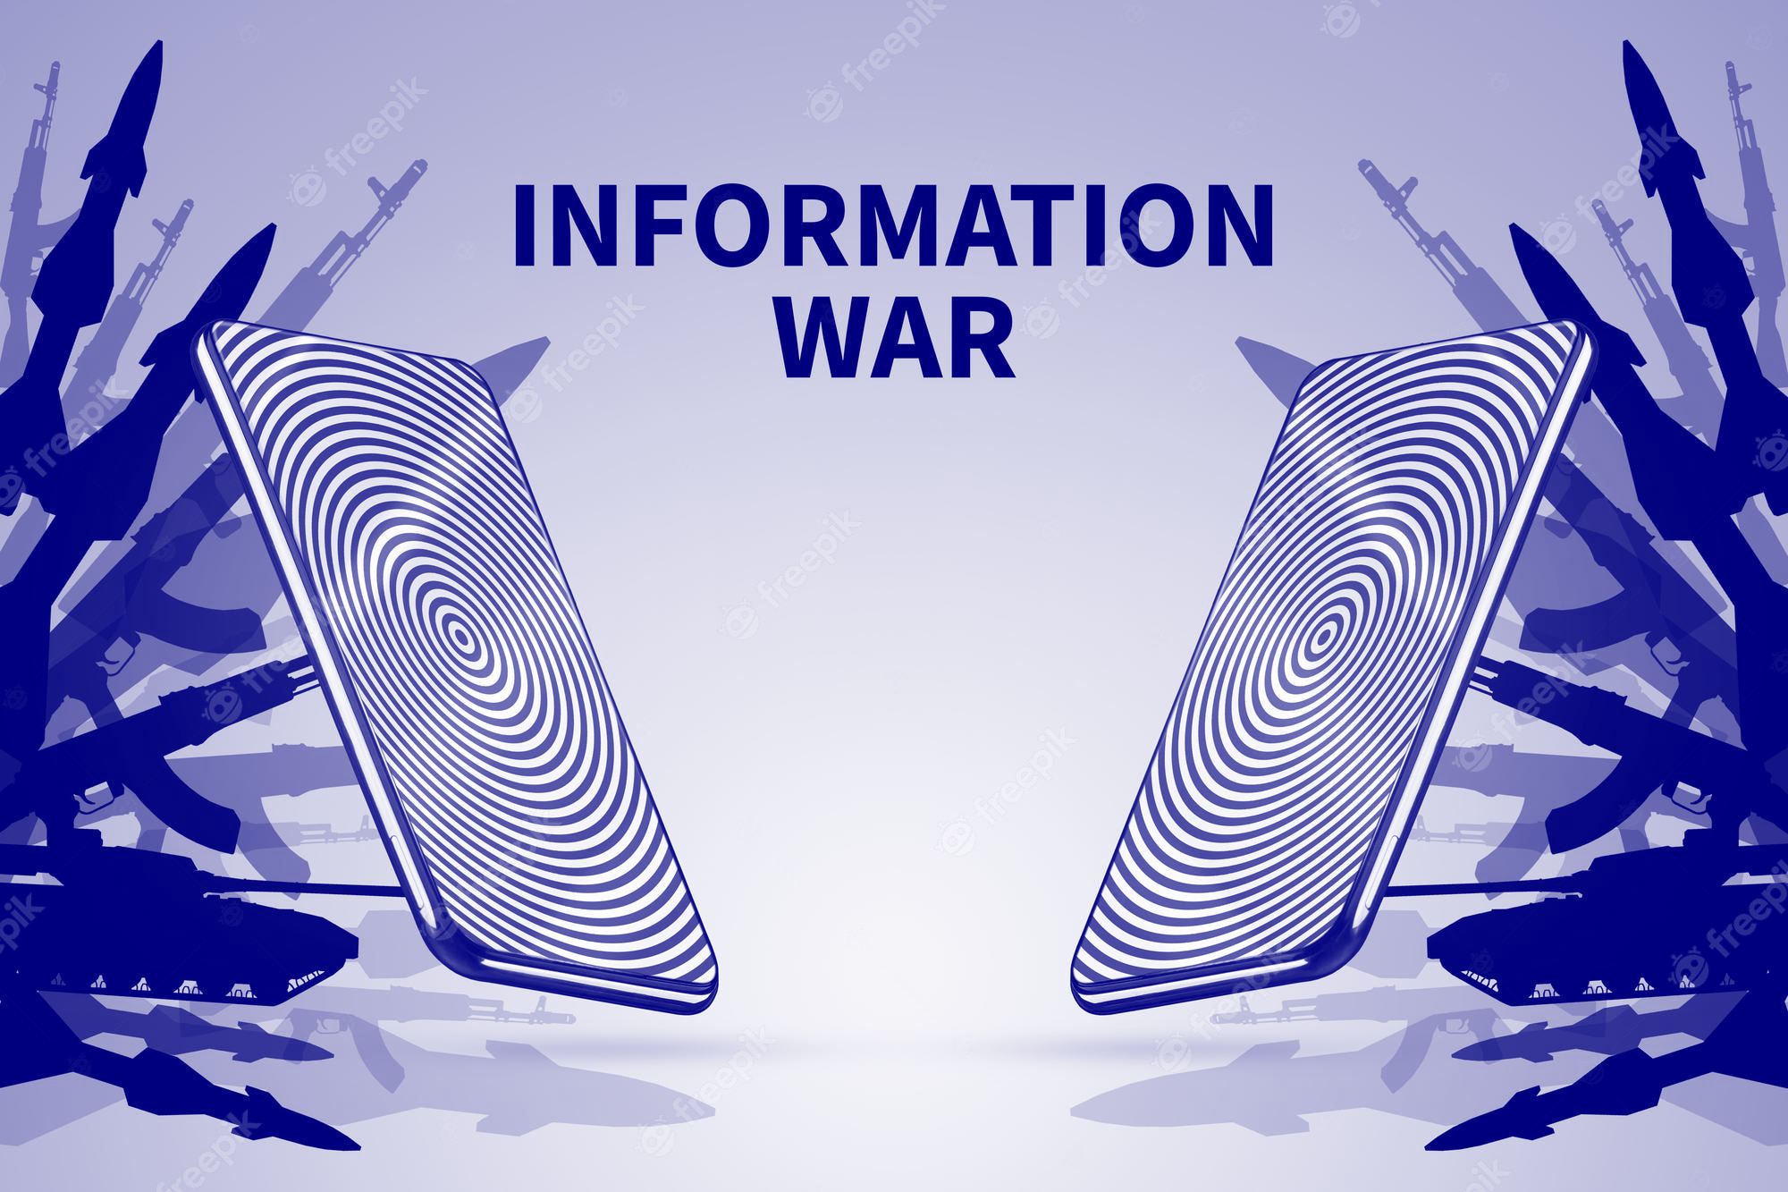
What is Information Warfare
Information warfare refers to the use of information and communication technologies to gain a strategic advantage in military, political, or economic conflicts. It involves the deliberate manipulation, exploitation, or disruption of information systems and communication networks to achieve specific objectives.

Slide 3
Information Warfare Strategy
Defensive and Offensive information warfare are two distinct strategies of cyber operations and information security
Defensive |  | Offensive
1. | Cybersecurity Practices | Cyber Espionage
2. | Incident Response | Cyber Attacks
3. | Encryption | Denial of Service (DoS) Attack
4. | Access Control | Advanced Persistent Threats (APTs)
5. | Security Awareness Training | Disinformation and Propaganda
7. | Vulnerability Management | Data Manipulation
8. | Security Monitoring and Analytics | Hardware Tampering

Slide 4
Information Warfare Strategy
Defensive and Offensive information warfare are two distinct strategies of cyber operations and information security
Defensive information warfare focuses on protecting one's own digital assets, networks, and information from cyber threats and attacks. The primary goal of defensive information warfare is to ensure the confidentiality, integrity, and availability of data and systems while safeguarding against unauthorized access, data breaches, and other cyber incidents

Slide 5
Defensive information Warfare
1. Cybersecurity Practices: Implementing robust cybersecurity practices, including firewalls, intrusion detection systems, antivirus software, and regular security updates to defend against common cyber threats.
2. Incident Response: Developing and practicing incident response plans to swiftly detect, contain, and mitigate cyber incidents when they occur.
3. Encryption: Using strong encryption methods to protect sensitive data, ensuring that even if it's intercepted, it remains unintelligible to unauthorized parties.
4. Access Control: Managing user access to networks and systems through authentication mechanisms, least privilege principles, and multi-factor authentication.

Slide 6
Defensive information Warfare
5. Security Awareness Training: Educating employees and users about cybersecurity best practices, recognizing phishing attempts, and being vigilant about potential threats.
6. Vulnerability Management: Regularly scanning and patching systems for known vulnerabilities to prevent exploitation by malicious actors.
7. Security Monitoring and Analytics: Continuously monitoring network and system activity for signs of potential security breaches or anomalous behavior.

Slide 7
Offensive information Warfare
Offensive information warfare involves taking proactive actions to target and exploit the digital assets and infrastructure of adversaries. The primary objective is to gain a strategic advantage, disrupt the adversary's operations, or extract sensitive information
1. Cyber Espionage: Using sophisticated hacking techniques to infiltrate an adversary's networks and steal sensitive or classified information.
2. Cyber Attacks: Launching targeted cyber attacks to disrupt or disable an adversary's critical infrastructure, communication systems, or other vital services.
3. Denial of Service (DoS) Attacks: Flooding an adversary's systems or networks with excessive traffic, causing them to become unresponsive or unavailable.

Slide 8
Offensive information Warfare
4. Advanced Persistent Threats (APTs): Employing long-term and stealthy cyber campaigns to gain access to an adversary's systems and remain undetected for extended periods.
5. Disinformation and Propaganda: Using social media and online platforms to spread false or misleading information, influencing public opinion or sowing discord.
6. Data Manipulation: Tampering with or altering data in an adversary's systems to undermine their operations or decision-making processes.
7. Hardware Tampering: Mass tampering any computer hardware in production level to surveillance other state or country.

Slide 9
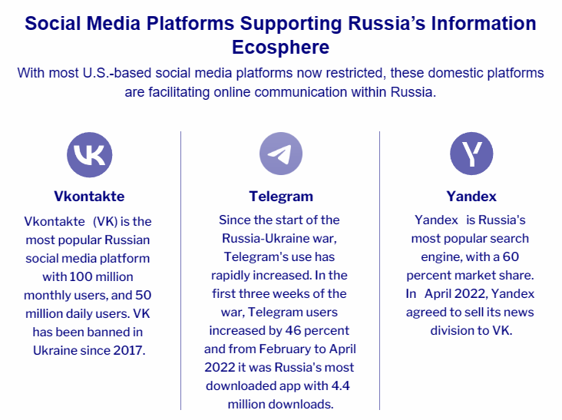
Information Warfare - Russia Ukraine

Slide 10
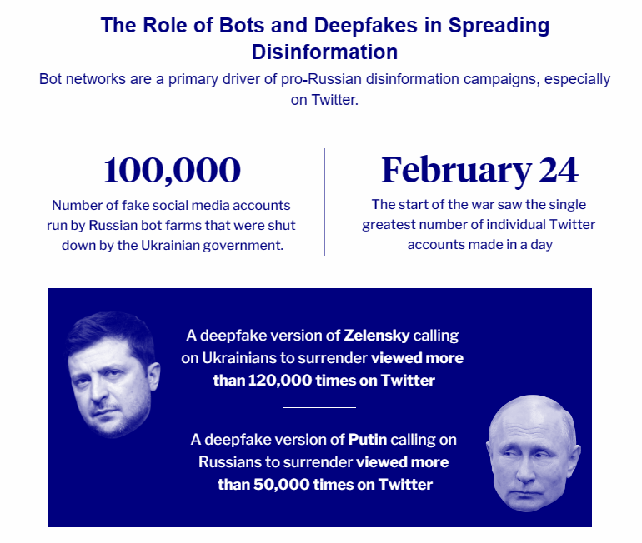
Information Warfare - Russia Ukraine (Cont.)

Slide 11
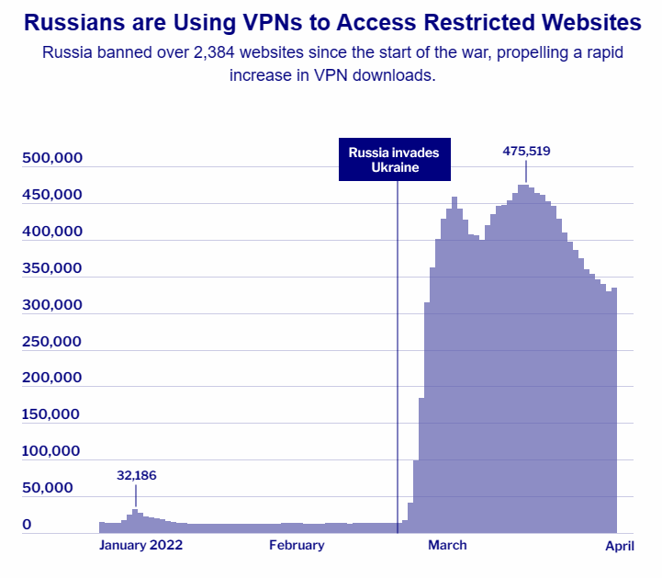
Information Warfare - Russia Ukraine (Cont.)

Slide 12
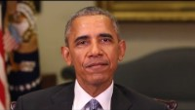
Use Of Deepfake In Information Warfare

Slide 13
Questions

Slide 14
Thanks!

