Slide 1


Skin Disease Detection
Introducing
an automated skin disease detection system
Available on
streamlit.app

Slide 2
The Team
Nafiz
Refat
Shafia
Documentation
Developer
Quality Assurance
ID: 1898
ID: 1568
ID: 1593

Slide 3



Problem Statement
8th Most Common Disease Worldwide.
Over 633 million people get affected by Acne.
And the Reasons?
Social Stigma.
Privacy Concerns.
Lack of easy access to Dermatologists.

Slide 4



Objective
A skin disease classification model using machine learning.
Developing a user interface for uploading and analyzing skin images.
Keeping the system simple and accessible.

Slide 5


Motivation
Our system allows individuals to upload an image and get an accurate prediction, all from the comfort of their device.
No judgments.
No waiting lines.
No need to explain to anyone.

Slide 6



Project Features
Deployed as Web Interface (Streamlit)
Image-Based Skin Disease Detection
High Accuracy Prediction
User friendly UI

Slide 7
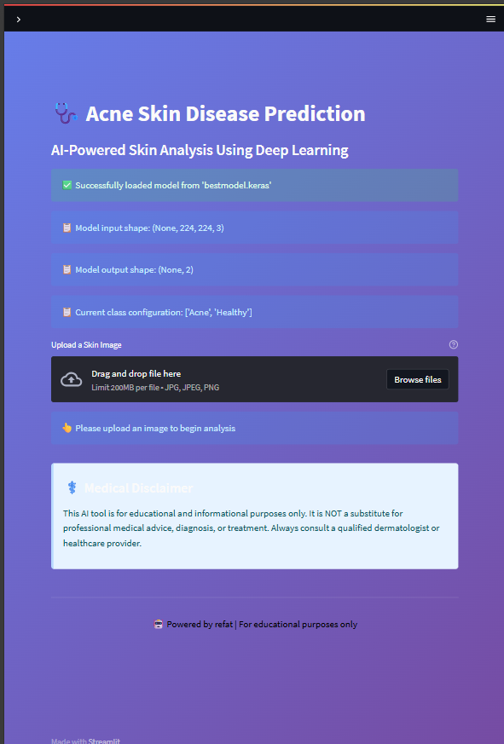
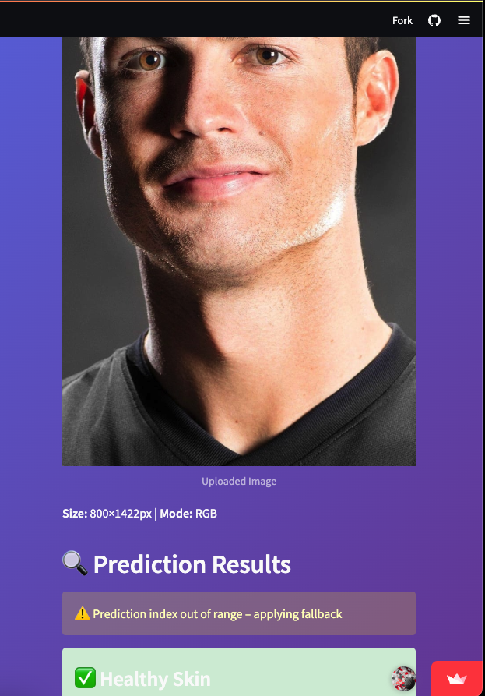
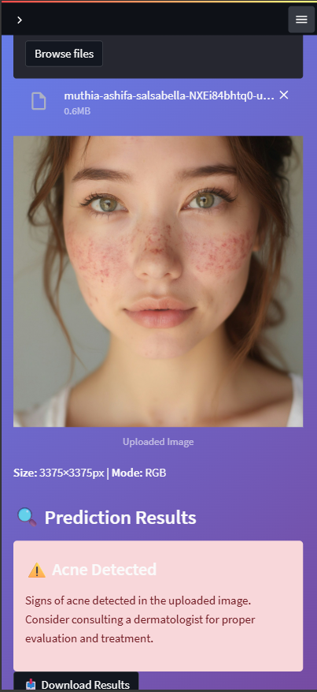
Project Demo

Slide 8

Dataset & Preprocessing Overview
Public Acne and Healthy skin dataset.
Data Source
Data Normalization, Augmentation.
Resize 224x224
Flip, Rotate
Preprocessing

Slide 9
Model Development
Deep Learning Models utilized for classification.
Transfer Learning from ImageNet applied.
VGG19
ResNet50
Xception

Slide 10
Performance Evaluation
Metrics used to assess model performance.
Accuracy
Precision
(TP + TN) / Total = (185 + 326) / (185 + 326 + 227 + 228) ≈ 52.90%
TP / (TP + FP) = 185 / (185 + 227) ≈ 52.91%
Recall
F1-Score
TP / (TP + FN) = 185/ (185 +228) ≈ 52.90%
2 × (Precision × Recall) / (Precision + Recall) = ~52.91%

Slide 11




Impact & Limitations
Focus only on acne initially.
Useful in Rural areas.
Accuracy may vary by image quality.
Potential integration with telemedicine.
Expands access to skin care tools.
Needs expert-labeled, larger dataset.

Slide 12



Future Works
Add more skin disease datasets enhancing quality.
Collaboration with Dermatologists.
Implement xAI on the model.

Slide 13
Conclusion
The project addresses the increasing demand for efficient and privacy-focused skin disease detection system
ResNet50 delivered the best performance.
Successfully detects Acne and Healthy skin types.
Ensures minimal cost and easy web deployment via Streamlit.
Can be effectively used in rural areas.

Slide 14

Thanks!

