Slide 1
Data Representation

Slide 2
Data Representation
Binary: The computer numbering system.
1 binary digit allows 2^{n} = 2 codes (0,1)
2 binary digit allows 2^{n} = 4 codes (00,01,10,11)
3 binary digit allows 2^{n} = 8 codes (000,…..111)
…………………………………………………
7 binary digit allows 2^{n} = 128 codes (0000000,…..1111111)
8 binary digit allows 2^{n} = 256 codes (00000000,…..11111111)
ASCII: American Standard Code for Information Interchange
EBCDIC: Extended Binary Coded Decimal Interchange Code

Slide 3
Data Representation
Bit: 0 (Off) or 1 (On).
Byte: 8 bits can make a byte.
Word: The word is the computer’s basic unit of data, the unit concerned in data storage, processing and transfer.

Slide 4
Data Representation
Integer:
Floating Point:
Character:
      ASCII
      EBCDIC
      Unicode
Boolean:

Slide 5
Integers
Decimal Binary
1 00000001
4 00000100
9 00001001
-1 11111111
-4 11111100
-9 11110111

Slide 6
Positive Number Representation
Using Integers: The simplest numbers to consider are the integers. The positive integer numbers are called unsigned. And the integer numbers that can also be negative are called signed.
For an example the number 13 represents,
13 = 1 × 10¹ + 3 × 10⁰

Slide 7
Positive Number Representation
Conversion between Decimal and Binary systems:
1. For an example the binary number 1101 represents the value
V = 1 × 2³ + 1 × 2² + 0 × 2¹ + 1 × 2⁰
V = 13
Hence, (1101)₂ = (13)₁₀
2. The decimal number 13 represents the value
2 13
2 6 – 1
2 3 – 0
1 – 1
Hence, (13)₁₀ = (1101)₂

Slide 8
Positive Number Representation
Conversion Octal and Hexadecimal Representation:
1. The decimal number 125 represents the octal value
8 125
8 15 – 5
1 – 7
Hence, (125)₁₀ = (175)₈
2. The decimal number 125 represents the Hexadecimal value
16 125
7 – 13
Hence, (125)₁₀ = (7D)₁₆

Slide 9
Positive Number Representation
Conversion Octal to Binary and Binary to Hexadecimal Representation:
1. The octal number 175 ₈ represents the binary value
(175)₈ = 001 111 101
Hence, (175)₈ = (001111101)₂
2. The binary number (001111101)₂ represents the Hexadecimal
(001111101)₂ = 0000 0111 1101
= 0 7 D
Hence, (001111101)₂ = 7D

Slide 10
Number in different systems
Decimal Binary Octal Hexadecimal
00 00000 00 00
01 00001 01 01
02 00010 02 02
03 00011 03 03
04 00100 04 04
05 00101 05 05
06 00110 06 06
07 00111 07 07
08 01000 10 08
09 01001 11 09
10 01010 12 0A
11 01011 13 0B
12 01100 14 0C
13 01101 15 0D
14 01110 16 0E
15 01111 17 0F
16 10000 20 10
17 10001 21 11
18 10010 22 12

Slide 11
Examples
Find out the unsigned integer, real, binary, octal and hexadecimal values of 150 denary number?
2. If the decimal value of B is 66, find out the both decimal and binary values of G and I?

Slide 12
Addition of Unsigned Number
x 0 0 1 1
+y +0 +1 +0 +1
c s 00 01 01 10
(a) The four possible cases
Carry Sum
x y c s
0 0 0 0
0 1 0 1
1 0 0 1
1 1 1 0
(b) Truth Table for half adder

Slide 13

Addition of Unsigned Number
(c) Circuit
x
s
y
c
x
HA
s
y
c
(d) Graphical symbol

Slide 14
Addition of Unsigned Number
c_{i} x_{i} y_{i} c_{i +1} s_{i}
0 0 0 0 0
0 0 1 0 1
0 1 0 0 1
0 1 1 1 0
1 0 0 0 1
1 0 1 1 0
1 1 0 1 0
1 1 1 1 1
(a) Truth table for full adder

Slide 15
Addition of Unsigned Number
s _{i} = x_{i} y_{i} c_{i}
x_{i} y_{i}
c_{i}
00 01 11 10
0
1
1
1
1
1
+
+
x_{i} y_{i}
c_{i}
00 01 11 10
0
1
1
1
1
1
c_{i +1} = x_{i} y_{i} + x_{i} c_{i} + y_{i} c_{i}
(b) Karnaugh maps

Slide 16

Addition of Unsigned Number
(c) Circuit for Full adder
x_{i}
y_{i}
s_{i}
c_{i}
c_{i+1}

Slide 17
Decomposed Full Adder
(a) Block diagram
s
x_{i}
HA
s_{i}
s
c
y_{i}
HA
c_{i+1}
c
c_{i}
c_{i}
s_{i}
x_{i}
y_{i}
c_{i+1}
(b) Detailed diagram

Slide 18
Ripple Carry Adder
The signal c_{n-1} is valid after a delay of (n-1)×dt, which means that the complete sum is available after a delay of n×dt. Because of the way the carry signals ripple through the full adder stages, the circuit in figure is called a ripple carry adder.
c_{n-1}
c₂
c_{i}
c_{n}
FA
FA
FA
c₀
s_{n-1}
s₁
s₀
MSB position
LSB position
Figure: An n-bit ripple carry adder

Slide 19
Negative Number Representation
Negative numbers can be represented in three different ways:
Sign and magnitude
1’s complement
2’s complement

Slide 20
2’s Complements
To Translate a negative denary (base 10) number to binary Using 2’s complements:
Find the binary value of the equivalent positive decimal
Number.
Change all the 1s to 0 and all the 0s to 1.
Add 1 to the result.

Slide 21
Interpretation of four bit signed integers
b₃b₂b₁b₀ Sign and magnitude 1’s complement 2’s complement
0111 +7 +7 +7
0110 +6 +6 +6
0001 +1 +1 +1
0000 + 0 + 0 + 0
1000 - 0 - 7 - 8
1111 - 7 - 0 - 1

Slide 22
Floating Point
Values that change continuously
Decimals and fractions
<Sign>0.Mantissa *2^{exponent}
Sign
Exponent
Mantissa

Slide 23
Character Codes
The American Standard Code for Information
Interchange (ASCII).
The Extended Binary Coded Decimal Interchange Code
(EBCDIC).
UNICODE

Slide 24
Examples of ASCII Codes
Character ASCII
0 00110000
1 00110001
2 00110010
-
8 00111000
9 00111001
-
A 01000001
B 01000010
-
Y 01011001
Z 01011010
-
a 01100001
b 01100010

Slide 25
Unicode
Worldwide Character Standard
      Enable Multilingual Text
      Mathematical Symbols
Compatible with ISO/IEC 10646
16 bit encoding system
- > 65,000

Slide 26
Boolean Data
True / False
1 bit required
… . . . . . . . . . . . . . . . . . . . . . . .
Value

Slide 27
Combinational Circuit Design
Binary Codes
  Meaning of a sequence of binary bits (e.g., 11001111)
    unsigned integer, character, floating-point number, part of a binary program, part of a video or audio stream, etc.
  Interpreting binary bits as an unsigned number
    radix r numbers (radix-10, radix-2, radix-16, etc.)
      q_{p-1} q_{p-2} ... q₀ . q₋₁ q₋₂ ... q_{-n} = Σ_{i=-n}^{p-1} q_{i} * r^{i}
    need to practice fast conversions: decimal, hex, binary
  Signed numbers
    1’s complement: negative -> invert every bit
    2’s complement: negative -> invert every bit, add 1 to “lsb”

Slide 28
  Examples
    Assume 8-bit words (p = 8, n = 0).
      1’s complement: 11001011 = ( ? )₁₀
      2’s complement: 11001011 = ( ? )₁₀
      Let A = ( 67 )₁₀ = ( ? ) in 2’s complement
      Let B = ( -128 )₁₀ = ( ? ) in 2’s complement
      perform A + B, A - B using two 2’s complement numbers
        Is there anything strange?
  Other codes
    BCD (binary coded decimal): 0011 1001 0101 = ( ? )₁₀
    excess-k: e.g., excess-3, excess-127, etc.
    Gray code: e.g., 00, 01, 11, 10
    parity (even parity, odd parity):
    101001010100 --> parity bit = ? with even parity
    010100010111 --> parity bit = ? with odd parity

Slide 29
Digital Logic Theory
Boolean Algebra (uses n-valued variables)
Switching Algebra (special case of Boolean Alg.)
  Defined on [ S, * , + , ‘ , 0 , 1 ]
    S : set of elements (variables)
    * , + , ‘ : set of operators
    0, 1 : elementary values
  Basic axioms: Table 1.1
  Basic theorems: Tables 1.2 and 1.3: practice proofs!
    Absorption (T9): A + A * B = A; (T9’): A * (A + B) = A
    Consensus (T12): XY + X’Z + YZ = XY + X’Z; dual = ?
    DeMorgan’s: (x + y)’ = x’y’; (xy)’ = x’ + y’
    Generalized DeMorgan’s: [ f (x₁, x₂, …, x_{n}, 0, 1, +, * ) ]’ =
    f (x₁’, x₂’, …, x_{n}’, 1, 0, *, + )
  Principle of Duality: interchange (+, *) and (0, 1)

Slide 30
Hardware Implementations
Representation of Logic 0 and Logic 1
  Positive logic: 0 = low voltage, 1 = high voltage
  (negative logic uses opposite convention)
  Figure 1.3: noise margins, voltage ranges used to permit small variations in input & output voltage values
    LSTTL: for inputs, ‘0’ = 0.0-0.8V and ‘1’ = 2.0-5.0V
    for outputs, ‘0’ = 0.0-0.5V and ‘1’ = 2.7-5.0V
SSI-Level Logic Gates
  AND, OR, inverter, NAND, NOR
  CMOS implementations: Figure 1.5

Slide 31
Logic Minimization
Karnaugh Map (K-Map) Example
  Minimize F = A’B + A’C + A’D + ACD
  F = A’B (C’D’ + C’D + CD’ + CD)
  + A’C (B’D’ + B’D + BD’ + BD)
  + A’D (B’C’ + B’C + BC’ + BC)
  + ACD (B’ + B)
  = A’BC’D’ + A’BC’D + A’BCD’ + A’BCD + …
  --> canonical sum-of-products (SOP) form
  Draw K-map and then solve
  Result should be F = CD + A’B + A’C + A’D
  (1) (2) (3) (4)

Slide 32
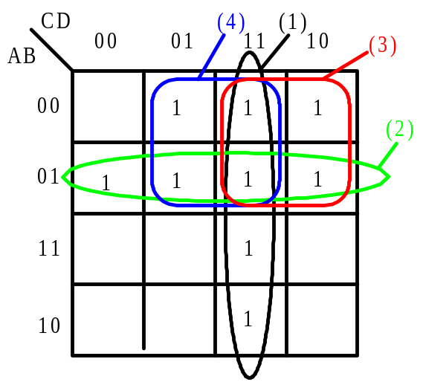
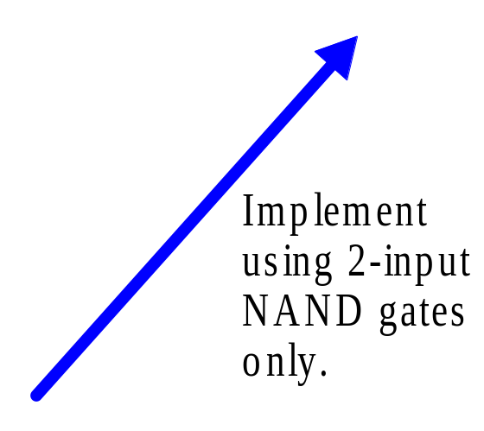
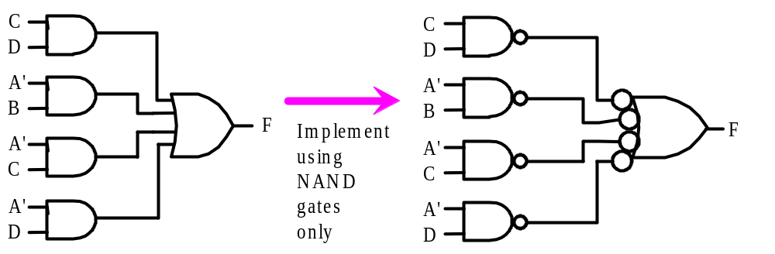
F = CD + A’B + A’C + A’D
(1)
(2)
(3)
(4)

Slide 33
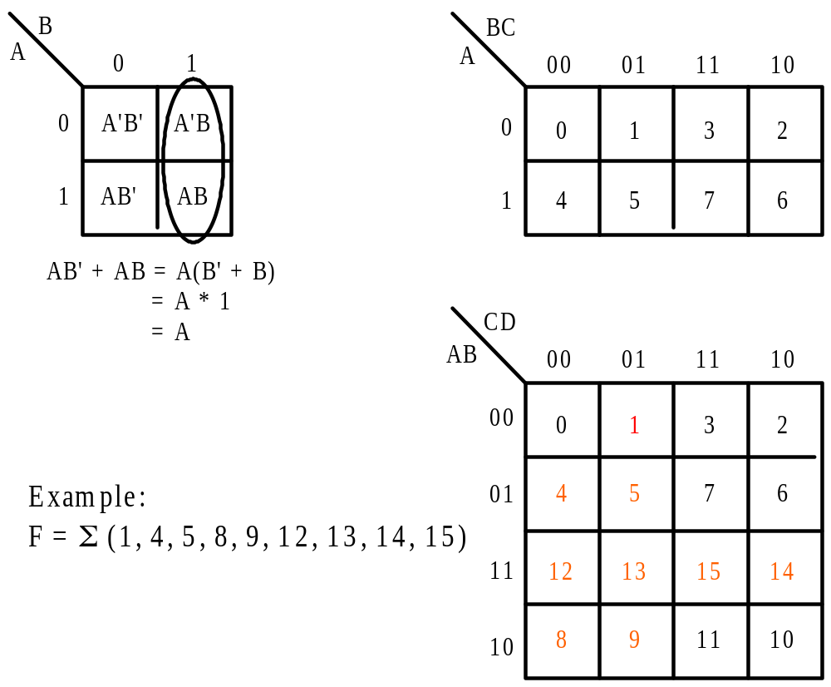
K-Maps

Slide 34
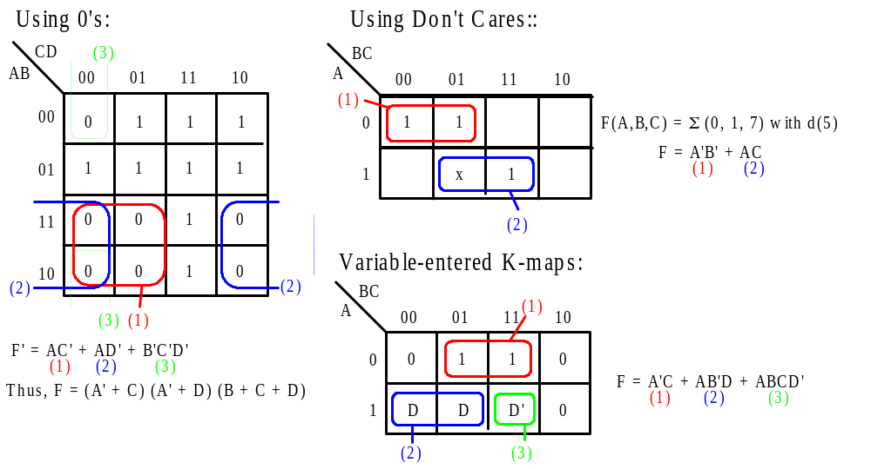

Slide 35
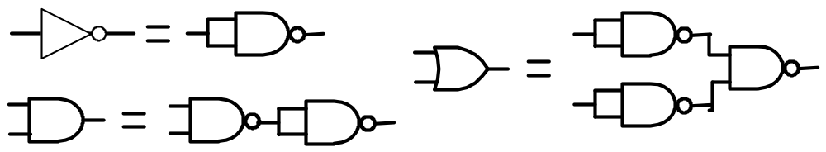
Logic Gate Implementations
Functionally Complete Set of Gates
  { + , * , ‘ }
  { + , ‘ }
  { * , ‘ }
Universal Gate
  NAND
  Similarly for NOR

Slide 36
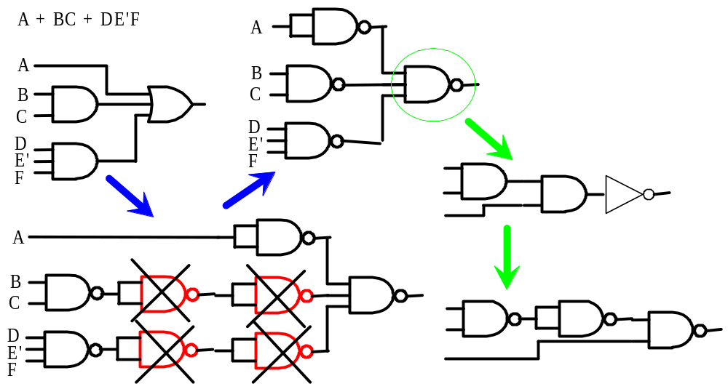
Conversion to NAND-Gate Circuits

Slide 37
Quine-McCluskey (Q-M) Method
Preliminary Concepts
  Minterm Ex: f1(w,x,y,z) = S (0, 1, 8, 9)
  Literal = w’x’y’z’ + w’x’y’z + …
  Implicant = w’x’y’ + wx’y’
  Prime Implicant (PI): A PI p of F is an implicant of F such that the deletion of any literal from p results in a product term which is NOT an implicant of F.
    A “largest possible” implicant is a PI
  An essential PI (EPI) of F is a PI that contains a minterm not covered by any other PI
  Non-essential PIs (NEPI): {NEPI} = {PI} - {EPI}

Slide 38
Sum-of-Products (SOP) Minimization
  must include all EPI’s and perhaps a few NEPI’s
Q-M Method
  A systematic tabular method for generating the EPI’s and NEPI’s
  Step 1: Find the PI’s
  Step 2: Find the EPI’s
  Step 3: Find the smallest collection of NEPI’s that cover the “remaining” minterms
Examples of Q-M Method
  3 examples given in textbook
  Ex. 3: f = Σ (1, 3, 6, 8, 9, 12, 13, 18, 19, 20, 21, 24, 25, 27, 28, 29)

Slide 39
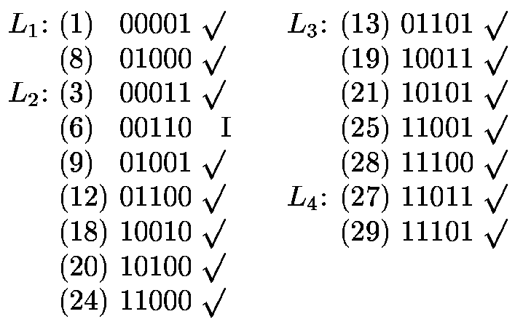
Step 1: Find the PI’s
Partition the minterms into Lists with the same number of 1 bits
vwxyz vwxyz

Slide 40
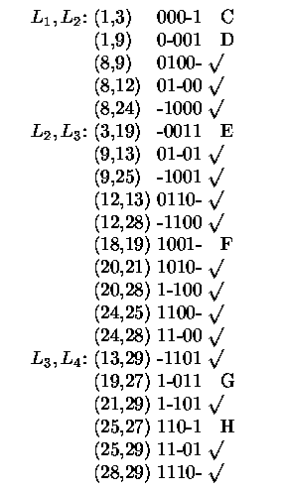
Merge Adjacent Lists

Slide 41
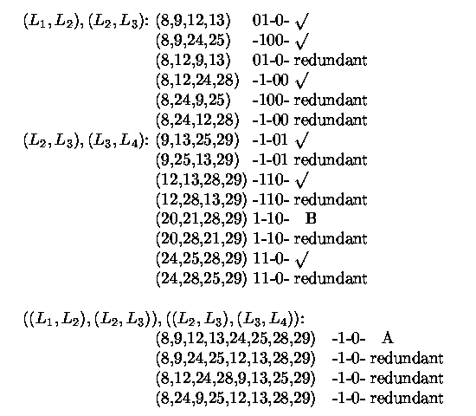

Slide 42
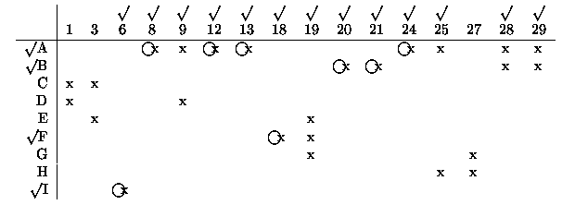
Step 2: Find the PI’s
Form a prime implicant chart

Slide 43
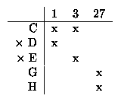
Step 3: Find the necessary NEPI’s
Form a reduced prime implicant chart
  Note: Dominated rows and dominating columns can be removed
Use Petrik’s Method to cover remaining minterms
  Form (C+D)(C+E)(G+H) = CG + CH + CEG + …
    “CG” and “CH” are the only 2-term products
    Either PI’s C and G or PI’s C and H are required => use CG
  Solution: {A,B,F,I,C,G} => f = wy’ + vxy’ + vw’x’z +...

Slide 44
Combinational Logic Design
Logic Gate Implementations
  AND-OR, NAND-NAND, OR-AND, NOR-NOR, …
Other SSI Gates
  XOR, XNOR, buffer, tri-state buffer, wired-AND
MSI Devices
  MUX, DEMUX, Decoder, Encoder, Priority Encoder,
  Adder, Buffer, Comparator,
  Parity Generator, Parity Checker, …

Slide 45
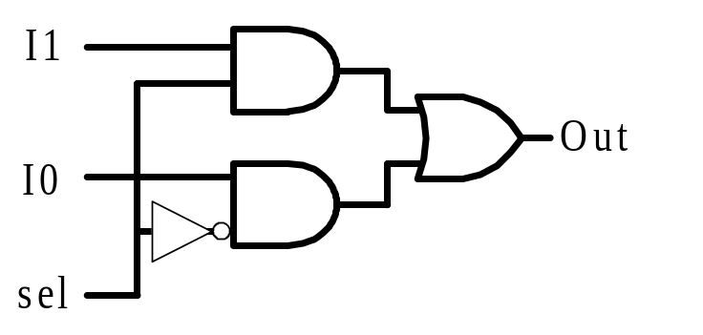
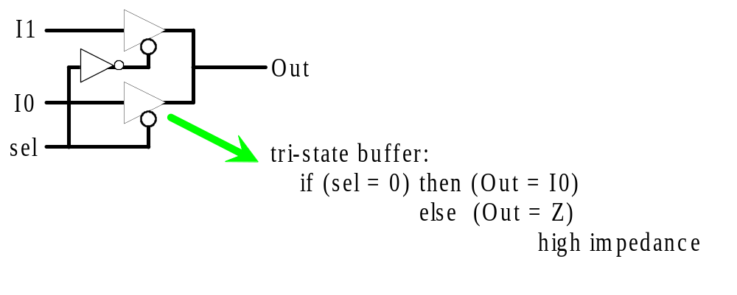
2-1 MUX Gate Implementation
  AND-OR implementation
  Tri-state buffer implementation

Slide 46
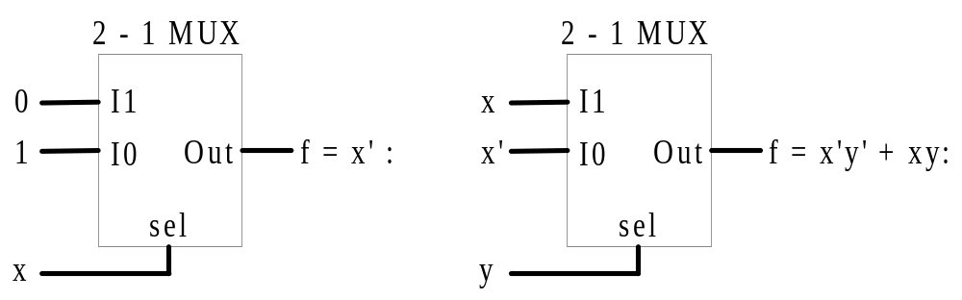
Using a MUX as a Universal Logic Device
  Any function of k variables can be implemented with a 2^{k}-1 (2^{k}-to-1)MUX
  Any function of (k+1) variables can be implemented with a 2^{k}-1 (2^{k}-to-1) MUX
    Use the (k+1)’th variable, in complemented or noncomplemented form, as a possible input
    Similar to a variable-entered K-map

Slide 47
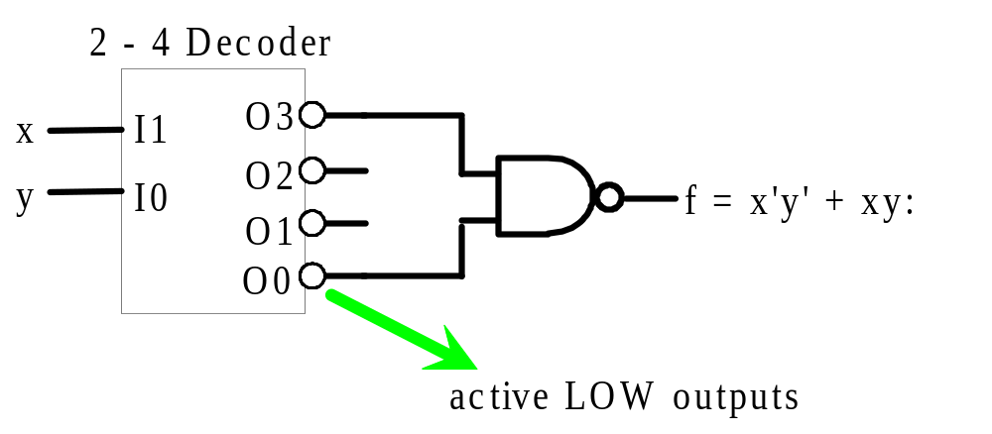
Using a Decoder and NAND Gates
  Any function of k variables can be implemented using a k-2^{k} decoder and NANDs

Slide 48
Addendum: Lab #1 Preparation
Design Cct. for ALU Function Select
  Use only 2-input NAND (74LS00) gates
    Implement from a simplified 2-level SOP expression
  Draw gate-logic diagram
    Verify that it is correct!!!
  Draw connection diagram with 74LS00 chips
    Look up pin numbers from data sheet
      Use the web or the university library (TTL data book)

