Slide 1
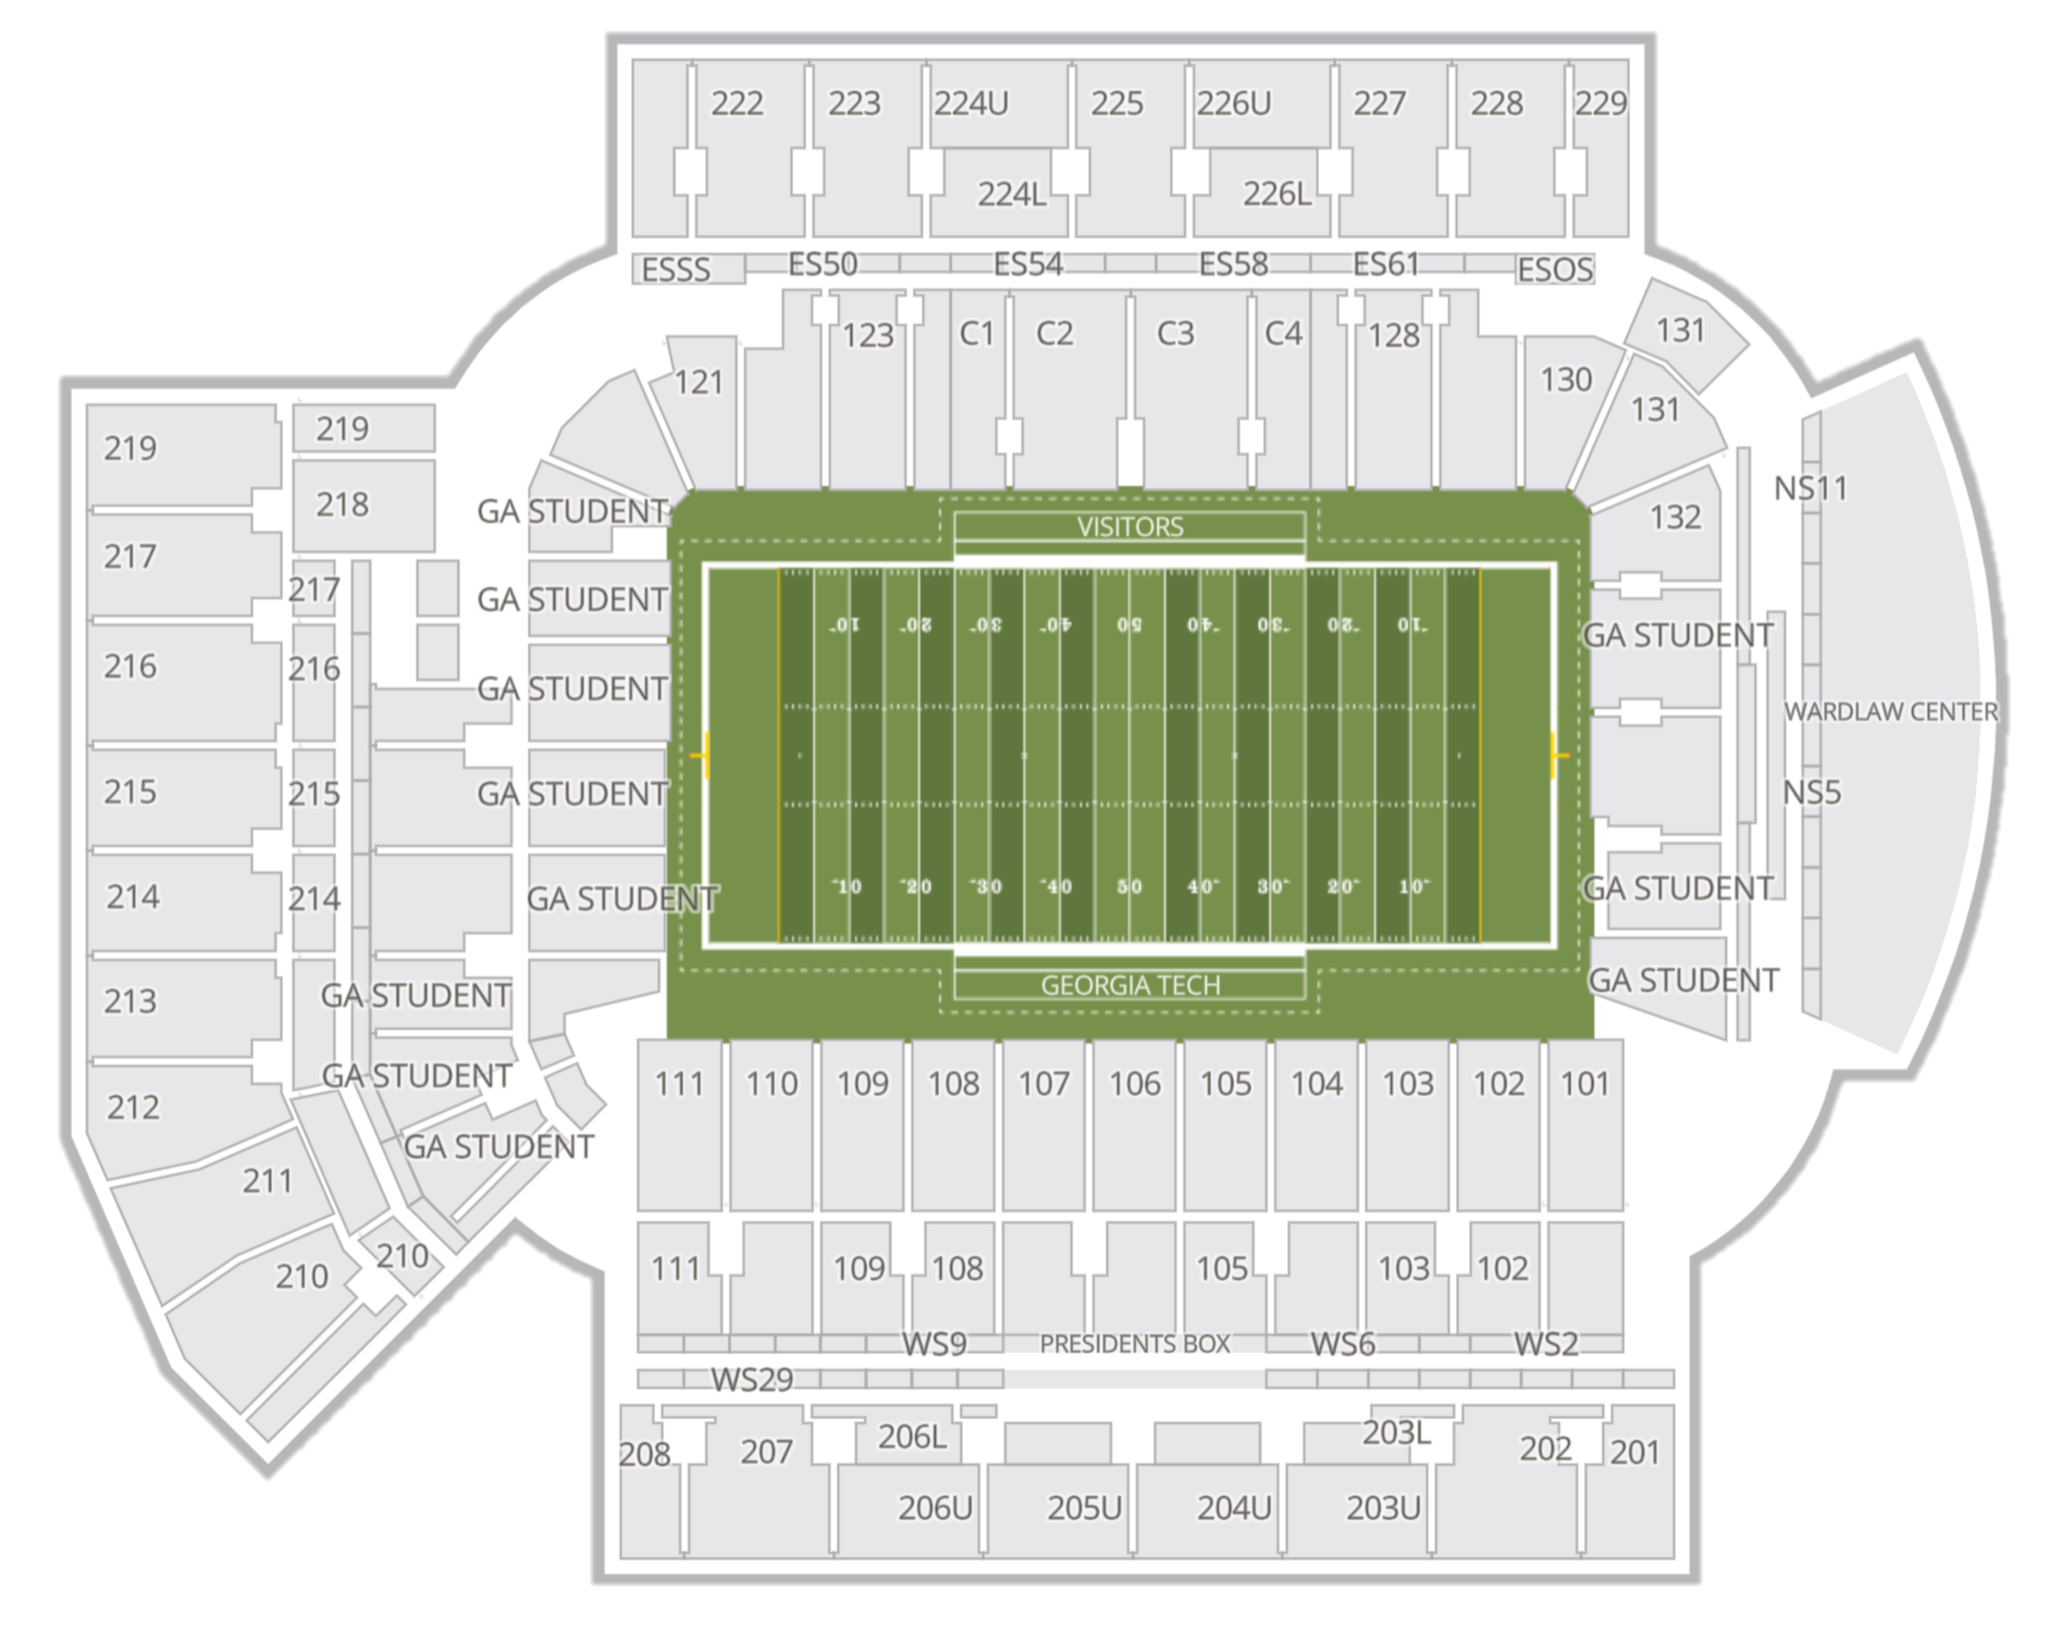
Notes:
Gate 4 to Section 108

Slide 2
Notes:
Gate 8 to Section 223

Slide 3
Notes:
Section 109 to Section 102

Slide 4
Notes:
Section 217 to Section 210

Slide 5
Notes:
Section 217 to Chick fil A

Slide 6
Notes:
Section 109 to Twisted Taco

Slide 7

Section 108
Notes:
Section 108

Slide 8
Section 223
Notes:
Section 223

Slide 9
Chick-fil-A
Notes:
Chick fil A

Slide 10
Twisted Taco
Notes:
Twisted Taco

Slide 11
Notes:
Blank

