Slide 1
Summary: See Pipeline 3
Query processing
Search Phrase
Aho-Corasick Matcher:
turn text into nodes
RedisGraph:
nodes and edges
Redis: List of titles and edges
Flask API
Answer: See Pipeline 2

Slide 2
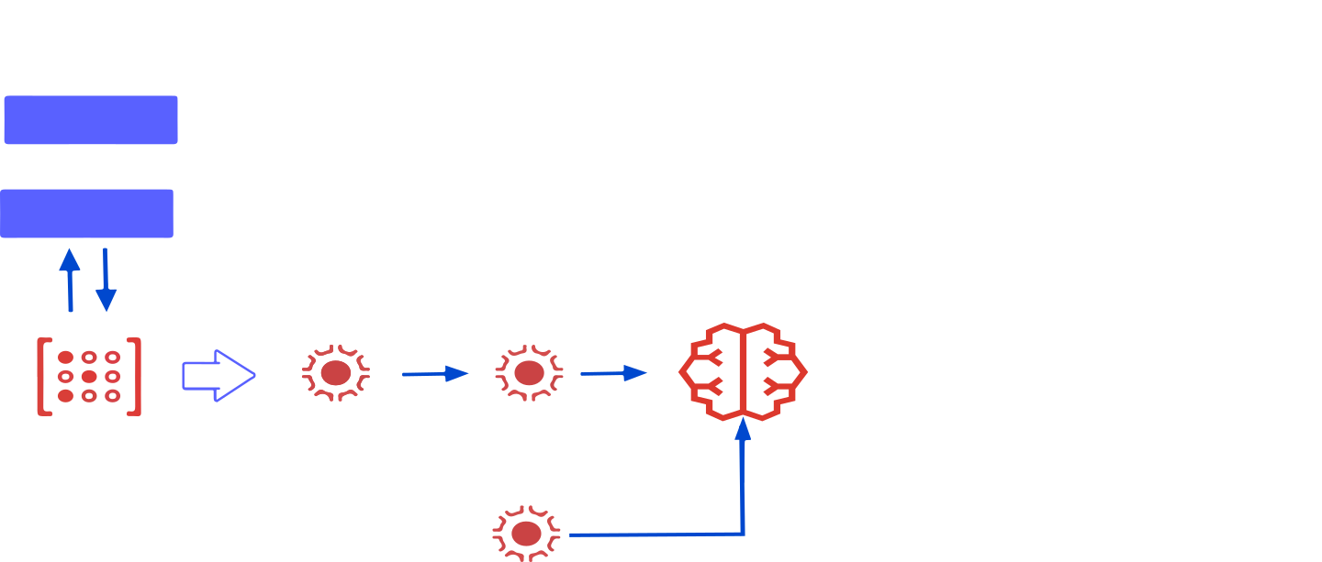
BERT Question/Answering NLP Pipeline with Redis AI
Question
Flask API
Keymiss event
Tokenize and append to potential answers
Run: BERT QA inference
Answer: stored on Redis shard
RedisGears: tokenize potential answers
Notes:
The purpose of keymiss event: if answer is not in cache, we are generating answer and saving it for future use. We are fetching key if key are not there whole NLP pipeline 2 is trigger.

