Slide 1
INTO THE CHATBOTS TREND
MG THAR HTET SAN (3CT-3)

Slide 2
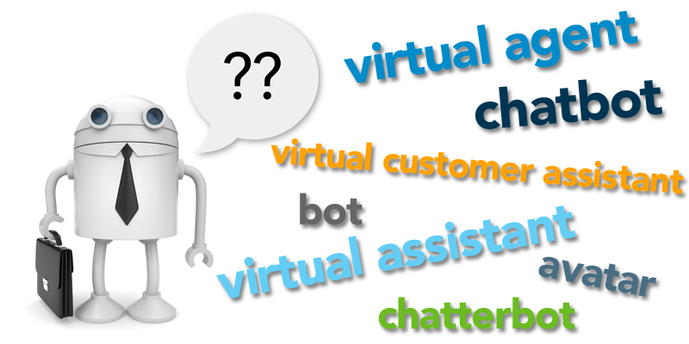
What is chatbot!

Slide 3
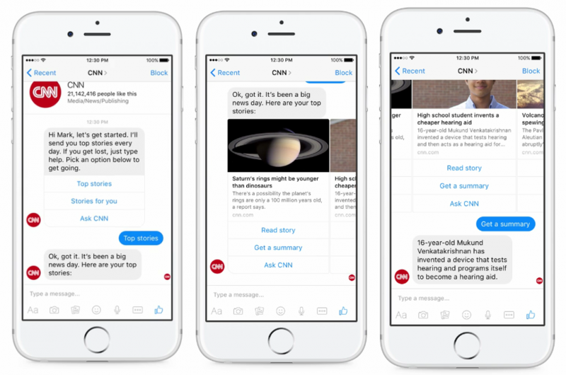
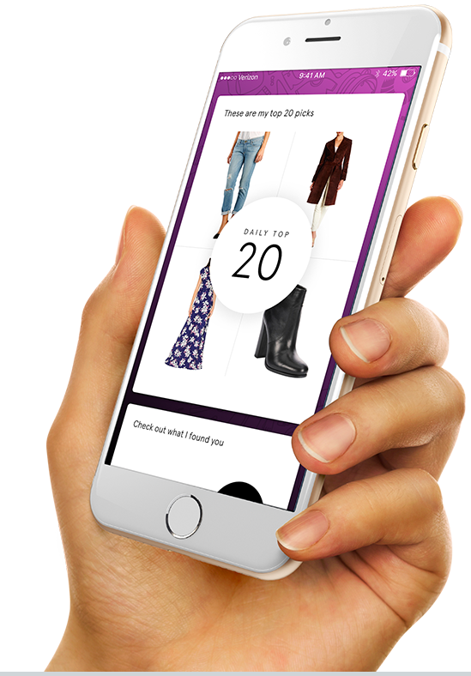
Business Chatbots

Slide 4
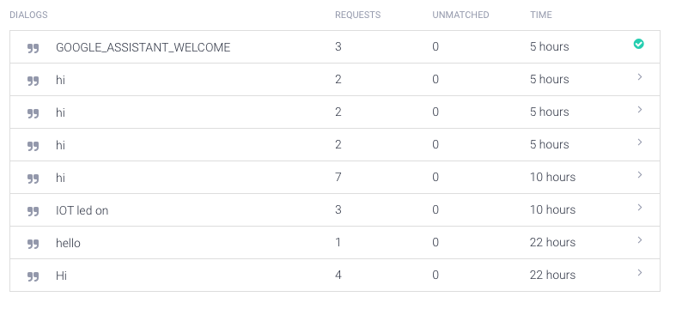
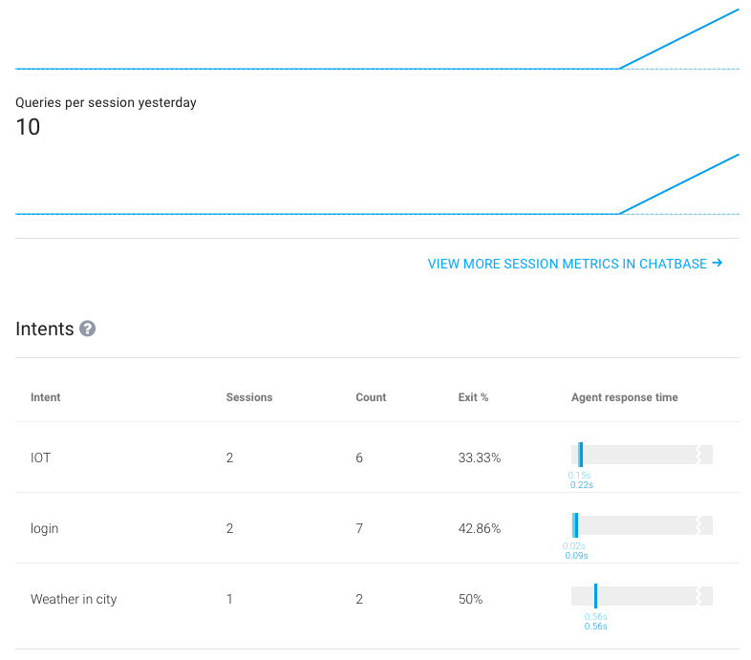
How Business Chatbots work

Slide 5
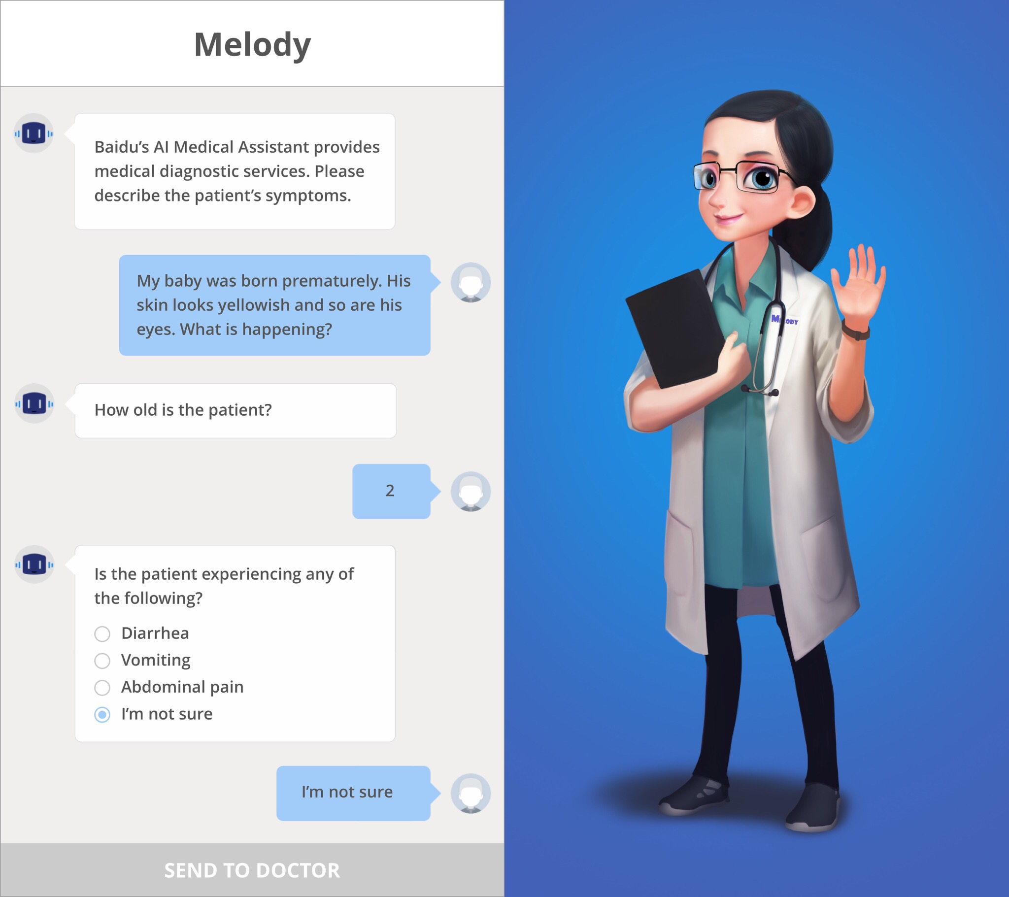
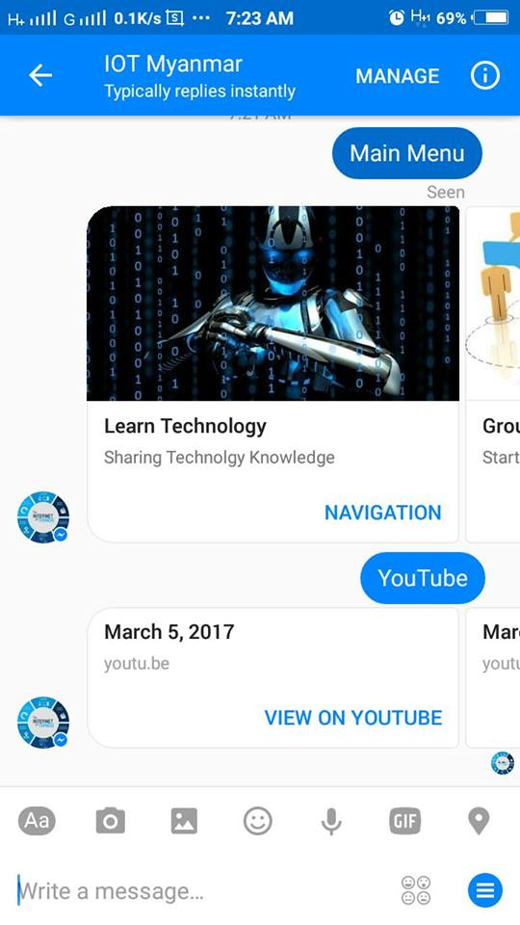
Usage of chatbots

Slide 6
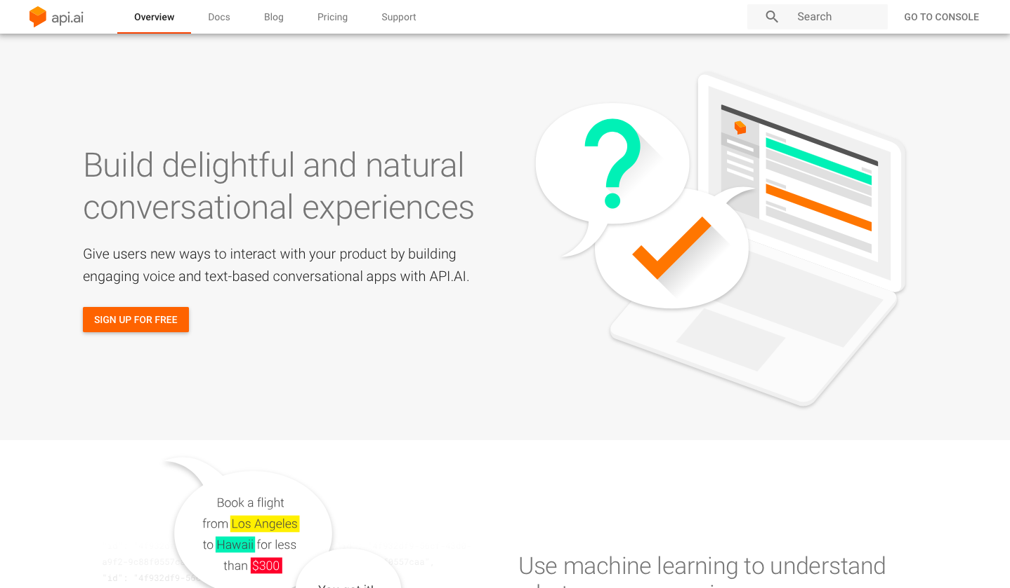
API.AI,best Chatbot servic for Developer.Why?
Machine Learning support.
Data Entry Analytics.
Support of Wehook.
Power of Prebuilt Agents
Developer support
Sing up for free.

Slide 7
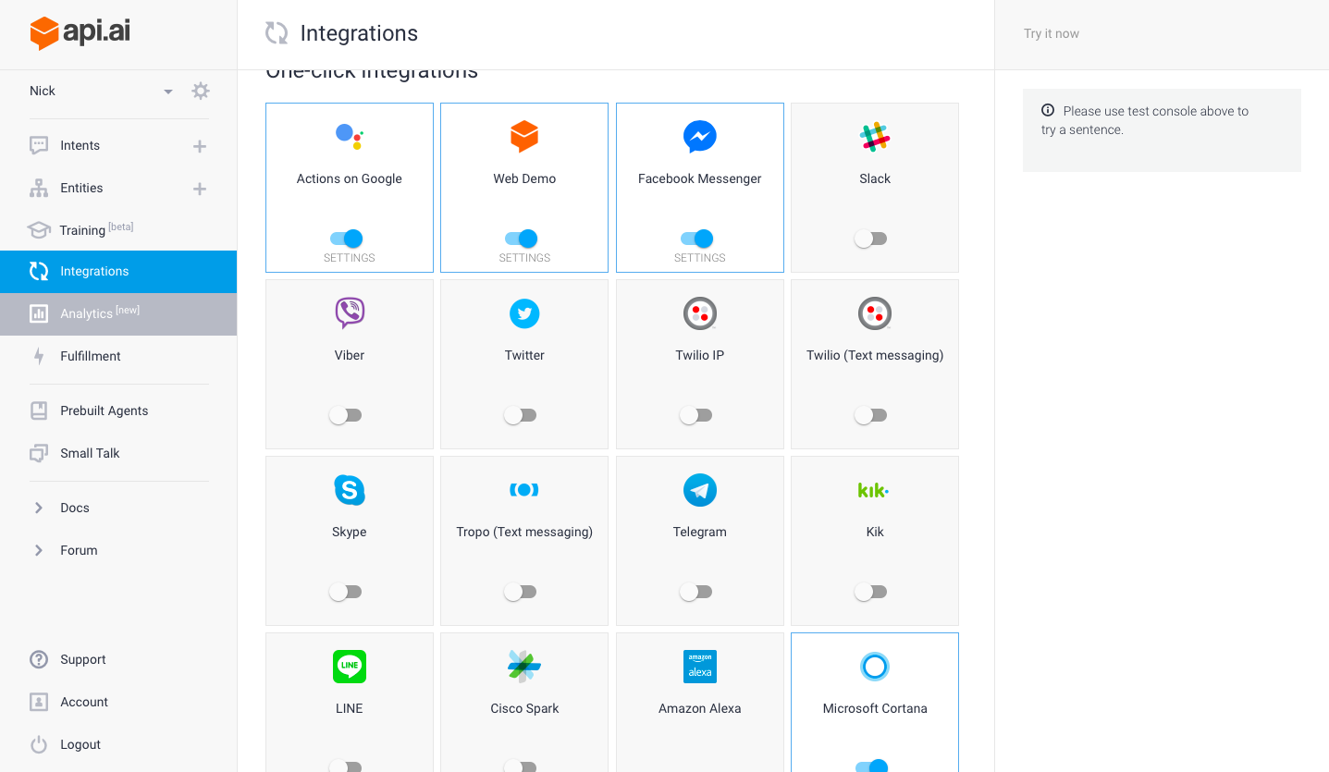
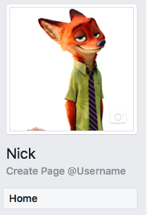
API.AI
USE APA.AI in Nick

Slide 8
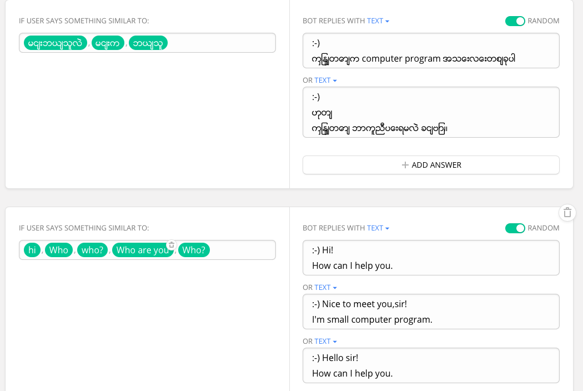
ChatFuel
Even can understand normal person.
Cost effective.
Data Entry Analytics.
Can use fully function with card.
Easy AI setup.
Various chat functions for free.

Slide 9
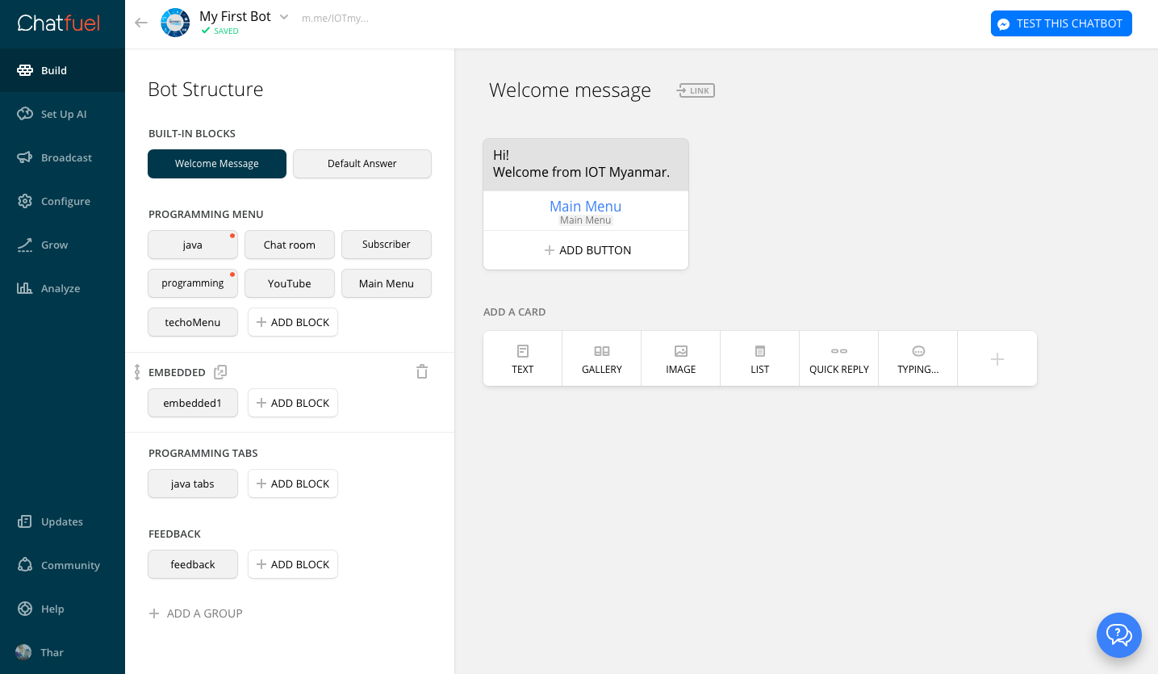
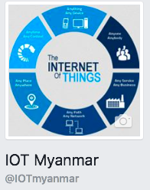
ChatFuel
USE Chatfuel in IOT Myanmar

Slide 10
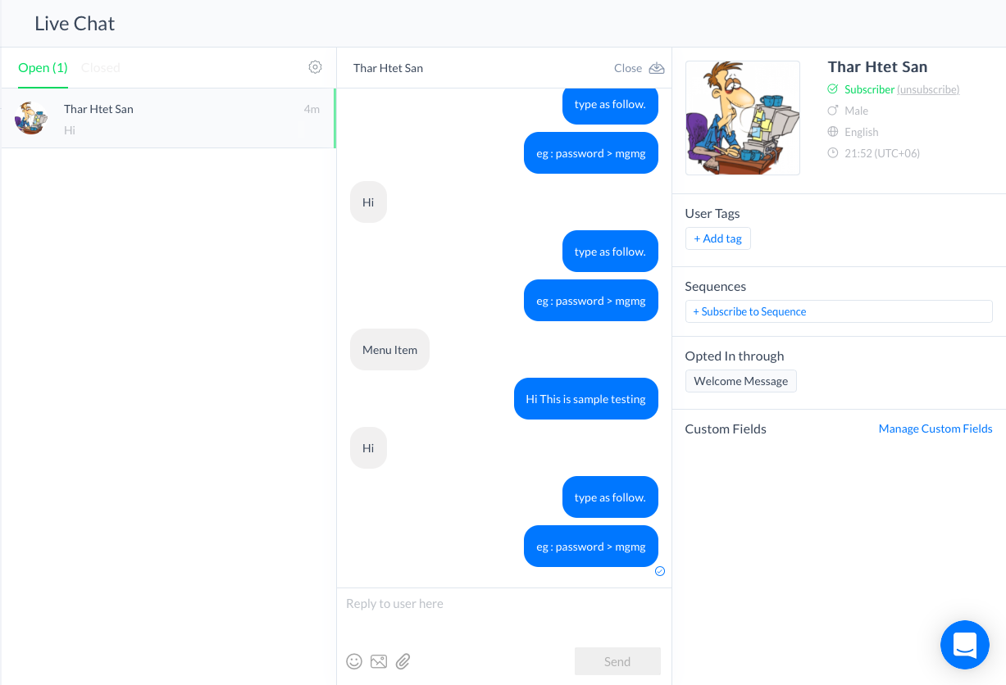
ManyChat
Most popular Business Chatbot Service.
Fully customize design.
Can be license version with only 10$
Fully Analytics with license version.
Easy to create contents

Slide 11
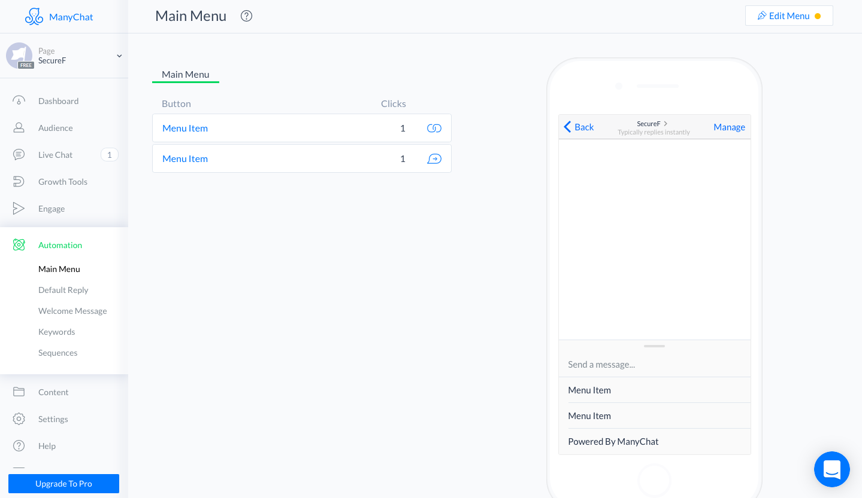
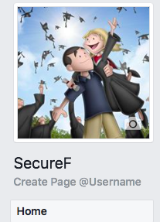
ManyChat
USE ManyChat in SecureF

Slide 12
Other popular Chatbot services
Duolingo
GymBot
Dinner Ideas
Luka
Cleverbot
ChatterBot
Prisma
Hipmunk
Mona
Doorbell
REF : https://masterofcode.com

Slide 13
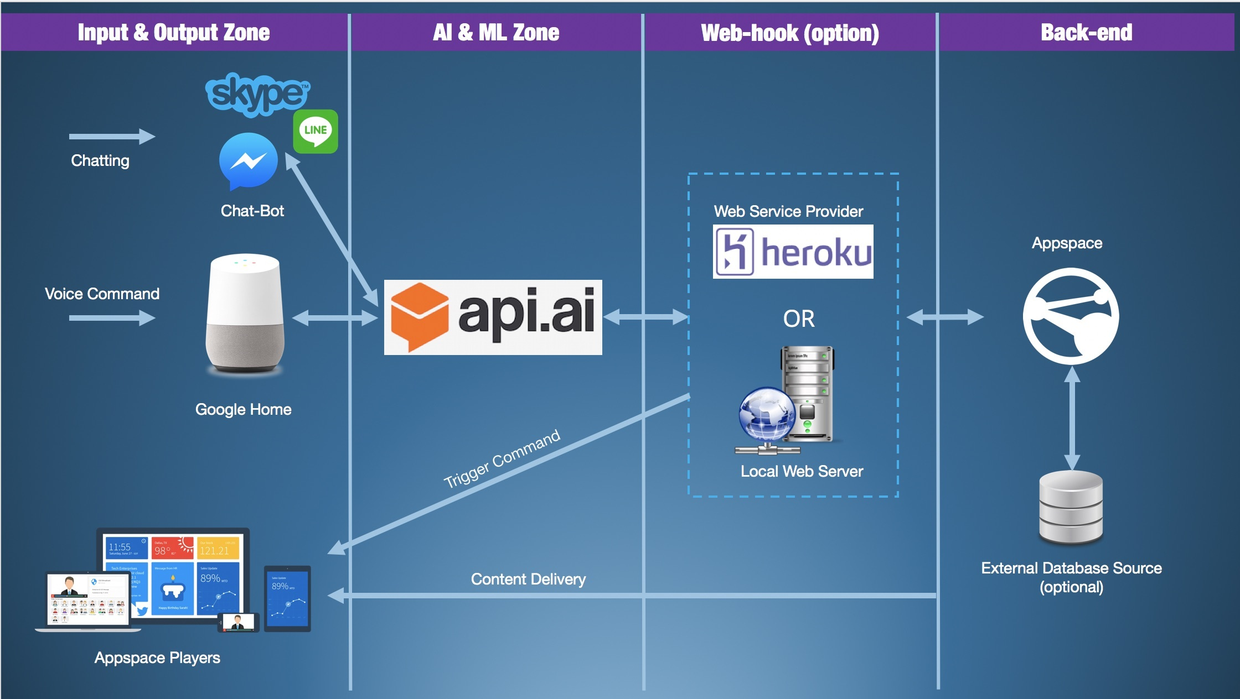
Most Popular API.AI Architecture

Slide 14
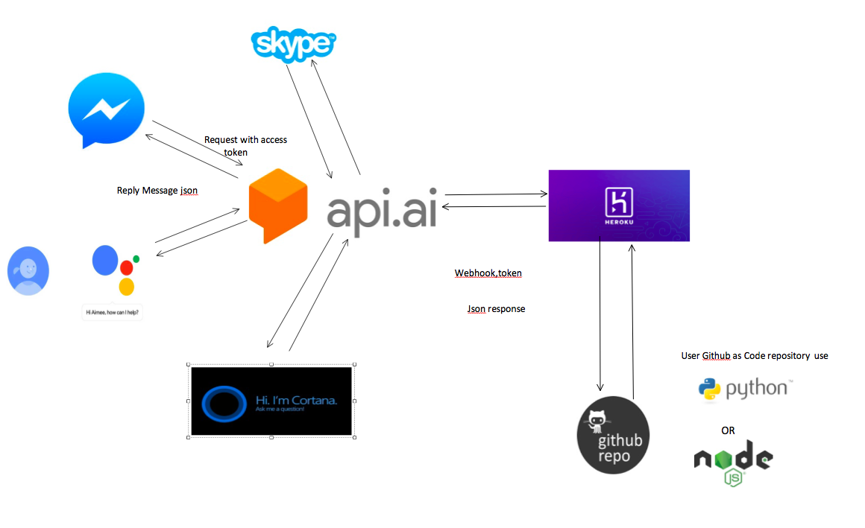
API.AI (Nick) Architecture

Slide 15
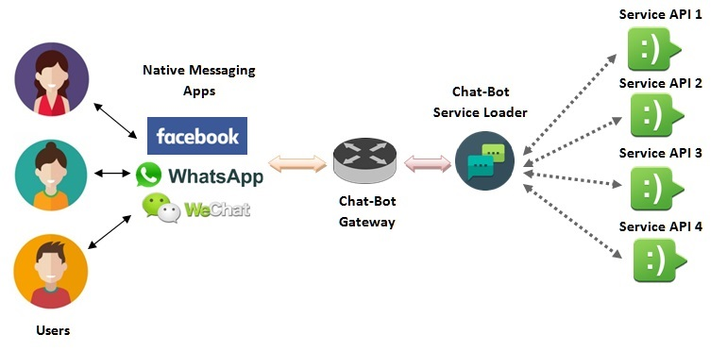
Chat bot service Provider

Slide 16
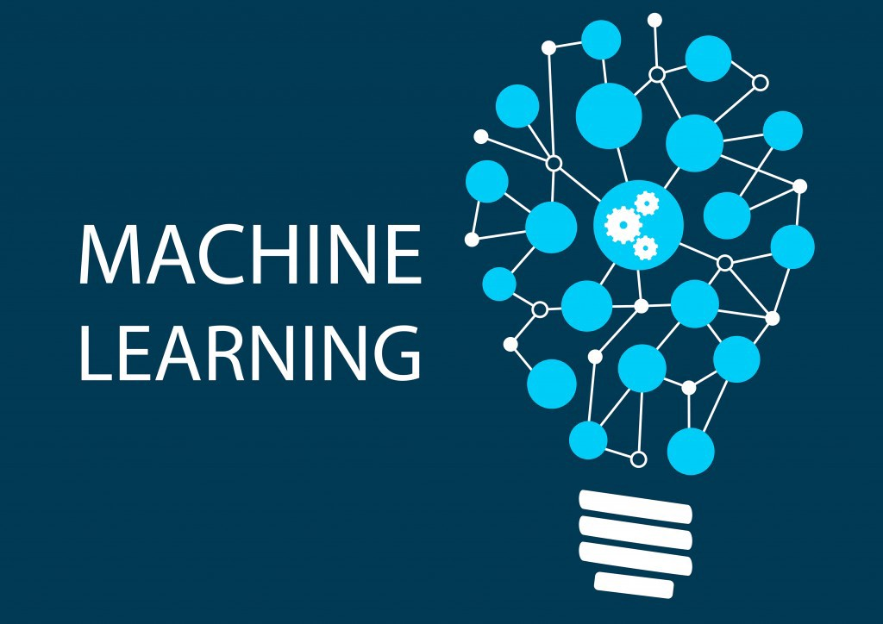
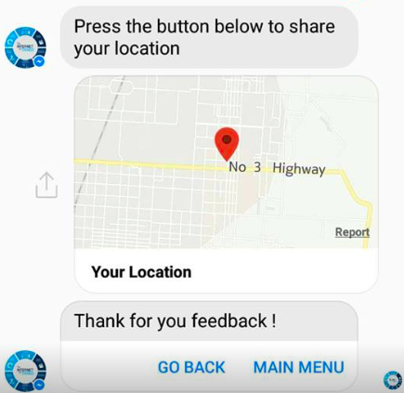
Machine learning in Chatbots
Machine learning is a type of artificial intelligence (AI) that allows software applications to become more accurate in predicting outcomes without being explicitly programmed.
machine learning are similar to that of data mining and predictive modeling.
Eg: Image Recognition
Location Detection
Prediction user mean
Speech Recognition

