Slide 1
Relational Model 2 12 November 2012 Lecture 5

Slide 2
Topics for Today
Enforcing Integrity Constraints
Transactions and Constraints
Querying Relational Data
Introduction to Views
Updates on Views
Destroying/Altering Tables and Views
Source: Ramakrishnan and Gehrke Chapter 3

Slide 3
Foreign Key in SQL
Students (sid:string, name:string, login:string, age:integer, gpa:real)
Enrolled (sid:string, cid:string, grade:integer)
Courses (cid:string, cname:string, credits:integer)
CREATE TABLE Enrolled (sid CHAR(20),
cid CHAR(20),
grade INT,
PRIMARY KEY (sid, cid),
FOREIGN KEY (sid) REFERENCES Students,
FOREIGN KEY (cid) REFERENCES Courses)
Does this allow students to received more than one grade for a given course id?
What would it take to allow that?

Slide 4
General Constraints
SQL allows for a variety of other constraints
Custom domains:
NOT NULL is a simple one
We can also write more generic ones
Table Constraints: restrict values in a relation
Assertions: Free form query checks
More about these in advanced SQL
Not all are supported by DB vendors

Slide 5
Enforcing Integrity Constraints
When adding or updating a row, DBMS must check:
UNIQUE constraints
Primary Key constraints
NOT NULL constraints
When deleting a row, we don’t need to check UNIQUE or Primary Keys
What about Foreign Key constraints?

Slide 6
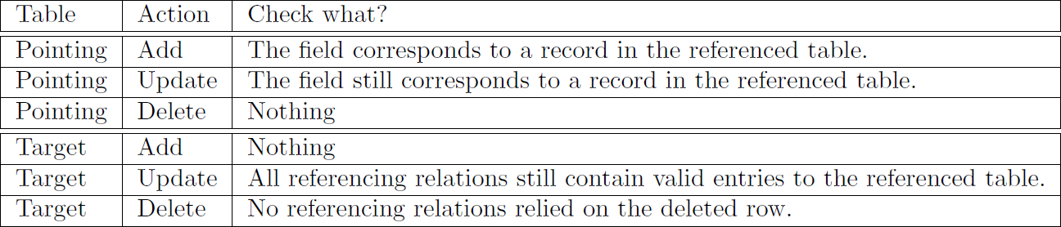
Foreign Key Checks
Students
Enrolled
sid | name | login | age | gpa
101 | Joe | joe@cs | 30 | 98
… | … | … | … | …
sid | cid | grade
101 | 20 | 89
… | … | …

Slide 7
What happens
In the pointing relation:
On Add/Update: If the new value is not in the target relation, the action is blocked
In the target relation, the user can decide:
NO ACTION (the default condition)
CASCADE
SET DEFAULT
SET NULL
One choice for Delete, one choice for Update
Let’s see some examples…

Slide 8
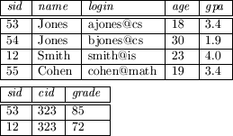
Foreign Key Example
DELETE FROM Students WHERE sid = 53
UPDATE Students SET sid = 13 WHERE sid = 12

Slide 9
ON Delete No Action
DELETE FROM Students WHERE sid = 53
Before
After
CREATE TABLE Enrolled (sid CHAR(20),
cid CHAR(20),
grade INT,
PRIMARY KEY (sid, cid),
FOREIGN KEY (sid) REFERENCES Students ON DELETE NO ACTION,
FOREIGN KEY (cid) REFERENCES Courses)

Slide 10
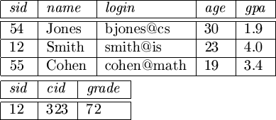
ON Delete Cascade
DELETE FROM Students WHERE sid = 53
Before
After
CREATE TABLE Enrolled (sid CHAR(20),
cid CHAR(20),
grade INT,
PRIMARY KEY (sid, cid),
FOREIGN KEY (sid) REFERENCES Students ON DELETE CASCADE,
FOREIGN KEY (cid) REFERENCES Courses)

Slide 11
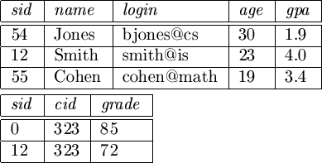
ON Delete Set Default
DELETE FROM Students WHERE sid = 53
Before
After
CREATE TABLE Enrolled (sid CHAR(20) DEFAULT ‘0’,
cid CHAR(20),
grade INT,
PRIMARY KEY (sid, cid),
FOREIGN KEY (sid) REFERENCES Students ON DELETE SET DEFAULT,
FOREIGN KEY (cid) REFERENCES Courses)

Slide 12
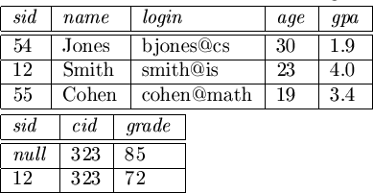
ON Delete Set Null
DELETE FROM Students WHERE sid = 53
Before
After
CREATE TABLE Enrolled (sid CHAR(20),
cid CHAR(20),
grade INT,
PRIMARY KEY (sid, cid),
FOREIGN KEY (sid) REFERENCES Students ON DELETE SET NULL,
FOREIGN KEY (cid) REFERENCES Courses)

Slide 13
ON Update No Action
UPDATE Students SET sid = 13 WHERE sid = 12
Before
After
CREATE TABLE Enrolled (sid CHAR(20),
cid CHAR(20),
grade INT,
PRIMARY KEY (sid, cid),
FOREIGN KEY (sid) REFERENCES Students ON UPDATE NO ACTION,
FOREIGN KEY (cid) REFERENCES Courses)

Slide 14

ON Update Cascade
UPDATE Students SET sid = 13 WHERE sid = 12
Before
After
CREATE TABLE Enrolled (sid CHAR(20),
cid CHAR(20),
grade INT,
PRIMARY KEY (sid, cid),
FOREIGN KEY (sid) REFERENCES Students ON UPDATE CASCADE,
FOREIGN KEY (cid) REFERENCES Courses)

Slide 15
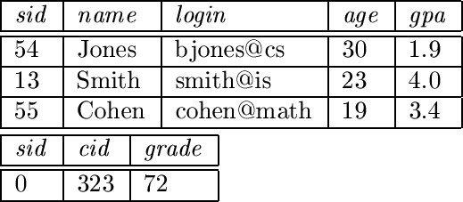
ON Update Set Default
UPDATE Students SET sid = 13 WHERE sid = 12
Before
After
CREATE TABLE Enrolled (sid CHAR(20) DEFAULT ‘0’,
cid CHAR(20),
grade INT,
PRIMARY KEY (sid, cid),
FOREIGN KEY (sid) REFERENCES Students ON UPDATE SET DEFAULT,
FOREIGN KEY (cid) REFERENCES Courses)

Slide 16
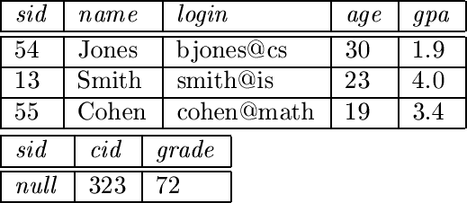
ON Update Set Null
UPDATE Students SET sid = 13 WHERE sid = 12
Before
After
CREATE TABLE Enrolled (sid CHAR(20),
cid CHAR(20),
grade INT,
PRIMARY KEY (sid, cid),
FOREIGN KEY (sid) REFERENCES Students ON UPDATE SET NULL,
FOREIGN KEY (cid) REFERENCES Courses)

Slide 17
Transactions and Constraints
By default, constraints are checked at the end of each SQL statement
Sometimes that is not the best time to check constraints
Complex conditions
Deleting, then adding rows in a complex network of foreign keys
We can instruct the DBMS to wait to check the constraints until the the end of the transaction instead
If the constraint is called “CstNames” we write:
SET CONSTRAINT CstNames DEFERRED
[Valid only for Oracle DB]

Slide 18
So Far
Enforcing Integrity Constraints
Transactions and Constraints
Querying Relational Data
Introduction to Views
Updates on Views
Destroying/Altering Tables and Views

Slide 19
Queries and SQL
We saw some implicit queries before, now let’s talk a bit more about them
We’ll see SQL in more depth next lecture
SQL is the most popular relational query language
There are others
There are also many varieties of SQL (dialects) per vendor: PL/SQL, Transact-SQL, etc.
The standard for all of what we’ll see this semester is SQL-92
SQL is a (4th generation) programming language
We describe what data we want to see and the DBMS goes out and fetches it
Learning to express what you want is the hardest part
It’s easy to write very computationally intensive queries

Slide 20
Example Queries
Show the students who are older than 18
SELECT * FROM Students S WHERE S.age > 18
* means to show all of the columns in the relation
S is an alias for Students (we could have chosen anything)
SELECT T.name, T.age FROM Students T WHERE T.age > 18
This shows only two columns – name and age
T is an alias now (note that it works backwards)
SELECT S.name FROM Students S WHERE S.age > 18
This shows just name (we don’t need to use the filtering condition column)

Slide 21
Example Queries
Show the students who are over 18 and have a GPA less than 80
SELECT * FROM Students S WHERE S.age > 18 AND S.gpa < 80
Two conditions – only rows which fulfill both of the conditions are included
For each student who received a 90 in a course, print the student’s name and course number
SELECT S.name, E.cid FROM Students S, Enrolled E WHERE S.sid = E.sid AND E.grade = 90
This combines data from two relations
Called a JOIN on Students and Enrolled (Inner Join)
Computes all pairs of rows between Students and Enrolled
Filters the pairs based on the WHERE condition
One of the most common uses of foreign keys

Slide 22
So Far
Enforcing Integrity Constraints
Transactions and Constraints
Querying Relational Data
Introduction to Views
Updates on Views
Destroying/Altering Tables and Views

Slide 23
Introduction to Views
A view is a virtual relation built from other relations (or views)
To the user, a view behaves exactly like a normal relation
Under the hood, it is recalculated each time it is accessed
To define a view of all students whose have an 80 in a course: CREATE VIEW B-Students (name, sid, course)
AS SELECT S.name, S.sid, E.cid
FROM Students S, Enrolled E
WHERE S.sid = E.sid AND E.grade = 80

Slide 24
Why use views?
Provide Logical Data Independence
We can rewrite the view’s logic and not change the reading applications
We can modify or update the queried relations without affecting the view’s interface
Example: We update the relations, breaking grades out of Enrolled and putting them in separate relation:
Students (sid, name, age, gpa)
Enrolled(sid, cid)
Grades(sid, cid, semester, grade)
We can then rewrite the view:
CREATE VIEW B-Students (name, sid, course)
AS SELECT S.name, S.sid, G.cid
FROM Students S, Grades G
WHERE S.sid = G.sid AND G.grade = 80

Slide 25
Why use views?
Provides information hiding and security
Can produce derivative relations which hide sensitive data
Example: Produce a list of students enrolled in a particular class, but don’t show their GPA
CREATE VIEW DB-Enrolled (name, sid, age) AS SELECT S.name, S.sid, S.age FROM Students S, Enrolled E WHERE S.sid = E.sid AND E.cid = ‘102322’

Slide 26
Updating Views
What about updating views?
In a word – don’t
But if you must…
SQL-92 allows view updates if: They are derived from a single relation and have no aggregation
Aggregation – averaging columns, counting rows, etc. (next time)
If you meet the condition:
If one update (or delete) one which row represents multiple rows in the source view, all source rows are updated (or deleted)
If you add a new row – missing columns are put in null
If that’s illegal, you can’t add a row

Slide 27
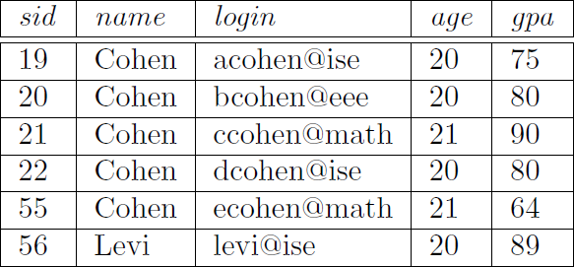
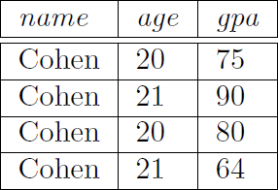

One row is many
Students:
Cohens:
CREATE VIEW Cohens(name, age, gpa) AS
SELECT DISTINCT S.name, S.age, S.gpa
FROM Students S
WHERE S.name = ’Cohen’
Removes duplicate rows

Slide 28
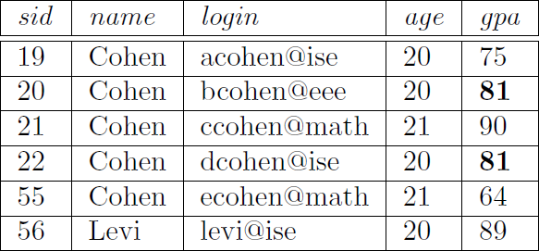
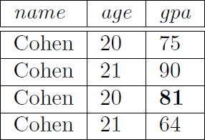
One row is many
UPDATE Cohens SET gpa = 81 WHERE age = 20 and gpa = 80
Before:
After:

Slide 29
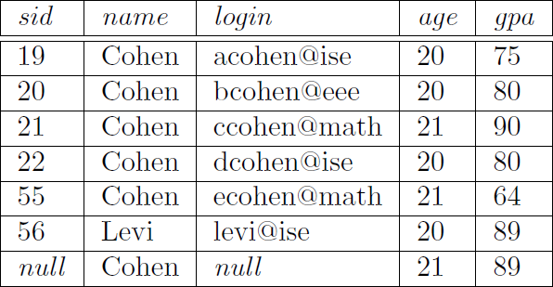
Adding a row
INSERT INTO Cohens (name, age, gpa) VALUES (‘Cohen’, 21, 89)
Before:
After:

Slide 30
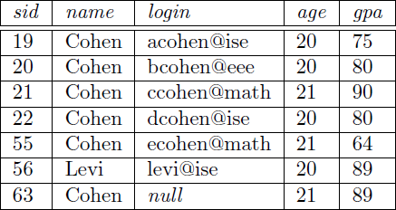
Adding a row
CREATE VIEW Cohens2 (id, name, age, gpa)
AS SELECT S.sid, S.name, S.age, S.gpa
FROM Students S
WHERE S.name = ’Cohen’
INSERT INTO Cohens2 (id, name, age, gpa) VALUES (63, ’Cohen’, 21, 89)

Slide 31
Invisible Updates
You can add a row to view which is invisible
INSERT INTO Cohens2 (id, name, age, gpa) VALUES (65, ’Levi’, 30, 88)
The new row is inserted into Students, but is invisible in Cohens2
You can prevent this using the WITH CHECK OPTION command at the end of the CREATE VIEW command
What if a view is built on another view and one has the WITH CHECK OPTION and the other doesn’t?
We won’t talk more about this – just be careful

Slide 32
So Far
Enforcing Integrity Constraints
Transactions and Constraints
Querying Relational Data
Introduction to Views
Updates on Views
Destroying/Altering Tables and Views

Slide 33
Destroying Tables and Views
To delete a table:
DROP TABLE Students
To delete a view:
DROP VIEW Cohens
What about ICs?
DROP TABLE Students RESTRICT (only drops if it won’t affect others) (Default)
DROP TABLE Students CASCADE (drops all other dependent tables)
Not supported in MS SQL
Same for views
To just delete all rows and leave the schema – use TRUNCATE or DELETE FROM Students

Slide 34
Altering Tables and Views
To alter a table – use ALTER TABLE
To add a column(s):
ALTER TABLE Students ADD maidenName CHAR(10)
ALTER TABLE Students ADD birthYear int, birthMonth int
To delete a column:
ALTER TABLE Students DROP COLUMN maidenName
To modify a column:
ALTER TABLE Students ALTER COLUMN birthMonth varchar(10)
To add a foreign key:
ALTER TABLE Courses ADD sid CHAR(20);
ALTER TABLE Courses ADD FOREIGN KEY (sid) REFERENCES Students
To modify a view – ALTER VIEW

Slide 35
Conclusion
Enforcing Integrity Constraints
Transactions and Constraints
Querying Relational Data
Introduction to Views
Updates on Views
Destroying/Altering Tables and Views

