Slide 1
Numerical Modelling of Photon Recycling in Solar Cells and its Simulation
Presenter: Refik Mert Cam

Slide 2
Outline
What is photon recycling?
How does photon recycling increase solar cell efficiency?
General formulization of photon recycling
Algorithm to simulate photon recycling
Simulation results

Slide 3
What is photon recycling?
Re-absorption of a photon emitted by the radiative recombination [1]
Figure 1. Physical illustration of photon
recycling process [2]
[1] Kayes and et al. 27.6% Conversion efficiency, a new record for single-junction solar cells under 1 sun illumination. 2011.
[2] Yablonovitch, Miller and et al. The opto-electronic physics that broke the efficiency limit in solar cells. 2012.

Slide 4
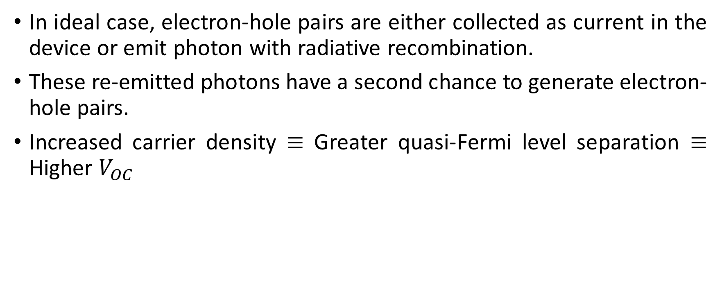
How does PR increase solar cell efficiency?
In ideal case, electron-hole pairs are either collected as current in the device or emit photon with radiative recombination.
These re-emitted photons have a second chance to generate electron-hole pairs.
Increased carrier density $≡$ Greater quasi-Fermi level separation $≡$ Higher $V_{OC}$

Slide 5
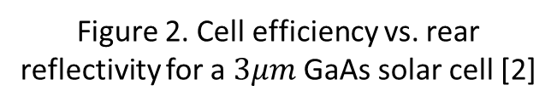
How does PR increase solar cell efficiency?
Having a good rear reflector improves PR and therefore efficiency of the solar cell.
Figure 2. Cell efficiency vs. rear reflectivity for a $3μm$ GaAs solar cell [2]
[2] Yablonovitch, Miller and et al. The opto-electronic physics that broke the efficiency limit in solar cells. 2012.

Slide 6
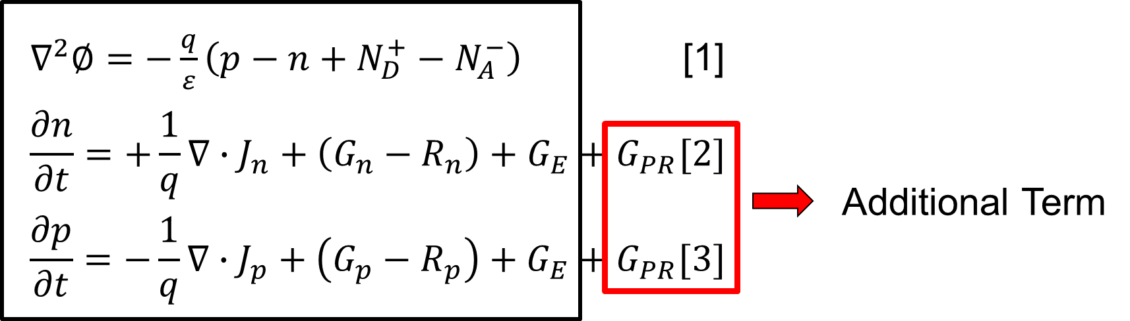
General Formulation of Photon Recycling
An additional term corresponding to generation rate due to PR has been added to the standard set of equations used in simulation programs.

Slide 7
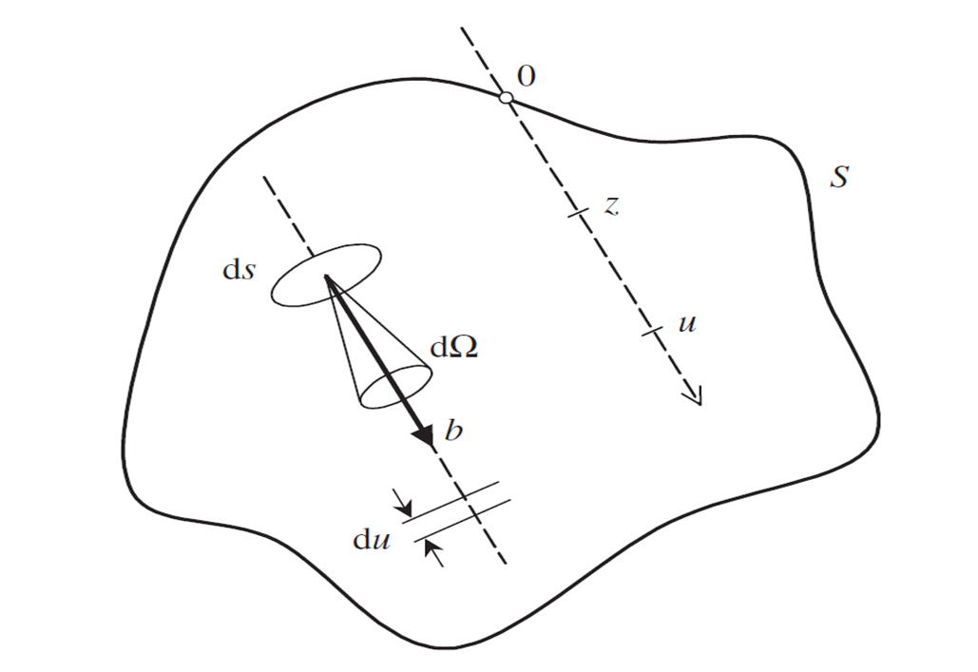
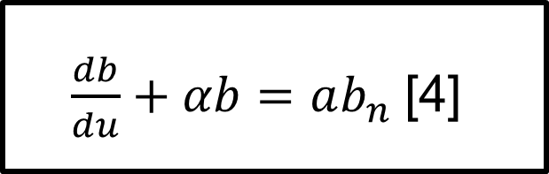
General Formulation of Photon Recycling
So as to formulate the generation term due to PR, we introduce a new equation, which is photon continuity equation.
Figure 3. Parameters involved in photon
continuity equation [3]
[3] Balenzategui and Marti. Detailed modelling of photon recycling: application to GaAs solar cells. 2006.

Slide 8
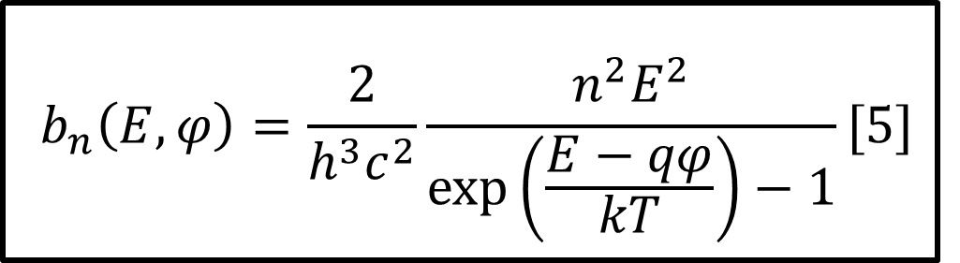

General Formulation of Photon Recycling
$b_{n}$ is formulated with generalized Roosbroeck and Shockley equation.[4]
[4] H.B. Bebb, E.W. Williams, Semicond. Semimet. 2 (1972) 181–320.

Slide 9
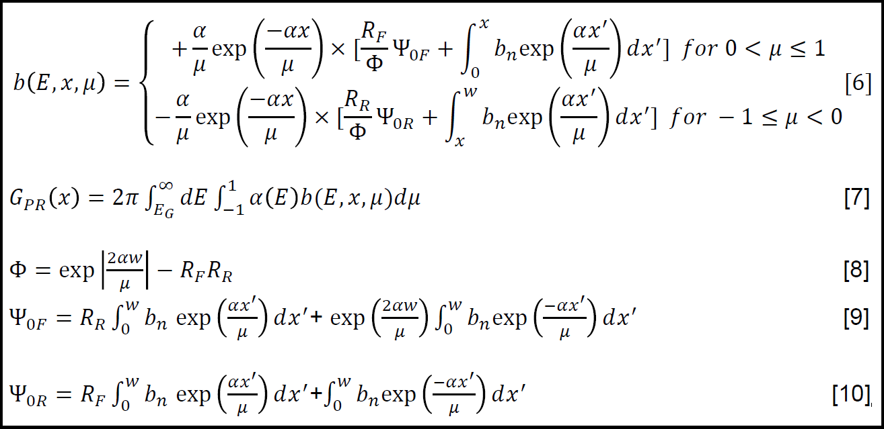
General Formulation of Photon Recycling

Slide 10
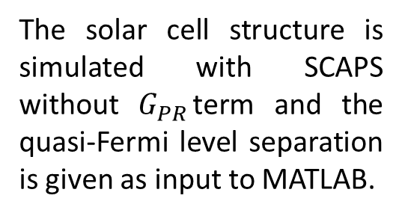
Algorithm to simulate photon recycling
The solar cell structure is simulated with SCAPS without $G_{PR}$term and the quasi-Fermi level separation is given as input to MATLAB.
MATLAB code generates an initial photon recycling generation rate profile and gives the profile to SCAPS.
This quasi-Fermi level separation and generation profile exchange continues until the quasi-Fermi level separation converges to some point.
SCAPS simulates the structure with additional photon recycling generation profile and new quasi-Fermi level separation is given again to MATLAB.

Slide 11
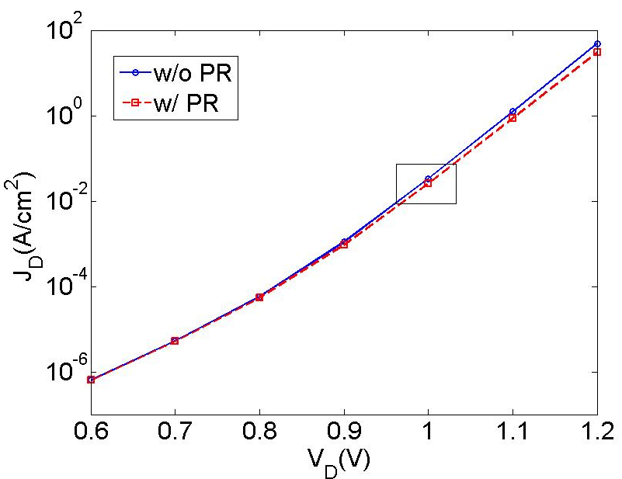
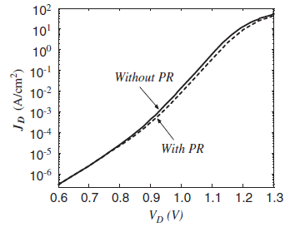
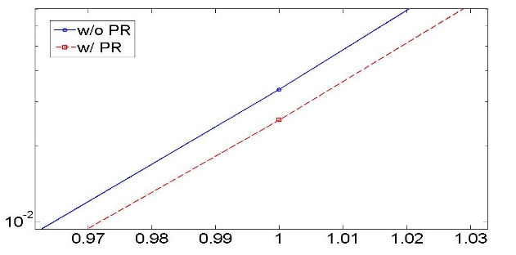
Simulation results
Our simulation results
Balenzategui’s simulation results

