Slide 1




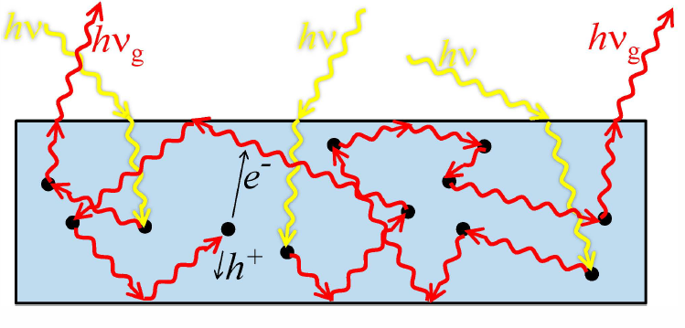
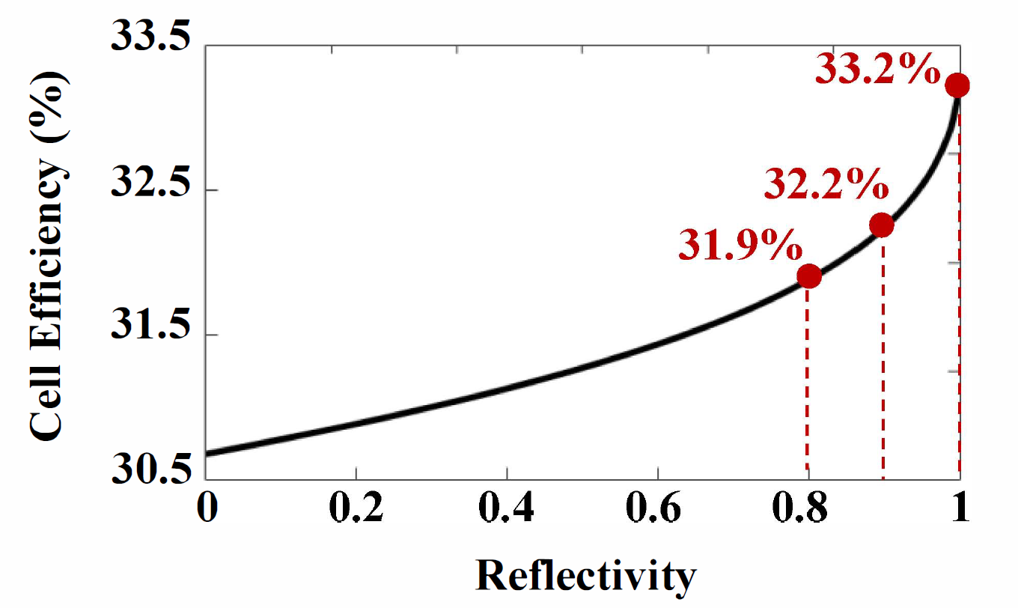
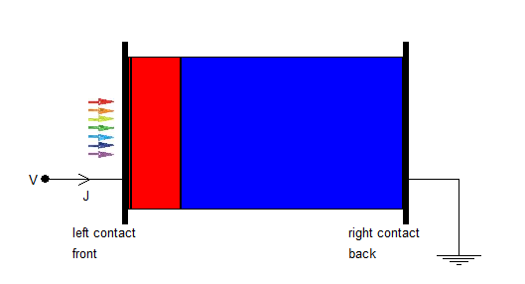
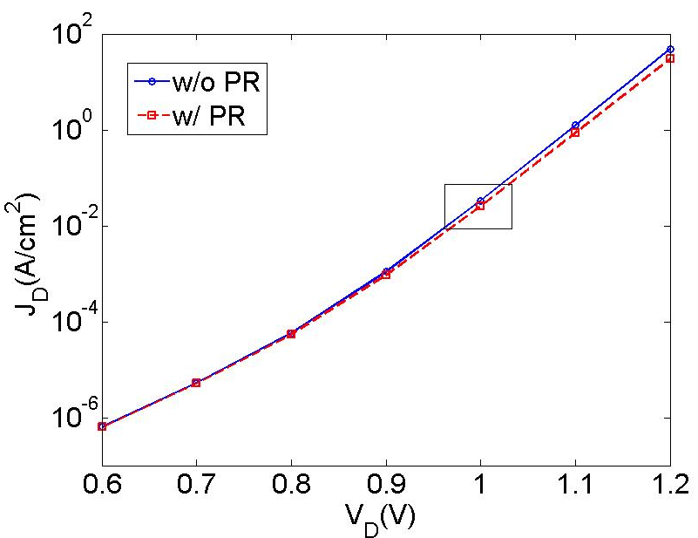
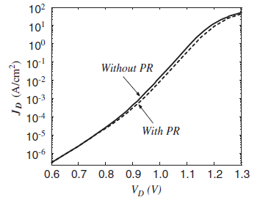
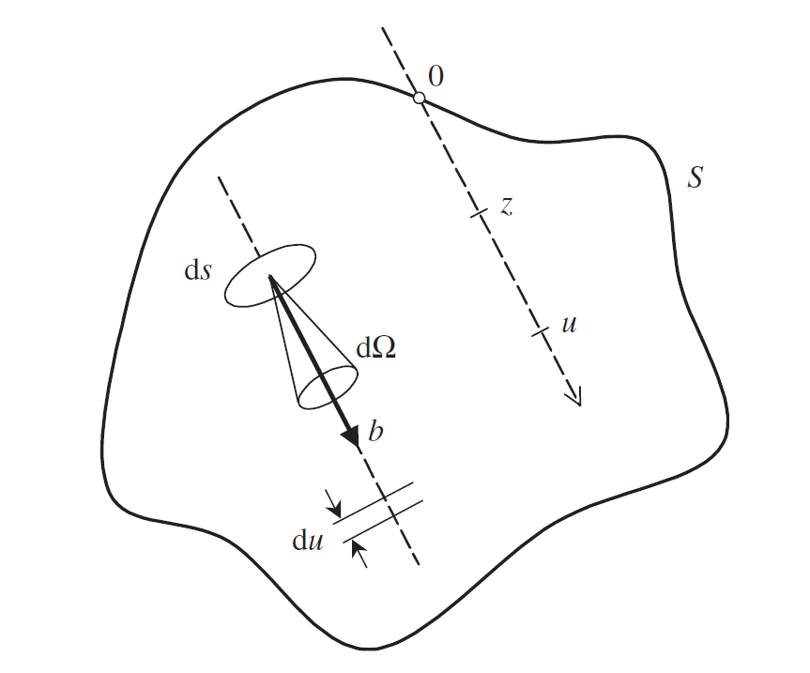
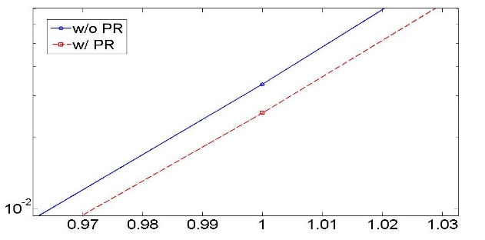
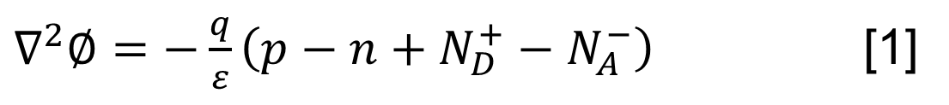
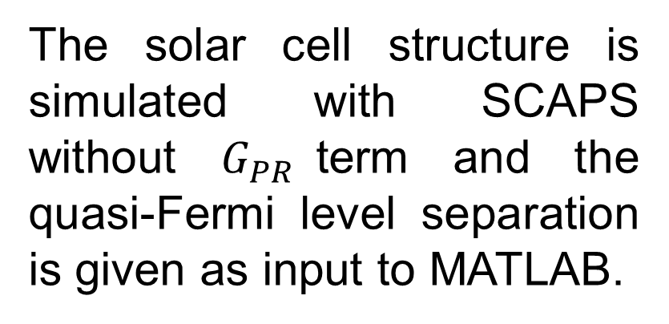
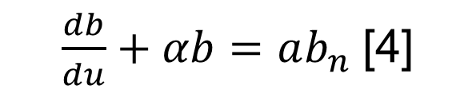

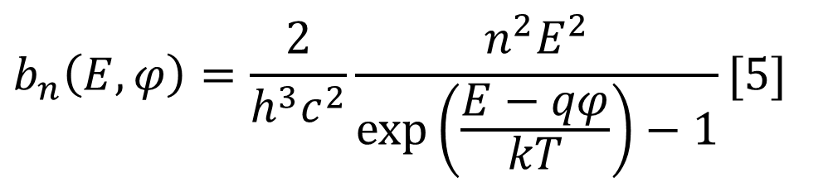

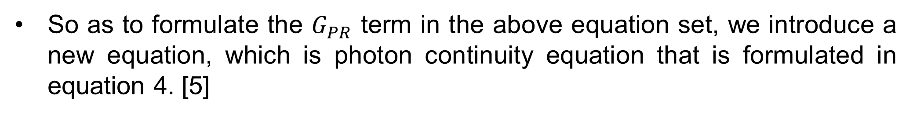
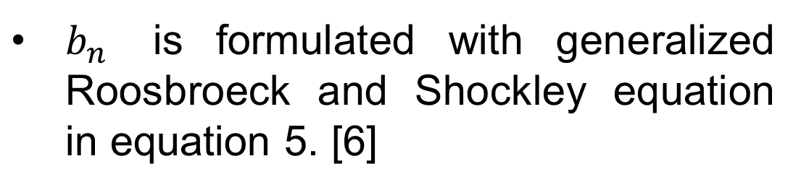
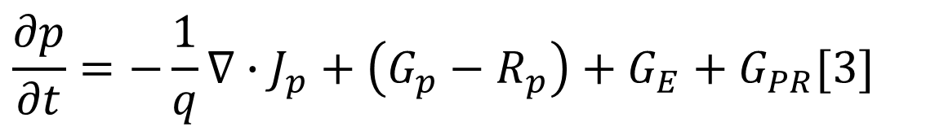
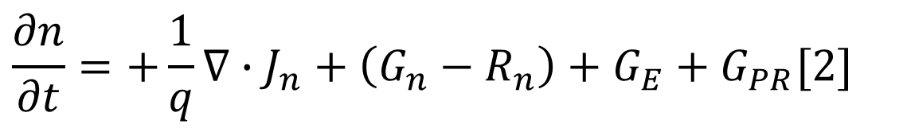
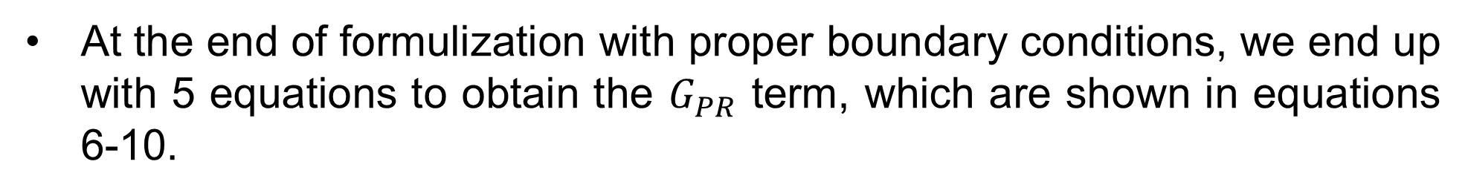
Numerical Modelling of Photon Recycling in Solar Cells and its Simulation
Refik Mert Cam^{1,2}, Deniz Turkay³, Selcuk Yerci^{1,3}
Department of Electrical and Electronics Engineering, Middle East Technical University, 06800, Ankara, Turkey
Department of Physics, Middle East Technical University, 06800, Ankara, Turkey
Department of Micro and Nanotechnology, Middle East Technical University, 06800, Ankara, Turkey
Introduction
The Algorithm to Simulate Photon Recycling
The process of re-absorbing a photon emitted by the radiative recombination is called as photon recycling [1].
In 2012, the solar cell efficiency record was renewed by a single-junction GaAs solar cell as 28.8% with the aid of effective photon recycling [3].
The solar cell structure is simulated with SCAPS without $G_{PR}$term and the quasi-Fermi level separation is given as input to MATLAB.
MATLAB code generates an initial photon recycling generation rate profile and gives the profile to SCAPS.
Physical illustration of photon recycling process [2]
This quasi-Fermi level separation and generation profile exchange continues until the quasi-Fermi level separation converges to some point.
SCAPS simulates the structure with additional photon recycling generation profile and new quasi-Fermi level separation is given again to MATLAB.
There is no available simulation tool for PR due to high-level complexity of modelling. In this project, we have tried to numerically model and simulate photon recycling in solar cells with MATLAB and SCAPS [4].
Cell efficiency vs. reflectivity [2]
After the convergence, simulation results taken into consideration photon recycling is obtained.
In this part of the project, we have got contact with Marc Burgelman, the programmer of SCAPS and he sent us to some useful codes which make SCAPS and MATLAB interact.
The aim of the project is that simulation of photon recycling will create a prognosis to aerogel applications in APP research group. Aerogel is a material which can be used as a back-reflector in order to enhance photon recycling.
Results
SEM image of aerogel layer in a solar cell
Simulation parameters:
p-GaAs emitter w=0.9 μm, $N_{A}=2∙{10}^{18} m^{−3}$
n-GaAs base w=4.0 μm, $N_{D}=2∙{10}^{17} {cm}^{−3}$
p- ${Al}_{0.8}{Ga}_{0.2}As$ window layer w=0.05 μm, $N_{A}=1∙{10}^{17} {cm}^{−3}$
Surface recombination velocity S$=1∙{10}^{4} cm/s$(base, emitter) S$=1∙{10}^{4} cm/s$(window)
Methodology
General Formulation of Photon Recycling
An additional term corresponding to generation rate due to photon recycling has been added to the standard set of equations used in simulation programs.
Front contact
Back contact
$∇^{2}∅=−\frac{q}{ε}\left(p−n+N_{D}^{+}−N_{A}^{−}\right)$[1]
The simulated structure
$$\frac{∂n}{∂t}=+\frac{1}{q}∇∙J_{n}+\left(G_{n}−R_{n}\right)+G_{E}+G_{PR}[2]$$
Additional Term
$$\frac{∂p}{∂t}=−\frac{1}{q}∇∙J_{p}+\left(G_{p}−R_{p}\right)+G_{E}+G_{PR}[3]$$
So as to formulate the $G_{PR}$ term in the above equation set, we introduce a new equation, which is photon continuity equation that is formulated in equation 4. [5]
$\frac{db}{du}+αb=ab_{n}$ [4]
Our simulation results
Balenzategui’s simulation results [5]
$b_{n}$ is formulated with generalized Roosbroeck and Shockley equation in equation 5. [6]
Conclusions and future work
$$b_{n}\left(E,φ\right)=\frac{2}{h^{3}c^{2}}\frac{n^{2}E^{2}}{\exp\left(\frac{E−qφ}{kT}\right)−1}[5]$$
Parameters involved in photon continuity equation [5]
A numerical model was implemented to simulate the effects of photon recycling. Due to some missing simulation parameters, the results are not same as in the literature. However, the decrease pattern in current density shows consistency.
As future work, all simulation parameters will be obtained to get the exact results with the literature data.
At the end of formulization with proper boundary conditions, we end up with 5 equations to obtain the $G_{PR}$ term, which are shown in equations 6-10.
$$b\left(E,x,μ\right)=\left\{\begin{aligned}+\frac{α}{μ}\exp\left(\frac{−αx}{μ}\right)×[\frac{R_{F}}{Φ}Ψ_{0F}+\int_{0}^{x}{b_{n}exp\left(\frac{αx^{′}}{μ}\right)dx^{′}] for 0<μ≤1⁡} \\ −\frac{α}{μ}\exp\left(\frac{−αx}{μ}\right)×[\frac{R_{R}}{Φ}Ψ_{0R}+\int_{x}^{w}{b_{n}exp\left(\frac{αx^{′}}{μ}\right)dx^{′}] for −1≤μ<0⁡}\end{aligned}[6]\right.$$
$G_{PR}\left(x\right)=2π\int_{E_{G}}^{∞}{dE\int_{−1}^{1}{α\left(E\right)b(E,x,μ)dμ}}$ [7]
$Φ=exp\left|\frac{2αw}{μ}\right|−R_{F}R_{R}$ [8]
$Ψ_{0F}=R_{R}\int_{0}^{w}{b_{n}}$ $exp\left(\frac{αx^{′}}{μ}\right)dx^{′}$+ $\exp\left(\frac{2αw}{μ}\right)\int_{0}^{w}{b_{n}exp\left(\frac{−αx^{′}}{μ}\right)dx^{′}}$ [9]
$Ψ_{0R}=R_{F}\int_{0}^{w}{b_{n}}$ $exp\left(\frac{αx^{′}}{μ}\right)dx^{′}$+$\int_{0}^{w}{b_{n}exp\left(\frac{−αx^{′}}{μ}\right)dx^{′}}$ [10]
References
[1] Kayes and et al. 27.6% Conversion efficiency, a new record for single-junction solar cells under 1 sun illumination. 2011.
[2] Yablonovitch, Miller and et al. The opto-electronic physics that broke the efficiency limit in solar cells. 2012.
[3] Miller and Yablonovitch. Photon extraction: the key physics for approaching solar cell efficieny limits. 2013.
[4] "PV Lighthouse", Pvlighthouse.com.au, 2019. [Online]. Available: https://www.pvlighthouse.com.au/cms/simulation-programs/scaps. [Accessed: 18- Feb- 2019].
[5] Balenzategui and Marti. Detailed modelling of photon recycling: application to GaAs solar cells. 2006.
[6] H.B. Bebb, E.W. Williams, Semicond. Semimet. 2 (1972) 181–320.

