Slide 1


Slide 2
What is it?
ReFramed is a general frame data analysis tool / platform
It collects, organizes, and provides a plugin API for processing frame data

Slide 3
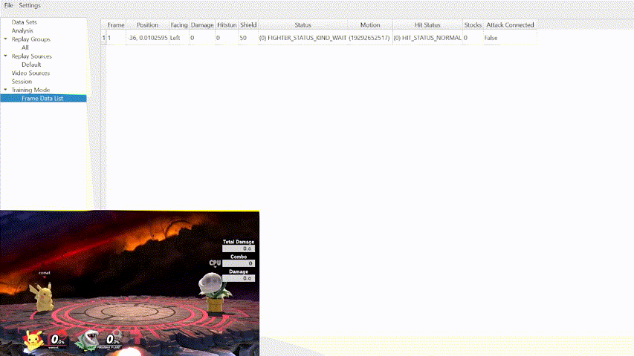
What is Frame Data?

Slide 4
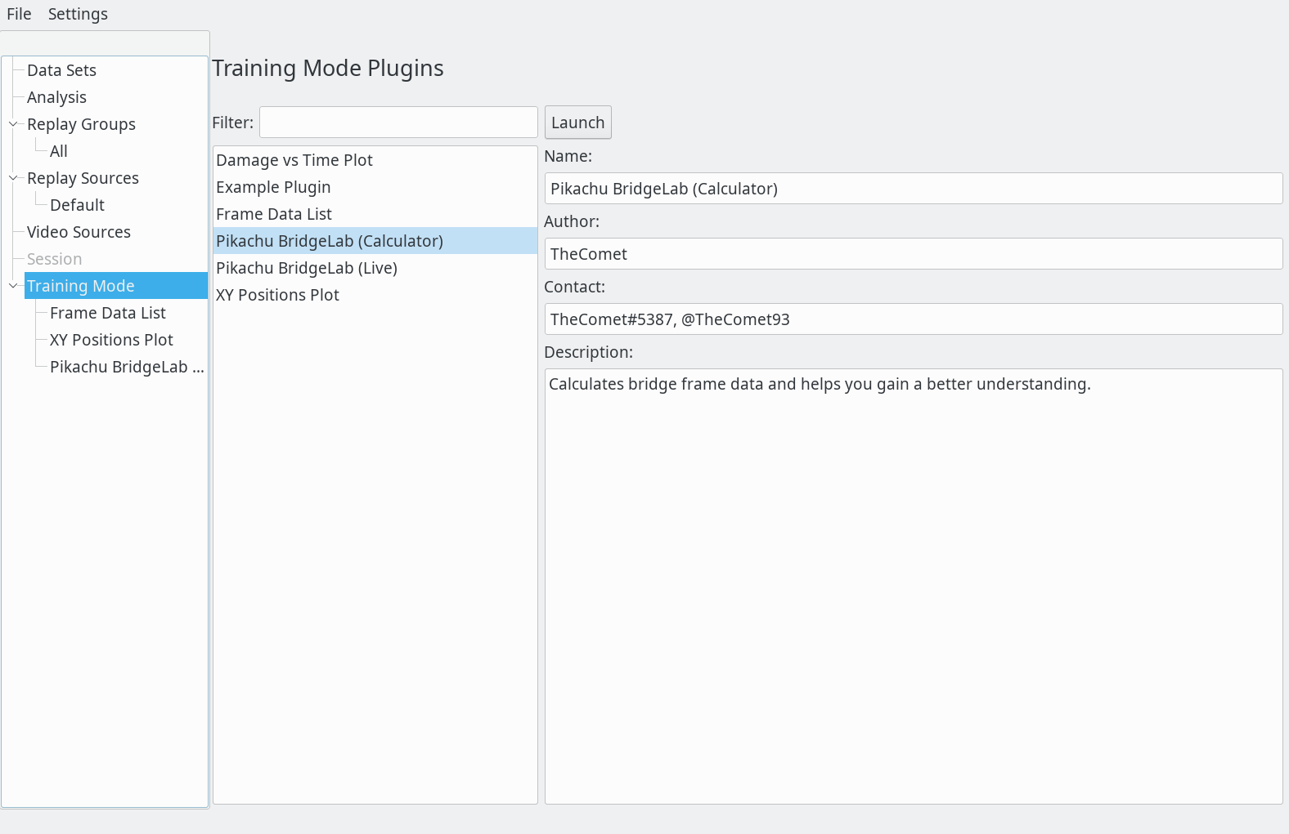




How do we collect Frame Data?
Server Component
Client

Slide 5
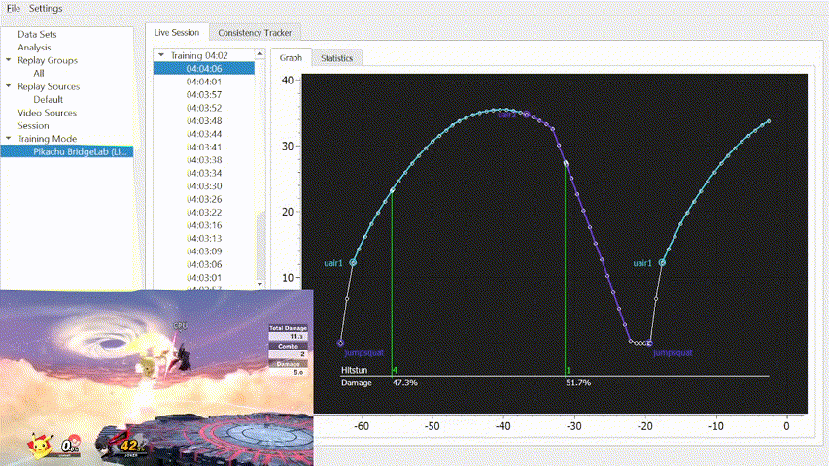
What can we do with Frame Data?

Slide 6
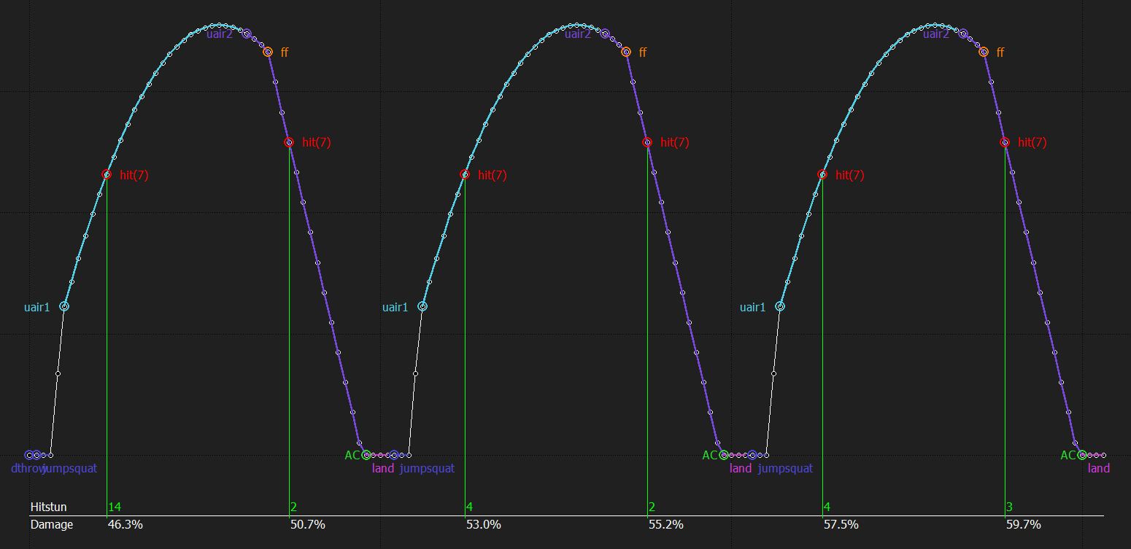
What can we do with Frame Data?

Slide 7
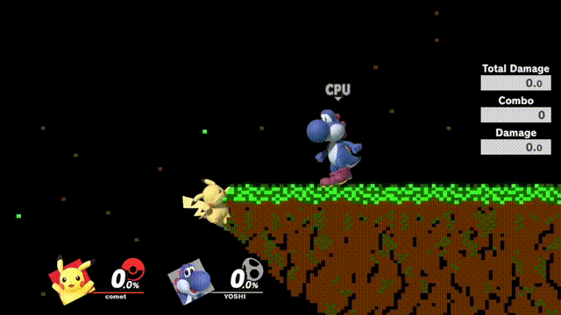
What can we do with Frame Data?

Slide 8
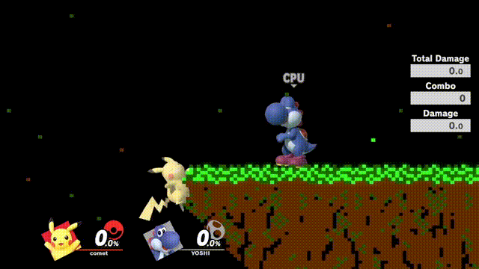
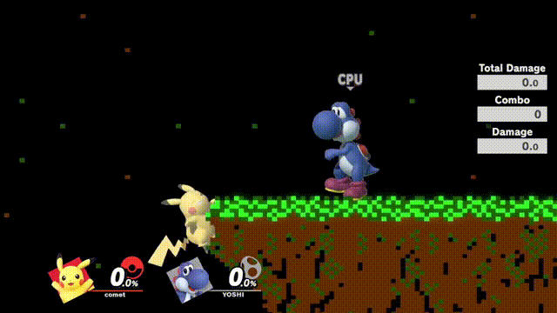
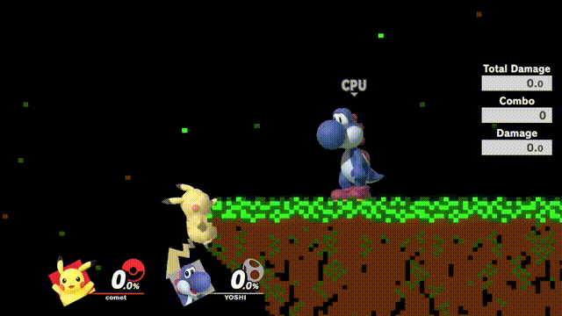

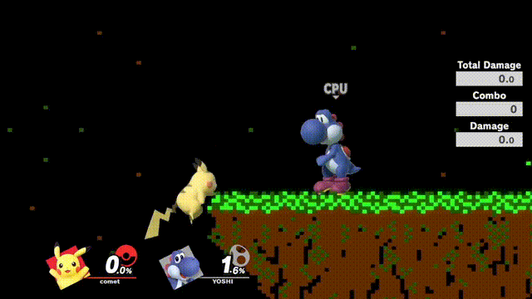

What can we do with Frame Data?

Slide 9
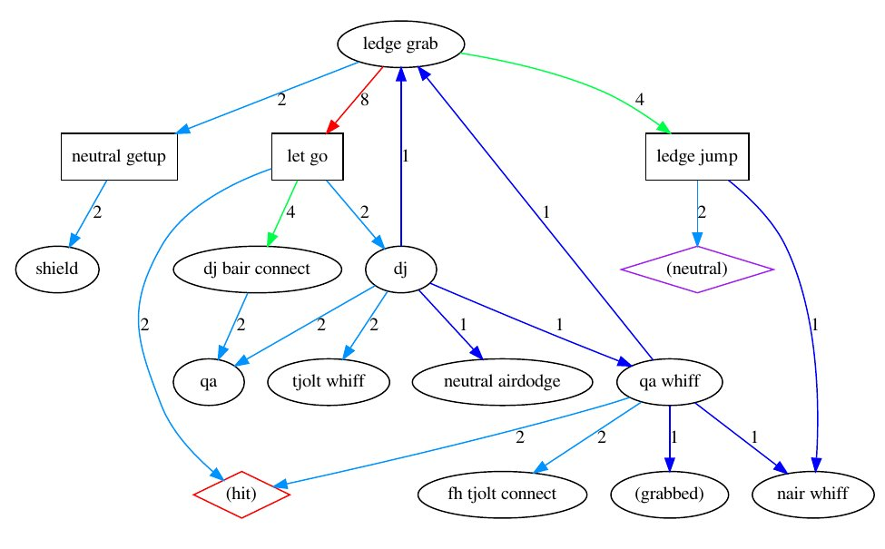
What can we do with Frame Data?

Slide 10
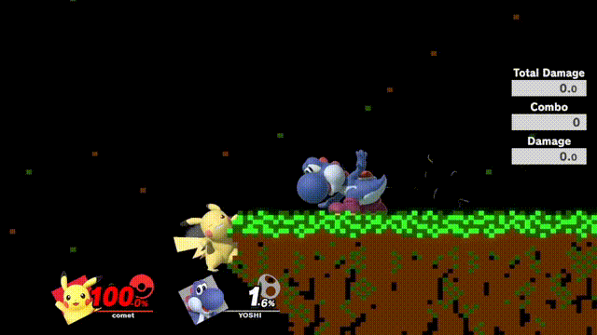
What can we do with Frame Data?

Slide 11
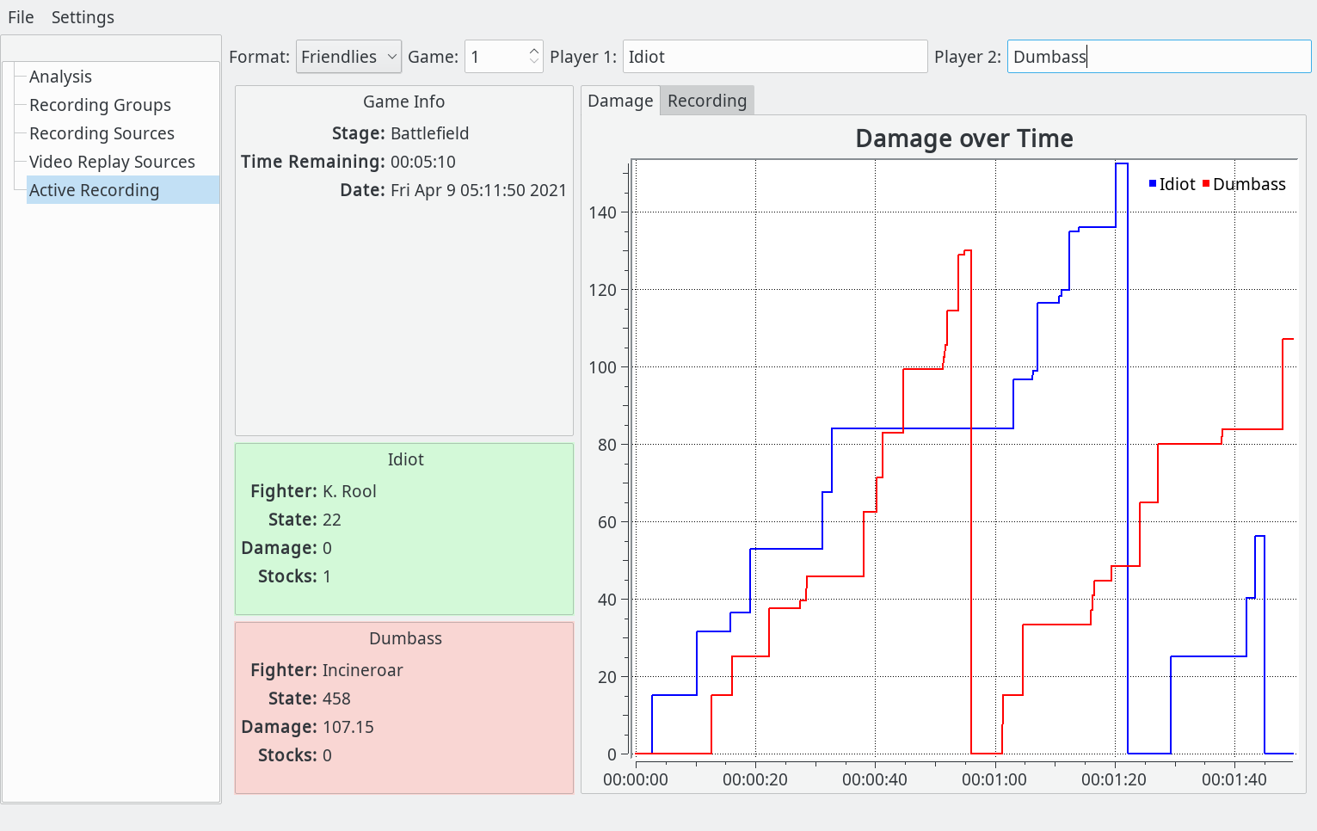

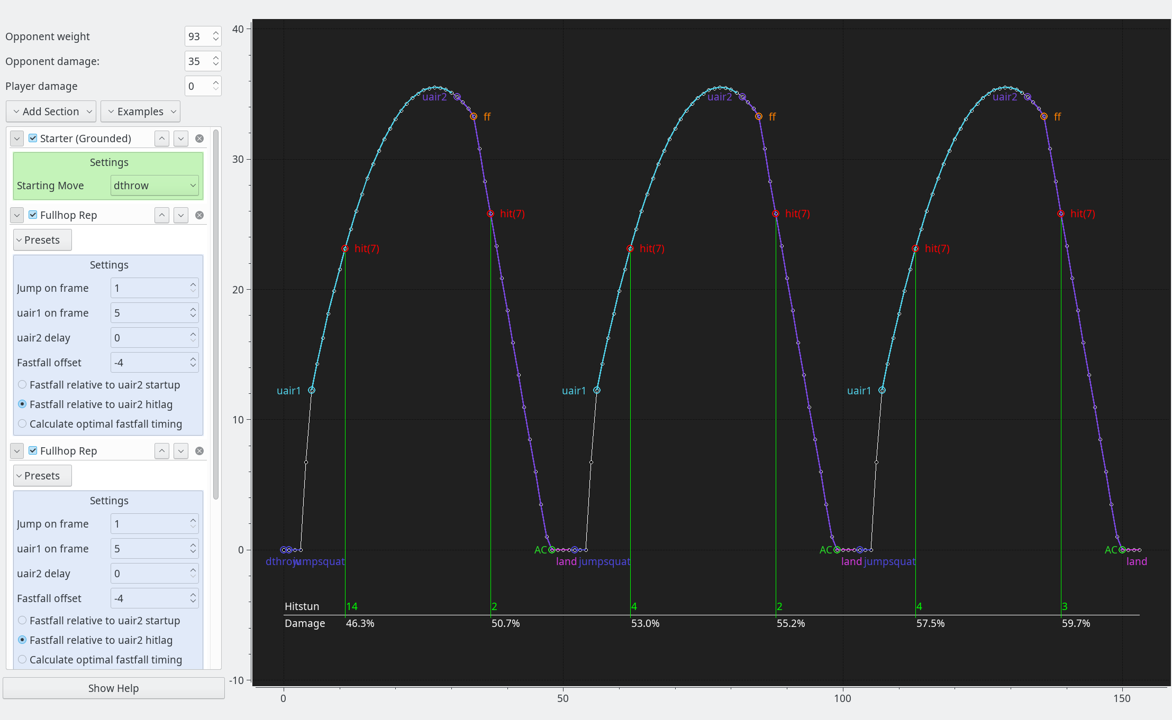
Structure
Plugins
Damage
plots
Decision analysis
Server Component
Video Player
Client
Combo Analysis

Slide 12

Questions?

