Slide 1
PREPCAST · SENIOR ANALYTICS ENGINEER CASE STUDY
What engaged viewership is,
and what it tells us about retention
A dimensional model over four raw extracts — 216,045 playback events, 8,014 subscription changes — built in dbt on DuckDB.
Notes:
Two questions in the title, and I answer both. The second answer is a null result - say so early rather than building to it.

Slide 2
CHALLENGE 1 · DISCOVER
The data fights back
Eleven issues found across the four extracts. Six that change a number:
3 timestamp encodings
mrr_amount is misnamed
3 currencies, no normalization
ISO-Z 54.9% · no-timezone 25.5% · epoch 19.7%.
Also in subscriptions — 1,225 rows.
Annual plans carry 79.99 — a yearly price in a
column called monthly. Sums overstate ~12×.
USD 7,935 · GBP 40 · EUR 39
12 asset_ids, 24 assets
20 impossible runtimes
600 duplicate events
Each is a game and its replay.
Joining fans 216,045 rows out to 218,782.
−600, −1 and 0 seconds — the denominator
of every completion metric.
Byte-identical, so safe to drop — and they
fabricated 29 phantom grain violations.
2

Slide 3
CHALLENGE 1 · THE WORST ONE
One column, three encodings
The middle row has no timezone. Calling it UTC is an assumption, not a reading — and it is a live question for the source team.
ISO-8601 with Z
118,592
54.9%
ISO-8601, no timezone marker at all
54,979
25.5%
Unix epoch seconds
42,474
19.7%
THE HYPOTHESIS THAT FAILED
Not correlated with app_version or device_type — all three spread evenly across all six of each. It is not one bad client build, so there is nothing to go and fix.
3

Slide 4
CHALLENGE 2 · THE TRAP
Fan-out, demonstrated
Joining playback events to the asset catalogue on asset_id:
216,045
218,782
214,286
rows before the join
after a LEFT JOIN (inflated by 12 duplicate ids)
after an INNER JOIN (orphans silently dropped)
Both are wrong, in opposite directions. My own first profiling query hit this — it reported more child rows than the child table has.
4

Slide 5
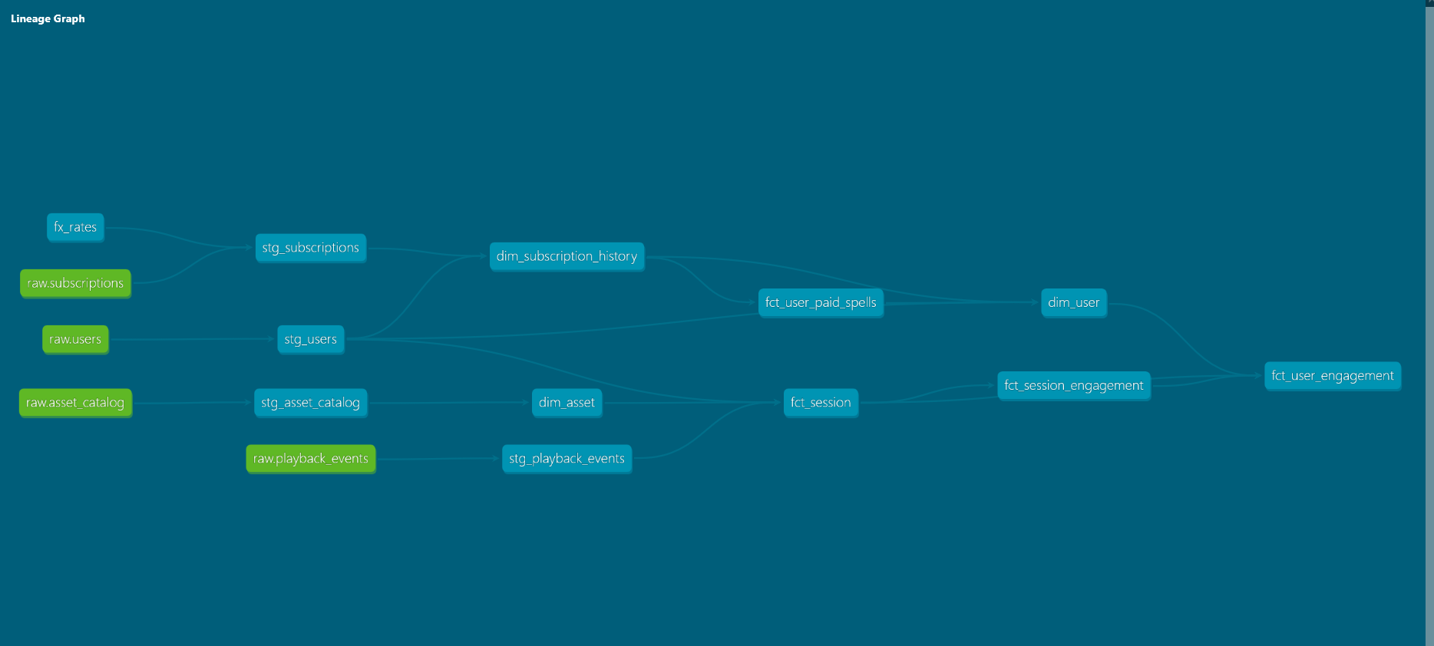
CHALLENGE 2 · VALIDATION
5

Slide 6
CHALLENGE 2 · VALIDATION
143 tests — and the three that earned their keep
None of these threw an error. Each produced a plausible number.
38 sessions had orphaned user_ids
TEST MIX
A grain test failed on first run. These sessions carry a user_id that is not in the users extract. Not null, so they look attributable. They remain in staging, in case someone outside product wants the data, but are filtered out via inner join in the fct_session mart
not_null
99
accepted_values
14
Custom Example: Identical playback events
unique
12
Confirms that playback events are indeed all identical in their duplication, and therefore that removal of duplicate rows is only removing true duplicates
custom
8
relationships
4
expression
2
Expression: State length
Makes sure states always come in with a two character length to the staging table
6

Slide 7
CHALLENGE 2 · WHAT I REJECTED
The candidates that looked best, and failed
PAUSE AS AN ENGAGEMENT SIGNAL
THE LESSON THAT GENERALISES
Sessions with a pause complete at 0.46 versus 0.134. Strong evidence of a present, deciding human — a device left running never pauses.
Pause and buffering are largely just a metric of how long someone watched.
EXCEPT
Nothing is paused — the playhead advances one heartbeat across 99.7% of pauses.
Nothing resumes — there is exactly one play event per session.
It tracks length — 22.9% of short sessions have a pause, 92.2% of long ones.
A 71-minute session has thirteen times the opportunity to contain any event that a 5.5-minute one does.
Normalise by session length. Always.
Also ruled out: seeking (fastforward or rewinding) is unobservable — playhead tracks the wall clock in all 185k heartbeat intervals, zero divergences. No seek event
7
Notes:
The prompt warns about someone hitting play and walking away. That failure mode is undetectable in this telemetry, and I would rather say so than pretend otherwise.

Slide 8
THE ANSWER
Who is an engaged viewer?
An engaged viewer is someone who has watched at least 30% of an asset
“An engaged session is a session in which the viewer watched at least 30% of the runtime of an asset in the past 3 months. A user with an engaged session is an engaged user.”
1,826
830
40%/10%
No
engaged views of 5,739 sessions
engaged users of 2,090 accounts with an event in the last 3 months
8,000 total accounts
Active in three month time period/
All users
relationship with retention
8

Slide 9
CHALLENGE 2 · THE DEFINITION
The distribution picks the threshold
Session completion, heartbeat positions only, 0.05 bins. Three clusters, two empty gaps.
THREE CLUSTERS
Abandoned
2,153
0.021 – 0.050
Sampled
1,760
0.172 – 0.200
Engaged
1,826
0.478 – 0.995
The gap 0.200–0.478 is 0.28 wide and completely empty. It is more than twice the width of the first gap.
9
Notes:
Volunteer the caveat: clusters this tight are a synthetic-data artefact. What transfers is the method - cut at the widest natural separation - not the number 0.30.

Slide 10
THE RESULT
Engagement does not predict retention here
Churn rate from paid, by engagement level. Users holding both playback and a subscription.
Users who never watched a single second churn less than users we classify as engaged.
Spread across all four groups is under 3 points, and non-monotonic.
This is a finding, not a failure. The likeliest explanation is that the generator drew viewership and subscriptions independently.
10
Notes:
Say the caveat: my test is not time-ordered - it does not verify engagement preceded churn. The proper test is a cohort: engagement in window W against retention at W+30.

Slide 11
CHALLENGE 3 · ARCHITECT
Ownership falls out of one question
Would this model change if Product’s definition of engagement changed?
RAW
CLEANED
STANDARDISED
CURATED
4 CSV extracts
staging · 4 models
marts/data · 5 models
marts/product · 2 models
›
›
›
landed all-VARCHAR
types, encodings, categoricals
facts about the sources
the Product team’s definition
Data team owns and governs →
↑ ownership boundary
A ratio is a measurement. A threshold is an opinion.
completion_pct is Data-owned. is_engaged_view is Product-owned. The Product team’s entire opinion surface is one model and one declared variable.
11
Notes:
Lead with the self-critique: I first put four models in an intermediate layer. Three did not belong - they were shared assets filed as private plumbing. The fourth mixed fact with opinion and was split.

Slide 12
CHALLENGE 3 · ARCHITECT OWNERSHIP
Eleven models, grain highlighted
The seven mart models below; four staging models sit behind them. The fact is at user grain, because the question is about people.
Why user grain? A session-grain fact weights heavy viewers by how often they showed up, and quietly answers a different question.
Concurrent subscriptions are real — 319 overlapping pairs across 268 users. Cancelling one of two looks like churn but is not, so paid windows are merged: 4,277 into 3,197 spells.
MODEL
ONE ROW PER
ROWS
fct_user_engagement
registered account
8,000
fct_session_engagement
viewing session
5,739
fct_session
viewing session
5,739
dim_user
registered account
8,000
dim_asset
asset_id
850
dim_subscription_history
subscription state, valid-from/to
7,896
fct_user_paid_spells
continuous paying period
3,197
■ Data team owns
■ Product team owns
12
Notes:
Every grain is one plain-English sentence in the YAML, and every one is enforced by a uniqueness test - so the sentence and the test have to agree.

Slide 13
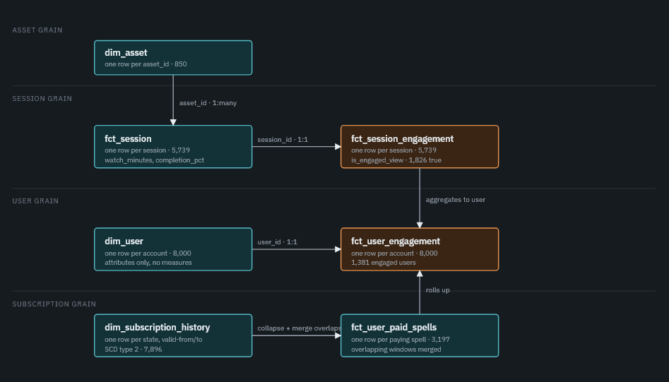
13
Notes:
Every grain is one plain-English sentence in the YAML, and every one is enforced by a uniqueness test - so the sentence and the test have to agree.

Slide 14
WHAT I’D DO NEXT
Where I stopped, and why
TO FINISH THE ANALYSIS
TO MAKE IT USEFUL
Run the time-ordered test. My retention test does not verify engagement preceded churn. The proper shape is a cohort — engagement in window W against retention at W+30.
Confirm four assumptions with the source teams. Are Timezone-less timestamps UTC? Expired versus canceled, involuntary and voluntary? Backwards Sub Status Transitions, win-backs? FX Rates, who owns them & approach
Investigate the middle tier for growth. 1,760 sessions watched 17–20% and stopped — people who engaged enough to form a judgement and left. Caveat: the tiers show no retention signal here.
Add additional analytic events, investigate odd data Add seek analytic, look at pause not pausing, and sort out orphaned foreign keys and other data issues at the source
14
Notes:
The prompt explicitly asks what I would do next. Naming what I cut, and why, is part of the answer.

Slide 15
HOW I WORKED WITH AI
How I used AI
Claude Usage
How Claude Worked
Practical Decisions
Profiled and explored the data
Identified data-quality issues
Maintained project documentation and changelogs
Wrote SQL and dbt models
Tested and validated the model
Drafted documentation and diagrams
Generated options and tradeoffs for decisions
Used AI for construction, while keeping final decisions human-led
Strict change-control & approval
Structured, versioned documentation
Automated data profiling & quality checks
Validation of AI-generated code and outputs
Human-in-the-loop analytical decision making
Used Claude Desktop, not Command Line
Agents, that Claude manages, were not used due to token usage risks. I used Claude desktop to have multiple agents I control work on the code or wiki simultaneously
Used Pycharm as it auto updates files, no saved vs unsaved version
Every design decision here is mine — the definition, the grain, the SCD treatment, the ownership boundary. Construction was delegated; judgement was not.
15
Notes:
The prompt asks specifically where the tool was wrong and how I caught it. The third column is the honest answer and the most useful one.

