Slide 1

Build a data platform over
and on the web
Erlang User Conference 2013
Benoît Chesneau

Slide 2


About me
Apache CouchDB committer and PMC member
PSF Member
Web craftsman
Do opensource for a living
Erlang User Conference 2013 - Benoît Chesneau

Slide 3

The big picture
Erlang User Conference 2013 - Benoît Chesneau

Slide 4
What is Refuge?
A way to store, sync, and share your data
Decentralized
Over and on the web
Opensource
Built in Erlang
Erlang User Conference 2013 - Benoît Chesneau

Slide 5

Part of
Erlang User Conference 2013 - Benoît Chesneau

Slide 6
Why?
Played too much with Apache CouchDB
Document oriented
Blobs can be attached to documents
Master-master replication (P2P)
Couchapps
Erlang User Conference 2013 - Benoît Chesneau

Slide 7
But
What we really need at the end is...
A simple way to store any blobs
Index or render them
And share them among people and machines
Can work with off-line devices
Or near you
Erlang User Conference 2013 - Benoît Chesneau

Slide 8
Coffer
Versatile storage service
Multi-backend (FS, Distributed FS, S3...)
Simple REST API: GET,PUT, POST, DELETE
Synchronization
All blobs are uniquely identified (content-hash)
Erlang User Conference 2013 - Benoît Chesneau

Slide 9
Coffer
Versatile storage service
Works with mobile & embedded devices
Partials upload & downloads supported
RESTFUL, resources visible on HTTP
Erlang User Conference 2013 - Benoît Chesneau

Slide 10
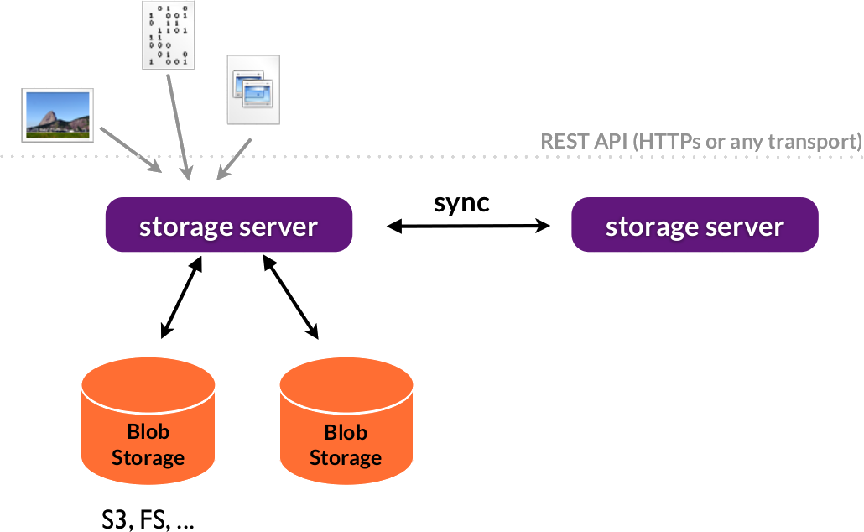
Erlang User Conference 2013 - Benoît Chesneau

Slide 11
Erlang Side
A gen_server to keep all the storage backend
configuration
gen_storage , a behaviour to keep a storage
states
Handle conflicts in the backend. Same file can't
be uploaded by 2 clients at the same time
Erlang User Conference 2013 - Benoît Chesneau

Slide 12
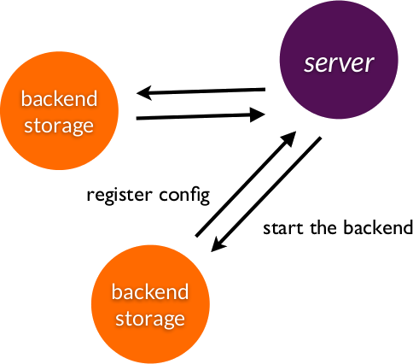
Erlang User Conference 2013 - Benoît Chesneau

Slide 13
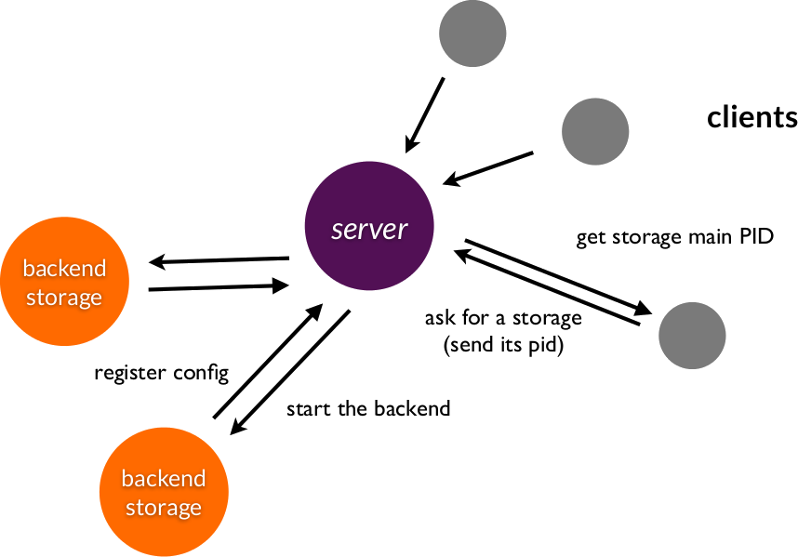
Erlang User Conference 2013 - Benoît Chesneau

Slide 14
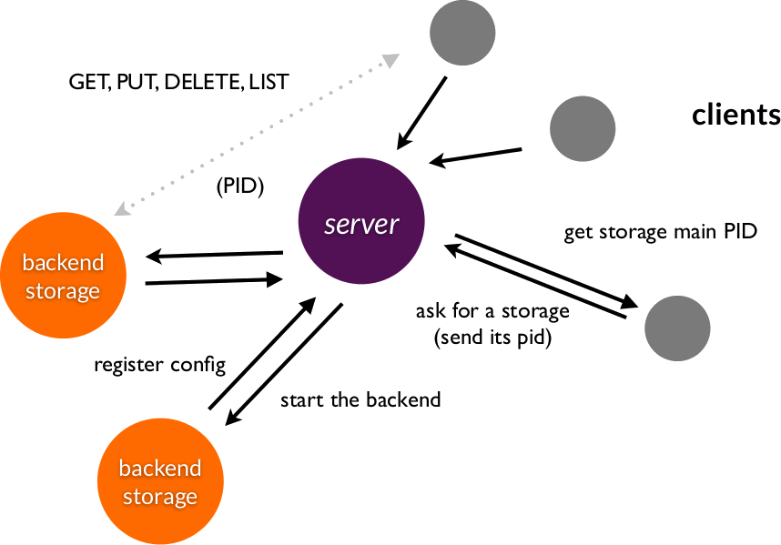
Erlang User Conference 2013 - Benoît Chesneau

Slide 15
Synchronization algorithm
Create a change queue on the source
Enumerate (list) all blobs on the source
and copy the blobs not on the target
Enumerate is cheap (we only compare
blobs ids)
Blobs already on the target aren't sent
Start to watch on the change queue
Blobs delivery guarantee
Erlang User Conference 2013 - Benoît Chesneau

Slide 16
How changes queues work in Erlang
Queues are kept in memory and persited
to the disk from time to time
A process / queue
A process / watcher is maintained
Pub/sub over websockets, event source or
longpolling
Erlang User Conference 2013 - Benoît Chesneau

Slide 17
Today support
Memory storage (ETS)
FS Storage
Distributed using riak-coree
More to come (S3, Redis, Memcache)
Erlang User Conference 2013 - Benoît Chesneau

Slide 18
Some tools we use
Modified cowboy version – http server
Hackney – http client
Gproc for a cheap pub/sub internal system
(changing)
Erlang User Conference 2013 - Benoît Chesneau

Slide 19
Hackney in action
ping(#coffer_conn{url=URL, options=Opts}) ->
case hackney:head(URL, [], <<>>, Opts) of
{ok, 200, _, Client} ->
hackney:close(Client),
pong;
_ ->
pang
end.
Erlang User Conference 2013 - Benoît Chesneau

Slide 20
How to use the blobs?
No metadata on the disk
No history
Just blobs
Erlang User Conference 2013 - Benoît Chesneau

Slide 21
Create a backup of a folder
3 kinds of blobs
1 blob for the file
1 blob keeping file metadata (name, type...)
1 blob keeping the directory structure
Erlang User Conference 2013 - Benoît Chesneau

Slide 22
file
{
"blobid": "blobobid",
"prev": "prevref or null"
}
Erlang User Conference 2013 - Benoît Chesneau

Slide 23
tree
{
"filename": {
“blobid: "blobbid",
“type”: “blob”
},
"foldername": {
“blobid: "blobbid",
“type”: “tree”
}
}
Erlang User Conference 2013 - Benoît Chesneau

Slide 24
Create a backup of a folder
Create a reference (or link) to the last version
of the tree
Another blob with a level of indirection
Can be signed
Just another blob
Erlang User Conference 2013 - Benoît Chesneau

Slide 25
Index your content
“just” replicate your index
An indexer receive {blobref, Blob, timestamp}
from the replication queue
Can be any kind of indexer: sql, apache couchdb,
an FTS (like elasticsearch)
Erlang User Conference 2013 - Benoît Chesneau

Slide 26
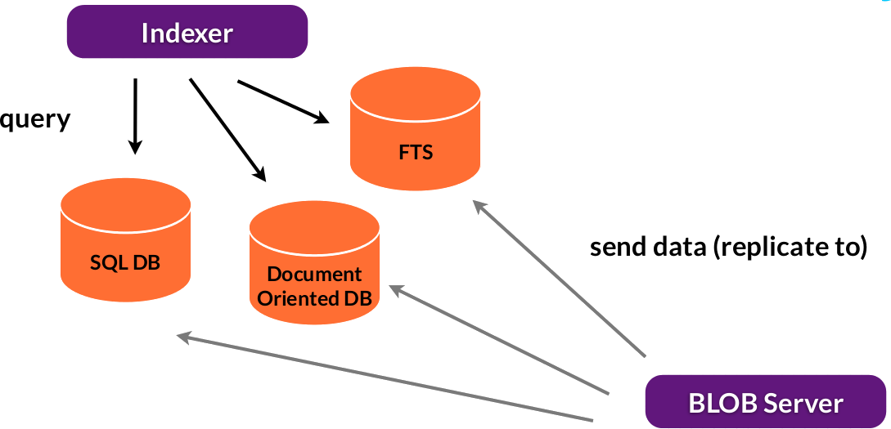
Erlang User Conference 2013 - Benoît Chesneau

Slide 27
Behind the scene
Mostly works like a blob server
Except it only pass mapped data to the index
Possibility to transform the data before indexing
(mapping)
Multi-language
Erlang User Conference 2013 - Benoît Chesneau

Slide 28
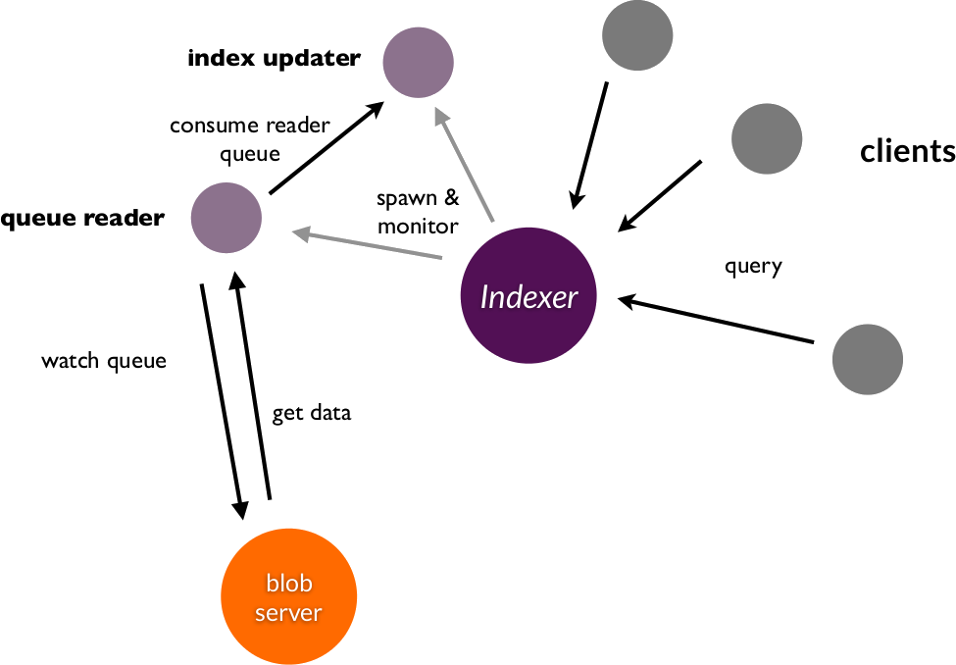
Erlang User Conference 2013 - Benoît Chesneau

Slide 29
The refuge node
Frontend to blobs servers and indexers
Manage blobs claims and access
Gateway to others nodes
Forward requests
WebRTC signaling
Erlang User Conference 2013 - Benoît Chesneau

Slide 30
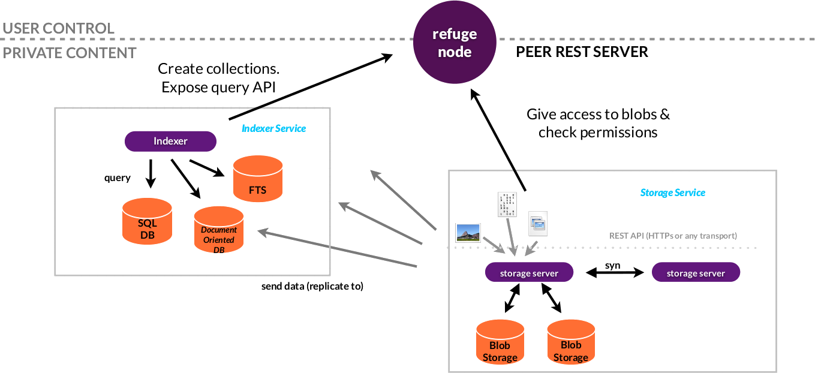
Erlang User Conference 2013 - Benoît Chesneau

Slide 31
The hub
True decentralized web system
Once found nodes are directly connected
A node can be authenticated using a signature
Webfinger & host-meta
Erlang User Conference 2013 - Benoît Chesneau

Slide 32
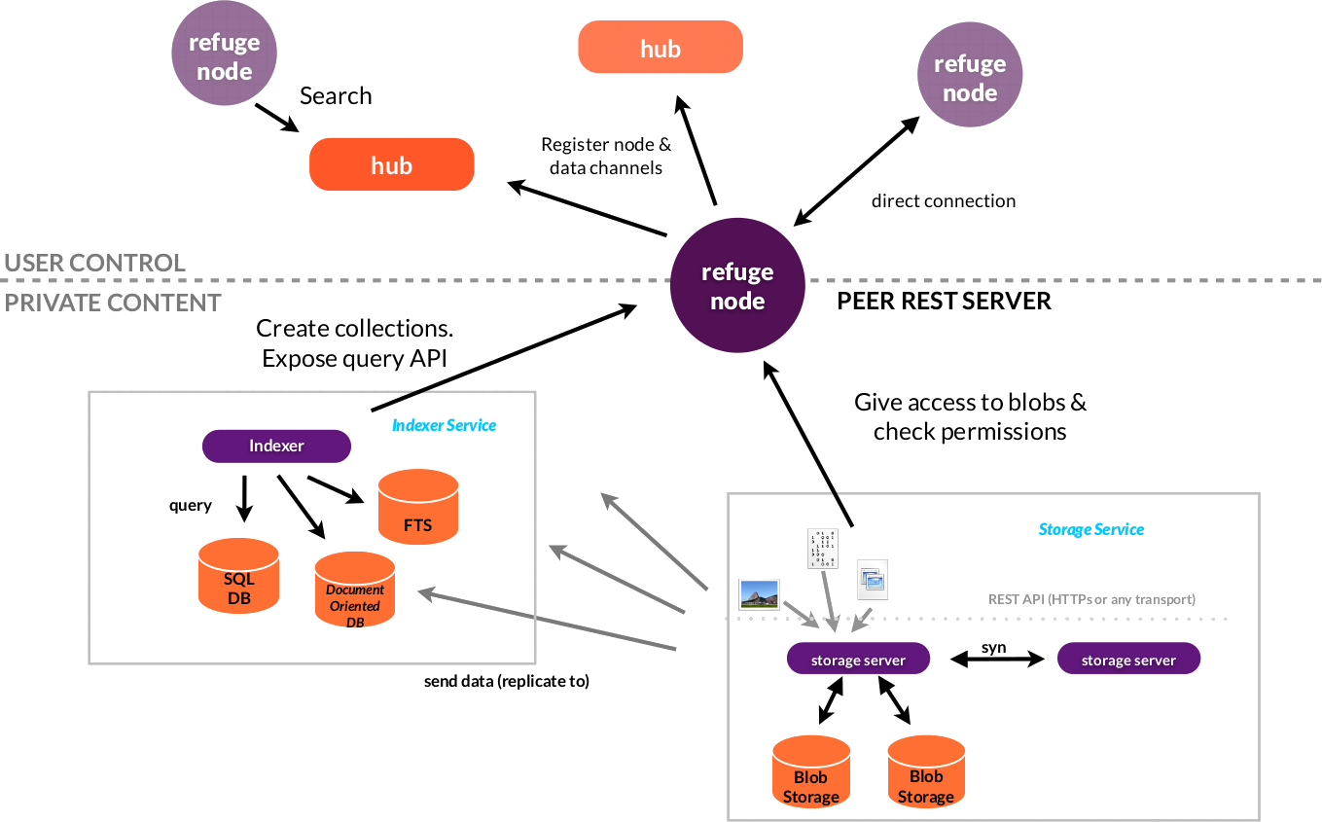
Erlang User Conference 2013 - Benoît Chesneau

Slide 33
The hub
Each node can open a connection to an hub
using a websocket
A node can connect to multiple hub
Once connected a node authenticated itself
with a signature
Erlang User Conference 2013 - Benoît Chesneau

Slide 34
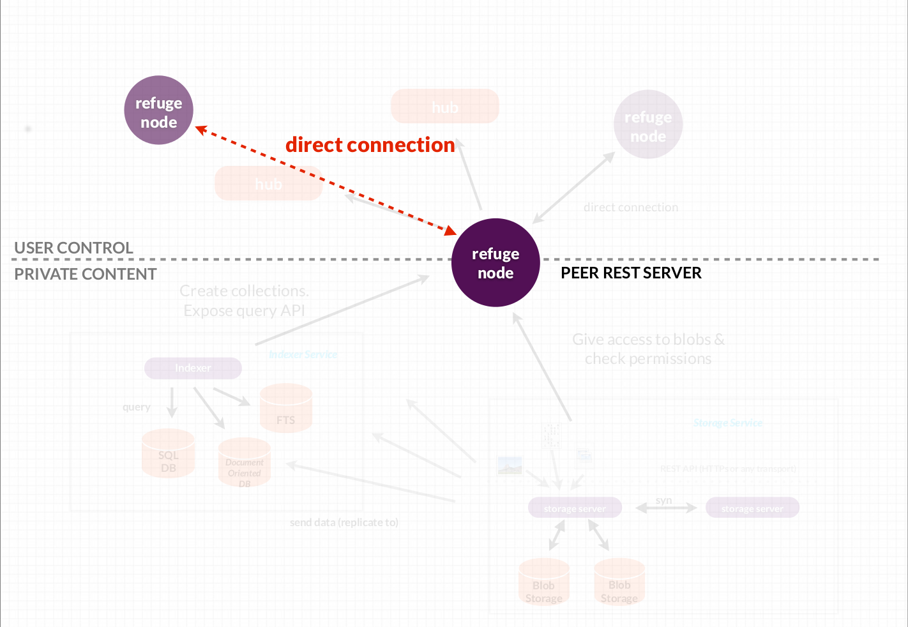
Erlang User Conference 2013 - Benoît Chesneau

Slide 35
The hub
Each refuge node open a connection to an
hub (websocket)
A node can connect to multiple hub
Once connected a node authentified itself
with a signature
Erlang User Conference 2013 - Benoît Chesneau

Slide 36
?
@benoitc
http://refuge.io
Thanks to
Laurent (@lolograph) for the website and logo design
Nicolas (@nrdufour) for the code and the ideas
Others for their feedback
Erlang User Conference 2013 - Benoît Chesneau

