Slide 1
SpartanLync Salesforce Implementation
Change Consultants:
Andres Serna Chavez
Prajwal Nagaraj
Change Management Plan

Slide 2

Agenda
Company Introduction & Client Context
Awareness:
Pressures and Drivers of Change
Problem Identification
Desire:
Proposed Change & Scope
Organizational Readiness
Anticipated Challenges & Resistance
Knowledge:
Communication Strategy
Training Plan
Ability:
Skill Application & Support Tools
Reinforcement:
Sustaining Adoption & KPIs
Outcome & Next Steps
References

Slide 3

Company Introduction
SpartanLync : Organization Overview
Mission : Combine sensor data and analytics to improve fleet safety, productivity, and cost-efficiency.
Vision : To lead innovation in fleet management technologies worldwide.
Structure : Medium-sized firm with functional departments in sales, IT, and engineering. Flat hierarchy with direct reporting to executive leadership.
Global Footprint : Canada (HQ), USA, Mexico, China, Australia.
Key Offerings :
TPMS (Tire Pressure Monitoring Systems)
Extreme Duty Solutions for mining and construction
TempTrac Cold Chain Management
ADAS, LIDAR, camera systems
Solar mats, battery sensors, EV charging stations
Core Values : Innovation, reliability, sustainability, global collaboration
Contact : Burlington, Ontario | sales@spartanlync.com | 905-631-6800

Slide 4
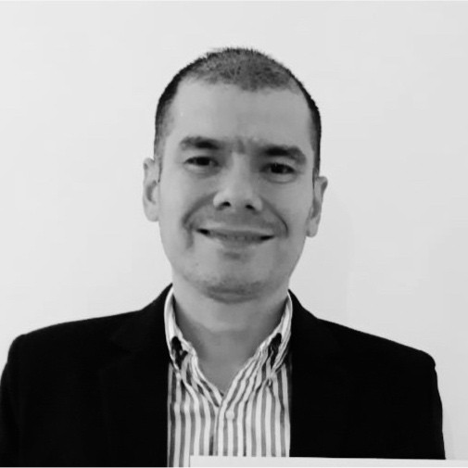
Jorge Cantor
Key Account Manager ( Primary contact for CRM improvement initiative )
“As a Key Account Manager, I excel in building and managing relationships with major clients across North America in diverse industries such commercial, buses and mining, offering tailored solutions to meet their unique fleet operational needs.”

Slide 5
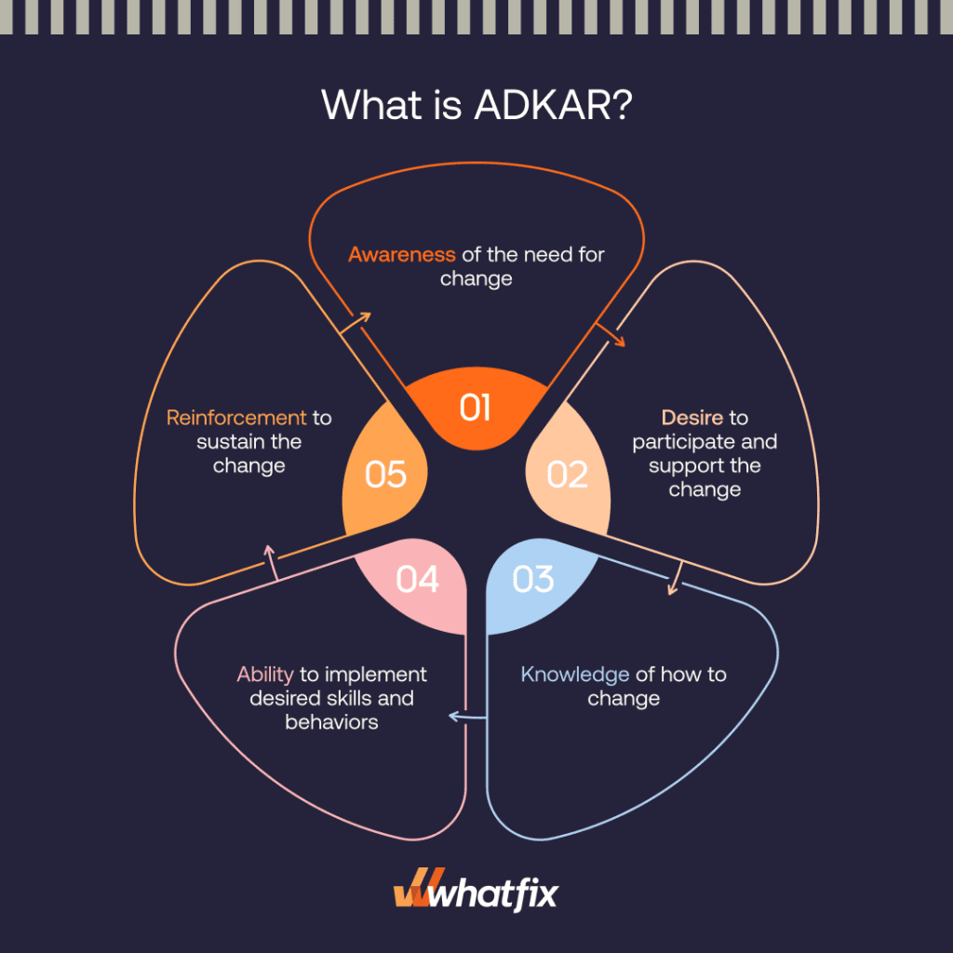
What is ADKAR?

Slide 6
Awareness -Pressures and Drivers of Change
Internal Drivers :
Sales inefficiencies from disconnected processes.
Growing demand for data-driven decision-making.
Employee frustration with manual reporting.
External Drivers :
Competitors adopting CRMs like HubSpot and Salesforce.
Tech trends in predictive analytics and AI integration.
Increased client expectations for real-time updates.
Source: Market research, internal stakeholder interviews.

Slide 7
Awareness - Problem Identification
Sales inefficiencies due to disconnected data systems
Problem
Frequent communication breakdowns lead to missed leads and follow-ups
Delayed customer response times
Inability to generate comprehensive analytical insights
Symptoms
Root Cause
Manual process, Lack of a unified and centralized CRM platform
Change Type: Transformational (Organization wide cultural and Tech shift)

Slide 8
Desire - Proposed Change and Scope
Change: Implementation of Salesforce CRM
Objective: Centralize sales processes, enhance customer management, streamline communications
Scope: Transformational, organization-wide integration
Impacted Areas: Sales, Marketing, IT, Management, Customer Support
Supports SpartanLync’s mission and vision of innovation and global collaboration

Slide 9
Desire - Organizational Readiness
Current State :
CEO-driven vision and initiated change
Employees not fully prepared (Mixed reaction and fear)
Assessment Tools :
Change Readiness Survey
Force-Field Analysis
Skills Gap Analysis

Slide 10
Desire – Anticipated Challenges and Resistance Factors
Resistance due to anxiety about job security and technological shifts
Existing skills gap among employees regarding CRM use
Absence of clearly defined KPIs and success milestones
Potential communication breakdowns during implementation phases
Kotter & Schlesinger Resistance Causes:
Fear of job impact → Address with education & negotiation
Lack of clarity on Salesforce use → Use facilitation and Q&A
Cross-departmental silos → Fix via inter-team collaboration forums

Slide 11
Knowledge - Communication Strategy
Bi-weekly CEO Town Halls: Updates and Q&A
Weekly Newsletters: Detailed Salesforce implementation progress
Dedicated Intranet Portal: Centralized resource hub with FAQs, live updates
Regular Live Q&A sessions: Addressing employee concerns directly
Suggestion Boxes and Feedback forms
Success Stories from Pilot teams

Slide 12
Knowledge - Training Plan
Role-specific workshops and hands-on training (Sales, IT, Service)
LMS-based interactive tutorials for continuous learning
Comprehensive pre- and post-training tests to measure knowledge gains
Certification options for key users

Slide 13

Ability - Enabling Skill Application
Supportive Measures :
Structured weekly mentorship programs (check-ins)
Availability of Salesforce technical experts for real-time support
Regular performance reviews and skill evaluations
Troubleshooting and skill reinforcement resources

Slide 14
Obstacle Strategy Table:
Obstacle | Solution
Low confidence | Gamified learning, mentor pair-up
Integration fear | System demos, IT support standby
Time constraints | 15-min microlearning chunks

Slide 15
Reinforcement Strategy – Sustaining Adoption
Key Performance Indicators :
Reinforcement Tactics :
Salesforce system adoption and usage rates
Enhanced sales productivity and customer conversion rates
Regular employee feedback and satisfaction surveys
Regular recognition of milestones and achievements (‘CRM Champion’ shout outs)
Monthly success stories and sharing best practices
Continuous improvement feedback forums

Slide 16
Outcome - Next Steps and Roadmap
Conduct comprehensive readiness assessments
Begin structured Salesforce training and onboarding
Initiate and maintain active internal communication strategies
Establish clear performance indicators and monitoring practices

Slide 17
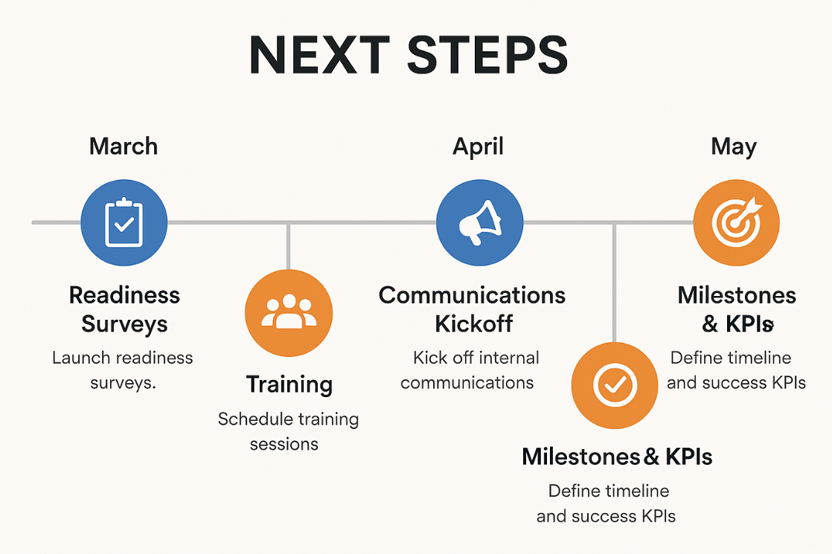

Slide 18
Conclusion
Salesforce CRM implementation crucial for SpartanLync’s digital transformation
Effective change management through clear communication, structured training, and ongoing reinforcement
Plan designed for sustainable and measurable performance improvement

Slide 19
References
Change Strategists. (2023). ADKAR Model Success Stories. Retrieved from https://changestrategists.com/adkar-model-success-stories-case-studies-of-companies-that-transformed-successfully/
Hiatt, J. (2006). ADKAR: A Model for Change. Prosci Learning Center Publications. Retrieved from https://www.prosci.com/adkar
Interview with Jorge Cantor (SpartanLync), conducted March 25, 2025, 9:00 PM via Microsoft Teams
Palmer, I., Dunford, R., & Buchanan, D. A. (2022). Managing Organizational Change: A Multiple Perspectives Approach. McGraw-Hill.
SAIT. (2025). Chapter 1-10 PPT. In MNGT-252: Change Management [MLA]. D2L/Brightspace. Retrieved from https://learn.sait.ca
SpartanLync Website – https://spartanlync.com
Whatfix. (n.d.). ADKAR Model: What Is It and How To Use It?. Retrieved from https://whatfix.com/blog/adkar-model-what-is-it-and-how-to-use-it/

Slide 20

Lets work together to make this change successful!
Thank You!

