Slide 1

Windows Platform Automation

Slide 2
Domains
Audio
Power Management
Storage

Slide 3

Hardware Requirement:
CPU(mother board) – Intel i5 / i7
Monitor –
Keyboard – Mouse
Laptop (Host )
Ethernet cables
Wi-Fi Adaptor
HDMI cables
3.5 mm splitter
Balancer
Male-Male – 3.5 mm Aux Cable
Sound Blaster
Roccat Juke
Storage devices – Hard disk and pen drives

Slide 4
Phase 1
Hardware Procurement.
Setting up the Hardware and Automation environment.
System setup (Dev testing) we establish the concept of system under test and the Host.
Involves writing detailed test case scenarios that covers various aspects of system under test for Audio , power and storage domains.
Manual execution (100% manual) of test case scenarios.

Slide 5
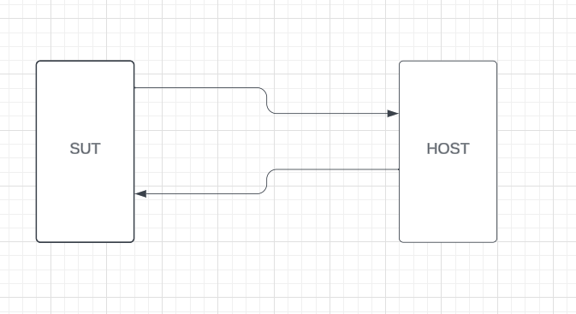
Concept of SUT and Host
SUT is generally the system under test where we perform the validation
HOST – Support the SUT for various requirements.
To support the System Under Test (SUT) as a human, we can simulate actions like pressing the power button or keyboard keys to wake it from sleep, hot plug/unplug and cold plug/ unplug actions just as a human would do.

Slide 6
Phase 2 [ 90% Automation]
Writing python scripts and execute the test scenarios.
Although the scripts require manual interventions for execution of the scripts individually.
We will verify or validate the expected outcomes.
Expected time

Slide 7
Phase 3 [ 100% Automation]
Python scripts execution with GitHub actions / Jenkins.
Here we take the automation to next level by integrating our python scripts with CI/CD tools like git hub actions or Jenkins
This achieves full automation with zero Manual intervention
Expected time

Slide 8

Audio Domain:
Audio Test scenarios.
Audio Quality verification.
Silence detection and silence verification.
Audio silence removal.
Audio forward verification.
Audio backward verification.
Audio Video sync verification.
Audio speech to text conversion.

Slide 9
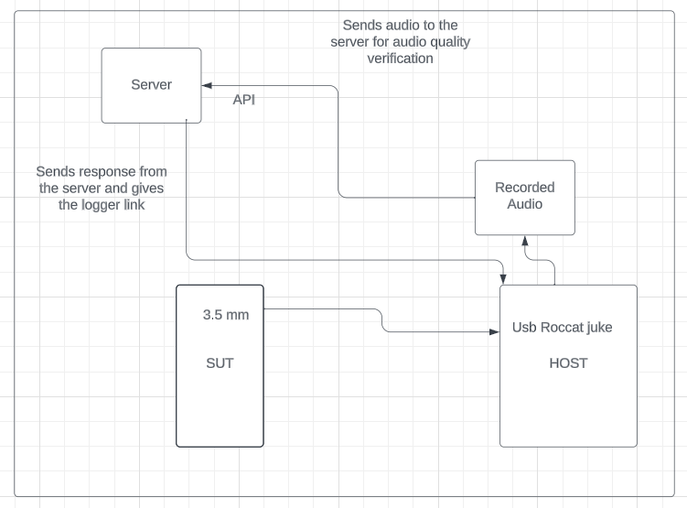
Audio Automation Flow

Slide 10
Phase – 4 of Automation
Developing our own Automation framework.
Case, component , Command level Tc implementations.
Domain wise Repo structured and creating WHL files , Choco files for customer usability.
External L-box requirements – Venkat to Speak

Slide 11
Power Domain
Performing all Sleep states.
Startup and Shutdown Tests.
Battery Life and Charging Tests.
AC/DC Power Source Switching.
Low Power Modes (S0ix) Tests.
Wake-on-LAN (WoL) Tests.

Slide 12
Storage Domain
Storage Device Detection and Recognition.
File System Tests.
Read/Write Performance Tests.
Storage Space and Capacity Tests.
Drive Encryption Tests.
Storage Performance Optimization Tests.

Slide 13

Time estimation for each phase :
Phase 1 – 2 weeks
1
Phase 2 – 6 weeks
2
Phase 3 – 6 weeks
3
Phase 4 – 10 weeks
4

Slide 14

Hiring plan
Plan to build a team of 5 members.
Team with 0–1-year experience people.
Training on automation about 3-4 months.

