Slide 1
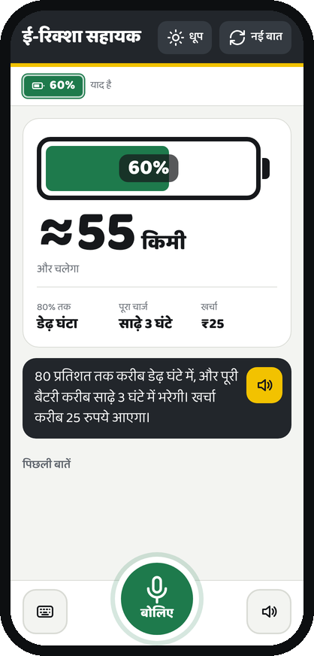
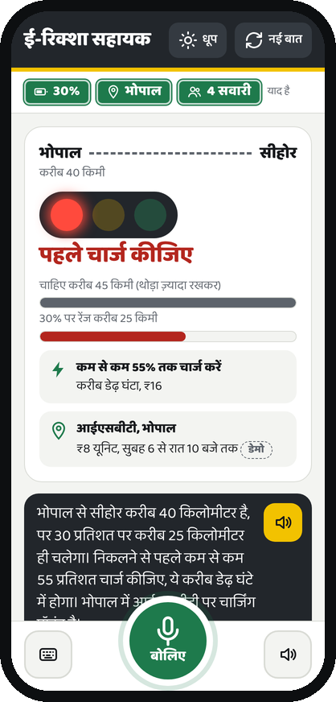
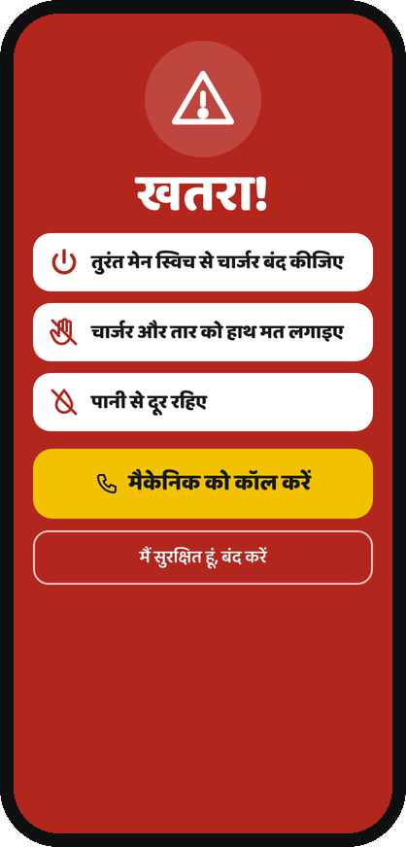
ई-रिक्शा सहायक
a voice app for e-rickshaw drivers
Ask in Hindi, get a spoken answer and a big, simple card: range, trip check, charging points, savings, step-by-step fixes and a safety alert.
Screens from the working web app
Notes:
Every screen in this deck is a screenshot of templates/index.html running against the real agent. Only the text-to-speech audio was replaced by silence for the screenshots, because no Gnani key was used.

Slide 2




Built for the driver's real conditions
Bright sunlight
One hand, cheap phone
High contrast cards, and a black-and-yellow sun mode.
Buttons of 58 px or more, no framework, works at 320 px wide.
Reading is hard
Noisy roads
Numbers, colours and icons carry the answer; the sentence is a backup.
Tap to answer, tap to confirm a number, and replay every reply.

Slide 3





How one question becomes an answer
Driver speaks
Gnani Prisma
Agent
Card on screen
Gnani Timbre
or taps a button
speech to text
rules, memory, tools
ui_view.py
Hindi voice reply
The agent is rule-based and works offline (no LLM). The card and the voice come from the same numbers.

Slide 4
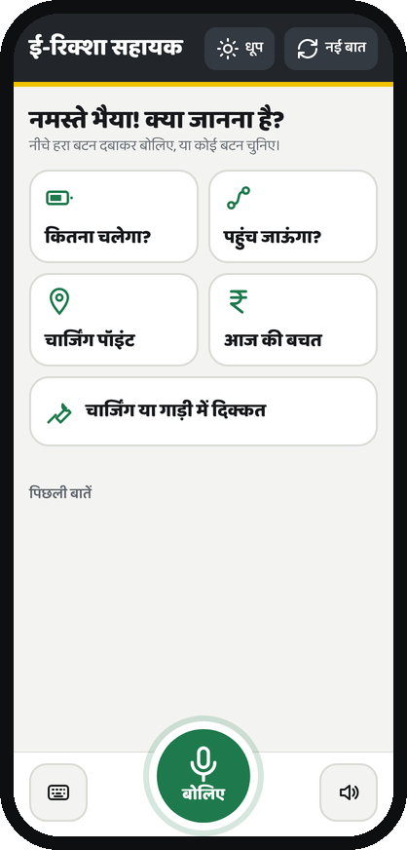


Start: one question, big buttons
Screen 1 of 12
What the driver sees
“नमस्ते भैया! क्या जानना है?” and five large tiles: range, trip, charging point, savings, a problem.
Why it helps
A driver who does not want to speak can still get every answer with one tap.
How it works
Each tile sends a Hindi sentence to /api/text, the same path as a spoken question.
Notes:
Start: one question, big buttons. “नमस्ते भैया! क्या जानना है?” and five large tiles: range, trip, charging point, savings, a problem. A driver who does not want to speak can still get every answer with one tap.

Slide 5
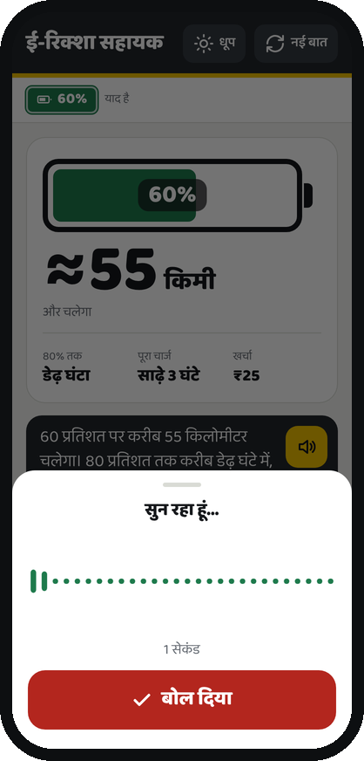
Speak: the mic sheet
Screen 2 of 12
What the driver sees
A sound wave while it listens, a seconds counter, and one big “बोल दिया” button.
Why it helps
The driver can see the phone is listening; it stops by itself after 15 seconds.
How it works
Browser records → 16 kHz WAV → /api/voice → Gnani Prisma speech-to-text.
Notes:
Speak: the mic sheet. A sound wave while it listens, a seconds counter, and one big “बोल दिया” button. The driver can see the phone is listening; it stops by itself after 15 seconds.

Slide 6
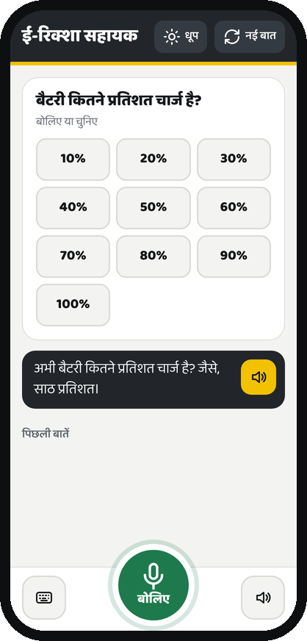
Tap instead of talk
Screen 3 of 12
What the driver sees
When the agent needs the charge %, it shows 10% to 100% as large buttons.
Why it helps
On a noisy road a tap is more reliable than saying “साठ” again.
How it works
The dialog manager sets a pending slot; ui_view.py turns it into choices.
Notes:
Tap instead of talk. When the agent needs the charge %, it shows 10% to 100% as large buttons. On a noisy road a tap is more reliable than saying “साठ” again.

Slide 7
Battery gauge: range, time and cost
Screen 4 of 12
What the driver sees
A battery filled to 60%, a huge “≈55 किमी”, time to 80% and full, and ₹25 cost.
Why it helps
The answer is readable in one glance; the voice says the same numbers.
How it works
range_calc and charge_time_cost tools; a test checks card and voice numbers match.
Notes:
Battery gauge: range, time and cost. A battery filled to 60%, a huge “≈55 किमी”, time to 80% and full, and ₹25 cost. The answer is readable in one glance; the voice says the same numbers.

Slide 8
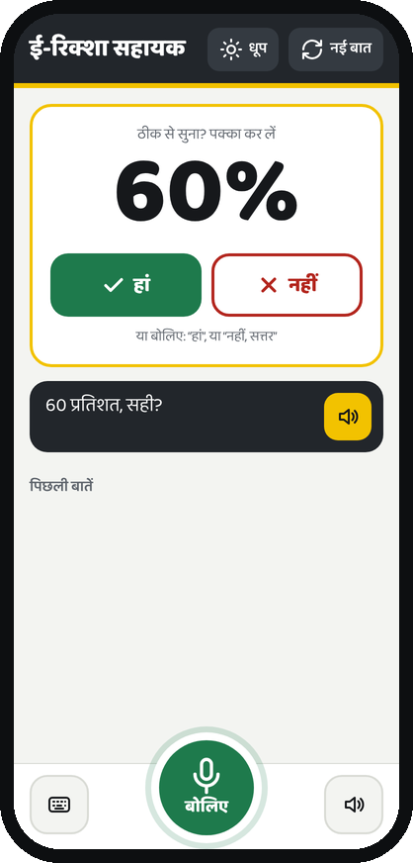
Confirm an unsure number
Screen 5 of 12
What the driver sees
A big “60%” with large हां / नहीं buttons when the number was heard without “प्रतिशत”.
Why it helps
A misheard number would give a wrong answer; one tap fixes it.
How it works
needs_confirm from the agent's read-back step.
Notes:
Confirm an unsure number. A big “60%” with large हां / नहीं buttons when the number was heard without “प्रतिशत”. A misheard number would give a wrong answer; one tap fixes it.

Slide 9
Will I reach? Red: charge first
Screen 6 of 12
What the driver sees
Bhopal to Sehore, a red light, range vs distance bars, a charge-to target and a demo station.
Why it helps
“पहुंच जाऊंगा?” becomes a colour plus one clear instruction.
How it works
trip_feasibility with a 15% safety buffer; the green plates show the 4 passengers it remembered.
Notes:
Will I reach? Red: charge first. Bhopal to Sehore, a red light, range vs distance bars, a charge-to target and a demo station. “पहुंच जाऊंगा?” becomes a colour plus one clear instruction.

Slide 10
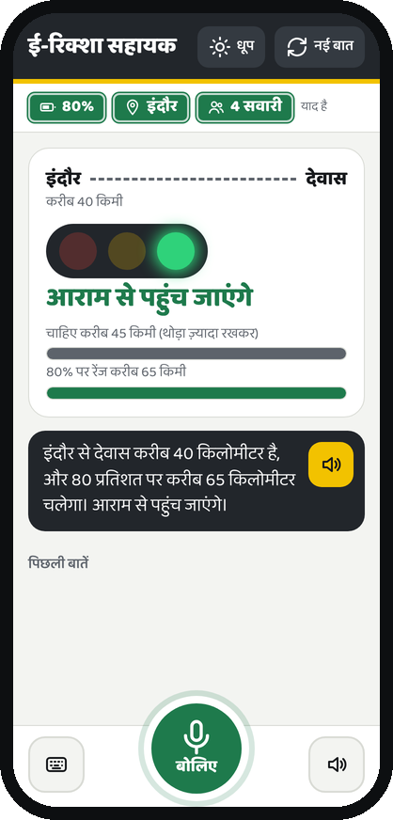
Will I reach? Green: go
Screen 7 of 12
What the driver sees
Indore to Dewas at 80%: green light and “आराम से पहुंच जाएंगे”.
Why it helps
When the trip is fine, the screen says so and nothing else.
How it works
Same tool, verdict “yes”; borderline trips show amber.
Notes:
Will I reach? Green: go. Indore to Dewas at 80%: green light and “आराम से पहुंच जाएंगे”. When the trip is fine, the screen says so and nothing else.

Slide 11
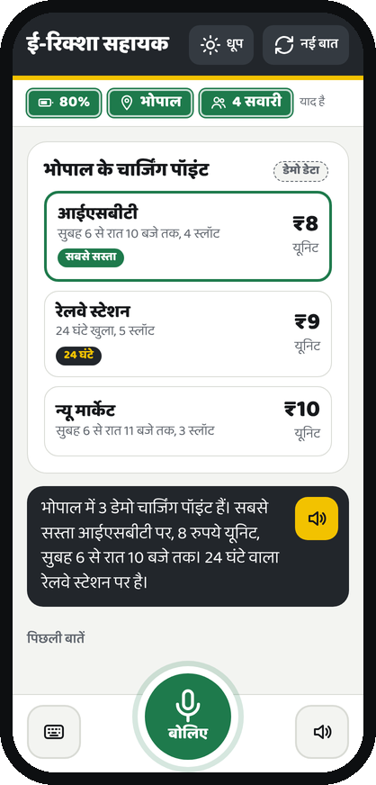
Charging points, cheapest first
Screen 8 of 12
What the driver sees
Cards with price per unit, hours and slots; cheapest and 24-hour points are tagged.
Why it helps
Comparing price and opening hours is easier on cards than in speech.
How it works
find_stations over stations.py, clearly labelled as demo data.
Notes:
Charging points, cheapest first. Cards with price per unit, hours and slots; cheapest and 24-hour points are tagged. Comparing price and opening hours is easier on cards than in speech.

Slide 12
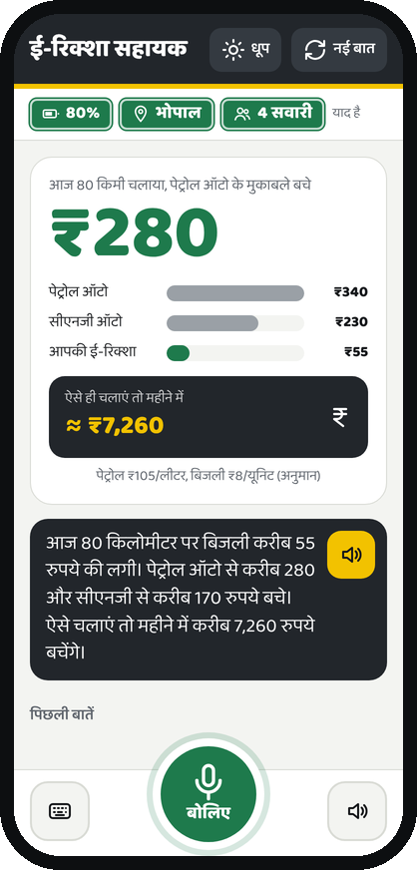
Today's savings
Screen 9 of 12
What the driver sees
“₹280” saved vs a petrol auto, bars for petrol, CNG and EV cost, and a monthly figure.
Why it helps
Money is what drivers care about; the fuel prices used are shown on the card.
How it works
savings tool; prices are assumptions in config.py.
Notes:
Today's savings. “₹280” saved vs a petrol auto, bars for petrol, CNG and EV cost, and a monthly figure. Money is what drivers care about; the fuel prices used are shown on the card.

Slide 13
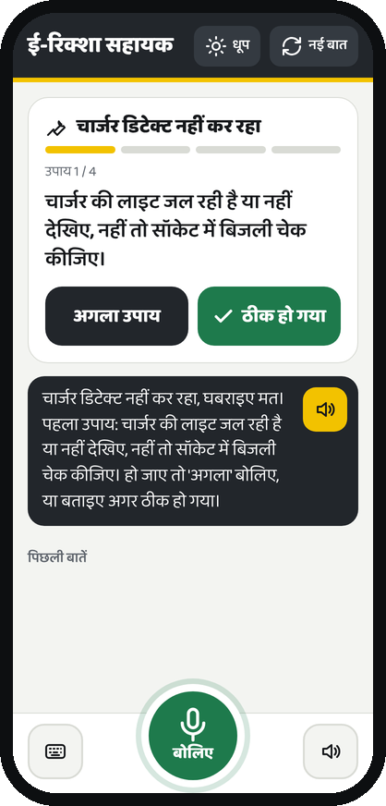
Fix a problem one step at a time
Screen 10 of 12
What the driver sees
One fix on screen with progress bars (1 of 4), and “अगला उपाय” / “ठीक हो गया”.
Why it helps
A long spoken list is hard to follow while standing at a charger.
How it works
trouble_flow and trouble_step in the session; a mechanic is suggested after the last step.
Notes:
Fix a problem one step at a time. One fix on screen with progress bars (1 of 4), and “अगला उपाय” / “ठीक हो गया”. A long spoken list is hard to follow while standing at a charger.

Slide 14
Safety takes over the screen
Screen 11 of 12
What the driver sees
Full red screen: switch the charger off, don't touch it, stay away from water, call a mechanic.
Why it helps
Smoke, sparks or a shock need an answer that cannot be missed; the phone also vibrates.
How it works
The safety check runs before every other intent and overrides open questions.
Notes:
Safety takes over the screen. Full red screen: switch the charger off, don't touch it, stay away from water, call a mechanic. Smoke, sparks or a shock need an answer that cannot be missed; the phone also vibrates.

Slide 15
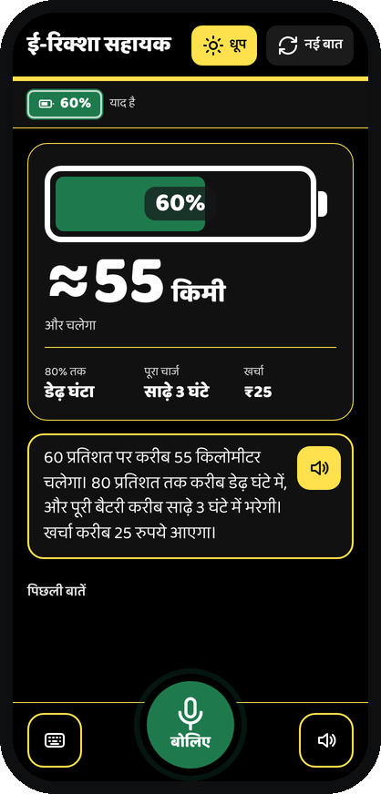
Sun mode for bright daylight
Screen 12 of 12
What the driver sees
Black and yellow, the same cards, and a replay button on every answer.
Why it helps
Readable in direct sunlight; replay helps when traffic drowns the voice.
How it works
A CSS theme toggle; the choice is remembered on that phone only.
Notes:
Sun mode for bright daylight. Black and yellow, the same cards, and a replay button on every answer. Readable in direct sunlight; replay helps when traffic drowns the voice.

Slide 16
Try it
Honest limits
Station data and route distances are demo data.
Range, charging and savings use assumed vehicle and fuel numbers.
No map: there is no GPS or real map data.
The mic needs HTTPS (or localhost) on a phone.
pip install -r requirements.txt
cp .env.example .env
python app.py
open http://localhost:5000
Without a Gnani key, buttons and typing still work; there is just no voice.

