Slide 1
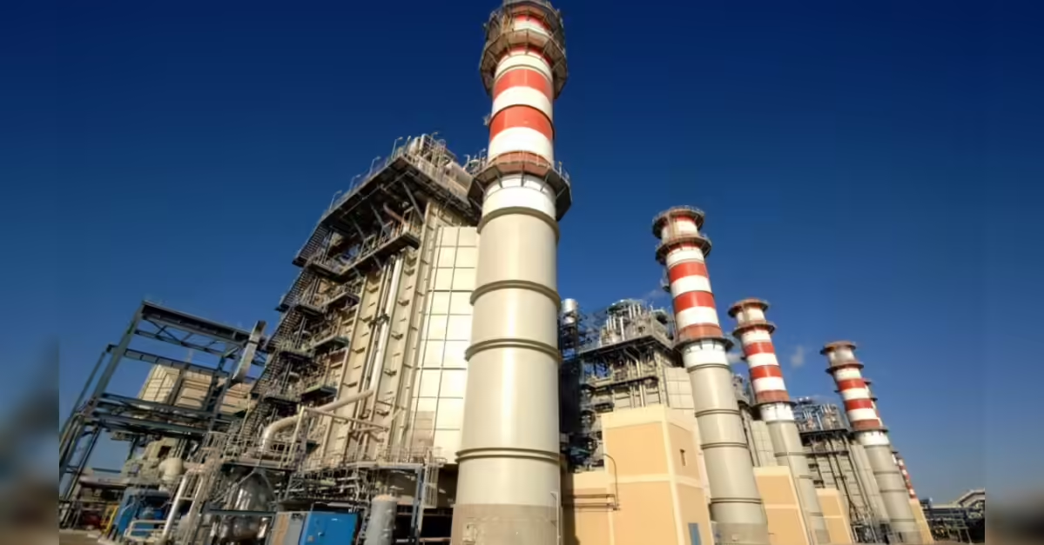

Overview of RIL VMD Power System
Prepared by
Vaibhav
GET Summer Intern - 2026

Slide 2
Content
Single Line Diagram
Distribution Network
Operating Scenarios
Load Shedding Scheme

Slide 3

Power Generation & Load
At RIL Vadodara Manufacuring Division,
65 MW
50 MW
Installed Generation Capacity
Average Peak Load

Slide 4








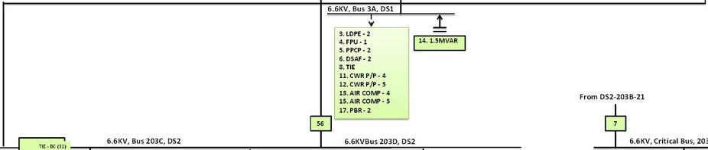










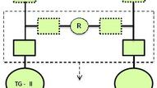


Jawaharnagar S/S GETCO
Jawaharnagar S/S GETCO
ABT Meter
ABT Meter
ABT Meter
GTG - (I & II) :-
Rating
33 KV GEB I/C - 1
33 KV GEB I/C - 2
GT - I
GT -II
CAPTIVE POWER PLANT
RELIANCE - VMD
STG - (I & II)
38.75MVA,11KV, 2P, 2034 A, Fld Cur - 538 A DC, Fld Vol - 250 V DC, GE make
33 KV GEB I/C - 3
:-15MVA,6.6KV,2P, 1367 A, Fld Cur - 404 A DC, Fld Vol - 170 V DC, BHEL make
Gen. Bkr.
Gen. Bkr.
STG - III :-
6.5MVA,11KV,4P,341 A, Fld Cur - 7.8A DC, Fld Vol - 84V DC, TDPS make
SLD - POWERGENERATION&DISTRIBUTION
URT - (I, II & III) :-
22.5/30MVA,ONAN/ONAF, 33/33 KV, DY1, BHEL make
Additional 33KV Switchboard
UT - (I & II)
:-40MVA,ONAN/ONAF, 11/33 KV, YD11, BHEL make
Additional 33KV Switchboard
SST & UAT - (I & II) :-
1600KVA,ONAN, 11/0.433 KV, DY1, Voltamp make
URT - 1
URT - 2
URT - 3
UT - 3 (Future Use)
TR - 101
:-20/26.5MVA,ONAN/ONAF, 33/6.9 KV, DY1, BHEL make
UT - 1
UT - 2
TR - 103
:-20/26.5MVA,ONAN/ONAF, 33/6.9 KV, DY1, Voltamp make
SST - 1
UAT - 1
11KV Switchboard
UAT - 2
SST - 2
TR - (X01, X02, 102 & 104)
:-16/21.5 MVA, ONAN/ONAF, DY1, 33/6.9 KV, BHEL make
TR-(111, 112, 131, 132, 133, 134):
1.6 MVA ONAN, 6.6/0.433 KV, Dy11
TR - 105 :-
16/21.5 MVA, ONAN/ONAF, DY1, 33/6.9 KV, BBL make 8.5 MVA, ONAN, Dyn1, 11/6.9 KV, Schneider make
7
Auxiliaries - GT1/HRSG1
Auxiliaries - GT2/HRSG2
TR - 106 :-
33KV Bus A
3
33KV Bus B
11
15
33KV Bus C
22
33KV Bus D
GTPP
TIE - AB (5)
10
TIE - BC(13)
TIE - CD(20)
24
25
26
27
GTPP
00
1
2
8
9
17
18
IOP
To BBP Plant - Feeder 1
To VCPVC Plant - Feeder 1
TR-X01
TR-102
TR-101
Spare
TR-104
TR-103
TR-X02
To VCPVC Plant - Feeder 2
TR-105
To BBP Plant - Feeder 2
IOP
9
6.6KV, Bus 205 DS1
13
6.6KV, Bus 204, DS1
1
6.6KV, Bus 3A, DS1
7
2. LDPE-2 3. PAD-1 4. PPCP-1 5. GAP-3
TIE - AB
14. FPU-2 16. PBR-1 19. ACN-2 20. N202-1
2. TIE (SWBD 205)
3. LDPE - 1
4. GAP-4
5. N2O2/EG - 2
8. CRITICAL BUS 203E
10. PAD - 2
3. LDPE - 2
4. FPU - 1
5. PPCP - 2
6. DSAF - 2
8. TIE
11. CWR P/P - 4
12. CWR P/P - 5
13. AIR COMP - 4 15. AIR COMP - 5 17. PBR - 2
7. 2MVAR
12. 2MVAR
9. 1.5MVAR
14. 1.5MVAR
Switchboards
From DS2-203B-21
From DS3-204-8
Bus - 33KV/A-B-C-D :- 1500 MVA, 26.2 KA, 3 Phase, 50 Hz
Bus - 11KV :- 750 MVA, 40 KA, 3 Phase, 50 Hz
Bus - 6.6KV/3A-203-204 :- 455 MVA, 40 KA, 3 Phase, 50 Hz
Bus - 6.6KV/1A-4A :- 250 MVA, 40 KA, 3 Phase, 50 Hz
Breaker - 33KV :- VCB, 1250A, 25KA/3S, Siemens make
Breaker - 11KV :- VCB, 1250A, 40KA/3S, Siemens make
Breaker - 6.6KV :- VCB & MOCB, 630-3150A, 26.2/40KA, jyoti/Siemens make
Breaker- 415 V:- ACB 800-2500 A, L&T make.
30
6.6KV, Bus 203A, DS2
9
6.6KV, Bus 203B, DS2
6.6KV, Bus 203C, DS2
TIE - CD (47) TIE - CD (47)
56
6.6KVBus 203D, DS2
7
6.6KV, Critical Bus, 203E, DS2
8
2. AIR COMP - 1
3. PTD LH TR - 109
4. BFW P/P - 4
5. XEC TR - 136 (ICI)
6. FD FAN - 4
7. LT TR - 112
8. CWR P/P - 6
11. LT TR - 132
13. W/S TR - 1
15. ACF REF COMP - 2
TIE - AB (16)
18. LT TR - 111
19. ACF REF COMP - 4 20. AIR COMP - 3
21. CRITICAL BUS 203E 22. FD FAN - 2
23. FIRE WATER P/P - 3
25. ACF COMP - 3
26. CWR P/P - 1
27. LDPE STAND BY
28. GTPP BFW P/P - 56
29. BFW P/P - 2
24
TIE - BC (31)
39
49. PTD LH TR - 110
50. LT TR - 131
51. FIRE WATER P/P - 2
52. ACF REF COMP - 7
54. BFW P/P - 3
55. CWR P/P - 3
57. LT TR - 134
58. FD FAN - 3
59. TR ESD BHAVAN - 135 60. AIR COMP - 6
61. ACF REF COMP - 6
62. BFW P/P - 5
1. VCPVC TR-114
2. LT EMG TR - 129
3. N2O2 EMG TR - 130 4.MAHISAGAR TRFDR 5. SST3
9. PBR - 1 EMG TR
11. SUMP TR2
12. PPCP EMG TR
13. LDPE EMG TR
Symbols
Legends
46
33. XEC TR - 137
34. LT TR - 133
35. ACF REF COMP - 5 36. BFW P/P - 3
37. W/S TR - 02
38. BFW P/P - 2
40. FIRE WATER P/P - 1 41. BFW P/P - 5
42. FD FAN - 5
43. CWR P/P - 2
44. AIR COMP - 2
Circuit Breakers (CB)
GT TG UT URT SST UAT
Gas Turbine Generator
Steam Turbine
Generator
Unit Transformer Unit Ratio
Tr a nsformer
Station Transformer
Unit Auxiliary
Tr a nsformer
Panel Nos.
GTPP IOP DS
Gas Turbine Power Plant
Integrated Offsite
Plant
Distribution
Substation
R
TR-106
Breakers generally not used for Isolation
STG Switch Board
33 KV Line
33 KV CB
11 KV Line
11 KV CB
TG - II
STG Switchboard
TG - I
6.6 KV Line
6.6 KV CB
NCP- TG-III
415 V Line
415 V CB
Plant Away
R
Reactor
00 to 62
Capacitor
Reliance Industries Limited
VadodaraManufacturing Division
P.O. - PETROCHEMICALS, Dist. Vadodara - 391346
CAPTIVE
POWER PLANT
Apr. By
Chk. By
Prep. By
MOC No
- BD012012BCESCPX006
Drg. No
- CPP-ELE-SLD-01
SLD of Captive Power Plant (CPP)

Slide 5
GTPP
(GTG-I & II
+ STG-III)
33 kV
Main Bus
(A/B/C/D)
Distribution
Transformers
(33/6.6 kV)
Plant
Loads
(6.6kV / 415V)
11 KV→UT→33 KV
Grid Support, 3 Incomers from GETCO
33 KV GEB I/C - 1 → feeds 33 kV Bus A
33 KV GEB I/C - 2 → feeds 33 kV Bus B/C area
33 KV GEB I/C - 3 → feeds additional 33 kV switchboard (Bus D side)

Slide 6
GTPP (GTG-I/II/STG-III) + GETCO 33kV
↓
33 kV Main Bus (A/B/C/D)
↓
Distribution Transformers (TR-101 to TR-106, TR-X01, X02)
↓
6.6 kV Buses (203A/B/C/D, 204, 205)
↓
LT Transformers (6.6/0.415 kV)
↓
415 V MCCs / DBs → Plant Loads

Slide 7
GTPP — Equipment Ratings & Status
Equipment
Rating
Make
Status
GTG - I
38.75 MVA, 11 kV, 2034 A
GE
RUNNING
GTG - II
38.75 MVA, 11 kV, 2034 A
GE
RUNNING
STG - I
15 MVA, 6.6 kV, 1367 A
BHEL
NOT IN SVC
STG - II
15 MVA, 6.6 kV, 1367 A
BHEL
NOT IN SVC
STG - III
6.5 MVA, 11 kV, 341 A
TDPS
IN SERVICE
UT - I & II
40 MVA, ONAN/ONAF, 11/33 kV, Ynd11
BHEL
Active
UT - III
53 MVA, ONAN/ONAF, 11/33 kV, Ynd11
Alstom
Active
URT - I & II
22.5/30 MVA, 33/33 kV, DY1
BHEL
Active
SST & UAT I/II
1600 kVA, 11/0.433 kV, DY1
Voltamp
GT Auxiliaries
SST - III
1600 kVA, 6.6/0.433 kV, DY11
Bharat Bijlee
Fed from 6.6kV

Slide 8
Single Line Diagram — VMD CPP Power Architecture
11 kV
33 kV
6.6 kV
415 V
Offline
GTG-I
20.76 MW
33 kV Main Bus A — B — C — D (1500 MVA, 26.2 kA)
GETCO 33kV (I/C 1, 2, 3)
UT-I
11/33kV
ABT Metered
GTG-II
20.48 MW
UT-II
11/33kV
TR-101 TR-102 TR-X01 TR-X02 TR-103 TR-104 TR-105 TR-106
33/6.6 kV | 16–26.5 MVA each
STG-III
6.5 MVA
UT-III
6.6 kV Buses 203A / 203B / 203C / 203D / 204 / 205 (455 MVA, 40 kA)
SST-III 6.6/0.415kV
(Bharat Bijlee)
LT Transformers 6.6/0.415 kV | 1.6 MVA each (TR-111, 112, 131–134, 129)
SST/UAT I&II 11/0.415kV
GT Auxiliaries
415 V Distribution | MCCs / DBs | Plant Loads
IOP Substations — PS1 | PS2 | PS3
Integrated Offsite Plant | Fed from 6.6 kV / 415 V network

Slide 9
Power Flow — Normal Operating Condition
GTG-I → 20.76 MW
GTG-II → 20.48 MW
STG-III → ~5 MW (est.)
Total Captive: ~46 MW
GETCO Grid
3 × 33 kV Incomers
Import: ~4–9 MW
(peak balance)
33 kV Main Bus (A/B/C/D)
Total supply: ~50 MW
Bus fault level: 26.2 kA
Power Balance
Installed Cap.
65 MW
Peak Load
50 MW
GTG-I
20.76
Distribution Transformers
33 kV → 6.6 kV
TR-101 to TR-106, X01, X02
GTG-II
20.48
STG-III
~5 MW
Grid Import
~4–9 MW
6.6 kV Buses | Plant Process Loads
LDPE, PPCP,, FPU, VCPVC, BBP
Pumps, Pumps, Air Compressors
Headroom
~15 MW

Slide 10
Distribution Network — 6.6 kV & 415 V
6.6 kV Bus Network
Distribution Transformer Ratings
Bus 203A (DS2)
TR-X01 → LDPE-2, PAD-1, PPCP-2, FPU-1
Tag
Rating
Ratio
Make
TR-101
20/26.5 MVA
33/6.9 kV
BHEL
Bus 203B (DS2)
TR-102 → LDPE-1, GAP-4, N2O2/EG-2, PAD-2
TR-102
20/26.5 MVA
33/6.9 kV
BHEL
Bus 203C (DS2)
TR-104 → AIR COMP, CWR P/P, FD FAN, PBR
TR-103
20/26.5 MVA
33/6.9 kV
Voltamp
TR-104
16/21.5 MVA
33/6.9 kV
BHEL
Bus 203D (DS2)
TR-103 → LT TR-133/134, BFW P/P, ACF COMP
TR-X01, X02
16/21.5 MVA
33/6.9 kV
BHEL
Bus 204 (DS1)
TR-X02 → BFW P/P, PTD LH TR, AIR COMP
TR-105
16/21.5 MVA
33/6.9 kV
BBL
Bus 205 (DS1)
TR-101 → LDPE-2, PPCP-1, GAP-3, PAD-1
TR-106
8.5 MVA
11/6.9 kV
Schneider
TR-111/112/131–134
1.6 MVA ea
6.6/0.415kV
Critical Bus 203E
Fed from 203B + 204 | EMG Transformers
SST-III
1600 kVA
6.6/0.415kV
Bharat Bijlee

Slide 11
Load Shedding Scheme — VMD Captive Power Plant
10 Sheddable Load Blocks
50 MW
28.8 MW
21.2 MW
Block
Load
MW
Site Load
Sheddable Load
Non-Sheddable Load
B-1
R&D AC, FPU Prop Comp, PPCP Extruder, PT, Water, PBR Finishing, VCPVC KPC Chiller
4.9
54.8 MW after ACN
10 blocks
Always live
B-2
LDPE #11
5.5
Generation Sources — Capacities
B-3
LDPE #12
5.5
Each GT Capacity
30 MW
STG-3 Capacity
3.5 MW
B-4
LDPE #11 + R&D
5.8
Each GETCO Incomer (cont.)
20 MVA
B-5
FPU Prop Comp, PT, Mahisagar, PBR1/2 Finishing
2.7
No. of GETCO Incomers
3
B-6
LDPE #12
5.5
How It Works
B-7
N2O2 (excl. NHPN) + EQ
2.7
1
PLC detects source loss
Generator breaker or grid incomer trips — detected within 50 ms
B-8
PPCP
2.0
2
Condition matched (C01–C16)
B-9
VCPVC
5.5
PLC maps live sources to one of 16 pre-defined conditions
3
Block breakers trip
B-10
PBR1 + PP4 / PBR2 + BBH (BD Comp)
5.5
Required load blocks shed simultaneously within 200 ms
Total Sheddable
28.8 MW

Slide 12
Load Shedding — 16 Operating Conditions (PLC Logic)
GT = Gas Turbine (30 MW each)
GEB = GETCO Grid Incomer (20 MW each)
STG3 = Steam Turbine Gen (3.5 MW)
UF2/UF3 = Underfrequency relay stages
Cond.
Generation Available
Operating Loads (remain ON)
MW Available
C01
1GT + 3GEB
Full plant — no shedding needed
90 MW
C02
1GT + 2GEB
Full plant — no shedding needed
70 MW
C03
1GT + 1GEB
MAHI, R&D, MLS Z0
50 MW
C04
STG3 + 3GEB
MAHI, R&D, MLS Z0, LDPE-11, LDPE-12
63.5 MW
C05
STG3 + 2GEB
MAHI, R&D, MLS Z0, LDPE-11, LDPE-12
43.5 MW
C06
STG3 + 1GEB
MAHI, R&D, MLS Z0, LDPE-11/12, FPU, PT, N2O2, EQ, PPCP, VCPVC, PP4, PBR-1/2, BD Comp, ACN
23.5 MW
C07
3GEB (no GT)
MAHI, R&D, MLS Z0, LDPE-11, LDPE-12
60 MW
C08
2GEB (no GT)
MAHI, R&D, MLS Z0, LDPE-11, LDPE-12, N2O2, EQ
40 MW
C09
1GEB (no GT)
MAHI, R&D, MLS Z0, LDPE-11/12, FPU, PT, N2O2, EQ, PPCP, VCPVC, PP4, PBR-1/2, BD Comp, ACN
20 MW
C10
1GT (islanded)
MAHI, R&D, MLS Z0, LDPE-11/12, FPU, PT, N2O2, EQ, PPCP, VCPVC, PP4, PBR-1/2, BD Comp
30 MW
C11
1GT + UF2
... + ACN added (UF2 stabilised)
30 MW
C12
1GT + STG3
MAHI, R&D, MLS Z0, LDPE-11/12, FPU, PT, N2O2, EQ, PPCP, PP4, PBR-1/2, BD Comp (VCPVC shed)
33.5 MW
C13
1GT + STG3 + UF2
... + VCPVC added back
33.5 MW
C14
1GT + STG3 + UF2 + UF3
All loads incl. ACN
33.5 MW
C15
2GT + STG3 + UF2
MAHI, R&D, MLS Z0, LDPE-11, FPU, PT, PP4, PBR-1/2, BD Comp
63.5 MW
C16
2GT + STG3 + UF2 + UF3
MAHI, R&D, MLS Z0, LDPE-11/12, FPU, PT, N2O2, EQ, PP4, PBR-1/2, BD Comp
63.5 MW

Slide 13
Load Shedding — Why, What Never Sheds, & Future State
Why Load Shedding?
Non-Sheddable Loads — 21.2 MW — ALWAYS ON
⚡
Generation < Load
Fire Water Pumps
Frequency drops — generators trip — complete blackout
Safety — cannot lose under any condition
⏱
Speed is critical
GT Auxiliaries
PLC detects & sheds within 200 ms — human reaction impossible
Lube oil, cooling — stops GT = more generation lost
🏭
Protect plant
Critical Bus 203E
Controlled shed prevents process upsets in LDPE, PPCP, VCPVC reactors
EMG transformers, ESD systems, dual-fed bus
🔒
Safety loads stay on
Min. Cooling Water Pumps
Fire pumps, ESD, GT auxiliaries — always live, always protected
Equipment protection — overheating risk
Control & Instrumentation
UF2 / UF3 — Underfrequency Relay Stages
DCS/PLC must stay live to manage the plant
Normal
50.0 Hz
All loads on, system stable
Township Essential Supply
UF2
~49.0 Hz
Additional blocks shed automatically
Safety lighting, emergency systems
Future State — After ACN Startup
UF3
~48.5 Hz
Further shedding — last safety net
Parameter
Now
After ACN
Site Load
50 MW
54.8 MW
Blackout
< 47 Hz
Total plant trip if nothing arrested it
Sheddable Load
28.8 MW
33.6 MW
Non-Sheddable
21.2 MW
21.2 MW
ACN added to scheme
—
4.8 MW block added

Slide 14
Gas Turbine
Steam → process
GT1 / GT2 | 38.75 MVA 11 kV | GE Mark VI | RIL VMD
HRSG
Gas fuel
11 kV → UT → 33 kV
563 °C exhaust
→ Main Bus
3381 l/min
Combustion
Compressor
Turbine
GCV + SRV (gas)
Generator
CPD 7.7 kg/cm²
FSR 45.6%
5078 rpm 99.6%
AIR IN
332 °C discharge
Max vib 3.65 mm/s
21.8 MW 14 MVAR
11 kV | CB1
shaft
36 °C
IGV
55°
CC
① Compressed air
② Combustion gases
③ Mechanical rotation
Dual output
7.7 kg/cm² | 332 °C
High temp + pressure
5078 rpm → shaft → gen.
Power + Steam
from one fuel

Slide 15
GT1 / GT2 — Gas Turbine Overview
GE Mark VI · 38.75 MVA · 11 kV ·
30 MW
5080 rpm
3000 rpm
2-Pole
11 kV
563 °C
Rated Power
Turbine Speed
Generator Speed
Sync @ 50 Hz
Terminal
Exhaust
① Inlet Air
② Compressor
③ Combustion
④ Turbine
⑤ Generator
⑥ HRSG
36 °C | IGV 55°
7.7 kg/cm²
332 °C
10 cans
FSR 45.6%
5078 rpm
99.6%
21.8 MW
14 MVAR
563 °C
Steam→proc
5080 → 3000 rpm
Combustion System
Generator & AVR
India grid = 50 Hz. 2-pole sync generator must spin at 3000 rpm:
Ns = 120 × f / P = 120 × 50 / 2 = 3000 rpm
10 Can combustors
Annular can-type
Rated MVA
38.75 MVA
Flame detectors
4 nos. UV/IR
Poles
2-pole synchronous
Can #1 (leftmost)
Diesel engine pilot
Sync speed
3000 rpm @ 50 Hz
GCV / SRV
Gas control / shutoff
Voltage
11 kV → UT → 33 kV
LCV
Distillate fuel valve
AVR
Holds 11 kV; controls MVAR
Fuel options
Gas / Mix / Distillate
Over-excit.
Exports MVAR (lagging pf)
Gas flow
3381 l/min
Droop / Isoch
Grid / Islanded mode

