Slide 1


2021
REGENERATION CONSULTANTS
Mpg prediction during Fleet Renewal

Slide 2

AGENDA
INTRODUCTION
OPERATION: NEW FLEET
FUEL CONSUMPTION
PROOF OF CONCEPT
BENEFITS
QUESTIONS

Slide 3
AGENDA
INTRODUCTION

Slide 4
Introduction/ Who we are?
Regeneration Consultants: International consultancy company.
Over 30.000 employees around the world.
For this project→ Department of Car rental companies consulting
Contact Us:
Tel +30210xxxxxxxxxx
Email rentcar@recon.com

Slide 5
AGENDA
OPERATION: NEW FLEET

Slide 6
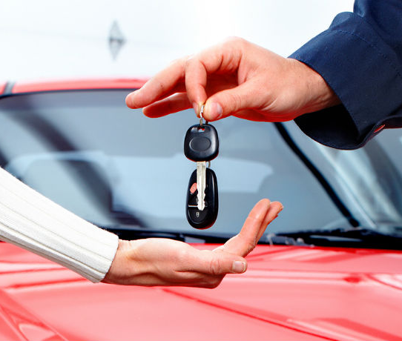
OPERATION: RENEW CAR FLEET
Takes part averagely every 13 months
Cars are replaced on 32.5 K miles on average
Many factors to take into account
We will focus on fuel consumption of the cars

Slide 7
AGENDA
FUEL CONSUMPTION

Slide 8

FUEL CONSUMPTION
Varies from car to car
One of the basic car expenses
Transport fuels produce CO2 emissions

Slide 9

Carbon Dioxide Emissions
Based on ourworldindata.org

Slide 10
Environmental Protection Agency of USA
“Every gallon of gasoline burned creates about 8887 grams of CO2’’

Slide 11
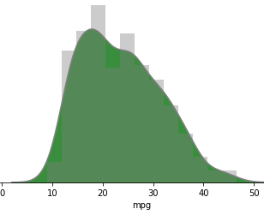
CURRENT SITUATION
According to our dataset:
Average mpg comes to 23.5
Median of mpg is 23
23.5 mpg equals to 10 L / 100 km

Slide 12
CURRENT SITUATION

Slide 13

Fuel expenses → Unhappy customers

Slide 14
CURRENT SITUATION

Slide 15
AGENDA
BENEFITS

Slide 16

BENEFITS OF LOW FUEL CONSUMPTION
Re- fuelling after more miles → Lower fuel costs
Reduction of CO2 emissions → Environmental Sustainability

Slide 17
The Dataset
Quantity of Cars: | 398 | Origins: | USA, Japan, Europe
Number of Attributes: | 8 | Regression on: | Miles per gallon
Provided by Airbnb

Slide 18
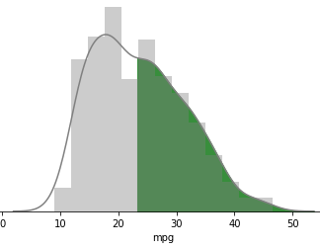
The Solution
Selection ONLY above the median of 23 mpg
Your new fleet average mpg → 30.32
30.32 mpg → 7.76 L/100 km

Slide 19
50 % SELECTION

Slide 20
50 % SELECTION

Slide 21
CURRENT vs 50% vs 75%

Slide 22
BENEFITS
Dropping to 50%
Reduction of customer’s fuel expenses to 77.6% of the current
Reduction of CO2 emissions also to 77.6% of the current
Dropping to 75%
Reduction of customer’s fuel expenses to 68.4% of the current
Reduction of CO2 emissions also to 68.4% of the current

Slide 23
AGENDA
PROOF OF CONCEPT

Slide 24
PROOF OF CONCEPT
DATASET PREPROCESSING
Replaced nan values of horsepower based on k means
Dropped rows containing mpg nan values
Extracted brand name of each car from car name
Created two clusters, taking into account all attributes except mpg
Performed get dummies to transform categorical attributes to numerical ( Origin etc.)

Slide 26
AGENDA
INTRODUCTION
OPERATION: NEW FLEET
FUEL CONSUMPTION
PROOF OF CONCEPT
BENEFITS
QUESTIONS

Slide 27


ANY QUESTIONS?

