Slide 1




2021
REGENERATION CONSULTANTS
Predicting the City-Cycle Fuel Consumption in Miles per Gallon of a Car

Slide 2

AGENDA
INTRODUCTION
OPERATION: NEW FLEET
FUEL CONSUMPTION
PROOF OF CONCEPT
BENEFITS
QUESTIONS

Slide 3
AGENDA
INTRODUCTION

Slide 4




Introduction
Regeneration Consultants → Greek consultancy company specialized in many domains
For this project → Department of Car rental companies’ consulting
Contact Us:
Tel +30210xxxxxxxxxx
Email rentcar@recon.com

Slide 5
AGENDA
OPERATION: NEW FLEET

Slide 6
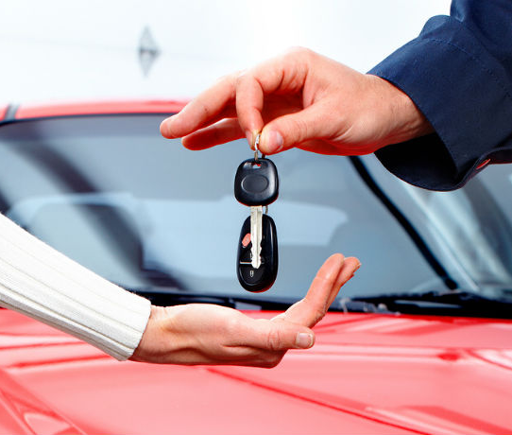
OPERATION: NEW FLEET
According to big companies annual reports ( Hertz ,Avis etc ) ,each year they change roughly 92% of their fleet.
Cars are replaced on 32.5 K miles on average
Many factors to take into account
We will focus on fuel consumption of the cars

Slide 7
AGENDA
FUEL CONSUMPTION

Slide 8
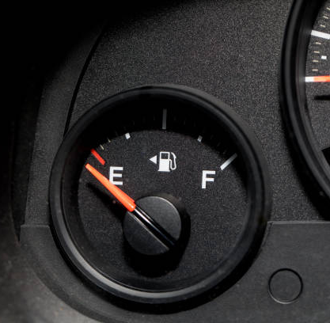
FUEL CONSUMPTION
Varies from car to car
One of the basic car expenses
Transport fuels produce CO2 emissions

Slide 9

According to a study conducted by market research firm Kelton Global for the American Chemistry Council
Americans rank fuel efficiency as the MOST important factor in their decision to purchase a vehicle.

Slide 10

Big fuel expenses →
Unhappy customers

Slide 11
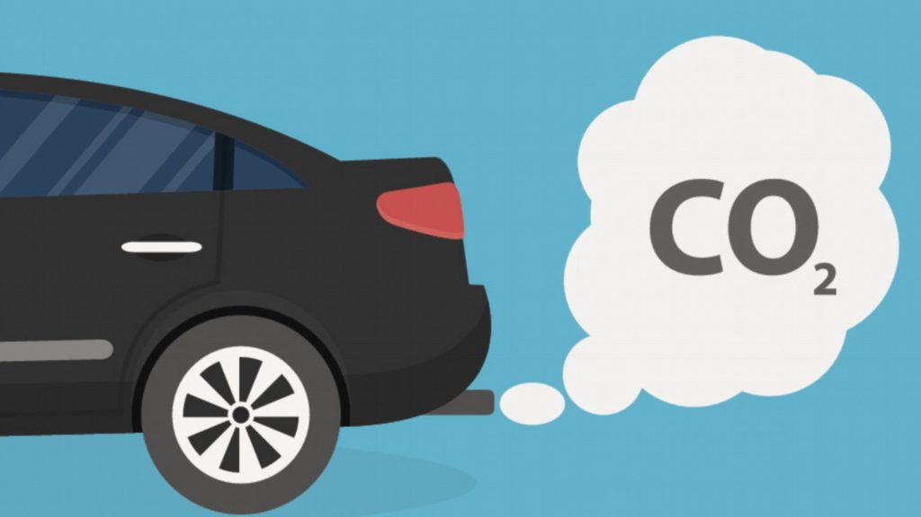
Carbon Dioxide Emissions
Based on ourworldindata.org

Slide 12
Environmental Protection Agency of USA
“Every gallon of gasoline burned creates about 8887 grams of CO2’’

Slide 13
AGENDA
BENEFITS

Slide 14

BENEFITS OF LOW FUEL CONSUMPTION
Re- fuelling after more miles → Lower fuel costs
Reduction of CO2 emissions → Environmental Sustainability

Slide 15
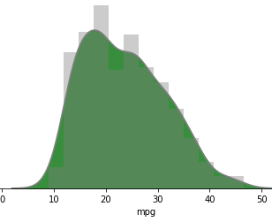
CURRENT SITUATION
Average mpg comes to 23.5
23.5 mpg equals to 10 L / 100 km
CO2 emissions up to 23.47 kg/100 km
Selection Area

Slide 16
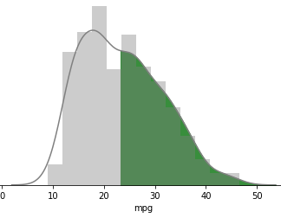
The Solution
Selection ONLY above the median of 23 mpg
Your new fleet average mpg → 30.32
30.32 mpg → 7.76 L/100 km
Selection Area

Slide 17
50 % SELECTION

Slide 18
50 % SELECTION

Slide 19
Comparison of Current , 50% and 75%

Slide 20
AS A RESULT
Select over 50%
Reduction of customer’s fuel expenses by 22.4%
Reduction of CO2 emissions also by 22.4%
Select over 75%
Reduction of customer’s fuel expenses by 31.6%
Reduction of CO2 emissions also by 31.6%

Slide 21
AGENDA
PROOF OF CONCEPT

Slide 22
The Dataset
Quantity of Cars: | 398
Number of Attributes: | 8
Target: | Miles per gallon
Attributes
Cylinders
Displayments
Horsepower
Weight
Acceleration
Model Year
Origin
Car name
Provided by Airbnb

Slide 23

Exploratory Data Analysis
Inspect for missing values, outliers
Study distributions of the data
Study correlations of the data
Make assumptions

Slide 24
Preprocessing
Fix cylinder error values (3 -> 4, 5 -> 6)
Train horsepower regression model
Use model to fill horsepower missing values
Drop rows with N/A mpg
Build dummies for origin, cylinders
Extract brand_name from car_name
Encode categorial values of brand_name

Slide 25

Model Evaluation
Build custom evaluation algorithm
Evaluate various regression algorithms
Choose the best regression algorithm
Optimize the regression algorithm
Build optimized model

Slide 27
In conclusion thanks to our product
Fuel consumption will convert into a critical factor during fleet renewal
Low fuel consumption will offer more and happier customers since they spend less
A company using it will produce less CO2 emissions, improving and proving its environmental consciousness
Visualize your fleet attributes at any time

Slide 28
AGENDA
INTRODUCTION
OPERATION: NEW FLEET
FUEL CONSUMPTION
PROOF OF CONCEPT
BENEFITS
QUESTIONS

Slide 29


ANY QUESTIONS?
For more details feel free to visit our portfolio https://github.com/regeneration-team-3/Project-Team-3

