Slide 1
Inside air TCd1
Concrete
Insulation
Convection
Wall TCd0
Glass TCd2
Double glazed
Roof TCd4
Ventilation
Heater
insulation
Dirt ground to 10m deep
Ventilation and heating TCd3
floor
TCd5
Air gap
Wooden Floor

Slide 2
Inside air TCd0
Concrete
Insulation
1 1 1
Convection
Wall TCd2
0 6 5
1 7 6
3 9 8
2 8 7
4 10 1
2 2 2
3 3 3
Glass TCd3
0 11 9
4 4 4
1 12 2
0 0 0
Double glazed
Roof TCd4
0 13 10
1 14 11
2 15 3
Ventilation
0 5 0
Heater
insulation
Dirt ground to 10m deep
0 16 12
1 17 13
2 18 14
3 19 4
Ventilation and heating TCd1
Floor TCd5
Air gap
Wooden Floor

Slide 3


W0
0
1
2
3
$$T_{0}$$
4
0
$$Φ_{0}$$
1
2
3
4
Floor
0
1
2
3
4
5
6
7
8
9
10
$$T_{0}$$
0
1
2
3
4
5
6
7
8
9
10
Roof
0
1
2
$$T_{0}$$
0
1
2

Slide 4


Inside air
0
0
1
1
4
2
3
2
3
0
$$T_{0}$$
0
1
$$T_{i,sp}$$
0
1
2
0
1
2
3
3
$$T_{0}$$

Slide 5
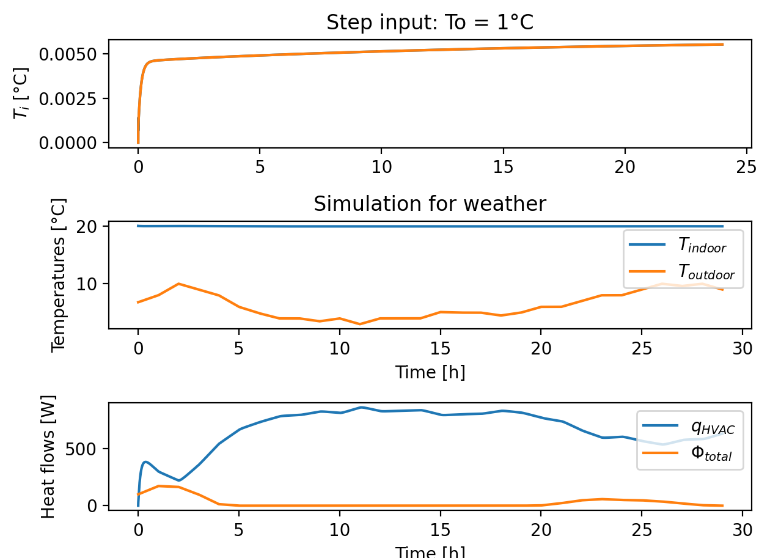
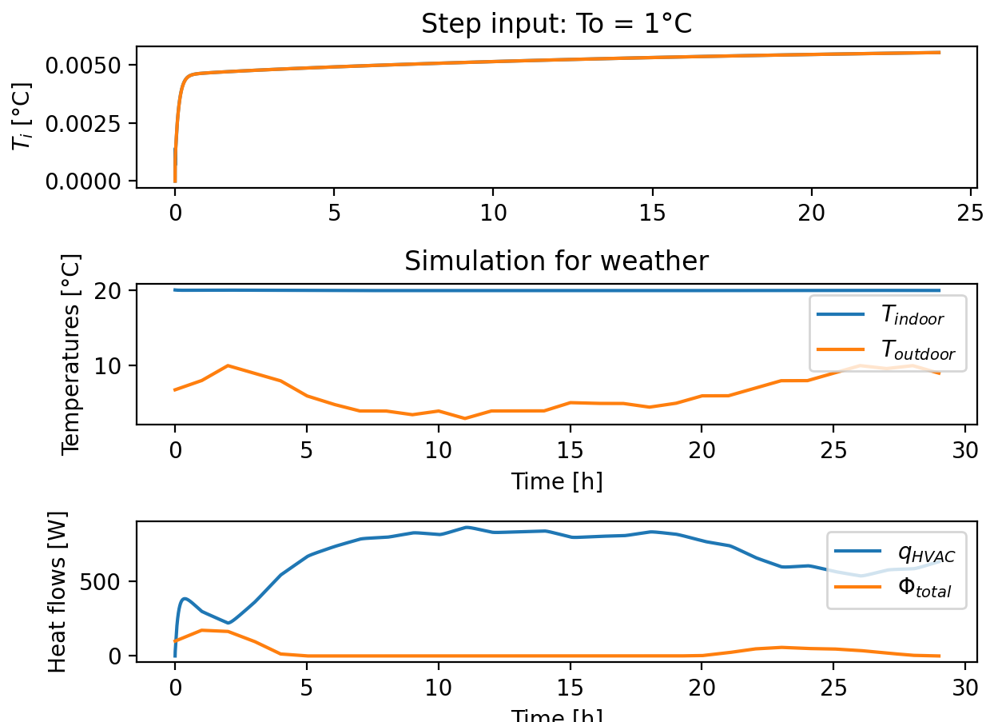

Slide 6
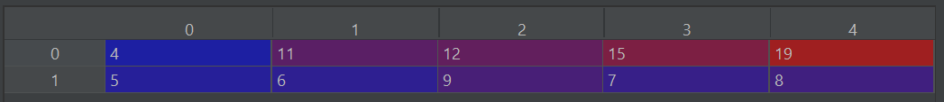
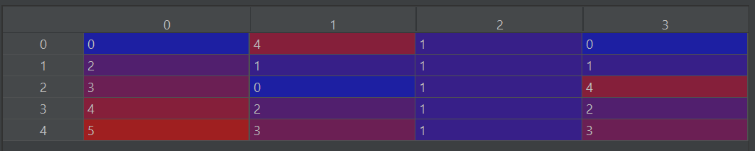

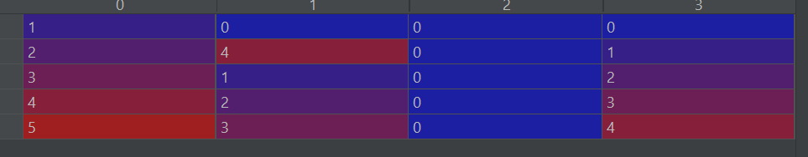
Current
New

Slide 7
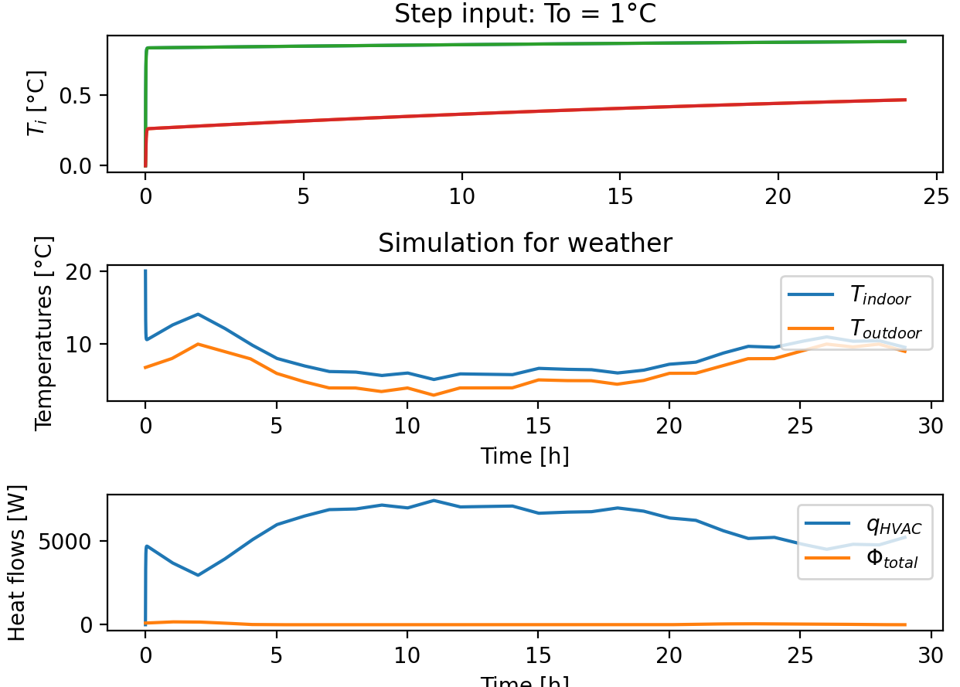

Slide 8



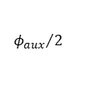

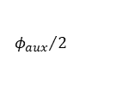

TCd2
0
1
2
3
$$φ_{i}$$
- +
4
$$T_{0}$$
0
1
2
3
4
$$φ_{0}$$
TCd3
0
1
2
3
$$φ_{i}$$
- +
4
$$T_{0}$$
0
1
2
3
4
$$φ_{0}$$
1
0
$$φ_{i}$$
2
1
TCd4
- +
0
1
2
3
TCd0
$$T_{0}$$
0
1
2
3
4
4
3
2
0
$$φ_{0}$$
4
$${φ_{aux}}/2$$
TCd5
$$φ_{a}$$
3
- +
0
1
$$T_{0}$$
0
1
5
4
$$φ_{i}$$
6
TCd6
- +
0
1
5
$$T_{0}$$
0
1
2
2
$$φ_{0}$$
- +
0
+ -
TCd7
$$T_{0}$$
0
1
$$T_{i,sp}$$
$$φ_{i}$$
TCd1
$${φ_{aux}}/2$$
- +
0
1
2
3
4
$$T_{g}$$
0
1
2
3
4

