Slide 1

Midterm Presentation Examination of TMS effect using EEG Signal
Students: Matan Allouche, Reggev Livney
Supervisor: Or Yair
Semester: Winter 2017-2018
Date: 17.1.2018
In Collaboration with: BrainSway

Slide 2
Outline
This slide should contain an outline (list of headings) of the presentation
Maximum 5-6 bullets

Slide 3

Background
MDD – also known as depression is estimated to affect $\sim 3\%$ of the world population.
Caused by genetics, environment and psychological factors.
Most commonly treated by counseling and by medication.

Slide 4
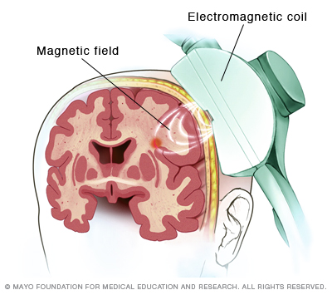
Background
The FDA approved new treatment called TMS.
TMS (Transcranial magnetic stimulation) – EM pulses through the skull.
TMS therapy on the left prefrontal cortex (lPFC), the right prefrontal cortex (rPFC), the right parietal cortex (rPC) and the cerebellum (Crbllm) showed evidences of ease of depression.

Slide 5
Background
BrainSway® treats patients by TMS.
Psychiatrist monitors the depression level of the patients using “Hamilton Depression Rating Scale” (HDRS).
The company measures EEG from subjects during the treatment.

Slide 6
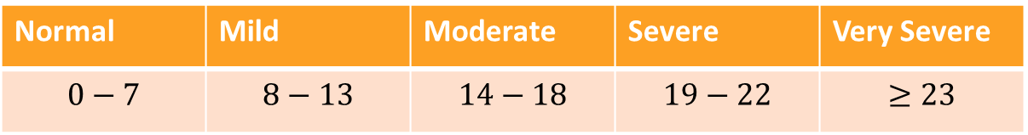
Background
HDRS contains 17 questions (+ 4 optional questions).
Each question contributes to the total rate.
Normal | Mild | Moderate | Severe | Very Severe
$$0−7$$ | $$8−13$$ | $$14−18$$ | $$19−22$$ | $$≥23$$
http://tools.farmacologiaclinica.info/index.php?sid=43496

Slide 7
Background
A psychiatrist graded the “depression level” during 5 sessions.
Each session contains around 45 trials made by (an arbitrary process).

Slide 8
Project Goal
To evaluate the depression rating of a patient using only EEG signals.
To find the therapy efficiency using those signals.

Slide 9
Main Approach
To find a regression algorithm that correlates with the HDRS using machine learning methods.
To use advanced techniques of feature extraction and selection.
Manifold learning using different metrics.
Non linear dimension reduction.

Slide 10
Chosen Solution
Geometric metric
Riemannian tools for dimension reduction
Diffusion maps and tSNE
Features selection
Non-linear dimension reduction
Regression algorithm to estimate efficiency
signals EEG
Psychiatrist evaluation

Slide 11
Raw Data
~23 subjects
62 EEG electrodes
5 sessions (every week)
35-50 trials for each subject in a session.
Trial time - 2 sec = 2000 samples at 1000 Hz
The pulse is in the middle of the trial.

Slide 13
Challenges
Noisy signals
High dimension data
No spatial information
Electrodes are linearly dependent
Varying signals intensities

Slide 16
Intermediate Results
WE ARE SCREWED!

Slide 17
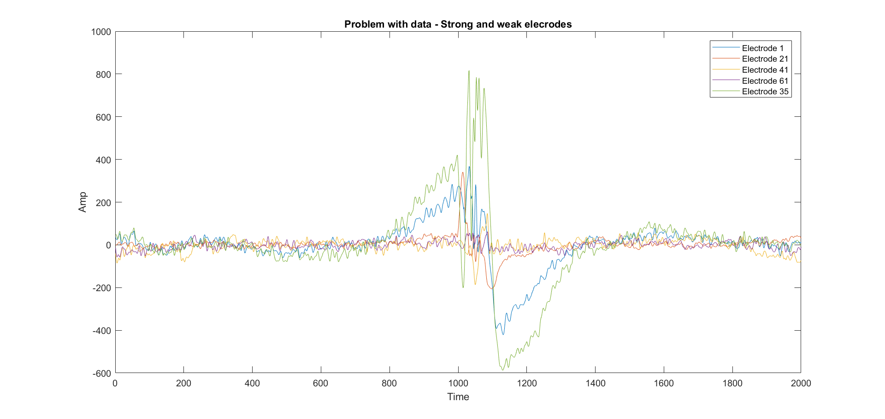
Stimulation Noise

Slide 18
Singularity of Covariance

Slide 19
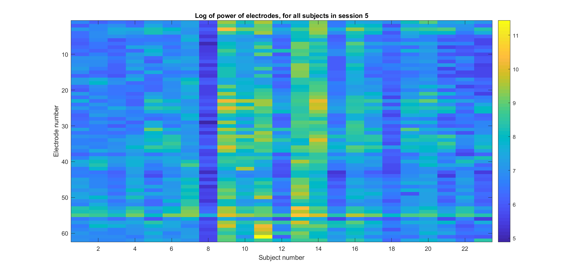
Dominant Electrodes

Slide 20
Future Work
Suggestions for continuation of your work

Slide 21
References
Only the most important references should be mentioned here, in IEEE format
Here are some examples:
Yariv Ephraim and David Malah. "Speech enhancement using a minimum-mean square error short-time spectral amplitude estimator." IEEE Transactions on Acoustics, Speech, and Signal Processing 32.6 (1984): 1109-1121.
Zhou Wang, et al. "Image quality assessment: from error visibility to structural similarity." IEEE Transactions on Image Processing 13.4 (2004): 600-612.

