Slide 1

Midterm Presentation Examination of TMS effect using EEG Signal
Students: Matan Allouche, Reggev Livney
Supervisor: Or Yair
Semester: Winter 2017-2018
Date: 17.1.2018
In Collaboration with: BrainSway

Slide 2
Outline
This slide should contain an outline (list of headings) of the presentation
Maximum 5-6 bullets

Slide 3
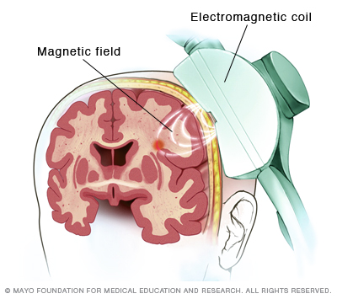
Background
TMS (Transcranial magnetic stimulation) – EM pulses through the skull.
TMS therapy on the left prefrontal cortex (lPFC), the right prefrontal cortex (rPFC), the right parietal cortex (rPC) and the cerebellum (Crbllm) showed evidences of ease of depression.

Slide 4
Background
BrainSways® treated by TMS and measured EEG of subjects during the treatment.
A psychiatrist graded the “depression level” during 5 sessions.
Each session contains around 45 trials made by (an arbitrary process).

Slide 5
Project Goal
EEG signals are hard to analyze and different for each subject.
Finding a regression algorithm to estimate depression and the therapy efficiency.

Slide 6
Literature Survey
Describe existing solutions for the problem that you’ve found in the literature survey
For each solution, give a general description, some details, pros and cons (quality, complexity, cost, …)

Slide 7
Chosen Solution
Riemannian tools for dimension reduction.
Diffusion maps and tSNE
?
Coefficients selection
Non-linear dimension reduction
Regression algorithm to estimate efficiency
signals EEG
Psychiatrist evaluation

Slide 8
Intermediate Results
Present your results compared with other solutions and emphasize the advantages (and disadvantages) of your solution

Slide 9
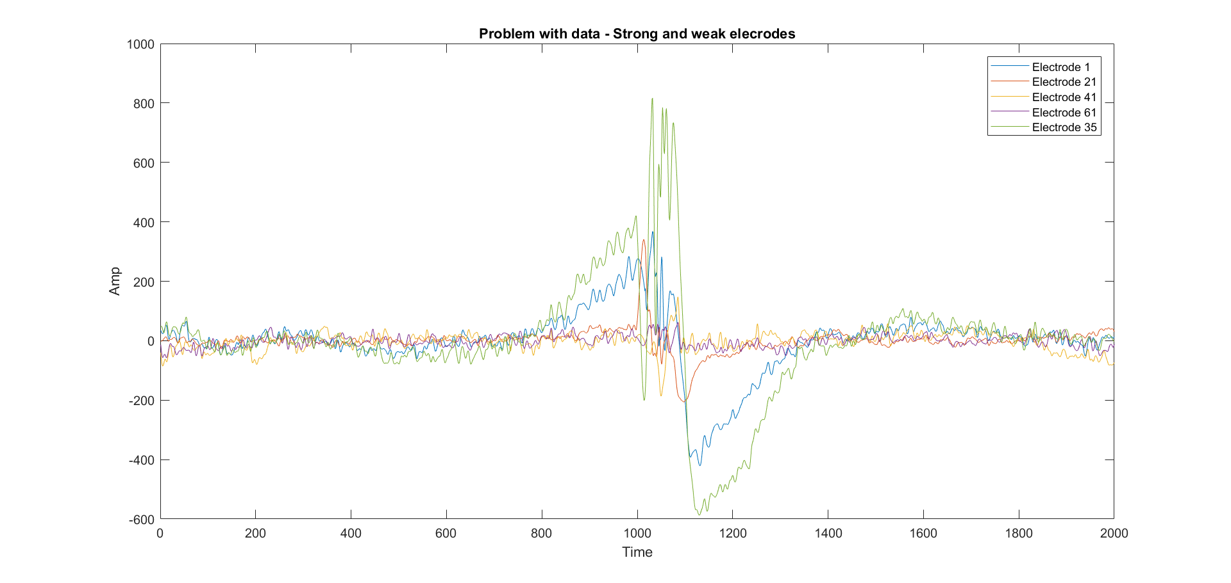
Stimulation Noise

Slide 10
Singularity of Covariance

Slide 11
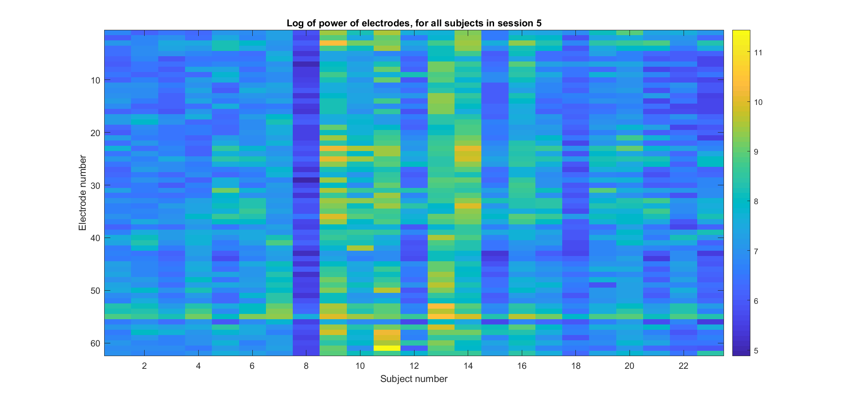
Dominant Electrodes

Slide 12
Conclusion
Repeat the project goal in other words
Have you achieved the goal? (if not, this is ok and you have to explain why)
Summarize your results
Emphasize original contribution

Slide 13
Future Work
Suggestions for continuation of your work

Slide 14
References
Only the most important references should be mentioned here, in IEEE format
Here are some examples:
Yariv Ephraim and David Malah. "Speech enhancement using a minimum-mean square error short-time spectral amplitude estimator." IEEE Transactions on Acoustics, Speech, and Signal Processing 32.6 (1984): 1109-1121.
Zhou Wang, et al. "Image quality assessment: from error visibility to structural similarity." IEEE Transactions on Image Processing 13.4 (2004): 600-612.

