Slide 1



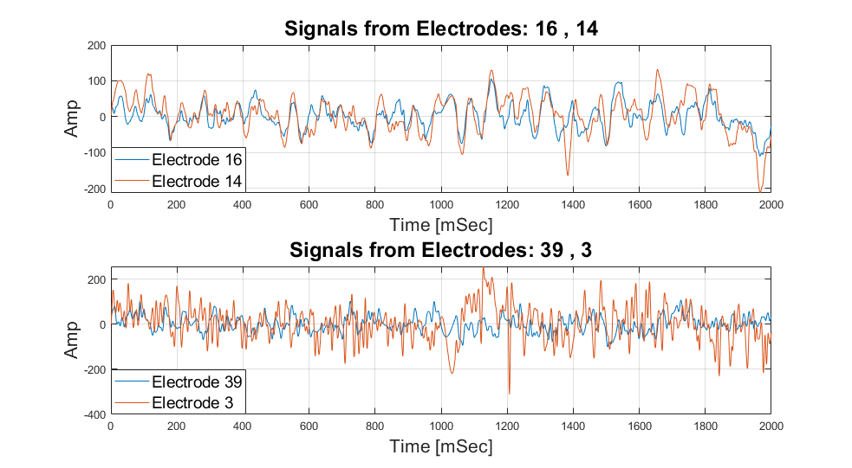
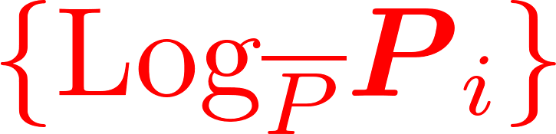
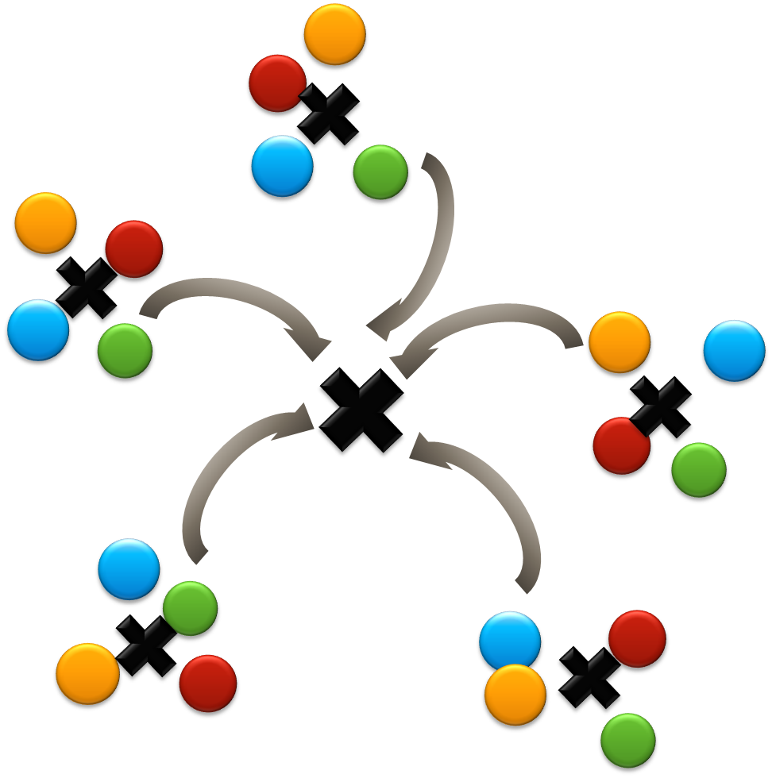


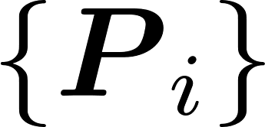

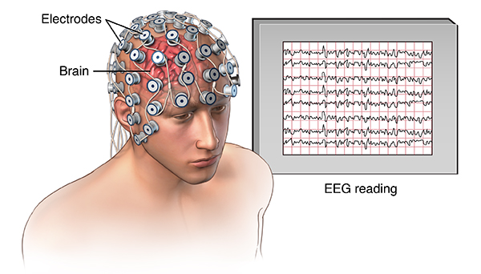
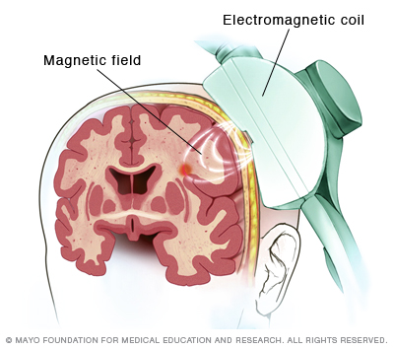
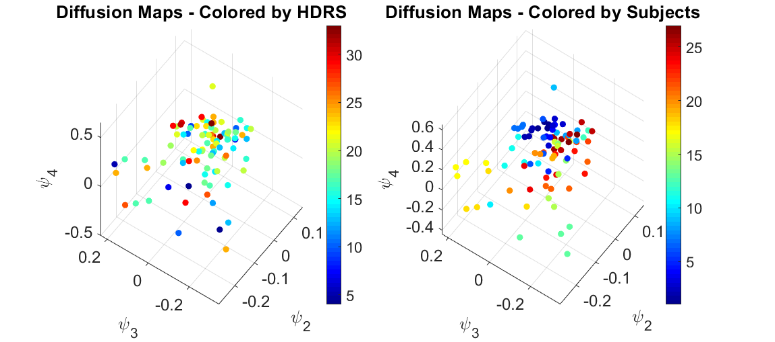
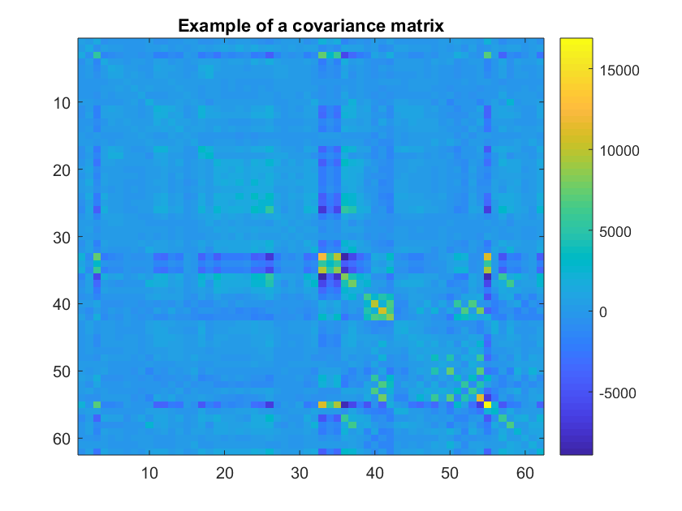
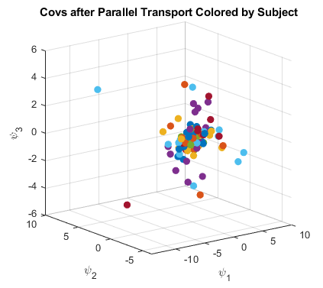
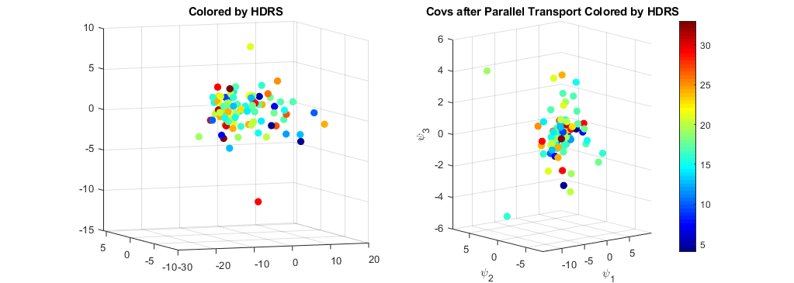
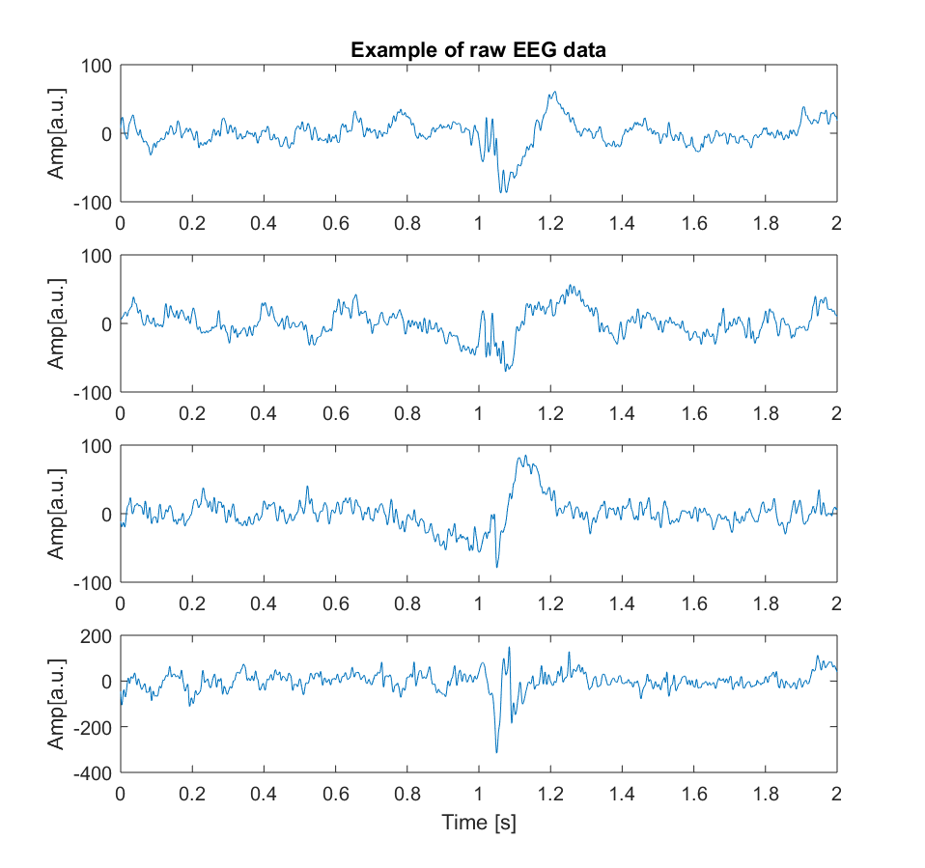
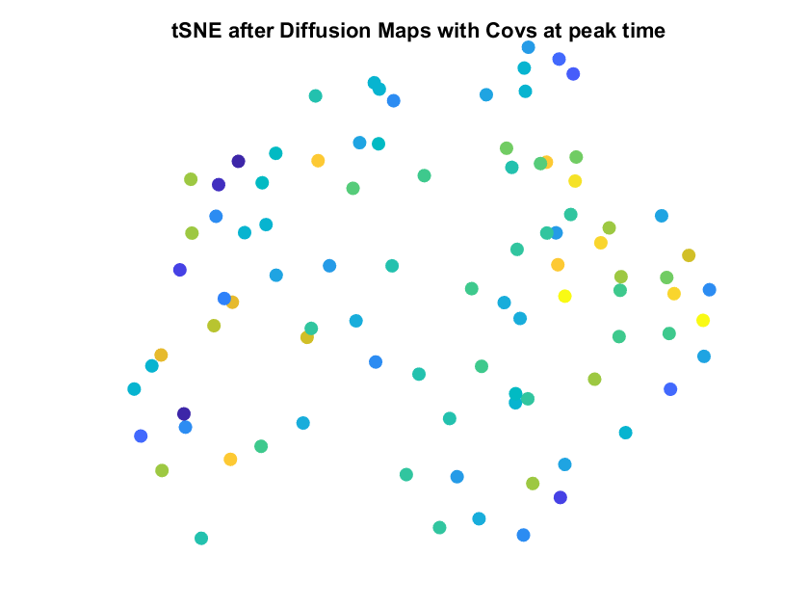


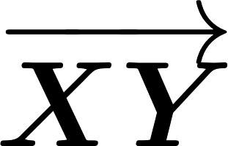





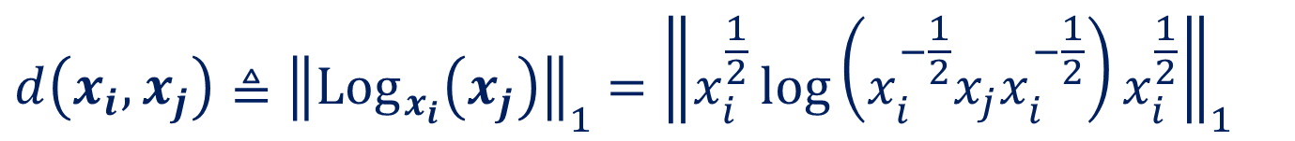
Andrew and Erna Viterbi
Faculty of Electrical Engineering
Signal and Image Processing Lab
Examination of TMS Effect Using EEG Signal
Matan Allouche and Reggev Livney, Supervised by Or Yair
Introduction
Covariance as Features
Parallel Transport
Transcranial magnetic stimulation (TMS) is a treatment in which EM pulses are sent to the brain through the skull
BrainsWay treat patients with TMS to cure MDD (Major Depressive Disorder)
Psychiatrists evaluate depression level using the Hamilton Depression Rating Scale (HDRS)
EEG is a method of recording electrical activity of the brain
Different subjects brains behave differently
These differences can be accounted for using parallel transport
Parallel Transport moves all the clusters, representing different subjects, to the same location on the manifold, using a non-linear metric
EEG signals from adjacent electrodes (top) and from distant electrodes (bottom). A large correlation can be seen between adjacent electrodes.
One EEG measurement (trial) is described by $S_{i}∈ℝ^{n×m}$
𝑛 = number of electrodes 𝑚 = number of samples in trial
The empirical covariance is $Σ_{i}=\frac{1}{m}S_{i}S_{i}^{T}∈ℝ^{n×n}$
Covariance is SPD
Here, the smallest eigenvalue was much smaller than the largest – a near non-inversible matrix
To allow numerical calculation of the Riemannian mean – some electrodes were not selected to allow inversibility
Left: A non-linear manifold, and 2 clusters, representing 2 subjects, are on different parts of the manifold, and cannot be compared. Right: An illustration of 5 clusters, and the necessary transport needed to compare the clusters
EEG scheme
TMS treatment scheme
Goals
Results
To find a correlation between EEG signals acquired from patients during therapy, and HDRS
To predict the HDRS rating of patients from their EEG signals
After applying diffusion maps, typical regions for each subject are recognized:
Example of diffusion maps. No significant correlation between the low-dimension representation and the HDRS has been found.
None of the manipulations that were done over the signals showed better correlation.
Covariances scattering after parallel transport by subjects. $\{ψ_{i}\}$ are PCA components in this example. Left: The subjects scatters around the center. Right: Covariances colored by HDRS after parallel transport.
Parallel Transport didn’t create a representation correlated to the HDRS.
Other representation methods, such as t-SNE, didn’t show better results.
Challenges
Small data sample (27 patients, 4 sessions)
EEG data is of very high dimension compared to HDRS scores
EEG also contains a large amount of brain activity information and noise which do not correlate to depression
Electrode signals, after standard preprocessing, were found to be linearly dependent, despite attempts to avoid this through pre-processing techniques
Electrode Number
Electrode Number
An example of a covariance matrix. Some pairs of electrodes have strong covariances (as demonstrated in the graphs above), creating a near non-inversible matrix.
Main Approach
Dimensionality Reduction
Selection of electrodes and time window, signal processing
Riemannian Mean Covariance
Covariances are very high-dimensional, and should be reduced to their principal components before applying regression
Diffusion maps:
Kernel: $K_{ij}≜\exp\left(−\frac{d^{2}\left(x_{i},x_{j}\right)}{2σ^{2}}\right)$
Compute: $A≜{\left(\sum_{j}{K_{ij}}\right)}^{−1}K$
Find eigenvectors: $A^{−1}Ψ=ΛΨ Λ=\left[\begin{matrix}λ_{1} & 0 & 0 \\ 0 & ⋱ & 0 \\ 0 & 0 & λ_{N}\end{matrix}\right]$
The columns of $Ψ$ are the new features and the rows correspond to observations
Distances between covariances are not Euclidean, hence we choose:
EEG signals of a subject in a session
Non-linear dimensionality reduction
Subject | Starting | Session 2 | Session3 | Session 4 | Session 5 | Final |  | dHDRS
203 | 25 | 23 | 21 | 23 | 15 | 9 |  | 0.64
204 | 27 | 14 | 9 | 17 | 10 | 10 |  | 0.62963
206 | 42 | 33 | 24 | 21 | 17 | 19 |  | 0.547619
207 | 19 | 24 | 17 | 21 | 16 | 16 |  | 0.157895
208 | 34 | 26 | 13 | 24 | 18 | 21 |  | 0.382353
210 | 28 | 29 | 29 | 20 | 19 | 16 |  | 0.428571
211 | 39 | 31 | 30 | 29 | 20 | 19 |  | 0.512821
212 | 27 | 21 | 15 | 13 | 10 | 19 |  | 0.296296
213 | 24 | 21 | 19 | 20 | 14 | 16 |  | 0.333333
214 | 29 | 25 | 22 | 19 | 17 | 16 |  | 0.448276
215 | 18 | 21 | 19 | 17 | 19 | 20 |  | -0.11111
216 | 26 | 19 | 24 | 15 | 11 | 11 |  | 0.576923
226 | 24 | 24 | 13 | 4 | 10 | 8 |  | 0.666667
227 | 20 | 23 | 20 | 14 | 19 | 14 |  | 0.3
229 | 20 | 27 | 20 | 12 | 17 | 10 |  | 0.5
230 | 28 | 19 | 18 | 23 | 21 | 15 |  | 0.464286
231 | 28 | 24 | 17 | 17 | 5 | 9 |  | 0.678571
232 | 31 | 27 | 24 | 29 | 17 | 20 |  | 0.354839
234 | 25 | 23 | 18 | 18 | 13 | 23 |  | 0.08
239 | 23 | 22 | 15 | 14 | 7 | 9 |  | 0.608696
242 | 19 | 16 | 15 | 17 | 18 | 14 |  | 0.263158
244 | 25 | 22 | 17 | 13 | 7 | 5 |  | 0.8
245 | 25 | 20 | 14 | 16 | 15 | 17 |  | 0.32
248 | 20 | 13 | 18 | 14 | 4 | 6 |  | 0.7
249 | 21 | 20 | 16 | 19 | 13 | 14 |  | 0.333333
250 | 33 | 33 | 30 | 26 | 24 | 16 |  | 0.515152
252 | 25 | 22 | 19 | 18 | 16 | 12 |  | 0.52
Regression Learner
t-SNE after Diffusion Maps on the covariances of the signals around the stimulation time only
Output Model
Other Tested Approaches
HDRS scores
Classification or regression: Data tagged by the HDRS, or by whether the treatment succeeded.
Using maximal amplitude, pulse response delay, etc. as features.
Selection of electrodes due to near-linear dependence
Signal processing may include a combination of filtering, FFT, selecting time windows, using signals in rest, etc.
Covariances were calculated for each trial, and then the Riemannian mean is calculated on all trial covariances
One session of one subject represented by one covariance matrix
$$d\left(x_{i},x_{j}\right)≜{\left\|{Log}_{x_{i}}\left(x_{j}\right)\right\|}_{1}{ =\left\|x_{i}^{\frac{1}{2}}\log\left(x_{i}^{−\frac{1}{2}}x_{j}x_{i}^{−\frac{1}{2}}\right)x_{i}^{\frac{1}{2}}\right\|}_{1}$$
Conclusions
The selected feature extraction techniques did not reveal a correlation to the HDRS
Parallel Transport was shown to be necessary, but was not enough to reveal a correlation
An illustration of a non-Euclidean manifold.
In collaboration with
June 2018

