Slide 1

Midterm Presentation Examination of TMS effect using EEG Signal
Students: Matan Allouche, Reggev Livney
Supervisor: Or Yair
Semester: Winter 2017-2018
Date: 17.1.2018
In Collaboration with: BrainSway

Slide 2



Background - Motivation
MDD (Major Depressive Disorder) – also known as depression - is estimated to affect $\sim 3\%$ of the world population
Caused by genetics, environment and psychological factors
Most commonly treated by counseling and by medication

Slide 3
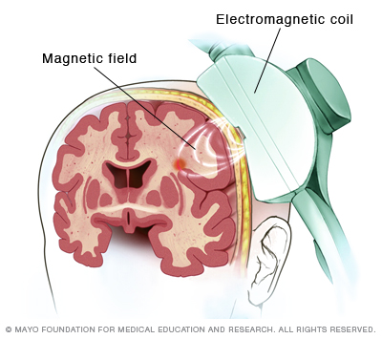
Background - TMS
TMS (Transcranial magnetic stimulation) – EM pulses through the skull
The areas in the brain related to emotions are excited by the pulses
FDA approved
Notes:
TMS therapy on the left prefrontal cortex (lPFC), the right prefrontal cortex (rPFC), the right parietal cortex (rPC) and the cerebellum (Crbllm) showed evidences of ease of depression

Slide 4

Background - TMS
BrainSway® treats patients by TMS
Psychiatrist monitors the depression level of the patients using Hamilton Depression Rating Scale (HDRS)
EEG signal was acquired during the therapy

Slide 5
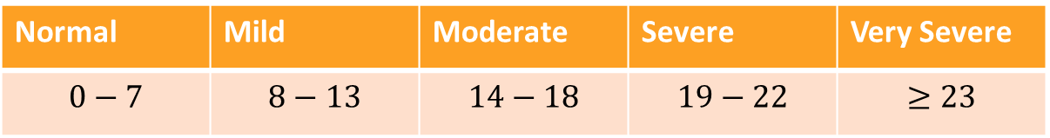
Background - HDRS
HDRS contains 17 questions (+ 4 optional questions)
Each question contributes to the total rate
Normal | Mild | Moderate | Severe | Very Severe
$$0−7$$ | $$8−13$$ | $$14−18$$ | $$19−22$$ | $$≥23$$
http://tools.farmacologiaclinica.info/index.php?sid=43496

Slide 6
Background – The Therapy
In each session, the patients were evaluated by a psychiatrist using HDRS
Patients were given the therapy, consisting of numerous TMS pulses

Slide 7
Project Goal
To help BrainSway develop an automatic algorithm to monitor the depression of patients and to find the efficiency of the TMS technique using EEG signals.

Slide 8
Objectives
To find a regression algorithm that correlates with the HDRS using machine learning methods

Slide 9
Main Approach
To use advanced techniques of feature extraction and selection
Manifold learning using different metrics
Non linear dimensionality reduction
Features selection
Non-linear dimension reduction
Regression algorithm to estimate efficiency
signals EEG
Psychiatrist evaluation

Slide 10
Chosen Solution
Covariances as features
Geometric metric
Riemannian manifold assumption
Riemannian tools for dimensionality reduction
A regression algorithm based on the HDRS

Slide 11
Preprocess
The pulse (1.5 T) removed and replaced by interpolation
Band Pass Filter – 1Hz-100Hz
Downsampled to 1kHz
Division to trials (2 sec each)
Double ICA to separate artifacts (blinks, movements, etc.)
CSD to cancel signal leakage between electrodes

Slide 12
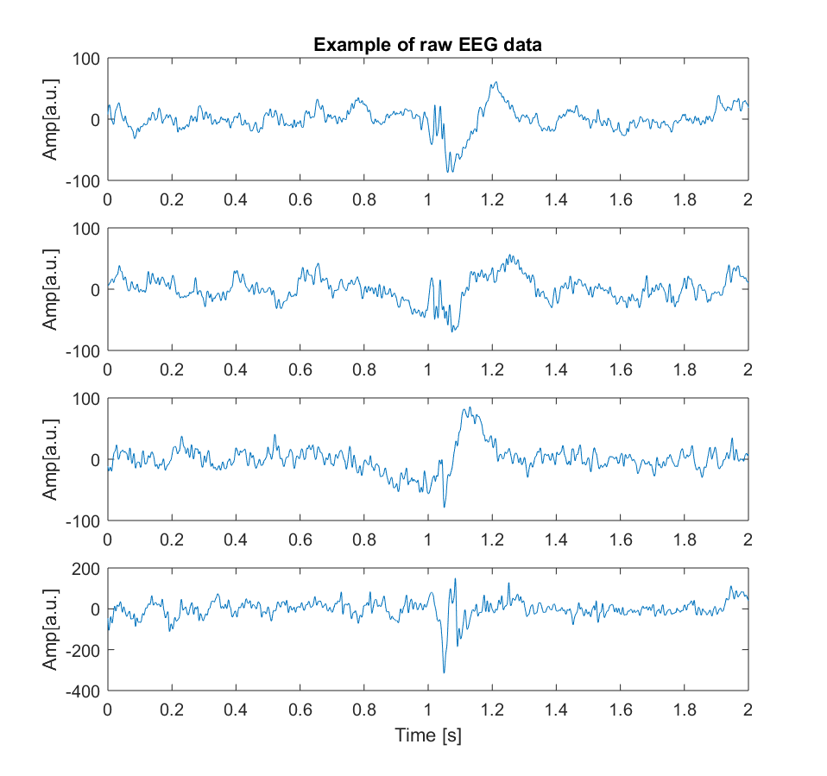
Given Data
27 subjects
62 EEG electrodes
5 sessions (every week)
35-50 trials for each subject in a session
Trial time - 2 sec = 2000 samples at 1000 Hz
The pulse is in the middle of the trial

Slide 13
30-50 Trials
62 Electrodes
2000 samples

Slide 14
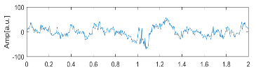
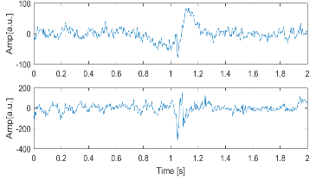
HDRS data
Subject | Starting | Session 2 | Session3 | Session 4 | Session 5 | Final |  | dHDRS
203 | 25 | 23 | 21 | 23 | 15 | 9 |  | 0.64
204 | 27 | 14 | 9 | 17 | 10 | 10 |  | 0.62963
206 | 42 | 33 | 24 | 21 | 17 | 19 |  | 0.547619
207 | 19 | 24 | 17 | 21 | 16 | 16 |  | 0.157895
208 | 34 | 26 | 13 | 24 | 18 | 21 |  | 0.382353
210 | 28 | 29 | 29 | 20 | 19 | 16 |  | 0.428571
211 | 39 | 31 | 30 | 29 | 20 | 19 |  | 0.512821
212 | 27 | 21 | 15 | 13 | 10 | 19 |  | 0.296296
213 | 24 | 21 | 19 | 20 | 14 | 16 |  | 0.333333
214 | 29 | 25 | 22 | 19 | 17 | 16 |  | 0.448276
215 | 18 | 21 | 19 | 17 | 19 | 20 |  | -0.11111
216 | 26 | 19 | 24 | 15 | 11 | 11 |  | 0.576923
226 | 24 | 24 | 13 | 4 | 10 | 8 |  | 0.666667
227 | 20 | 23 | 20 | 14 | 19 | 14 |  | 0.3
229 | 20 | 27 | 20 | 12 | 17 | 10 |  | 0.5
230 | 28 | 19 | 18 | 23 | 21 | 15 |  | 0.464286
231 | 28 | 24 | 17 | 17 | 5 | 9 |  | 0.678571
232 | 31 | 27 | 24 | 29 | 17 | 20 |  | 0.354839
234 | 25 | 23 | 18 | 18 | 13 | 23 |  | 0.08
239 | 23 | 22 | 15 | 14 | 7 | 9 |  | 0.608696
242 | 19 | 16 | 15 | 17 | 18 | 14 |  | 0.263158
244 | 25 | 22 | 17 | 13 | 7 | 5 |  | 0.8
245 | 25 | 20 | 14 | 16 | 15 | 17 |  | 0.32
248 | 20 | 13 | 18 | 14 | 4 | 6 |  | 0.7
249 | 21 | 20 | 16 | 19 | 13 | 14 |  | 0.333333
250 | 33 | 33 | 30 | 26 | 24 | 16 |  | 0.515152
252 | 25 | 22 | 19 | 18 | 16 | 12 |  | 0.52
30-50 Trials
62 Electrodes
2000 samples

Slide 15
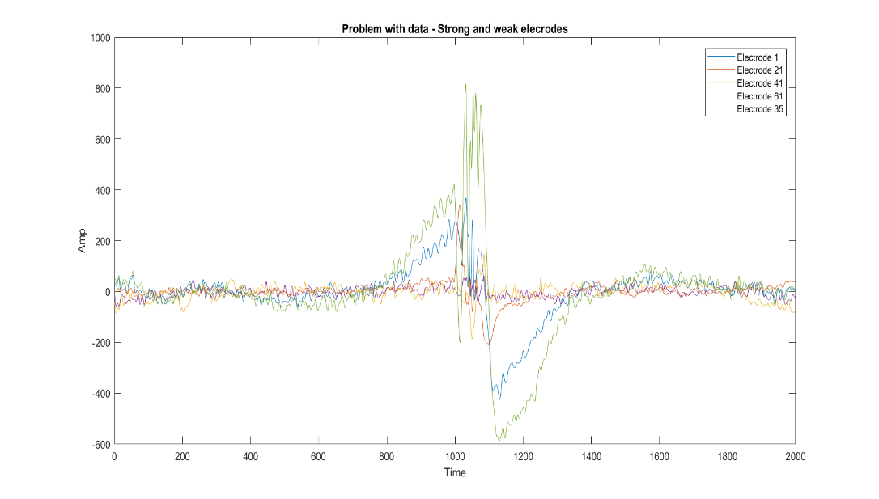
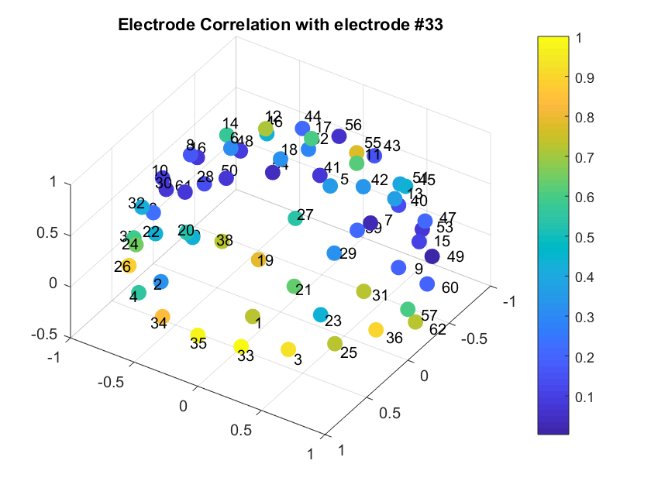
Challenges
Noisy signals
High dimensional data
Poor spatial information
Electrodes are linearly dependent
Varying signals intensities

Slide 16
Dominant Electrodes
EM pulse was picked up by the electrodes, causing high amplitude noise
Muscle movements affect measurement

Slide 17
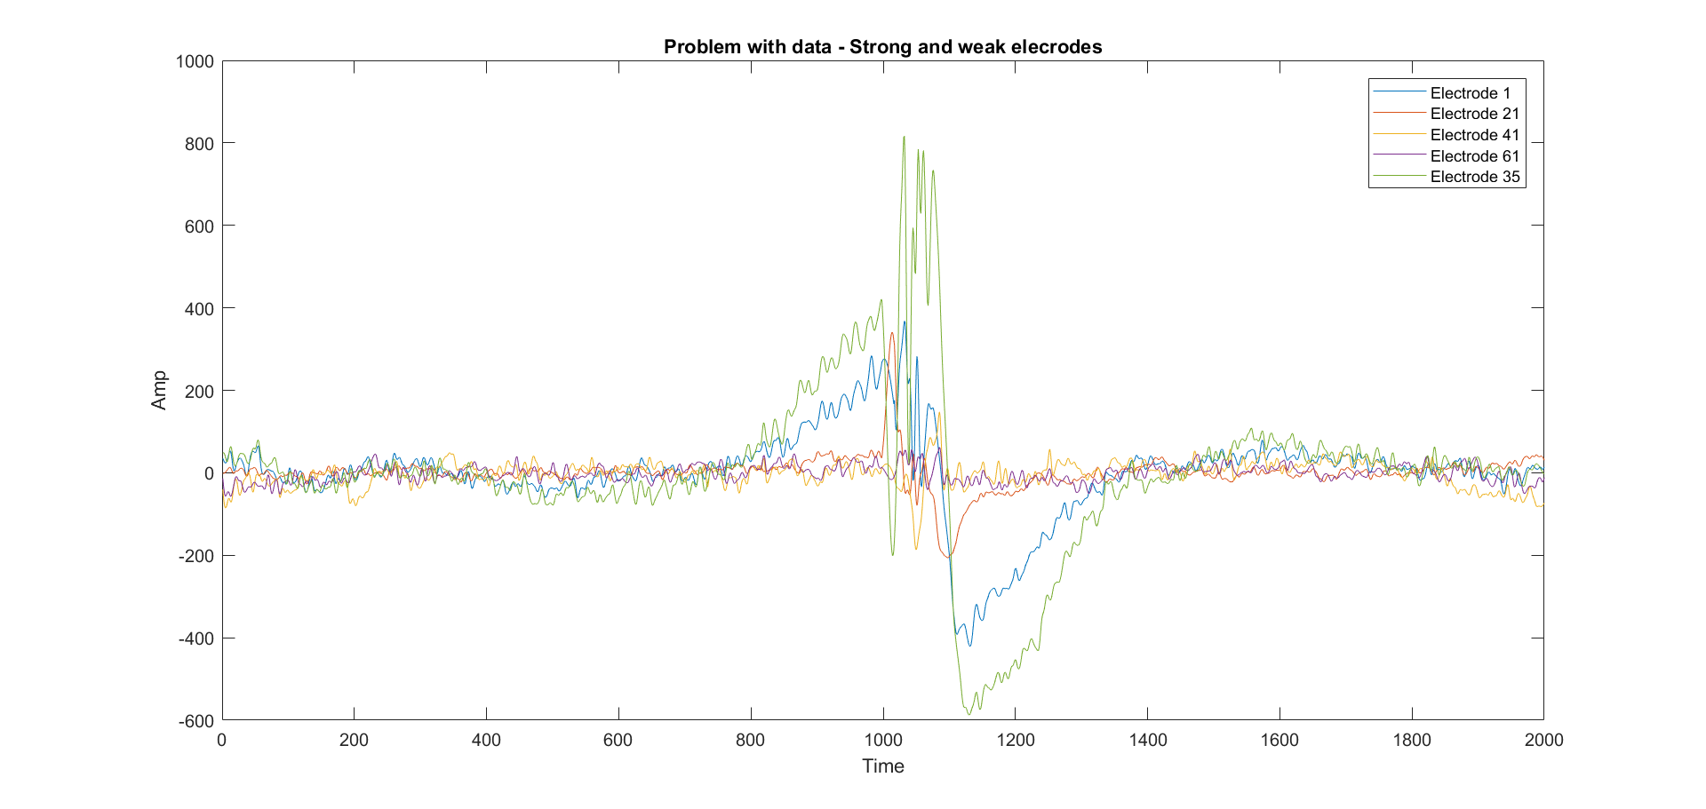
Stimulation Noise

Slide 18
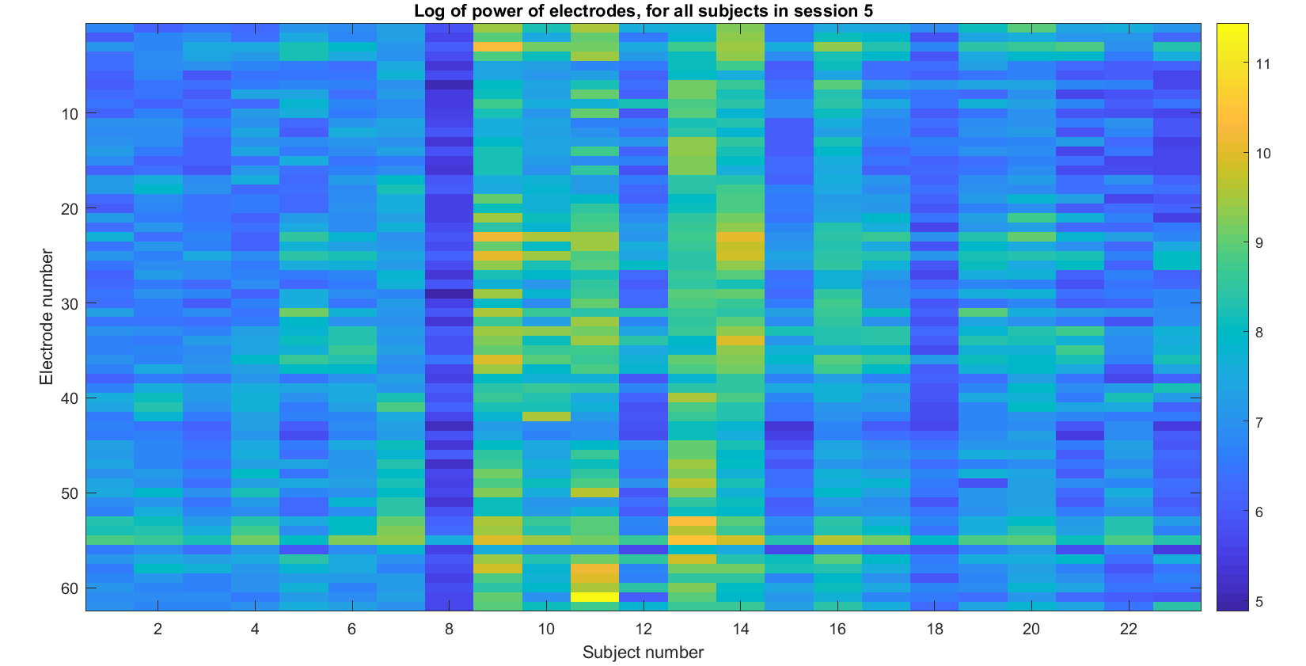
Dominant Electrodes
Possible Solutions:
Remove the peak from data completely
Ignore “loud” electrodes

Slide 19
Dominant Electrodes

Slide 20
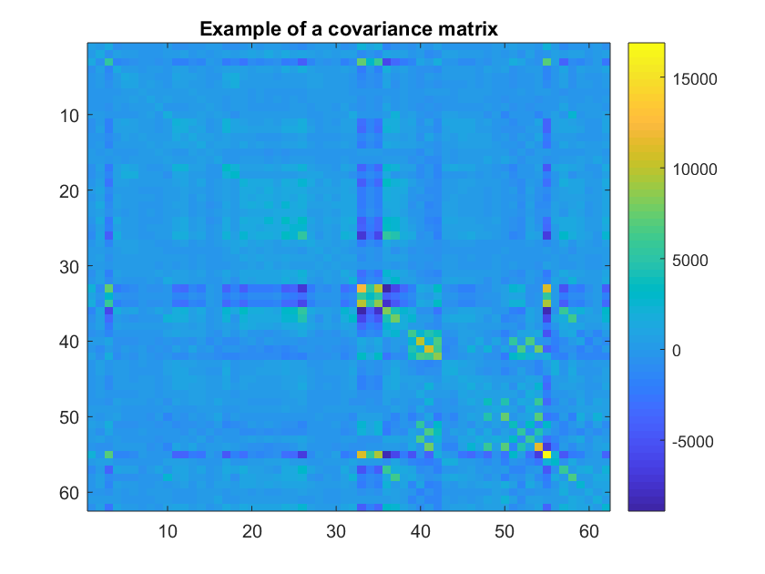
Covariance as Features
Covariance matrices are candidates for feature vectors
Covariance matrices are definite positive
Therefore we can apply Riemann tools on them

Slide 21
Singularity of Covariance

Slide 22
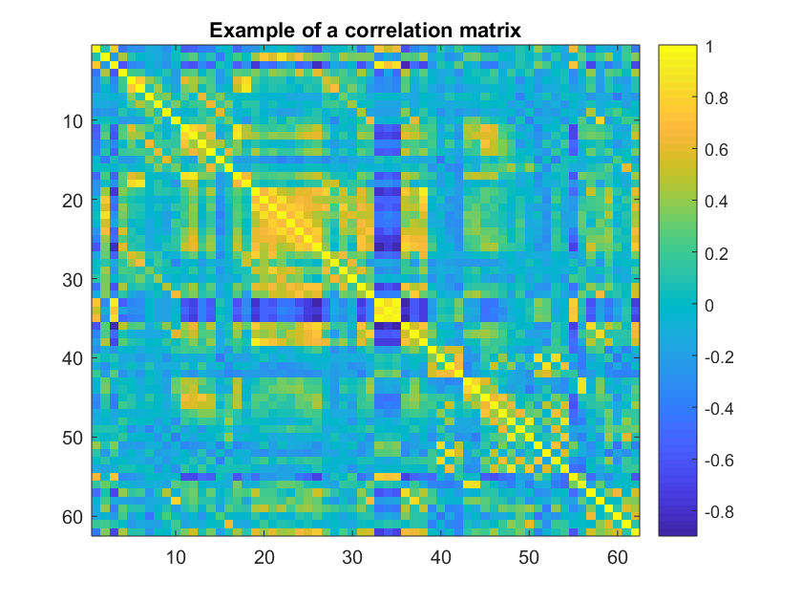
Singularity of Covariance

Slide 23
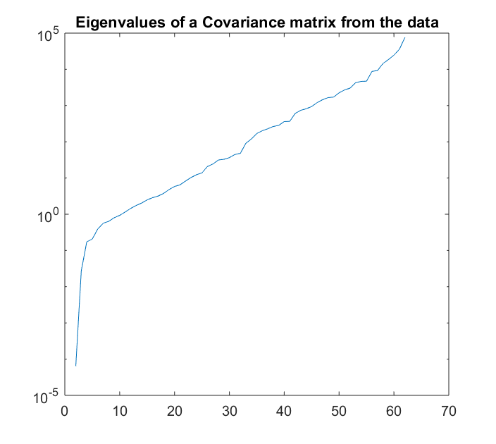
Singularity of Covariance
Near-zero eigenvalues?

Slide 24
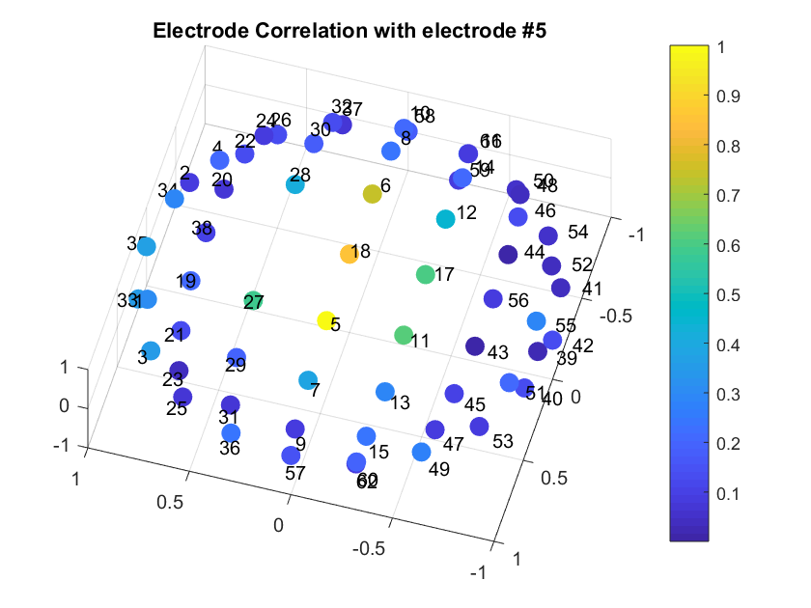
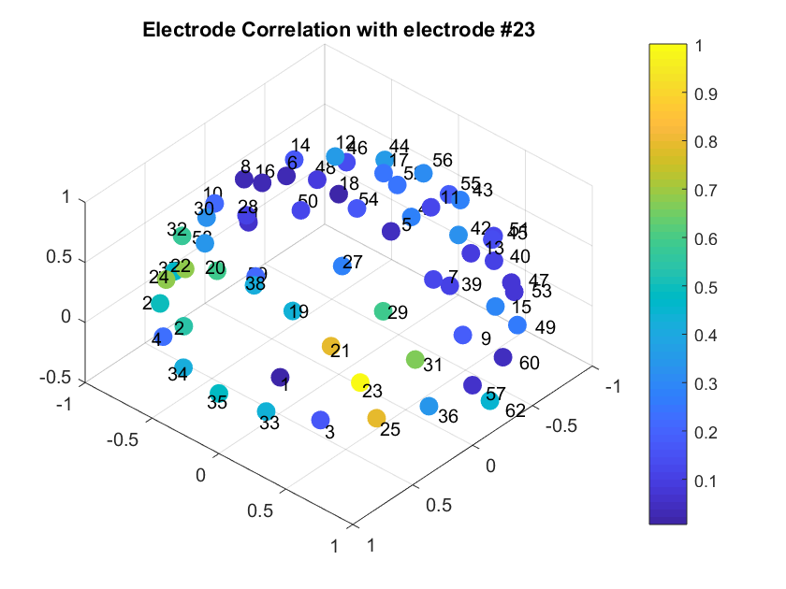
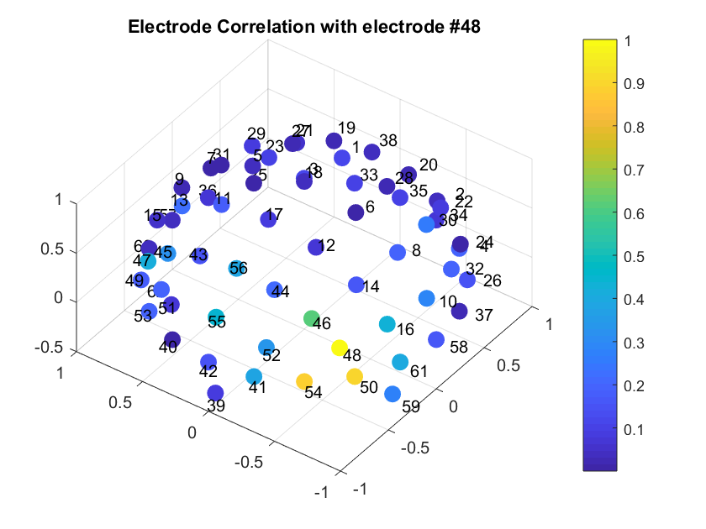

Slide 25
Singularity of Covariance
Linear dependency caused by electrode proximity
Possible Solutions:
Select fewer electrodes to work with
Cluster electrodes together

Slide 26

Intermediate Results
Electrodes are linearly dependent due to proximity
No singularity using random electrodes selection
To this point, no correlation between the EEG data and the HDRS has been found (using Diffusion Maps and tSNE)

Slide 27
Intermediate Results
tSNE after diffusion map
No pattern is observed…

Slide 28
Future Work
Using filters for specific frequencies
Using only a specific part of each signal
Search for EEG signals of non depressed people in order to use them as a control group

Slide 29
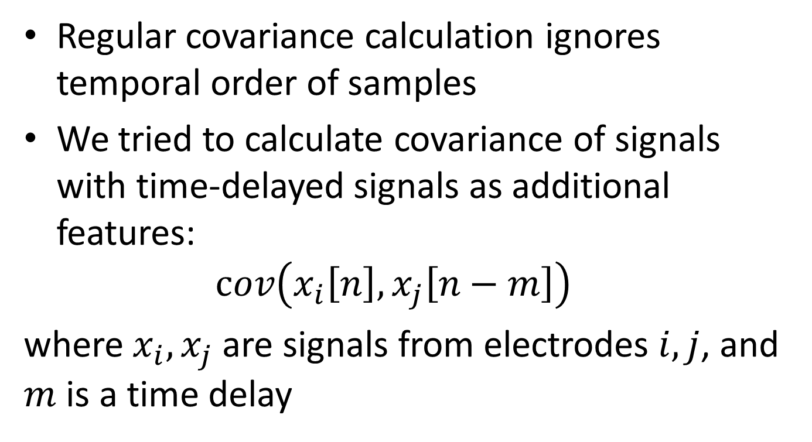
Covariance with delayed signal
Regular covariance calculation ignores temporal order of samples
We tried to calculate covariance of signals with time-delayed signals as additional features: $cov\left(x_{i}\left[n\right],x_{j}\left[n−m\right]\right)$
where $x_{i},x_{j}$ are signals from electrodes $i,j$, and $m$ is a time delay

Slide 30
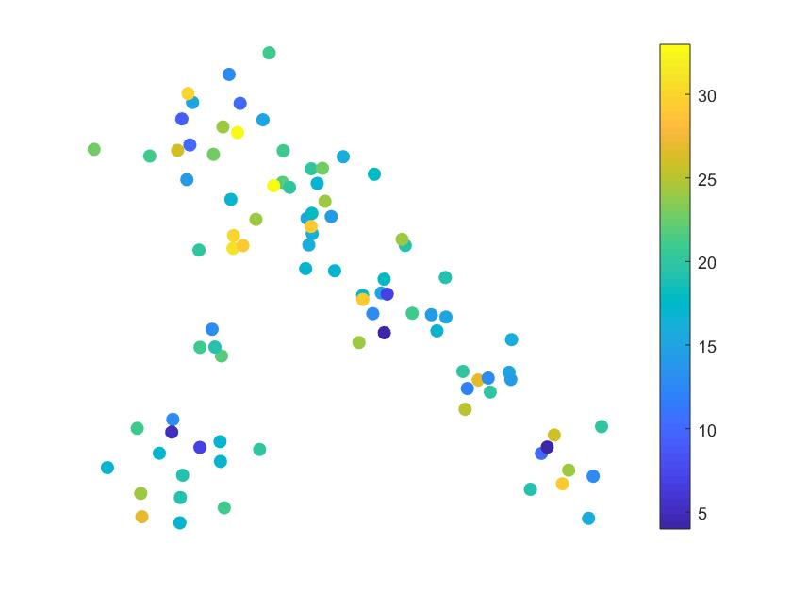
Covariance with delayed signal
tSNE result for these features:

Slide 31

Covariance with derivative of signal
An additional attempt to introduce temporal dependence, is to use covariance with the derivative of the signal: $cov\left(x_{i}\left[n\right],x_{j}\left[n\right]−x_{j}\left[n−1\right]\right)$

Slide 32
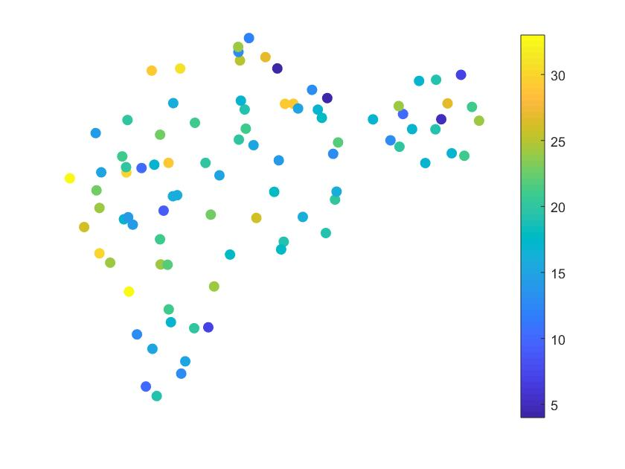
Covariance with derivative of signal
tSNE results for these features:

Slide 33
Covariance at peak time
Originally, we treated the peak in the middle of the signal as unwanted noise
In this test we examined the possibility that the information is hidden in the peak
We cut the signal, leaving only the peak, and calculated the covariance matrix

Slide 34
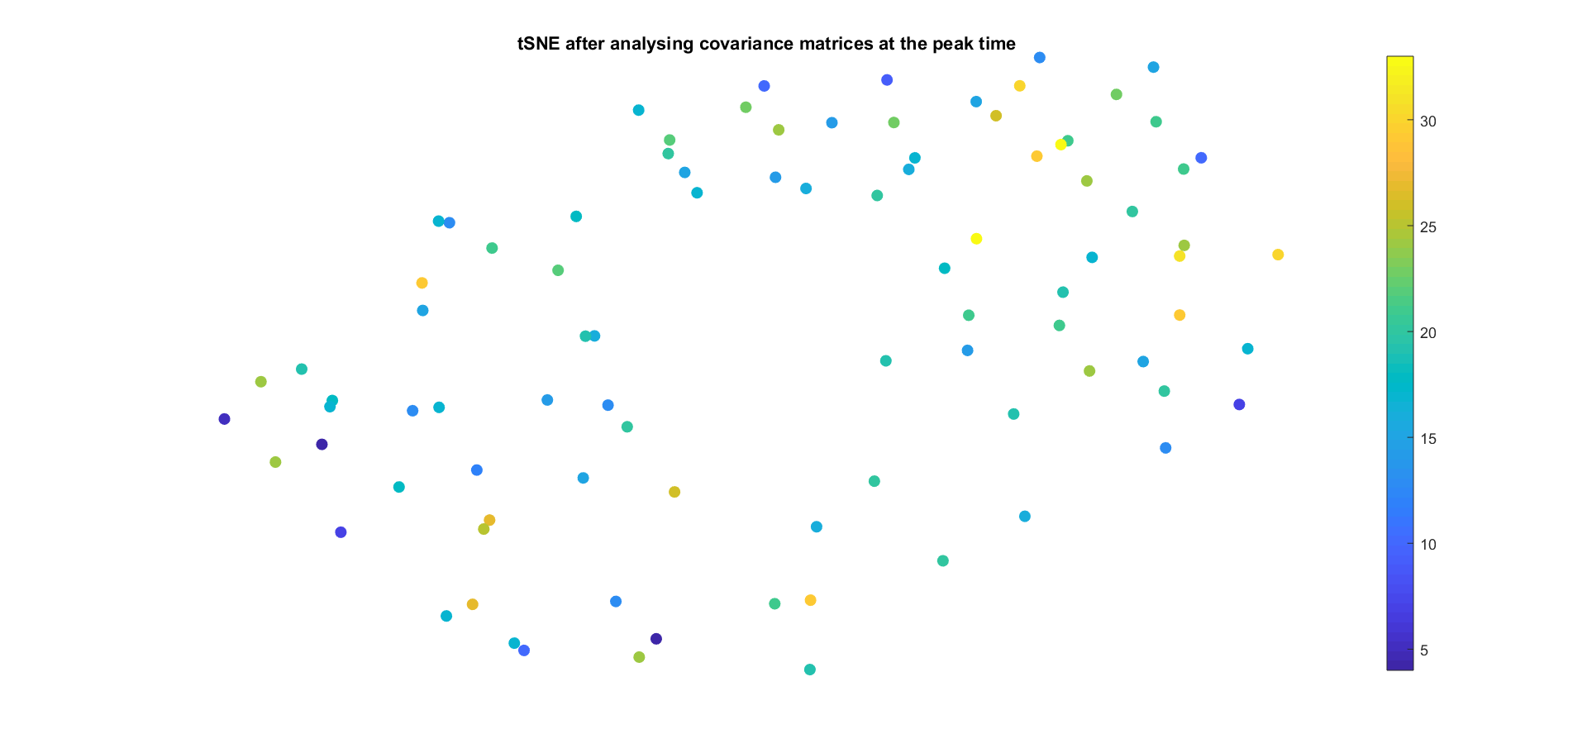
Covariance at peak time
tSNE results for these features:

Slide 35
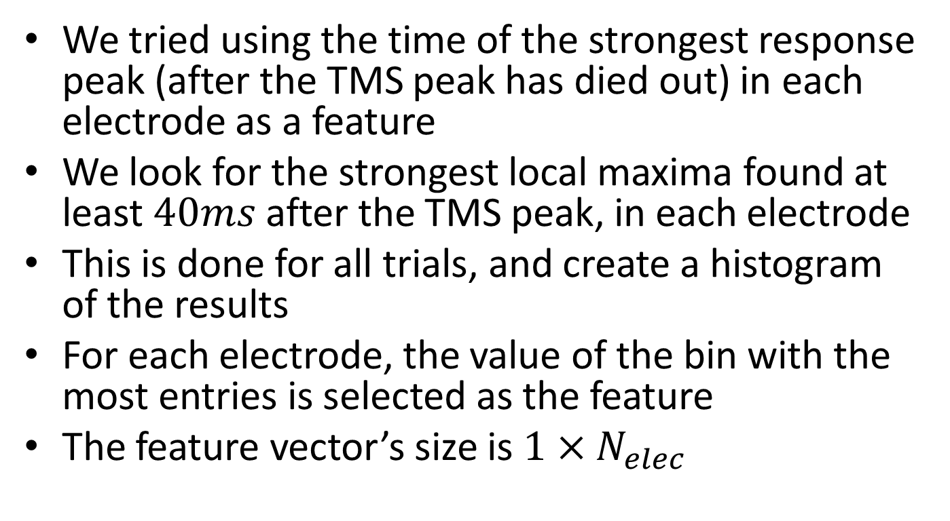
Time of response peak
We tried using the time of the strongest response peak (after the TMS peak has died out) in each electrode as a feature
We look for the strongest local maxima found at least $40ms$ after the TMS peak, in each electrode
This is done for all trials, and create a histogram of the results
For each electrode, the value of the bin with the most entries is selected as the feature
The feature vector’s size is $1×N_{elec}$

Slide 36
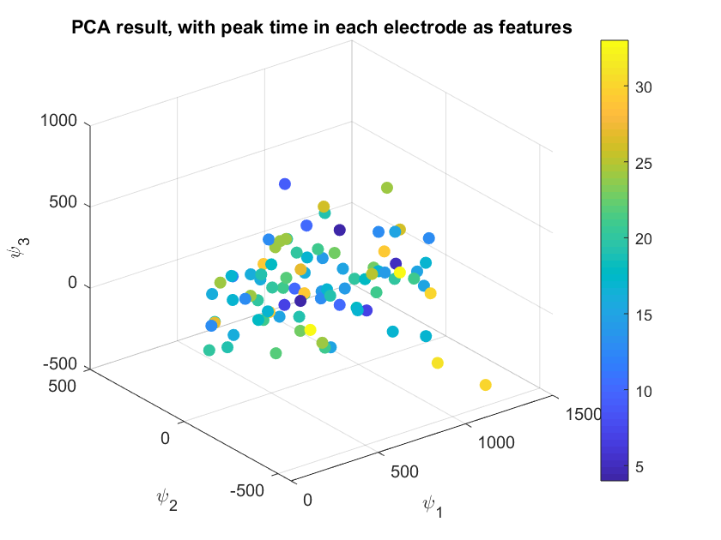
Time of response peak
PCA on the data yields:

Slide 37
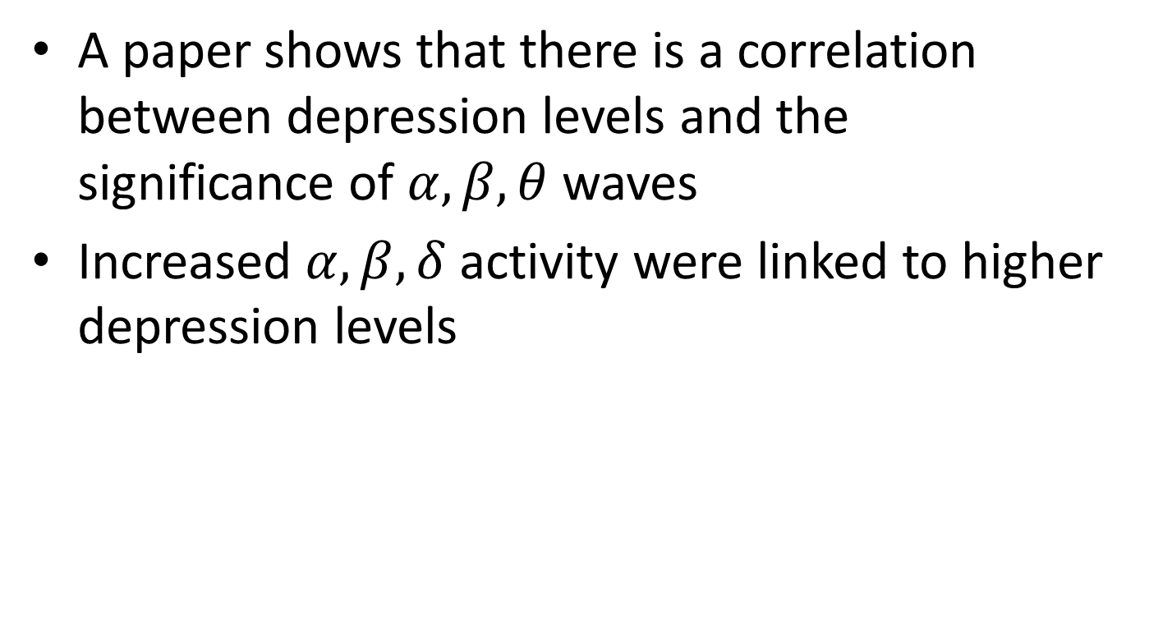
Filtering
A paper shows that there is a correlation between depression levels and the significance of $α,β,θ$ waves
Increased $α,β,δ$ activity were linked to higher depression levels

Slide 38
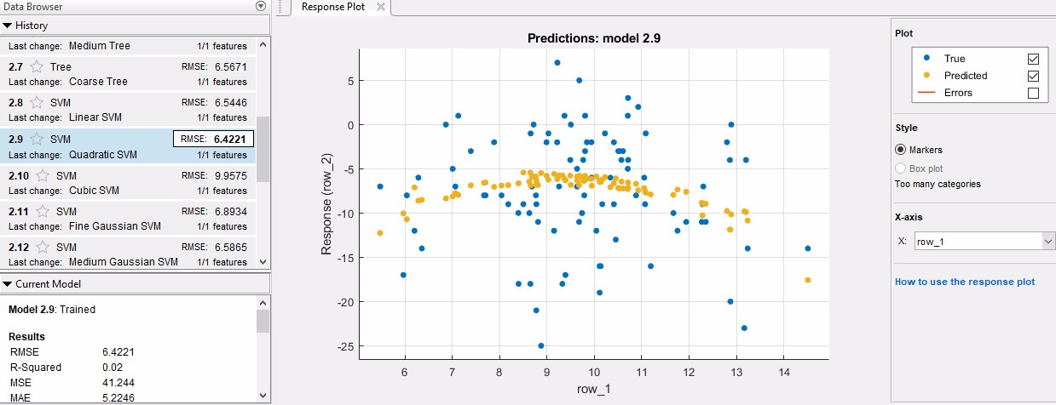
Filtering

Slide 39
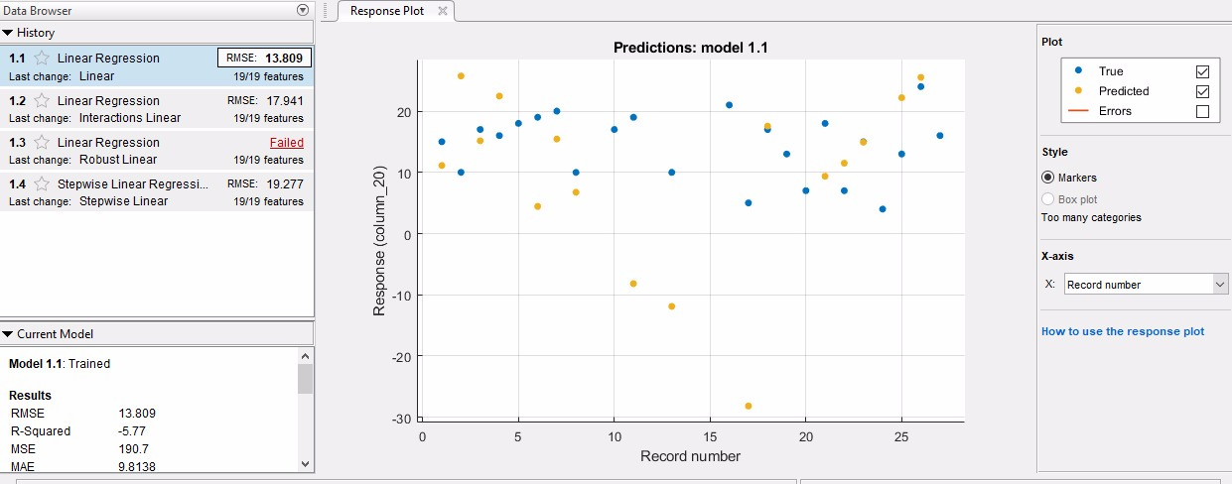

Slide 40
Parallel Transport
Previous research on similar problems revealed large differences in behavior of different subjects
This was solved by using a parallel transport algorithm, to account for these differences
We attempted a similar approach on our data, aiming to find possible patterns

Slide 41
Parallel Transport
Covariance was used as features,

