Slide 1
Introduction to Unit & Integration Tests
Reginald Johnson – 19 February 2019
Presentation and example code can be found at https://github.com/reggie3/testing-examples
Notes:
Welcome to an introduction to unit and integration tests.

Slide 2
Purpose, Terms, and Agenda
Provide a practical guide to creating and using unit & integration tests in Atlas
Terms :
Assertion: a statement that can be tested for truthiness
Unit Test: automated tests of a single piece of functionality
Integration Tests: automated tests of multiple pieces of functionality and their interactions
Agenda
Why Write Tests
Basic Test Structure
Unit Tests
Integration Tests
Snapshot Tests

Slide 3
Why Write Tests
Good Tests Help Ensure:
Correctness: code wrote satisfies Acceptance Criteria
Completion: code satisfies all ACs
Concreteness: code won’t break silently after refactor
Confidence: fearless refactoring
Automated development testing proactively helps ensure code works and continues to work

Slide 4
Basic Test Structure
import { add, double, asyncDouble } from "./examples";
// description block to help organize tests
describe("example tests", () => {
// Basic synchronous test
it("should add correctly ", () => {
expect(add(1, 1)).toEqual(3);
});
a) “Describe” block to organize related tests
b) Test and description
c) Assertion
f) Expected Result
This test will fail
d) Item being tested
Function “add” with arguments “1,1”
e) Matcher
Full list of Jest matchers : https://jestjs.io/docs/en/expect
Notes:
a) Create a descript block to associate related tests
b) Individual tests start with “it” followed by a description of what the item being tested show do in order pass this test
c) Next, we have our assertion which begins with the word “expect”
d) This is followed by the item being tested, which in this case is the “add” function which receives 2 numbers, adds them and returns the sum
e) We then use the “toEqual” matcher to assert that the result of the “function”
f) Equals “3” which in this case will cause the test to fail

Slide 5
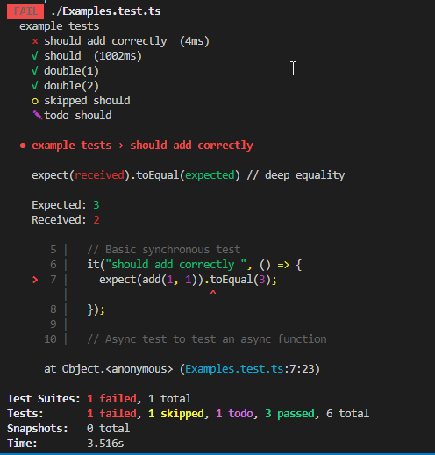
Test Results
Failed test
Successful tests
Failed test feedback
Test summary
Notes:
After running a test with Jest, you’ll see the following:
Summary status of individual failed and successful tests
Feedback on the failed test
And an overall summary of the tests that ran

Slide 6
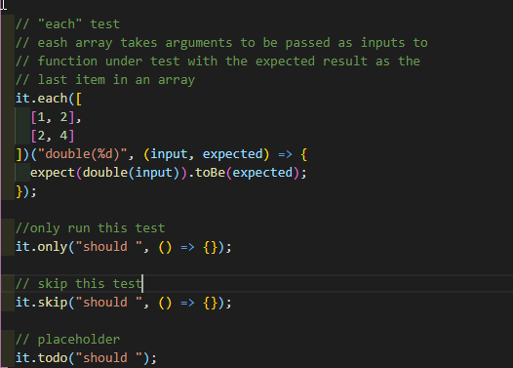
Optional Test Modifiers
Tests multiple inputs
Only run this test (good for debugging)
Skip this test
Placeholder for future test
Notes:
In addition to starting a test with it, there are several modifiers that can help you control your tests during development

Slide 7

Questions on Test Structures?

Slide 8
JavaScript Unit Test
Tests a single piece of functionality usually a function
Good For:
Does the function do what it’s supposed to do?
Finding broken things
Bad For:
Does the function fit in with everything else?
Great for pure functions that receive all required information as arguments and return an expected output:
export const add = (a: number, b: number):number => {
return a + b;
};
Take Away: Write application logic as pure functions to simplify testing
Notes:
Now that we’re a bit more familiar with test structures and their results let’s look at unit tests.
Unit tests are good for testing a single piece of functionality, usually a function. They are good at confirming that the function does what it is supposed to do.
However, they are not good at confirming that the tests works well in relationship to everything around it. For example, it can confirm that the add function returns the sum of two numbers; however, unit are of is of no help if the calling function expects the result to be a string. In fact, the unit test would not even know that the calling function expected a string.
Unit tests work great with pure function, that is functions that take in all required information as arguments, perform no side effects, and return a value that can be tested.

Slide 9
Unit Testing Class Component Function
Not Pure
private getMarginTop = (isKeyboardVisible: boolean): number => {
if (isKeyboardVisible) {
const margin =
this.state.keyboardHeight +
this.state.authenticatorContainerLayout.height -
Dimensions.get("window").height;
return margin > this.state.touchLocationY ? 0 : -margin;
}
return 0;
};
Make the function to be tested “pure”
Instantiate the component
Test the function (may not work initially)
Replace broken dependencies with mocks
Repeat steps 3 & 4 as required
Successfully instantiate the component
Test the function
Pure
private getMarginTop = (
authenticatorContainerLayout: any, isKeyboardVisible: boolean,
keyboardHeight: number, touchLocationY: number
): number => {
if (isKeyboardVisible) {
const margin =
keyboardHeight +
authenticatorContainerLayout.height -
Dimensions.get("window").height;
return margin > touchLocationY ? 0 : -margin;
}
return 0;
};
Notes:
Unit tests can be used on the functions that exist inside of our components, because I most cases our components are just classes.
We’ll start by making our function pure
Next, we will attempt to instantiate our component
Then attempt a test. This test may fail if the component has external dependencies such as atlas-services, but that is okay
Because the next step is to replace those broken dependencies with mocks
We’ll repeat steps 3 & 4 as required in order to identify and mock dependencies as need until
We can finally successfully instantiate the component and test the function
So, notice the first step is make the function to be tested pure. Well, how do we identify a function that isn’t pure and how do we make it pure? One way is to identify impurities such as accessing information directly from state or props, and then turning those values into function arguments.

Slide 10
Mocking
export class FrozenDrinks {
getFavoriteMilkShake = () => {
return "Strawberry";
};
}
“Mocking is a technique to isolate test subjects by replacing dependencies with objects that you can control and inspect. A dependency can be anything your subject depends on, but it is typically a module that the subject imports.”
import { FrozenDrinks } from "./frozenDrinks";
let frozenDrinks: FrozenDrinks;
let mockGetFavoriteMilkShake: any;
beforeEach(() => {
frozenDrinks = new FrozenDrinks();
mockGetFavoriteMilkShake = jest.spyOn(frozenDrinks, "getFavoriteMilkShake");
});
describe("Mock Example", () => {
it("should return strawberry as favorite milkshake", () => {
expect(frozenDrinks.getFavoriteMilkShake().toLowerCase()).toBe(
"strawberry"
);
});
it("should return banana as favorite milkshake", () => {
mockGetFavoriteMilkShake.mockImplementation(() => "banana");
expect(frozenDrinks.getFavoriteMilkShake().toLowerCase()).toBe("banana");
});
});
A mock can return a desired result independent of what the function is supposed to return
Atlas mocking examples:
TestContext (complete)
ColorSchema (complete)
this.appContext.getServiceExecutor().execute (TBD)
Jest Mock Functions
Source: “Understanding Jest Mocks”, Rick Hanlon II
Notes:
Mocking lets us replace a chunk of code like a package that we don’t want to test with a function that provides the results that we need for our test. Some of the mocks in Atlas are the TestContext and a mock color schema. Additionally, Jest exposes several methods to mock functions and return desired values that facilitate testing.
In this example you can see that FrozenDrinks is a class with a function called getFavoriteMilkShake which returns “Strawberry”
In our test, lines 5 and 6 setup a mock getMilkShake function. On line 15 we make the mock get milkshake function return “banana”
This concept could be extended to mocking the service layer in atlas, specifically this.appContext.getServiceExecutor().execute so that a service call provides a defined response which will enable testing the result of API calls. This will let us test our component’s behavior based on different service call responses without interacting with the service layer

Slide 11
Testing React Components
Components must be rendered in order to be tested
Can receive props and context
Use matchers to find buttons, labels, inputs, etc.
Fire events to push button, fill in input, etc.
Test state, presence, absence, labeling, styling, status, etc. of components
a) Finder function from @testing-library
b) Render the component
it("should render a 'sign in' button if the user is not signed in", () => {
const { queryByText } = render(<LandingScreen {...landingScreenProps} />, {
initialState: { user: { isSignedIn: false } }
} as RenderProviderProps);
expect(queryByText(labels.landingScreen.signInButton.signIn)).toBeTruthy();
});
c) Optional initial appstate
d) Jest Matcher
Notes:
A component must be rendered in order to tests it’s React elements.
The test structure is very similar to the other tests that we’ve seen so far with just a few differences:
In this example we’re using the @testing-library to render the LandingScreen component. And destructuring the “queryByText” function from the resulting object. There are several other functions that could be destructured, and we’ll see some more shortly.
The LandingScreen component is receiving the landingScreenProps object and setting that as the component props
We’re also setting some initial app state to set the global isSignedIn variable to false
Then, in the test assertion, we’re using the “queryByText” function from @testing-library to determine if the rendered Component contains the signIn label on the screen. In this case we expect that string that to be rendered, so we use the “toBeTruthy” matcher to test that assertion

Slide 12

Questions on Unit Testing?

Slide 13
Integration Testing
Test based on user behavior, not implementation
Good For:
Testing connected behavior for of multiple items (functions, components, etc.)
Bad For:
Finding individual broken items
Render Component(s):
@testing-library/react-native
Get handles to components
queryByText, getById, getAllById, etc
Perform Actions:
@testing-library/react-native
Assert expectations using matchers:
Jest matchers
@testing-library/jest-native/extend-expect
Repeat steps 3 and 3 until finished
Notes:
Integration testing is good for testing interactions between multiple components, functions, etc. However, since we’re testing multiple items at one time, it can be difficult to find individual broken items that result in a test failure.
Integration tests follow a basic pattern:
First, we render the top-level component,
Then we get handles to children components that we want to interact with or make assertions against
Next, perform actions on those components and make assertions against component state based on those actions

Slide 14

Example
describe("ChatComponent", () => {
it(`should take a value from input, show it in the chat window, and
remove the input text from the input box upon submit`, async () => {
// Setup and get handles to components
const testMessage = "test message";
const { getByTestId, getByText } = render(<ChatContainer />);
const messageScrollView = getByTestId("messageScrollView");
const messageInput = getByTestId("messageInput");
const messageSubmitButton = getByTestId("messageSubmitButton");
// we expect the input box to be empty and the submit
// button to be disabled on chat component mount
expect(messageInput).toBeEmpty();
expect(messageSubmitButton).toBeDisabled();
// type our text message in the input box
fireEvent.changeText(messageInput, testMessage);
// submit button should be enabled now that there is text in the input box
expect(messageSubmitButton).toBeEnabled();
// press the submit button
fireEvent.press(messageSubmitButton);
// we expect to find the test text message on the page
expect(getByText(testMessage)).toBeTruthy();
// in fact, we expect the scroll view to have a child element containing
// the test message as text
expect(messageScrollView).toContainElement(getByText(testMessage));
// also expect the input box to be empty and the submit button to be disabled
expect(messageInput).toBeEmpty();
expect(messageSubmitButton).toBeDisabled();
});
One integration test for more than five components and multiple Acceptance Criteria
https://github.com/reggie3/react-native-simple-chat
Notes:
In this example
The ChatContainer component is rendered on line 7
Lines 8 through 10 get handles to various components based on their TestIDs which is a Prop available on React Native primitives
We then start making assumptions and firing events
This single 29-line integration test confirms the functionality of the entire chat feature that is shown in this video

Slide 15
Snapshot Testing
Save and compare…
Function output
Rendered component state and structure
Tests fail if existing saved snapshot does not match new snapshot
Update saved snapshot if new snapshot is correct
Snapshot files are saved as part of the project
Good test to add near component completion
describe("LandingScreen", () => {
it("should render", () => {
const { asJSON } = render(<LandingScreen {...landingScreenProps} />, {});
expect(asJSON()).toMatchSnapshot();
});
Create a JSON representation of the component
Expect new snapshot to match the saved one
Notes:
The final type of test we’ll discuss is snapshot testing.
It is used to compare current information with previously saved information.
It can be used to compare React render trees or objects output as functions,
And the test fail if the current snapshot does not match the previous snapshot
Because of this, snapshot tests are good to add near a component or function’s completion

Slide 16
JSON Snapshot
// Jest Snapshot v1, https://goo.gl/fbAQLP
exports[`LandingScreen should render 1`] = `
<View
collapsable={true}
pointerEvents="box-none"
style={
Object {
"flex": 1,
}
}
>
<View
style={
Array [
Object {
"backgroundColor": "#fff",
"flex": 1,
"height": 1334,
},
Object {
"backgroundColor": "aliceblue",
},
]
}
>
</View>
</View>
`;
Save and compare
Function output
Rendered component state and structure
Tests fail if existing saved snapshot does not match new snapshot
Update saved snapshot if new snapshot is correct
Take Away: Know why a snapshot tests broke and if that breakage is desired before updating the saved snapshot
Notes:
The biggest take away when using snapshot testing is to not update the saved snapshot after a failed unless you know why the test failed.

Slide 17

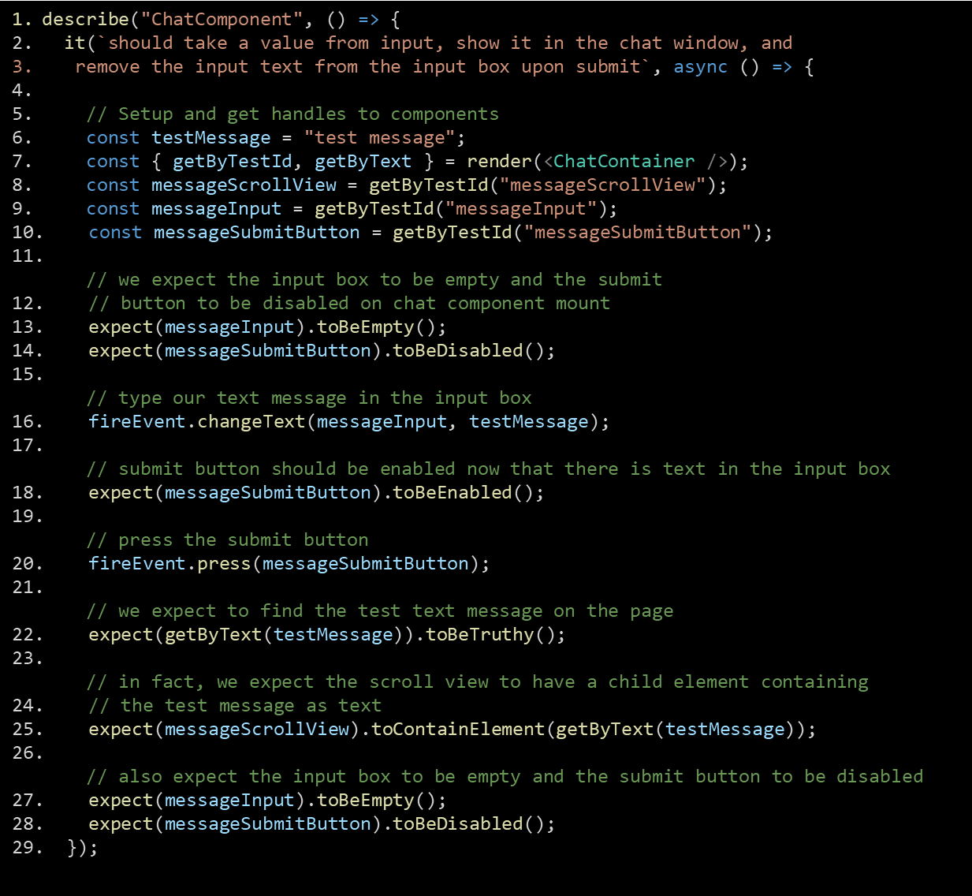
Questions on Integration or Snapshot Testing?

Slide 18
Conclusion
Build pure functions
Use unit tests for functions inside of components
Use integration tests for interaction between components
Even within the same smart component
PRs for new functionality should include tests
PRs refactoring old code should include tests
Comment on testing opportunities in PRs
Tests should be accounted for in planning and pointing stories
Estimate an additional 25%-50% in points
Don’t update an existing snapshot without asking why

Slide 19
Resources
Videos
Unit Testing in JavaScript – 6-part video series introducing JS testing
Jest Crash Course – Unit Testing in JavaScript – (60 mins)
Assert(js) 2019: Josh Justice (Big Nerd Ranch) - Old solutions to new testing problems (30 mins)
Blog Posts
Kent C. Dodds – multiple blog posts on testing
Integration Testing a Chat Component Using native-testing-library
VS Code Extensions
Jest
Jest Snippets
Questions?

