Slide 1
5/1進度報告
E組

Slide 2
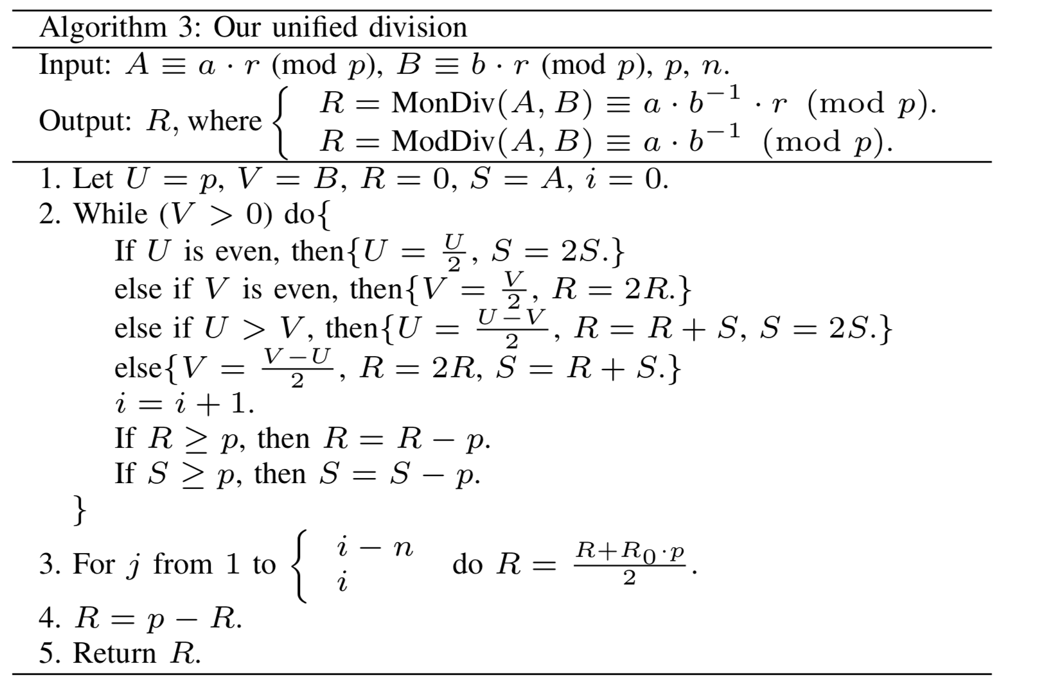
平行化的可能性
由於每個Iteration的運算結果會直接影響到下個Iteration，因此我們判斷平行話是不可行的。

Slide 3
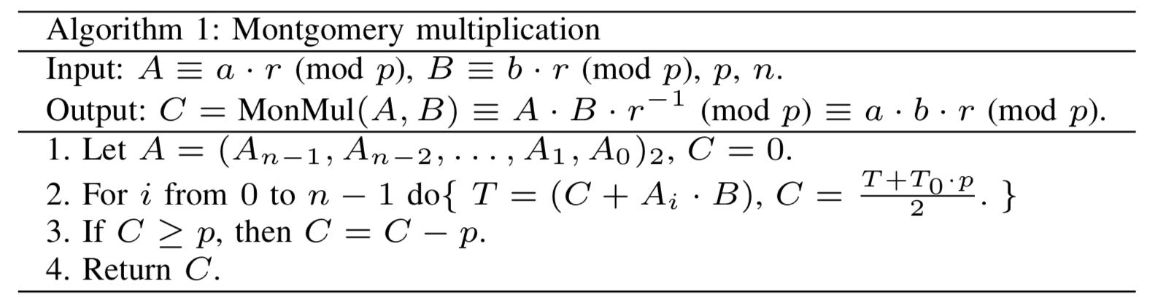
Montgomery Multiplication
Algorithm runs in O(2n), where n is the number of bits

Slide 4
Montgomery Division
Algorithm runs in O(3n), where n is the number of bits

Slide 5
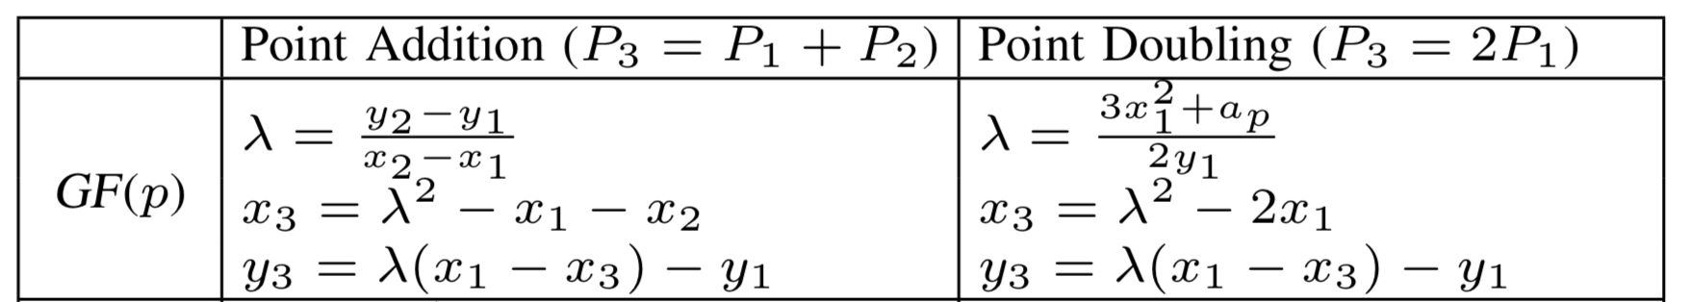
演算法流程
K = 100...1001
P = 010...1011
Get 4 bits from K, K[3:0] = 1001 (9)
Calculate Lookup Table
Add 9 P to result, Double if needed

Slide 6
Point Addition
2 Montgomery Multiplication +
1 Montgomery Division
Run time: O(7n)

Slide 7
Point Multiplication
3 Montgomery Multiplication +
1 Montgomery Division
Run time: O(9n)

Slide 8
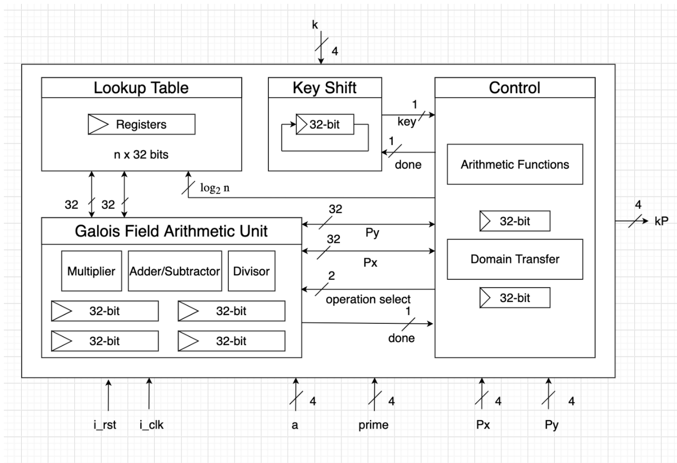
Block Diagram

Slide 9
工作分配
王珽: GFAU
賴繹文: Control
徐瑞擇: Testing Data

