Slide 1

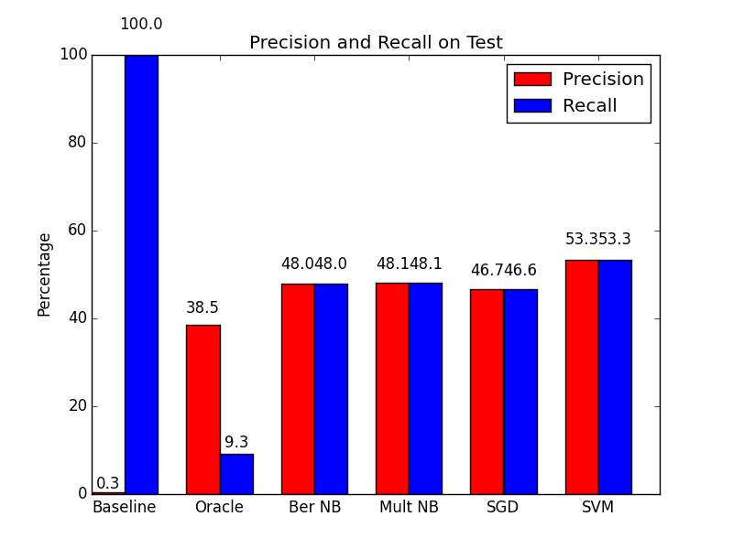
Extraction Based Text Summarization
Reginald Long, Michael Xie, Helen Jiang
Introduction
Our Approach
Analysis
Project Goal
(1) Load Corpus
Remove Stop Words from each document
The oracle performed poorly, implying that summarization is an inherently hard problem
We improved baseline by changing our model from a holistic approach where we summarize one document at a time to one where we take context into account
Training data precision ranged from 20-50%, recall ranged from 30-70% → data has high variance
Classifiers mostly had high training accuracy on low # of documents
Training performance degrades with more training documents, so training data has high variance
Given a document, summarize it by extracting the most important sentences.
(2) Preprocessing
Lemmatize the corpus using a wordnet lemmatizer
Results
(3) Label the data
Project Motivation
(4) Extract features:
Part of Speech
Most knowledge is stored in a textual format, but it is impossible for a person to absorb most of this knowledge due to the text’s length, redundancy, and complexity.
Automatic summarizers help distill the most important knowledge without needing to spend as much human power.
(5) Learn classifier
Word Count
(6) Predict important sentences given an unseen document
Sentence Location
Presence of high-frequency word
Results
Project Definition
Challenges
We define examples as sentences and batches of examples as documents.
Input: tuple containing a document and the # of sentences to extract
Output: the set of important sentences in the document
Importance varies & is context-dependent, hard to generalize
High subjectivity
Asymmetry between important and non-important sentences
Notes:
Include challenges in the conclusion

