Slide 1

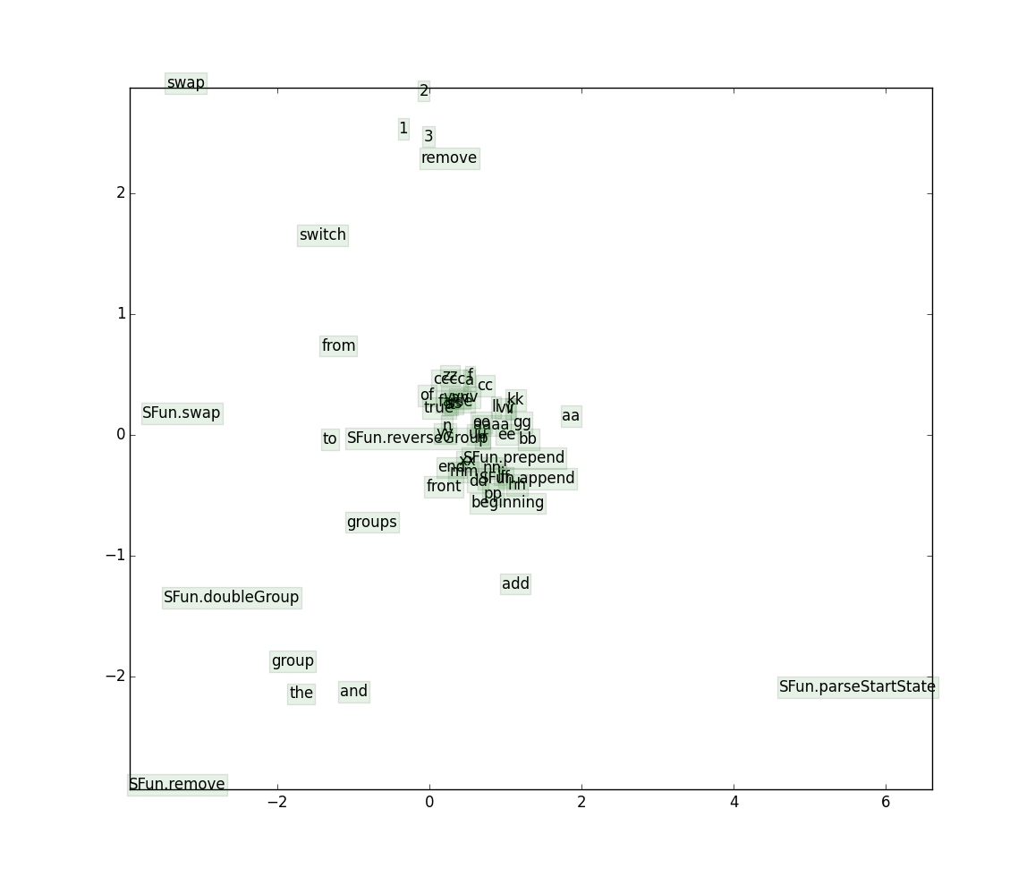
Deep Learning for Simple Program Generation
Reginald Long and Colin Wei
Introduction
Our Approach
Analysis
Project Goal
We use SEMPRE’s built-in semantic parser to generate potential candidate parses of an utterance. We take those parses, and then apply a neural network model to generate a ranking. Our evaluation metric is accuracy; a parse is correct if it is exactly the same as the oracle parse. We consider an utterance correctly parsed by the oracle if there exists a generated program that returns the annotated desired result.
As expected, the recurrent neural network was our best model; however, every neural network model we tested outperformed the baseline. The biggest difference we found between the RNN and other models was that it was able to capture semantic meaning for word order – for the other models where we simply add word vectors, the “swap” command gets parsed inaccurately as either input order suffices.
Our goal is to generate simple Java programs based off of a natural language utterance (i.e. English)
Results
Project Motivation
The popularity of simple, but powerful tools for data manipulation like Excel (vs. CSV manipulation using a programming language) show how the average person can reap the benefits of computation without knowing how to program. We attempt to take this idea one step furter by allowing the user to specify generic programs in English.
Results
Type | Train | Dev
Baseline (1-gram on functions) 16k iterations | 0.3232 | 0.3246
Baseline (1 through 4 grams, function args). 40k iterations. | 0.6371 | 0.6272
Word Vectors w/ negative sample. 1 million iterations | 0.6279 | 0.5425
Siamese w/ word vector backprop. 100k iterations | 0.6442 | 0.6378
Siamese w/ neg sample, w/o word vector backprop. 100k iterations | 0.8278 | 0.8105
RNN w/ word vector backprop, negative sampling. 10k iterations. | 0.9711 | 0.9721
Project Definition
Word Vectors
Each program consists of an input and a command in English (Ex: aa bb cc ||| add an a to the end of the last group). Our training set has 6127 examples, and our dev has 681 examples. We train on utterances for the following string operations:
{Pre|Ap}pending characters
Removing characters from the {front|end}
Reversing a string
Swapping two strings
Doubling a string
No action
Notes:
Include challenges in the conclusion

