Slide 1



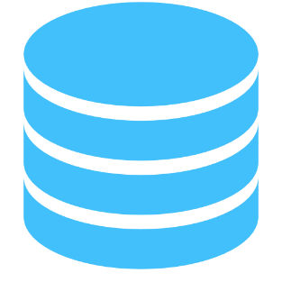
BLE
BEACONS
RFID
Tags
BLE
Gateway
Data Store
RFID
Readers
API
Gateway
HTTP / UDP / TCP-IP-SSL
MongoDB /
MySQL
RESTful APIs
Java / Python / PHP / NodeJS
LoRa
Nodes
WebApp /
Mobile Apps
LoRa
Integrators
MongoDB /
MySQL
Java / Python / PHP / NodeJS

