Slide 1
Illegal Parking at Bus Stops
Impact on On-Time Performance | CEO Executive Briefing
July 2026

Slide 2
The Illegal Parking Study
The evidence
OTP impact
Network-wide scale
Benchmarking & actions

Slide 3
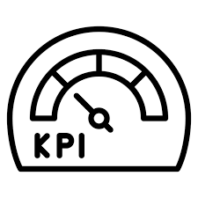





Executive Summary
60 blocked laybys in 3 hours at 11 busy stops — 1 in 21 AM-peak bus arrivals met an obstructed layby
≈30,000 obstructed bus arrivals per year at the 11 surveyed locations alone
Up to −0.7 pp on-time performance loss on affected peak trips at 60 s delay per obstruction
Network-wide: ≈346,000 blockage events per year across 912 stops — ≈2,900 bus-hours of delay
Safety risk: passengers board and alight in the live traffic lane when the layby is blocked
New York, London and Singapore fixed this with automated camera enforcement

Slide 4


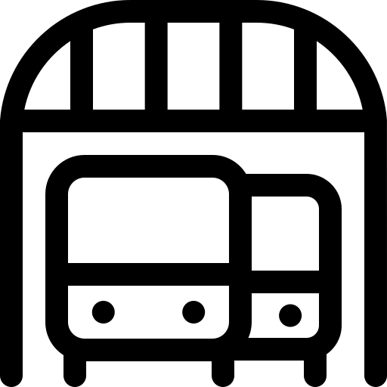

The Study in Numbers
60
11
1/21
30K
Cases (3 h)
Locations
of AM buses
Cases/year
38 Routes
75,780 AVL Records
2,999 Trips
826 Stops
Field Survey: 11 Sites
Method: 6 Steps
Match surveyed sites to AVL stops Count peak bus exposure (AM + PM) Baseline OTP from AVL records Flip probability: on-time to late Annualise: 60 × (1 + PM) × 261 days Tier all 2,873 GTFS stops by risk
Parameters
30 s average blockage per case
OTP window: −1 min to +5 min

Slide 5
The Evidence: 11 Locations Surveyed
Location | Cases (3 h) | What the Data Shows
Business Bay (all stops) | 10 | Highest count of the survey; 9.8 cases per 100 AM buses
Sharaf DG Metro | 8 | Worst OTP of the eleven: 78.7% vs 87.2% network average
Burjuman | 7 | 9.1 cases per 100 AM buses at a 26-bus-per-hour stop
Al Jafliya | 6 | Most intense: 13.3 cases per 100 AM buses
Naif & Burj Nahar | 5 + 5 | Busiest corridor (65 buses/h each); routes 10/13A hit repeatedly
Five further sites | 19 | Al Rigga (16.1 per 100 — highest rate), Salah Al Din, Al Hana, Emirates Tower, Al Khail Mall
60 blocked laybys in 3 hours — 1 in 21 AM-peak arrivals obstructed

Slide 6
Impact on On-Time Performance
Delay per Obstruction | Late Trips / Year | Effect on OTP
15 s | ≈ 430 | −0.16 pp on affected peak trips
30 s — ops estimate | ≈ 780 | −0.29 pp on affected peak trips
60 s — queue + re-approach | ≈ 1,900 | −0.70 pp on affected peak trips
90 s — international evidence | ≈ 2,700 | −1.00 pp — a full point off peak OTP
Where it bites | — | Damage lands on trips already 4–5 min behind — the peak, where 12.7% of events are already late
Compounding | — | A route 10/13A trip can be blocked 2–3 times; each case counted once (conservative)
The 11 locations alone: ≈ 250–500 bus-hours of direct delay per year

Slide 7
Network-Wide Scale: 912 At-Risk Stops
Risk Tier | Stops | Annual Cases & Impact
High — profile-matched | 112 | ≈182,000 cases/yr; 24% of peak arrivals; at the survey rate (2.9 per 100 buses)
Medium — next 400 | 400 | ≈134,000 cases/yr at 50% of the survey rate
Low — following 400 | 400 | ≈30,000 cases/yr at 25% of the survey rate
Total | 912 | ≈346,000 cases/yr; ≈2,880 bus-hours; −0.35 to −0.85 pp peak OTP
Largest unsurveyed sites | — | Ibn Battuta, Union Metro, Mall of the Emirates, Gold Souq, Dubai Mall Metro
To validate | — | A 1–2 week spot survey at ~20 High/Medium stops firms the tier rates
912 at-risk stops carry 76% of all peak bus arrivals

Slide 8
Benchmarking: How Global Cities Enforce
City | Penalty | Programme & Reported Outcomes
New York — MTA ACE | $50–250 | Bus-mounted cameras: ~5% faster buses, ~20% fewer collisions, ~30% fewer repeat violations
London — TfL | £160 | 24/7 CCTV-enforced stop clearways; near-universal kerb access at stops
Singapore — LTA | S$150 | Camera-equipped buses since 2008; sustained bus-lane and stop compliance
Sydney — TfNSW | A$390 | Deterrence driven by penalty level
Dubai today | AED 500 | Manual patrols only; 60 cases in 3 hours signals low deterrence
The gap | — | Fine is mid-range globally; missing piece is automated, continuous enforcement — NYC model fits corridors 10 / 13A / C01
The gap is not the fine — it is automated, continuous enforcement

Slide 9
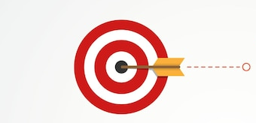
Recommendations
Enforce: Automated Cameras
Pilot bus-mounted or pole-mounted cameras
Start at the 5 worst sites: Sharaf DG, Business Bay, Burjuman, Naif, Burj Nahar
Focus on high-frequency corridors 10 / 13A / C01
Measure OTP before/after — this study is the baseline
Design: Remove the Cause
Marked drop-off bays 30–50 m from laybys at metro stops
Target taxi and limousine drop-off behaviour
Clear layby markings and signage
Review bus-station laybys separately (Ibn Battuta, Gold Souq)
Coordinate patrol timing with Dubai Police
Measure: Build the KPI
Extend survey: multi-day, AM + PM, log blockage duration per case
Monthly join of AVL runtime × violation records
Track: obstructed arrivals per 100 peak buses
Re-run this model to verify OTP recovery

Slide 10
Thank You

