Slide 1

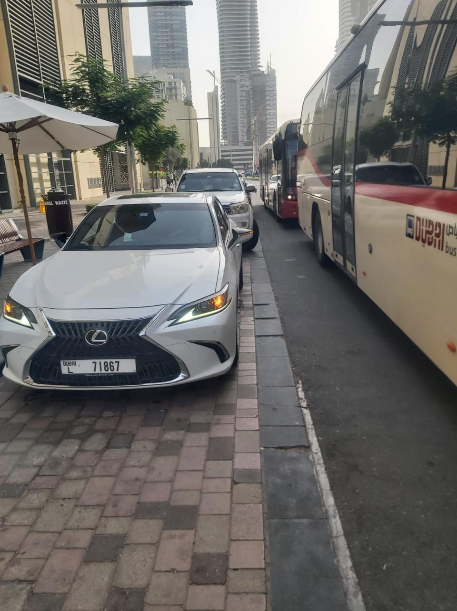



Illegal Parking in Bus Stops
Revenue generation via fines & kerb fees
improved On-Time Performance of buses
Passenger-safety exposure
A self-funding enforcement & monetization programme
Public Transport Agency · Bus Performance Study · July 2026

Slide 2

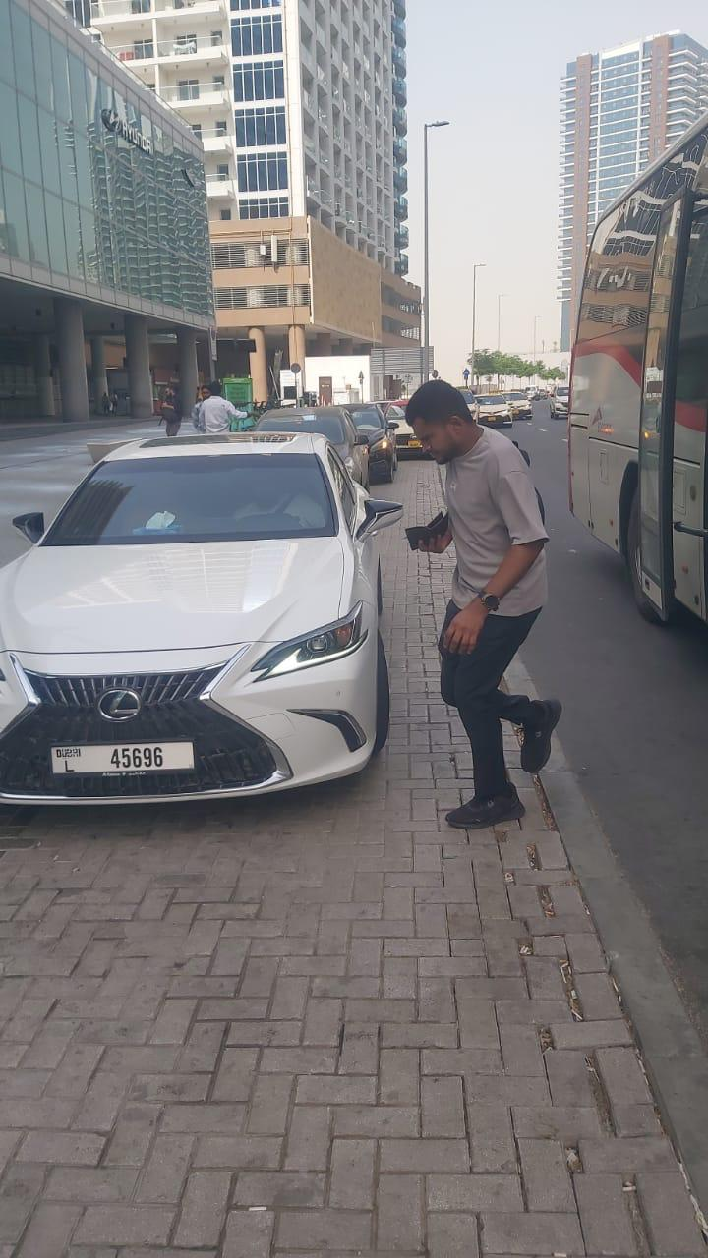
Executive summary
THE PROBLEM
346k
~1.5 %
2,900 h
Annual Estimated Illegal Parking at 912 stops carrying 76% of peak arrivals
Peak On-Time Performance Loss lost network-wide (60s per obstruction scenario)
Annual Bus Delay AVL data and an 11-stop field survey
THE FIX PAYS FOR ITSELF
AED 46M
+98M
< 1 year
Year-1 fine revenue (AED 200/violation, 56% ticket-to-cash) + kerb fees growing to 4.2M/yr
5-yr NPV @7% Hybrid fixed 512 stops + 20 portable + kerb monetization
Payback period Revenue declines only because deterrence works
CRITICAL SAFETY ISSUE
Passengers board and alight in live traffic lane (field photo)

Slide 3
CRITICAL SAFETY ISSUE
Passengers step off into moving traffic
!
346,000 / year
obstructed arrivals — each one a potential boarding or alighting in the live lane
!
The most vulnerable pay first
elderly passengers, wheelchair users, parents with children — level kerb access is exactly what the layby exists to provide
!
Zero-distance near-misses
the door opens into the same lane cars use to overtake the stopped bus
!
A liability the Agency carries
every peer city (NYC, London, Singapore) criminalised bus-stop parking on safety grounds before revenue grounds
Field photo, 28 Jul 2026 — layby blocked by a private car; the bus serves the stop from the carriageway and the passenger alights on the road, not the kerb.

Slide 4
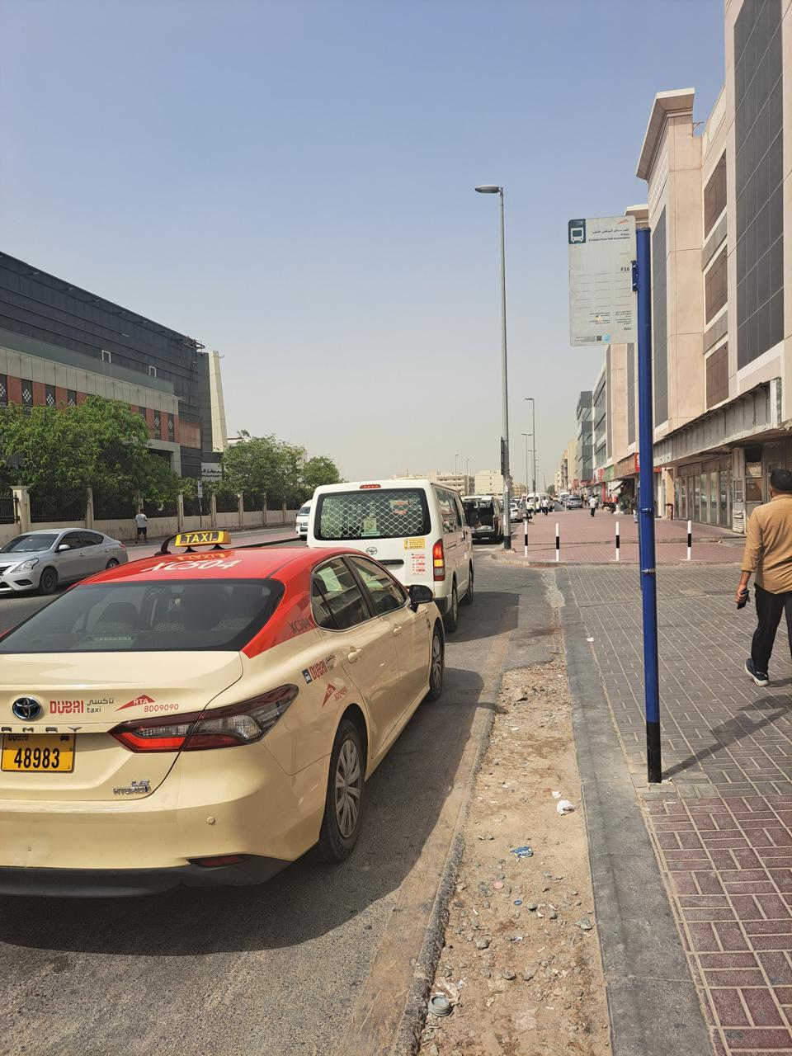
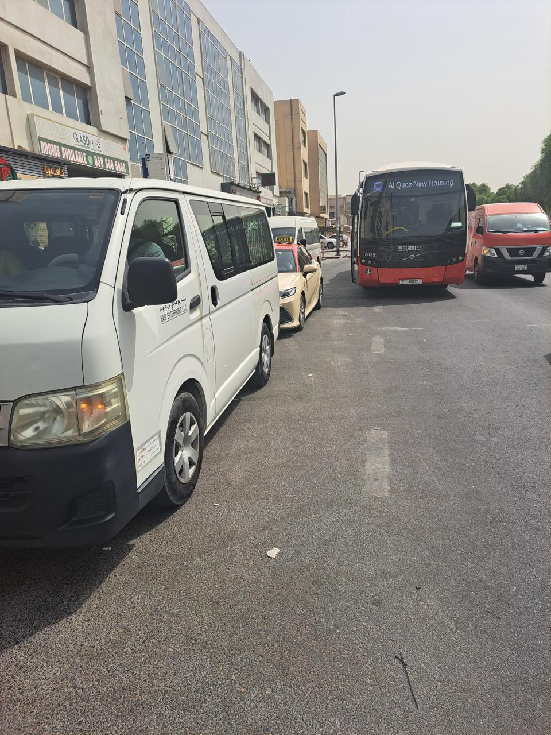
Documented daily, across the network
Who blocks the stops Taxis & limousines labour/shuttle vans private cars 60 cases Average 3-hour morning at just 11 stops
Private car holds the layby — the bus loads in the traffic lane beside it
Taxi and van parked hard against the marked, signed bus stop (route F16)
Vans occupy the stop — the Al Quoz New Housing bus is forced to serve from the lane
All photos: PTA field observations, Jul 2026.

Slide 5
The evidence: Morning Peak (7 to 10 AM), 11 stops
60
1 in 21
87.2%
78.7%
Average blocked-layby cases
(07:00–10:00)
AM-peak bus arrivals met
an obstructed layby
baseline OTP that day
(38 routes, 72,679 stop events)
OTP at Sharaf DG Metro —
worst stop, most blockages (8)
Cross-check AVL data (22 Jul 2026) confirms these stops carry 1,254 bus arrivals in the AM peak alone — and that late running already concentrates in peak hours.

Slide 6
Network-wide: 912 stops carry the risk
Every stop in the GTFS network was scored on the surveyed hotspot profile: peak bus throughput plus metro-station or mall adjacency.
Tier | Stops | Definition | Share of peak arrivals | Annual blockages
High | 112 | Matches surveyed profile (metro/mall + heavy throughput) — survey-calibrated rate | 24% | ≈ 182,000
Medium | 400 | Next 400 by peak throughput — 50% of survey rate (assumption) | 36% | ≈ 134,000
Low | 400 | Following 400 — 25% of survey rate (assumption) | 16% | ≈ 30,000
Total | 912 | 4 in 10 network stops | 76% | ≈ 346,000
76%
of all peak bus arrivals happen
at these 912 stops
7.5
violations per stop per day
at High-tier stops
Biggest non-surveyed exposures: Ibn Battuta, Union Metro, Mall of the Emirates, Gold Souq, Dubai Mall Metro, ADCB Metro.

Slide 7
What it costs the network every year
346,000
2,900 h
−0.85 pp
bus arrivals obstructed per year
(912 stops, both peaks)
of direct bus delay per year
(at 30 s per obstruction)
peak OTP lost network-wide
(30–60 s scenarios: −0.35 to −0.85)
Why small delays matter OTP counts a trip late beyond +5 minutes. The damage lands on trips already 4–5 minutes behind — 12.7% of peak stop events. A 30-second obstruction tips 1 in 38 of the trips it touches over the line; at 60 seconds, 1 in 16.

Slide 8
Enforcement pays: the violation-to-cash funnel
415,000
290,000
232,000
AED 46M
detectable violations / yr
→
valid tickets (70%)
→
collected (80%)
→
gross revenue, year 1
cameras watch 24/7 — off-peak adds 20%
plate readable, stationary, de-duplicated
at AED 200 per violation
declining by design as deterrence works
The honest pitch Fines finance the system in years 1–3. The permanent returns are OTP recovery, safe boarding — and kerb fees that grow as fines shrink.

Slide 9
Option A — fixed cameras: invest where density pays
Tier | Capex | Revenue yr 1 | 5-yr NPV @7% | Payback
High — 112 stops | AED 4.5M | AED 24.4M | +56.6M | < 1 year
Medium — 400 stops | AED 16.0M | AED 18.0M | +22.6M | ~1 year
Low — 400 stops | AED 16.0M | AED 4.0M | −13.8M | never
Recommended Stop at High + Medium. 512 stops · AED 20.5M capex 5-yr NPV +79.2M · payback < 1 yr The Low tier's violation density is too thin to carry a fixed installation — leave it to the portable fleet.
Assumed: AED 40k/site capex, 5k/yr opex (benchmark; pre-RFP).

Slide 10
Option B — portable cameras: small capex, follows
the problem
7.5
3.5×
violations seen per
deployed camera per day
daily revenue vs daily
all-in cost per unit
Deployed at High-tier stops; deterrence decay 15%/yr under monthly rotation.
Economics per unit: ≈ AED 830/day collected vs ≈ AED 240/day cost (AED 15k capex + 60k/yr crew, vehicle, redeployment). Every fleet size is NPV-positive — value scales with units, and rotation adds a "cameras could be anywhere" deterrence halo that fixed sites lack. Trade-off: only 2–5% of stop-time covered, so OTP recovery is slower than fixed coverage.

Slide 11
Monetize the kerb: charge operators for legal use
Enforcement creates a licensed product to sell: managed, off-peak layby access (max 3-min dwell, geofence-verified) — billed by the same ANPR cameras, so marginal field cost is ~zero.
AED 2.4M / yr
Annual layby-access permits 2,000 licensed shuttle & coach vehicles × AED 1,200/yr — off-peak windows only, never during bus peaks
AED 1.8M / yr
Pay-per-use kerb fee 1,000 paid dwells/day × AED 5, ANPR-billed — the airport kerb-fee model applied to bus laybys
+10.2M NPV · payback year 2 · and unlike fines, this line grows: it converts today's violators into paying customers with a legal option, and becomes the programme's permanent revenue as deterrence shrinks the fine curve. Setup: AED 2M platform + 0.5M/yr admin (assumptions, adjustable).

Slide 12
The 5-year money story — full programme
Fixed cameras at 512 High + Medium stops, 20 portable units, plus kerb monetization. All figures AED, undiscounted cash per year.
PHASE 1 — deploy High tier + portable
PHASE 2 — Medium tier + kerb permits
PHASE 3 — steady state: kerb fees replace fines
BREAK-EVEN ~ MONTH 7
Start
Year 1
Year 2
Year 3
Year 4
Year 5
−22.8M
+48.5M
+38.9M
+31.2M
+24.8M
+19.9M
capex: 512 fixed sites,
20 portable, kerb platform
fines 46.8 + kerb 1.7
opex −4.3M
fines 35.5 + kerb 3.4
opex −4.3M
fines 27.0 + kerb 4.2
opex −4.3M
fines 20.6 + kerb 4.2
opex −4.3M
fines 15.7 + kerb 4.2
opex −4.3M
net +44.2M
net +34.6M
net +26.9M
net +20.5M
net +15.6M
+119M
+98M
+0.85 pp
cumulative cash by end of year 5
net present value @ 7% discount
peak OTP recovered — the return that compounds

Slide 13
Recommendation: the hybrid programme
Phase 1 · Months 0–6
Phase 2 · Months 6–18
Phase 3 · Year 2+
Fixed cameras at 112 High-tier stops + 20 portable units.
Run the validation survey that firms Medium/Low rates.
Capex ≈ AED 4.8M.
Extend fixed coverage to the 400 Medium-tier stops.
Launch layby-access permits for licensed operators.
Grow portable fleet to 30–50. Capex ≈ AED 18M — funded by Phase 1 revenue.
Scale pay-per-use kerb fees — the permanent revenue line.
Portable rotation covers the Low tier and emerging hotspots.
Publish OTP recovery; review AED 200 vs AED 500 federal fine.
+98M
+0.85pp
< 1 yr
5-yr NPV, full programme (AED)
peak OTP recoverable network-wide
payback on every element deployed
Fines are the financing bridge; kerb fees are the steady state. Both decline/grow exactly as compliance improves — while OTP and safety gains compound.

Slide 14
Benchmarking: Every peer city has already moved
New York — MTA ACE
London — TfL
Bus-mounted cameras, escalating fines US$50–250
Bus stop clearways, CCTV-enforced 24/7, PCN £160
~5% faster buses, ~20% fewer collisions, ~30% fewer repeat violations
Near-universal kerb access; compliance underpins the iBus OTP regime
Singapore — LTA
Sydney — TfNSW
Camera-equipped buses since 2008, ~S$150 fine
Bus-zone offence ≈ A$390
Sustained bus-lane and stop compliance
Deterrence through penalty level
Dubai today: manual patrols only. This study models a conservative AED 200 fine — the federal schedule already allows AED 500 for stopping in a bus stop, which would scale every revenue figure ×2.5 and turn even the Low tier positive.

Slide 15
Benchmarking: cities already charge for the kerb
Airports — SFO, LAX & most large US hubs
Smart loading zones — Pittsburgh, LA, Columbus, Aspen
Kerb-access fees: US$2.50–5 per pick-up
Camera-billed per-minute commercial kerb use
Taxis, ride-hail and shuttles billed automatically via geofence/AVI — the direct template for ANPR-billed layby dwell fees
Registered operators pay per minute, violators get fined — enforcement and monetization on the same sensor
Central London — Westminster
Chicago & US CBDs
Paid coach bays & permits
Ride-hail pick-up zone surcharges
Coaches pay for timed use of high-demand kerb bays via permit/app
Designated TNC zones carry a per-trip fee for kerb access rights
The pattern: the same camera that fines illegal use bills legal use. Cities monetise scarce kerb instead of only policing it — RTA's laybys at 912 high-demand stops are exactly that asset.

Slide 16

Thank you

