Slide 1
Bus Depot Action Plan
CEO Executive Briefing
Jan 2025

Slide 2


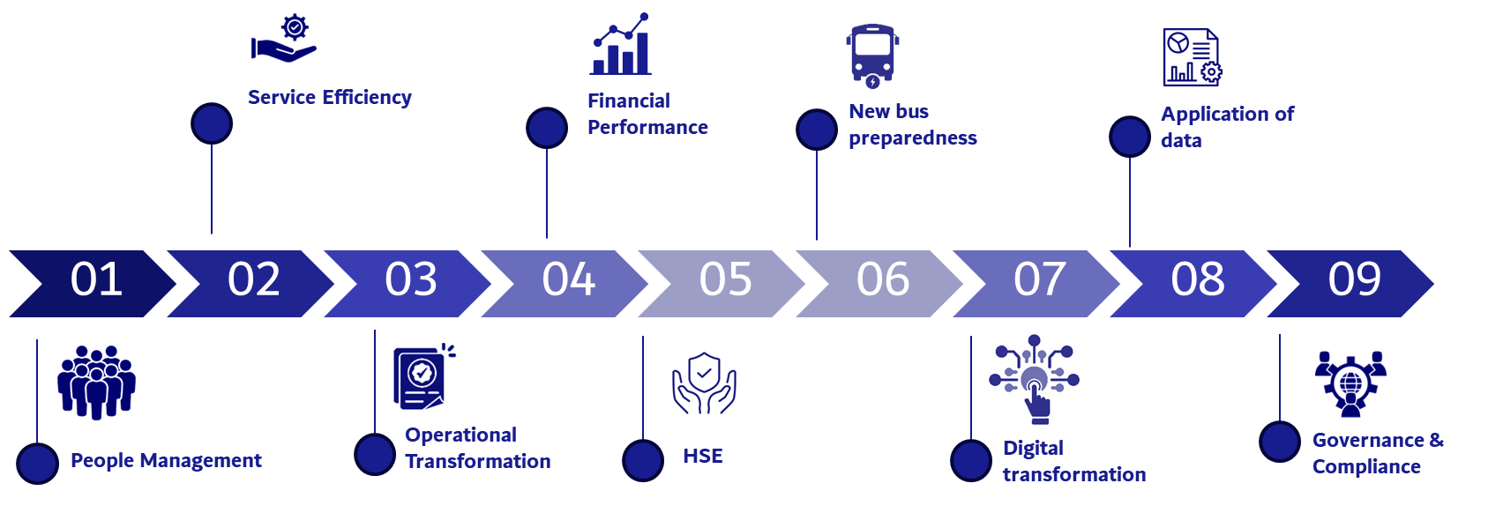
Executive Summary
Overall operational maturity of the section is 40%. The section critically needs to mature for governance and compliance
Non-uniformity and non-standardization between depots can be observed in all aspects like processes; infrastructure and organizational structure
Focus Areas
9 focus areas
64 Initiatives for overall development of bus depots

Slide 3




Facts & Figures
1385
32XX
7
128
Buses
Drivers
Depots
Employees
CAPEX
OPEX
Operational Revenue
Operational Cost
Projects in the section
6 Processes
PT.W.3.13 - Manage Advertisement Material on Buses PT.W.3.18 - Operate Short Term Rental Notification PT.W.3.5 - Assign Drivers on Routes & Buses PT.W.3.6 - Assign and Dispatch Buses on Routes PT.W.3.7 - Replace of Buses or Drivers During Operation PT.W.3.8 - Receive and Prepare Buses for Next Shift
Contracts
Bus Fuelling and Washing
Bus Rental

Slide 4



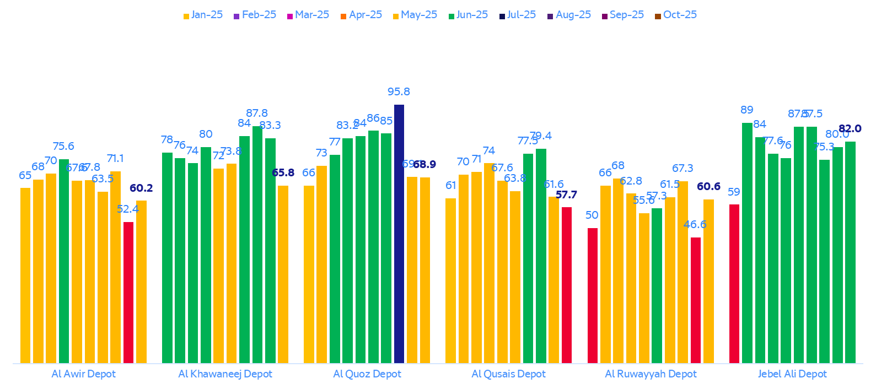
KPI Performance (2025-YTD)
110 Million
4 Million
161 Million
Total Driven kms
Total Trips
Passengers
Depot Performance Index
KPI Performance of the section
KPI | Performance Summary (2025)
Delay Log-in
Bus Depot Gate Departure
Bus Accident Rate (Declarable red accidents)
* Red accidents are still being reported
Accident injury rate
Accident fatality rate
Bus passenger complaint rate
Bus replacement ratio
Majority of KPIs (department and agency level) are achieved consistently.
However, certain indicators need to be improved, and new indicators need to be added which attribute to HSE, Passengers, contract management etc

Slide 5
Maturity of Bus Depots (Framework- Where do we stand?)
Dimension | Score | Remarks
Processes | 2.5 | Critical processes are documented which is very basic using flowcharts No defined mechanism to evaluate the process adherence Processes are linked to KPIs; However, not controlled or stagnant
Technology & Automation | 2 | Disintegrated systems which require manual data correlation Some level of automation in routine tasks however at the level of POCs Minimal intervention using AI and predictive systems Manual data entry exists for few systems
Data & Metrics | 3 | Data driven decision making is practiced. However, not uniform across all depots All operational units track KPIs consistently New KPIs need to be developed; Data accuracy is still an issue with manual entries
Organization & Culture | 2 | Majority of staff have received basic foundational trainings Team is effectively working for cross functional responsibilities Role clarity and accountability is poor in section Staff retention is good; However, engagement with management is still limited
Governance & Compliance | 1 | No clarity in compliance on operational policies, SOPs, etc No ownership exist in individual unit for policies: Basic performance on SOP/SLA Compliances
Risk Management | 2 | A combination of reactive incident response rate and identified risk document. Some risks are identified, mitigated and managed. However, for rest of the risks- its more of reactive
Overall maturity score: 40%

Slide 6
Benchmarking Against Global Leaders
Benchmark Area | Us Today | Global Leading Practice & How We Close the Gap
Operational Maturity | 40% | Global leaders (Singapore LTA, London TfL) run at 75–85% maturity Our 1-year target of 70% closes most of the gap
Automation & AI | 2 / 5 | Automated washing, fuelling and gates are the norm at top depots Bus Allocation AI in 4 depots and auto-washing close this gap
Lean & 5S Management | 1–2 | Top operators sustain 5S maturity of 4–5 with visual management Full 5S SOP roll-out targets maturity of 5 in all depots
Fleet & Electrification | Aged | Shenzhen: 100% electric; London and Singapore in transition New buses from 2026 and EV infrastructure keep us on the curve
Digital Depot Systems | 2 / 5 | Integrated Depot Management Systems (DMS) are the global norm DMS pilot, Maximo migration and uniform systems mirror leaders
Safety & Risk | 2 / 5 | Leaders use predictive route-risk profiling and proactive KRIs Route risk profiling and safety stewards make HSE predictive
Our goal: Match top global depots – 70% maturity by 2027

Slide 7








Focus Areas
01
02
03
04
06
07
08
09
05
Service Efficiency
Financial Performance
New bus preparedness
Application of data
Operational Transformation
Digital transformation
Governance & Compliance
People Management
HSE

Slide 8






Bus Depots Roadmap
Implement and Uplift Bus Depots
Execute projects, initiatives, empower teams, and ensure cross-department collaboration.
Improve and Comply; Monitor and Measure
Effective compliance mechanism; KPIs, evaluate outcomes; benefits
Q1 2026
Q3
2026
Q1 2027
Q3 2027
2028
Analyse and Establish
Evaluate current situation; establish mechanisms, systems, process, for transformation in Bus depots
Stabilize & Optimize
Automate the tasks and apply tools to enable lean management with flexibility for smooth bus operations
Sustain & Future Ready
Sustain the performance and be future ready
HSE
Digitalization / Data Analyses / AI
Operational Governance
KPI
Revenue Streamline
Stakeholder Management

Slide 9
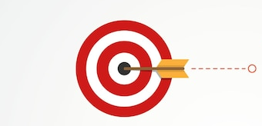
Our Targets for 2026
Operational Performance
Achieve all operational KPIs
2 operational cost saving initiatives
1 new revenue stream
Reduction in customer complaints for cleanliness by 30%
Futuristic Vision
Readiness for digital depot
Maturity level of 70% in 1 year
Model depot for bus operations
Autonomous bus depot roadmap
5S Maturity of 5
Excellence
Secure awards under operational efficiency and employee category
Benchmark against top global depots
Submit for 1 IP
Research papers published

Slide 10




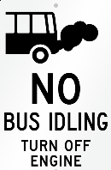





04: Financial Performance
CAPEX
OPEX
Fare Revenue
Non-fare revenue
Increase compliance on anti-idling to increase savings to AED 500 K in Q1 2026
Increase advertisement revenue on buses or bus depot assets by AED 200K in 2026
Decrease in dead km to save upto AED 300 K in 2026
Increase commercial revenue in bus depots by AED 100K per year
Develop all supporting infrastructure required in 2 depots for commercial investment
Eco-Drive to enhance sustainable Driving

Slide 11
Thank You

